Slide 1
Physically-Based Simulation of Rainbows
基于物理方法模拟的彩虹
Iman Sadeghi¹, Adolfo Munoz², Philip Laven³, Wojciech Jarosz⁴, Francisco Seron², Diego Gutierrez², Henrik Wann Jensen¹
¹ UC San Diego
² Universidad de Zaragoza
³ Horley, UK
⁴ Disney Research Zurich
报告人：何江达 课程老师：李启雷

Slide 2
·报告摘要
在该论文中，作者提出了一个基于物理模拟的彩虹模型。先前用于模拟彩虹的技术使用几何光学（光线追踪）或Lorenz-Mie理论。Lorenz-Mie理论是迄今为止最准确的技术，因为它考虑了诸如色散，偏振，干涉和衍射等光学效应。这些效果对于准确模拟彩虹至关重要。但是，由于Lorenz-Mie理论仅限于球形水滴的散射，因此它不能应用于非球形的实际雨滴，尤其是对于较大的雨滴。作者提出了第一个模拟光的波前与基于物理的水滴形状的相互作用的综合技术。作者的技术基于扩展的光线跟踪以解决色散，偏振，干涉和衍射问题。作者的模型与球形粒子的Lorenz-Mie理论相符，但它也可以对非球形粒子进行准确的模拟。它可以模拟许多不同的彩虹现象，包括双彩虹以及多重彩虹。

Slide 3
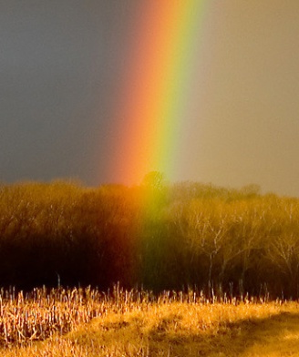
APPEARANCE OF RAINBOWS
© Dan Bush
Primary Bow
Notes:
Can be explained by optics
3

Slide 4
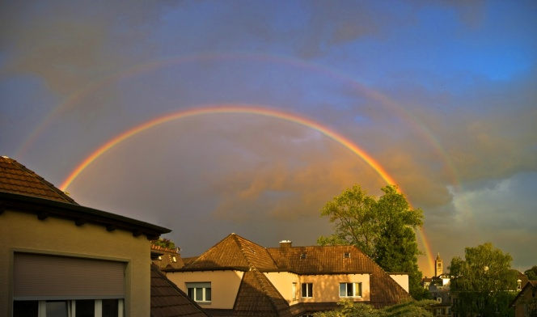
APPEARANCE OF RAINBOWS
© Wojciech Jarosz
Double Rainbow
Notes:
Can be explained by optics
4

Slide 5
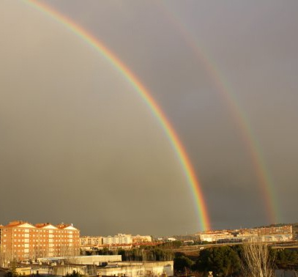
APPEARANCE OF RAINBOWS
© Diego Gutierrez
Double Rainbow / Alexander Dark Band
Notes:
Can be explained by optics
5

Slide 6
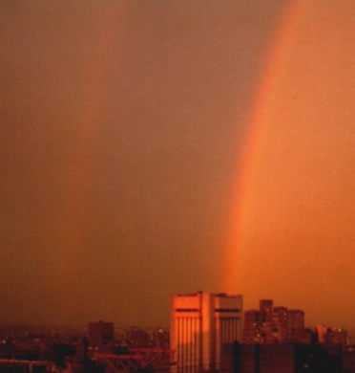
APPEARANCE OF RAINBOWS
© Philip Laven
Red Bow at Sunset
Notes:
Can be explained by optics
6

Slide 7
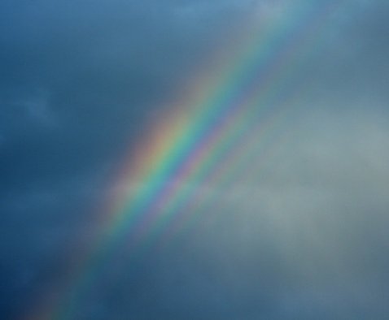
APPEARANCE OF RAINBOWS
© Ian Goddard
Multiple Supernumerary Arcs
Notes:
Can be explained by optics
7

Slide 8
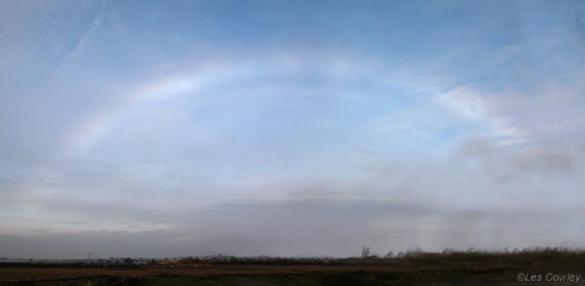
APPEARANCE OF RAINBOWS
Fog Bow
Notes:
Can be explained by optics
8

Slide 9
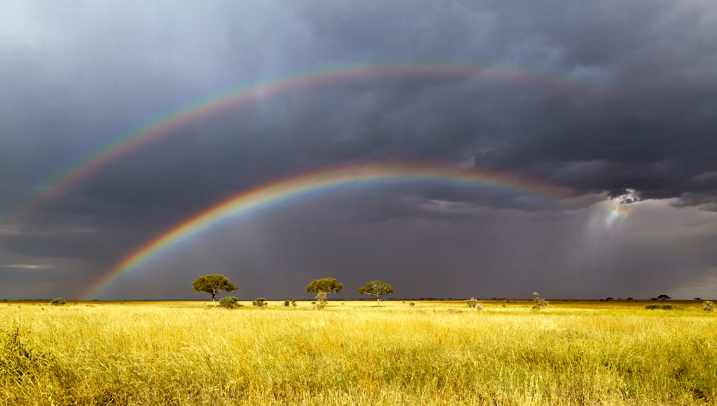
APPEARANCE OF RAINBOWS
© Aravind Krishnaswamy
Twinned Bow
Notes:
Prior to my research there was no solid theory existed for … The explanation was there but nobody was able to simulate them properly (with physically-based water drops)
9

Slide 10
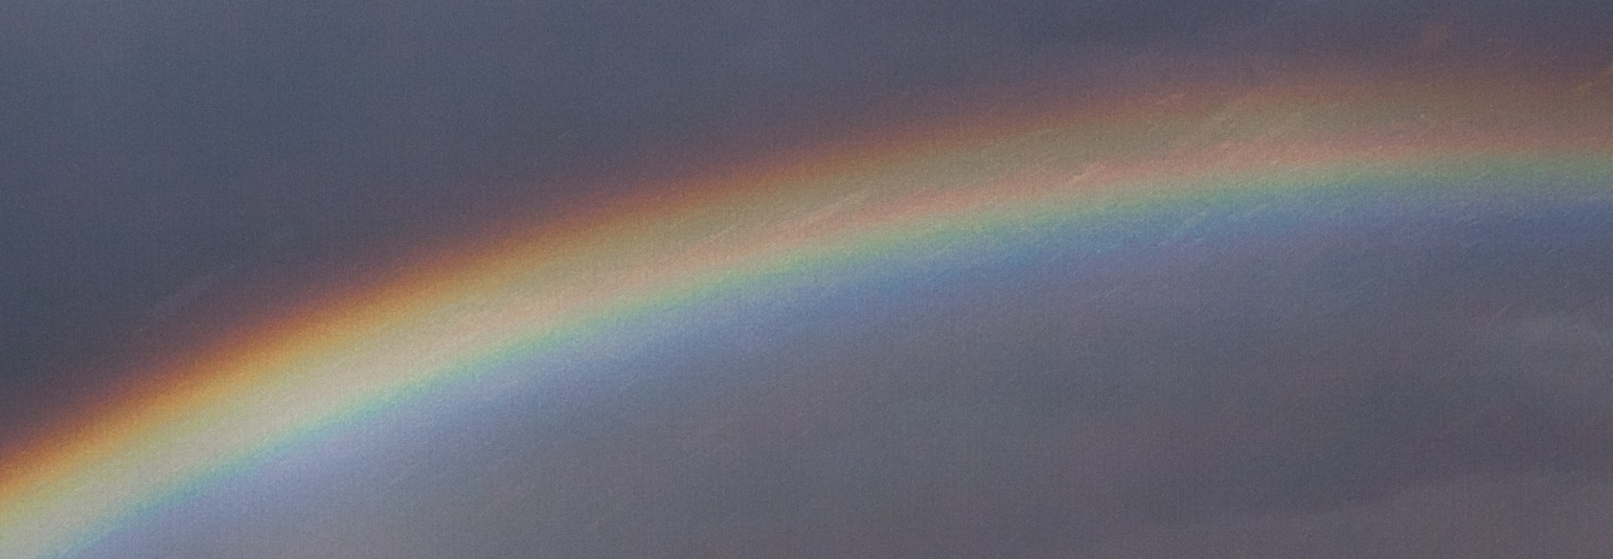
APPEARANCE OF RAINBOWS
© Aravind Krishnaswamy
Twinned Bow
Notes:
Prior to my research there was no solid theory existed for … The explanation was there but nobody was able to simulate them properly (with physically-based water drops)
10

Slide 11
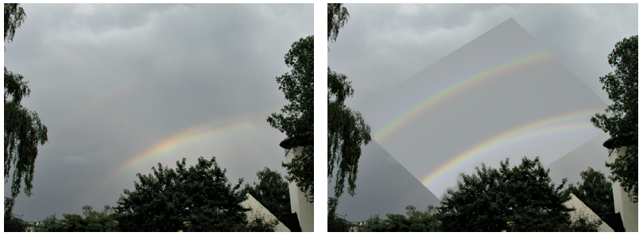
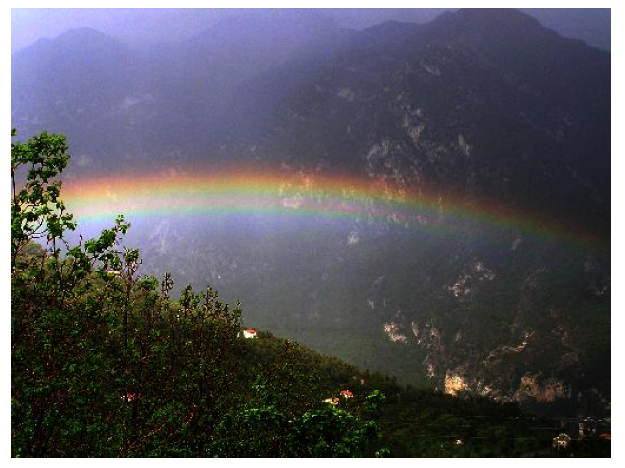
APPEARANCE OF RAINBOWS
© Benjamin Khne
© Vincent Jacques
Twinned Bows
Notes:
Prior to my research there was no solid theory existed for … The explanation was there but nobody was able to simulate them properly (with physically-based water drops)
11

Slide 12
WATER DROP SHAPES
Gravity vs. surface tension vs. air resistance

Slide 13
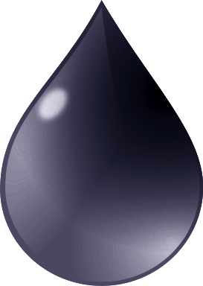
WATER DROP SHAPES
Gravity vs. surface tension vs. air resistance

Slide 14
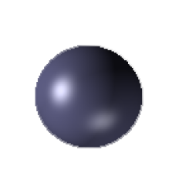
WATER DROP SHAPES
Gravity vs. surface tension vs. air resistance
Misconception
Small Drops

Slide 15
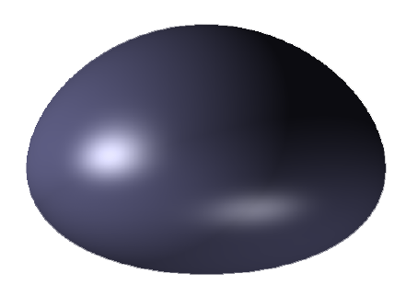
WATER DROP SHAPES
Gravity vs. surface tension vs. air resistance
Misconception
Small Drops
Large Drops

Slide 16
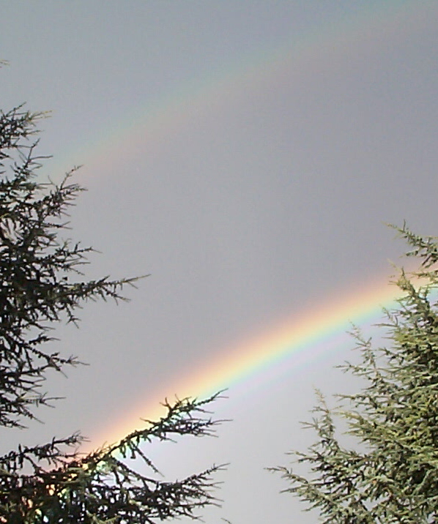
APPEARANCE OF RAINBOWS
折射
色散
干涉
衍射

Slide 17
APPEARANCE OF RAINBOWS
折射
色散
干涉
衍射

Slide 18
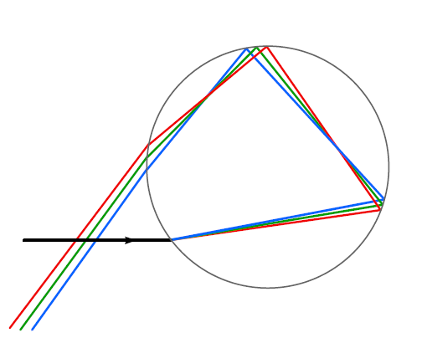
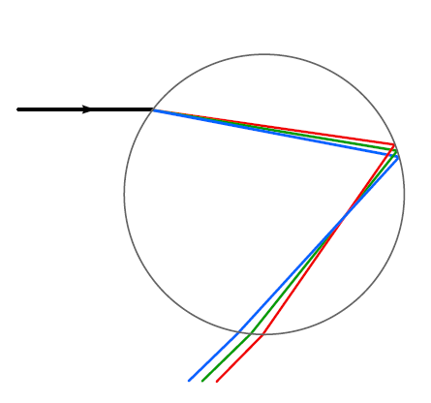
APPEARANCE OF RAINBOWS
折射
色散
Secondary bow
Primary bow

Slide 19
APPEARANCE OF RAINBOWS
折射
色散
Secondary bow
Alexander Dark Band
Primary bow

Slide 20
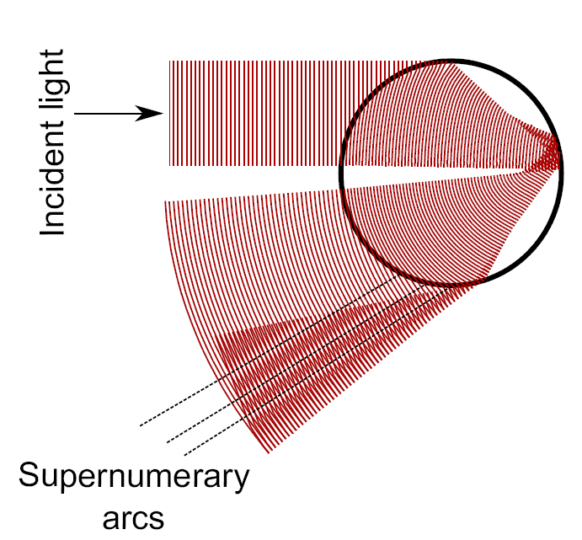
APPEARANCE OF RAINBOWS
干涉

Slide 21
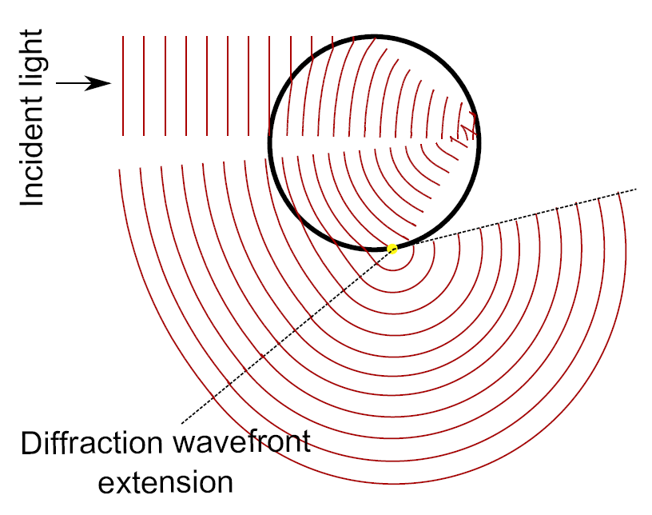
APPEARANCE OF RAINBOWS
衍射

Slide 22
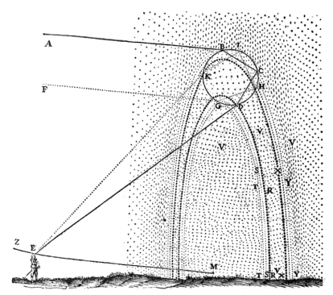
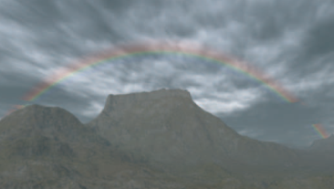
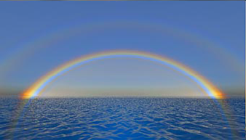
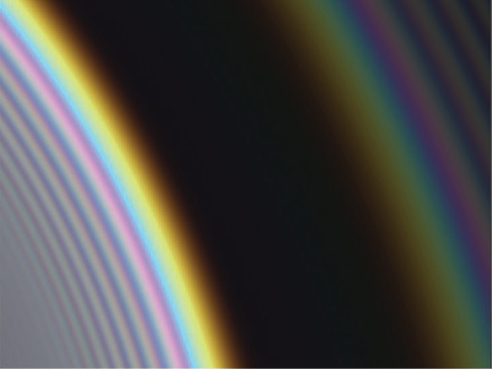
PREVIOUS WORK
Ray Optics
  Aristotle 384-322 BC
  Descartes 1637
  …
  Musgrave 1989
  Frisvad et al. 2007
Lorenz-Mie Theory
  Jakel and Walter 1997
  Lee 1998
  Laven 2003, 2004
  Riley et al. 2004
  Gedzelman 2008
FDTD Methods
  Yang and Liou 1995 (Ice halos)

Slide 23


PREVIOUS WORK
 | Interference/ Diffraction | Physically Based Drops | Practical
Ray Optics
Lorenz-Mie
FDTD 时域有限差分
Our Goal

Slide 24
OUR APPROACH
Model physically based shape of water drops
Compute the scattering profile of a water drop
Use the scattering profile in rendering

Slide 25
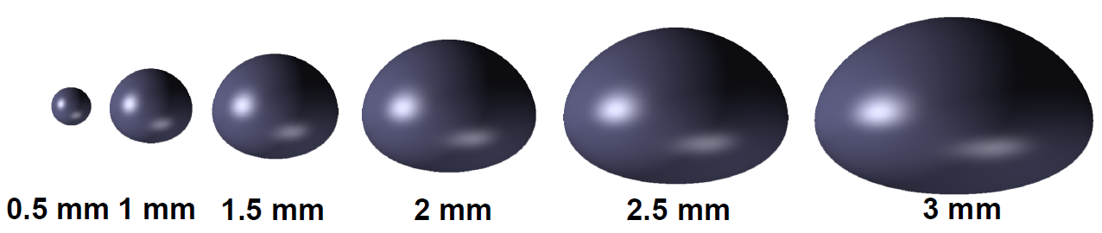
PHYSICALLY BASED SHAPES
Based on [Beard and Chuang 1987]
Considered:
  Surface tension（表面张力）
  Hydrostatic pressure（液体静压力）
  Aerodynamic pressure（空气压力）

Slide 26
SCATTERING PROFILE
SIMULATION
Key ideas
  Ray tracing
    Arbitrary geometry
    Interference
  Keep track of the phase of light
    Interference

Slide 27
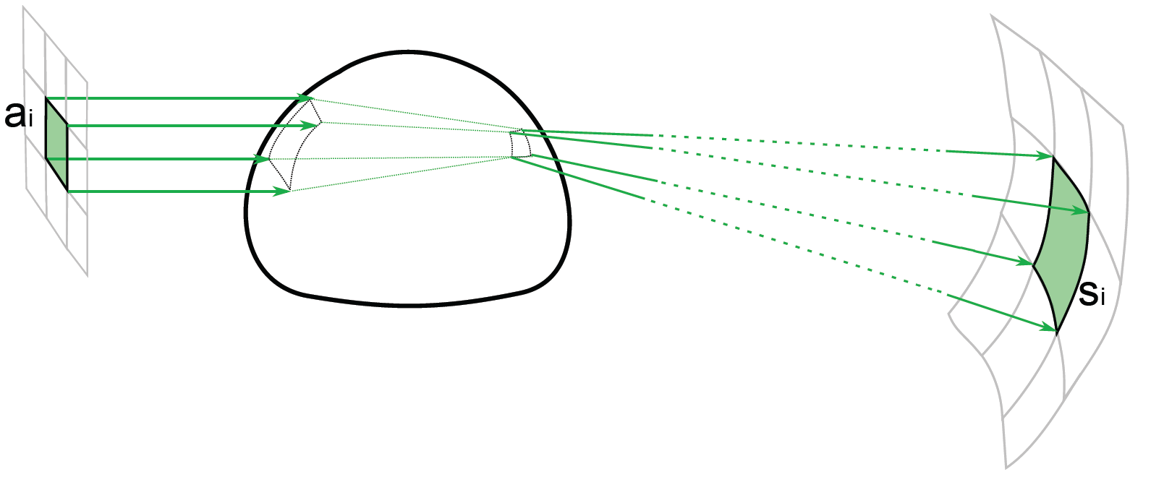
SCATTERING PROFILE
SIMULATION
Algorithm (per wavelength)
1. Cast
2. Interact
3. Collect

Slide 28

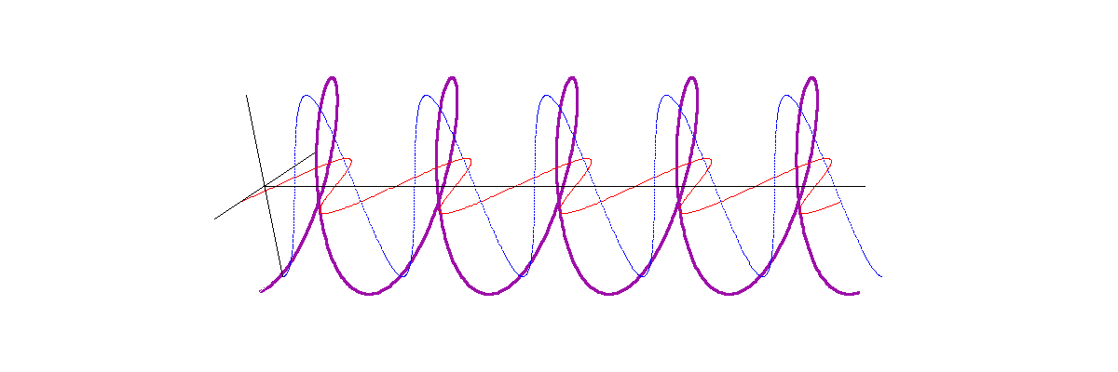
SCATTERING PROFILE
SIMULATION
1. Cast
2. Interact
3. Collect
1. Cast
  Electromagnetic wave information

Slide 29
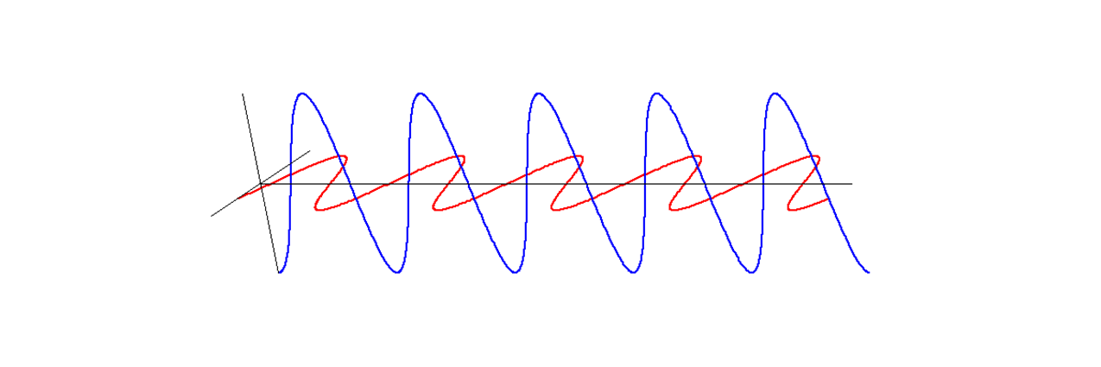
SCATTERING PROFILE
SIMULATION
1. Cast
2. Interact
3. Collect
1. Cast
  Electromagnetic wave information
Vertical phasor
Coordinate
system
Horizontal phasor
Wavelength

Slide 30
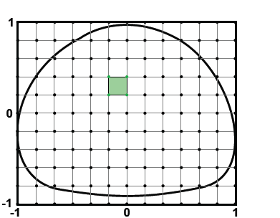
SCATTERING PROFILE
SIMULATION
1. Cast
2. Interact
3. Collect
1. Cast
  From a reference plane
  Grid of rays

Slide 31
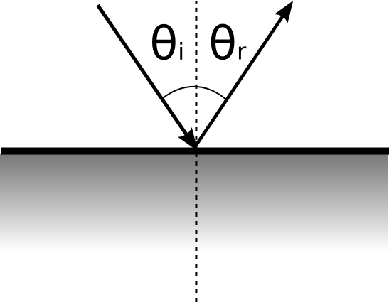
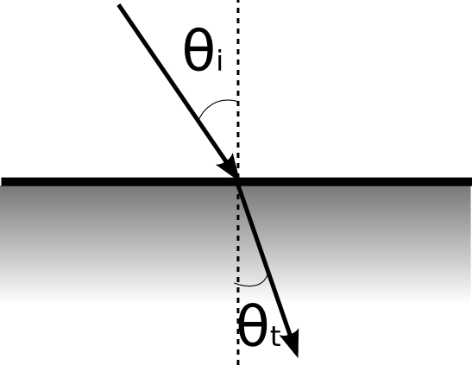
SCATTERING PROFILE
SIMULATION
1. Cast
2. Interact
3. Collect
2. Interact
  Geometric optics
Reflection: law of reflection
Refraction: Snell's law

Slide 32
SCATTERING PROFILE
SIMULATION
1. Cast
2. Interact
3. Collect
2. Interact
  Fresnel coefficients
  Focal lines
  Optical path

Slide 33
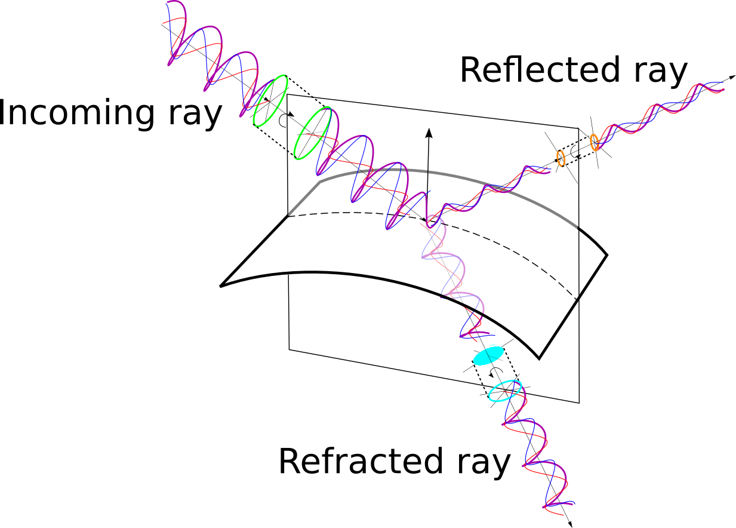
SCATTERING PROFILE
SIMULATION
1. Cast
2. Interact
3. Collect
2. Interact
  Fresnel coefficients

Slide 34
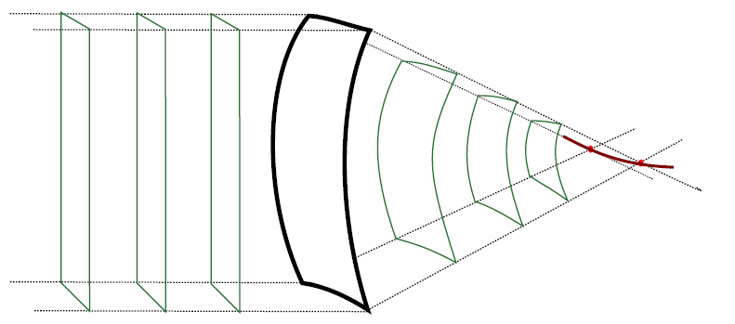

SCATTERING PROFILE
SIMULATION
1. Cast
2. Interact
3. Collect
2. Interact
  Fresnel coefficients
  Focal lines

Slide 35
SCATTERING PROFILE
SIMULATION
1. Cast
2. Interact
3. Collect
2. Interact
  Fresnel coefficients
  Focal lines
  Optical path
Inside the particle
To reference plane
From reference plane

Slide 36
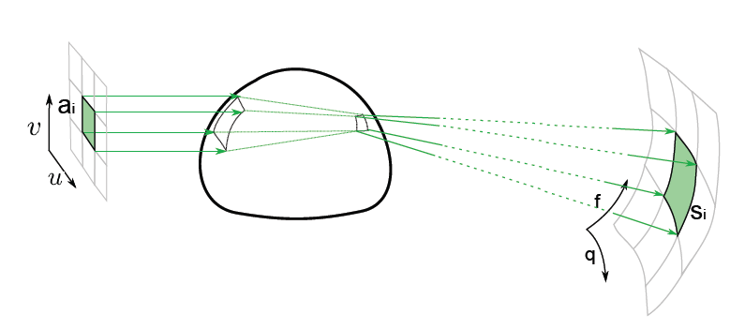
SCATTERING PROFILE
SIMULATION
1. Cast
2. Interact
3. Collect
3. Collect

Slide 37
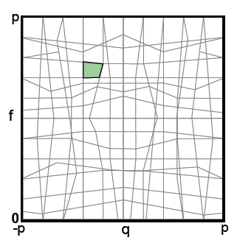
SCATTERING PROFILE
SIMULATION
1. Cast
2. Interact
3. Collect
3. Collect
latitude
longitude

Slide 38
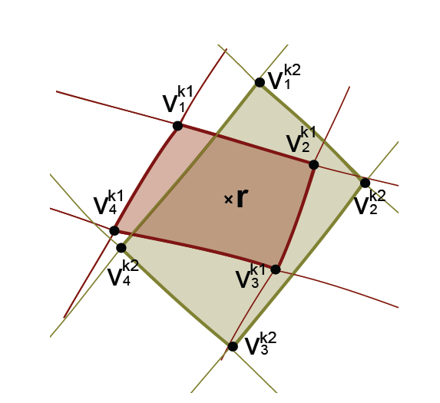
SCATTERING PROFILE
SIMULATION
1. Cast
2. Interact
3. Collect
3. Collect
latitude
longitude
Per-patch interpolation
Phasor addition

Slide 39
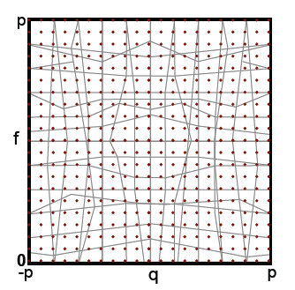
SCATTERING PROFILE
SIMULATION
1. Cast
2. Interact
3. Collect
3. Collect
  Query and tabulate data (per wavelength)
latitude
Per-patch interpolation
Phasor addition
longitude

Slide 40
SCATTERING PROFILE
SIMULATION
Diffraction

Slide 41
SCATTERING PROFILE
SIMULATION
Diffraction approximation

Slide 42
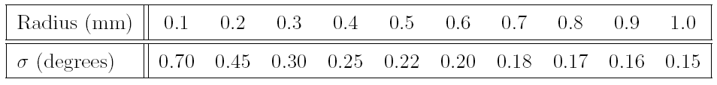
SCATTERING PROFILE
SIMULATION
Diffraction approximation
  Smooth sharp transitions

Slide 43
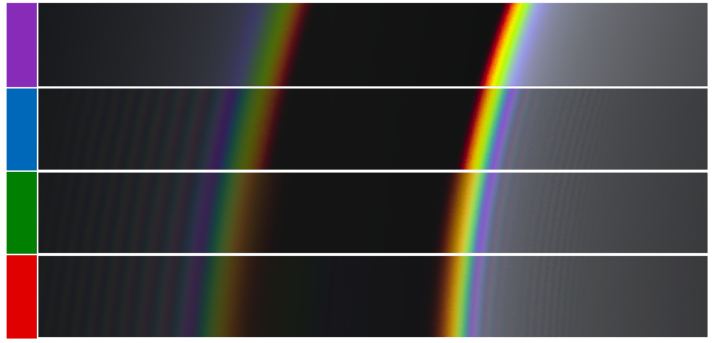
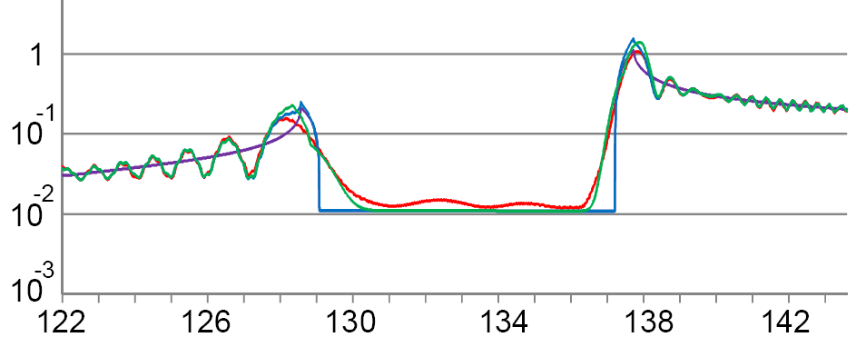
OUR MODEL VS. LORENZ-MIE
Our Model
Dispersion
+ Interference
+ Diffraction
Lorenz-Mie
Intensity
Angle

Slide 44
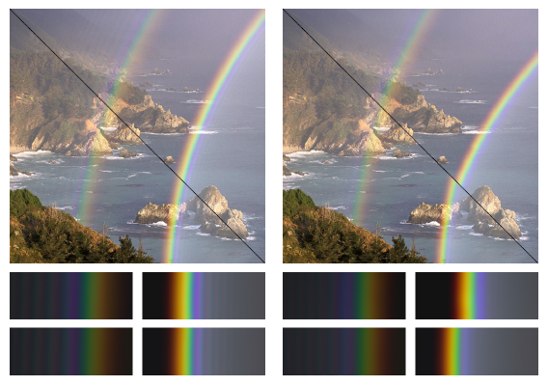
OUR MODEL VS. LORENZ-MIE
(a)
(a)
(a)
(a)
(b)
(b)
Our model
Lorenz-Mie
(b)
(b)
(a)
(b)
Spherical (0.4mm)
Nonspherical (0.5mm)

Slide 45
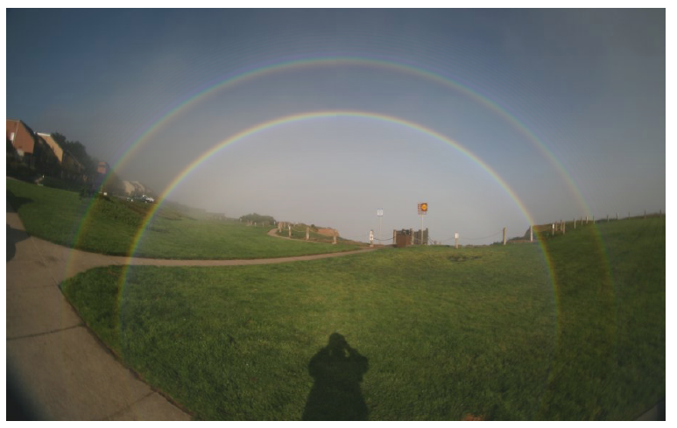
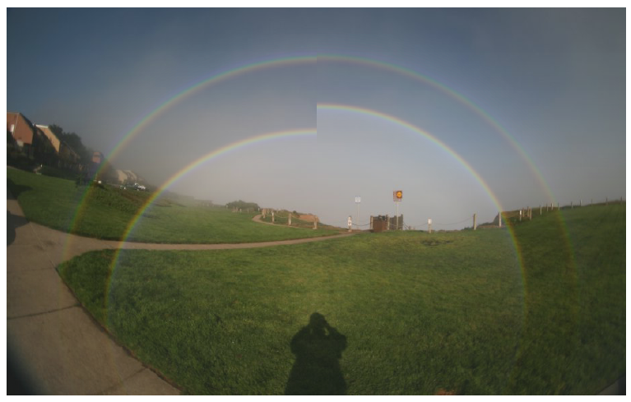
OUR MODEL VS. LORENZ-MIE
(a)
(b)
(a)
(b)
Spherical (0.4mm)
Nonspherical (0.5mm)
Our model
Lorenz-Mie

Slide 46
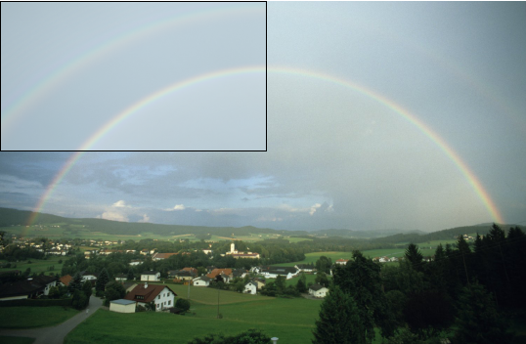
MATCHING PHOTOGRAPHS
© Karl Kaiser
Double Rainbow

Slide 47
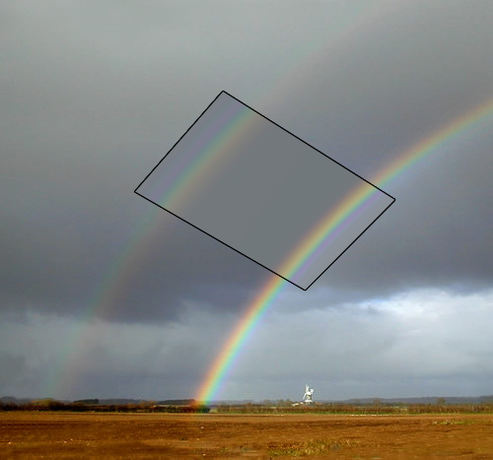
MATCHING PHOTOGRAPHS
© Les Cowley
Double Rainbow / Alexander Dark Band

Slide 48
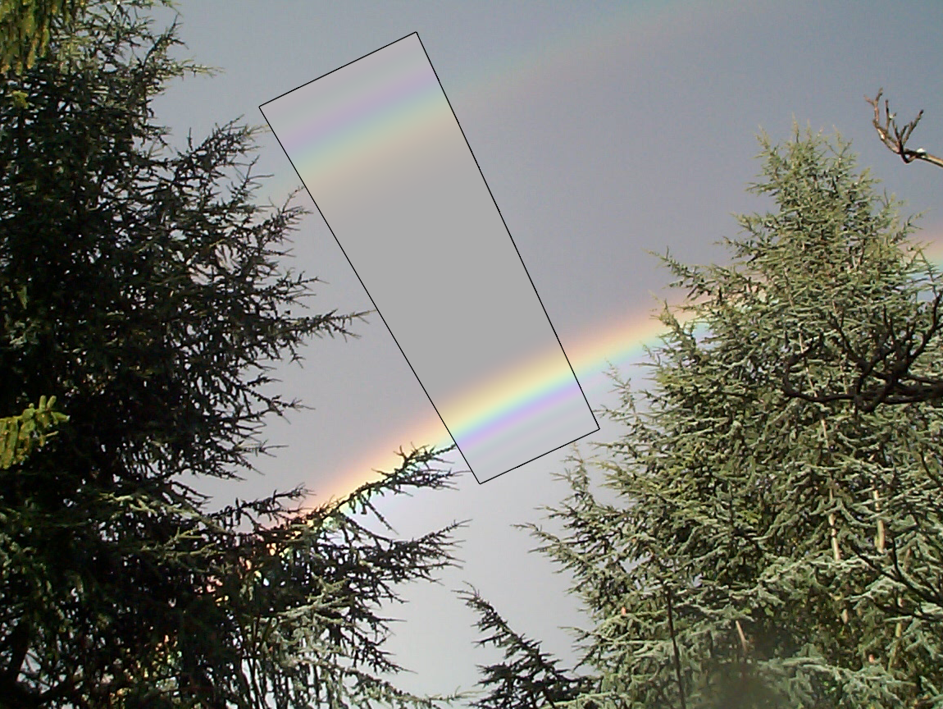
MATCHING PHOTOGRAPHS
© Philip Laven
Double Rainbow with Supernumerary Arcs

Slide 49
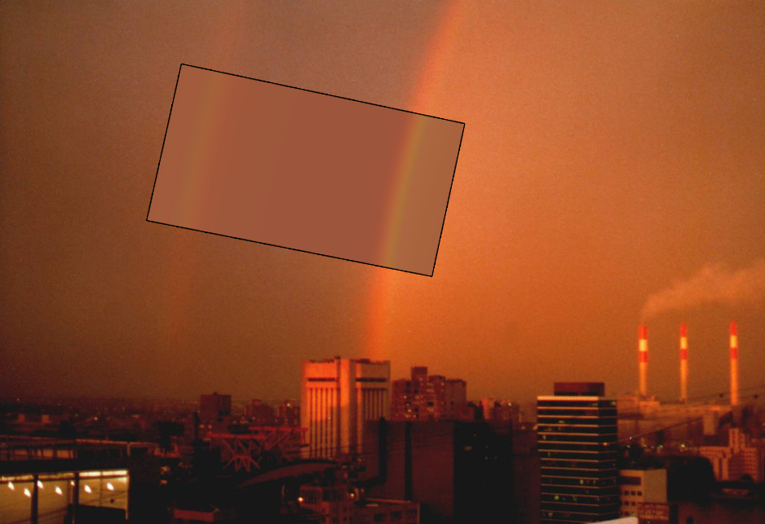
MATCHING PHOTOGRAPHS
© Philip Laven
Red Bow at Sunset

Slide 50
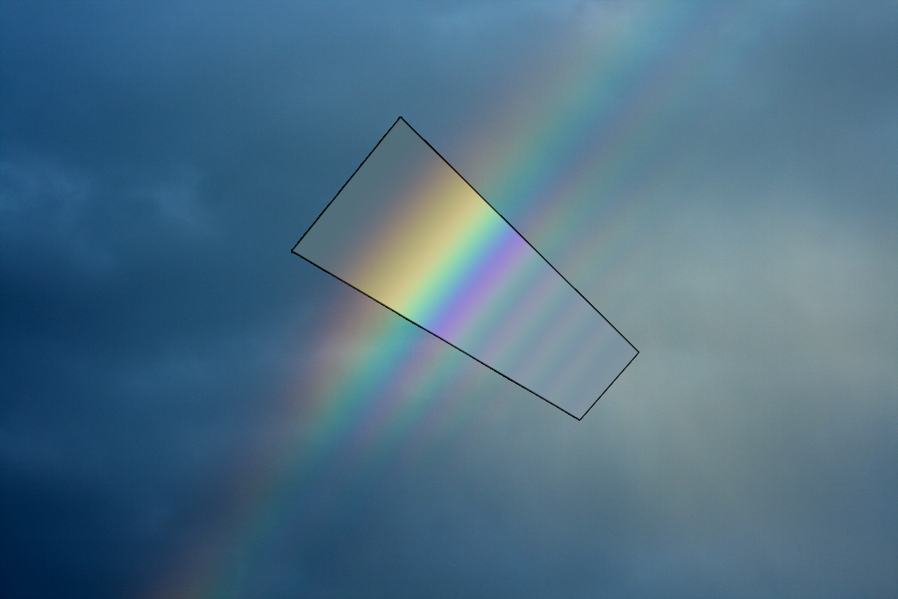
MATCHING PHOTOGRAPHS
© Ian Goddard
Multiple Supernumerary Arcs

Slide 51
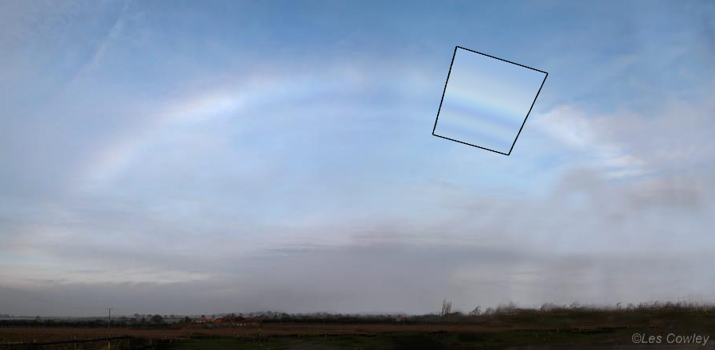
MATCHING PHOTOGRAPHS
Fog Bow

Slide 52
MATCHING PHOTOGRAPHS
Rendering
(0.4 mm & 0.45 mm)
Photograph
© Benjamin Khne
Twinned Bow

Slide 53
SUMMARY
Rainbow simulation from physically based shapes
  Match Lorenz-Mie for spheres.
  Not limited to spheres.
Matched photographs of real rainbows
  Double rainbows, supernumerary arcs, fogbows, red bows, etc.
  First comprehensive simulation of twinned bows

Slide 54

谢谢！

