Slide 1
Mobile3DRecon

Slide 2
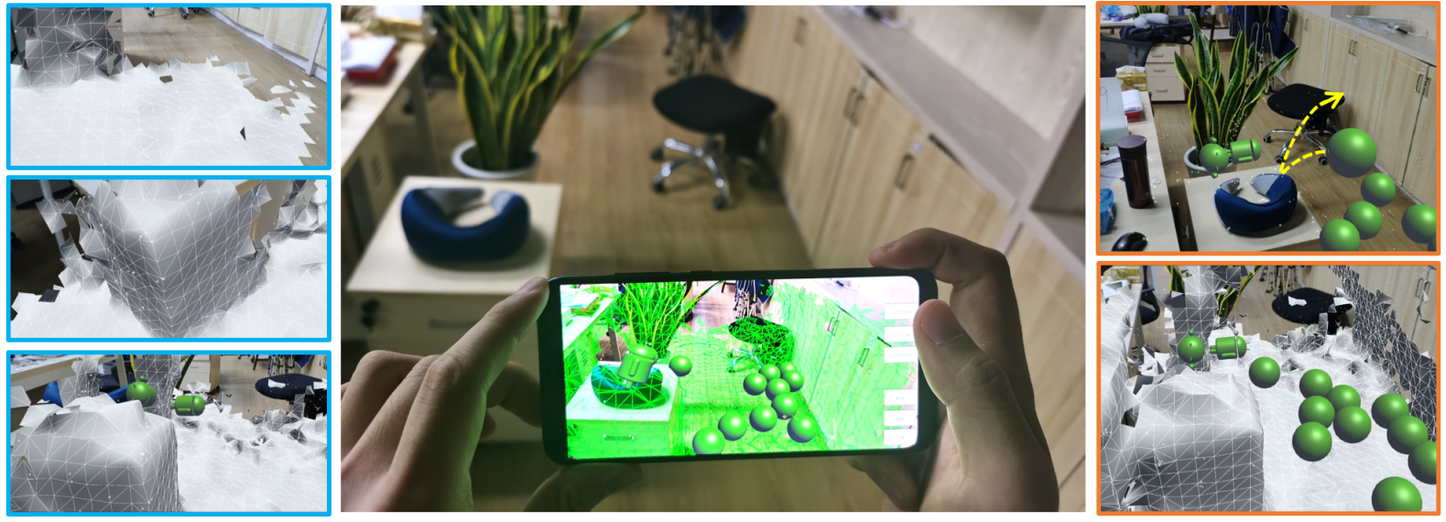

Slide 3
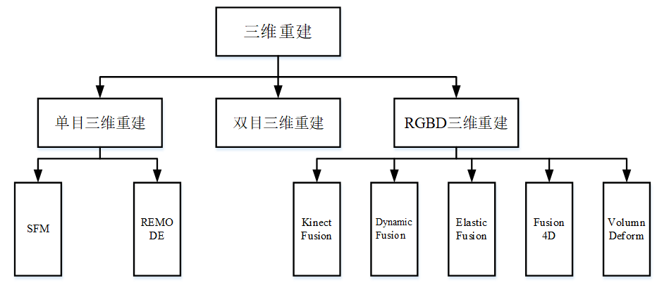

Slide 4
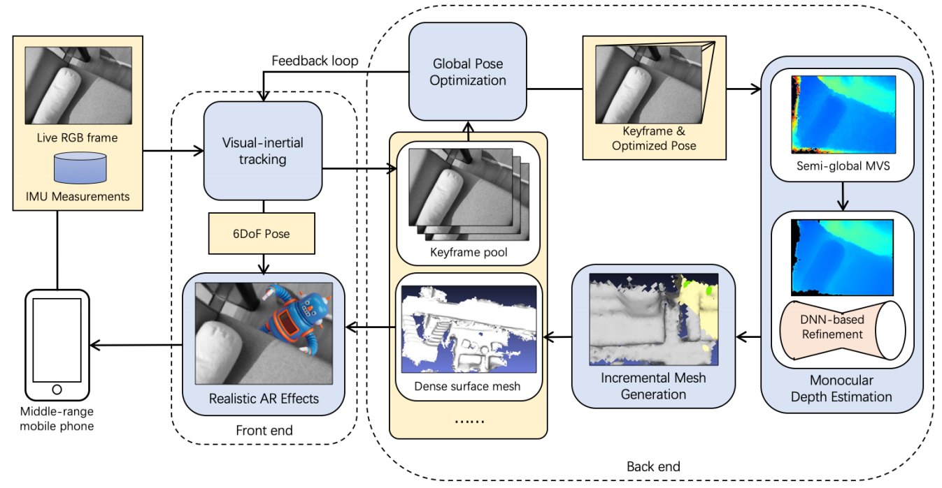
System framework

Slide 5
Future work

