Slide 1
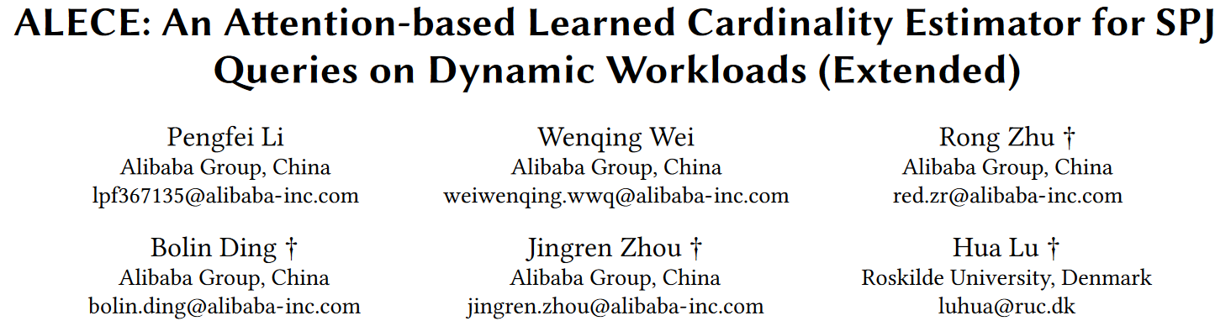

Slide 2
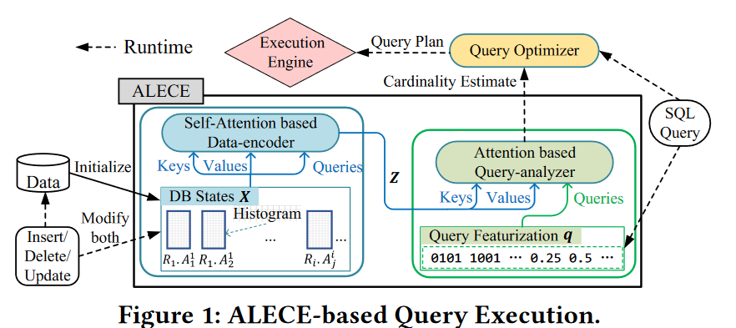
ALECE
Attention-based LEarned Cardinality Estimator (ALECE for short) for SPJ queries
core idea
carefully designed featurizations for data and queries
discover the implicit relationships between queries and underlying dynamic data using attention mechanisms in ALECE’s two modules
data-encoder
query analyzer

Slide 3
ALECE
attention in two modules
1. the ‘data-encoder’ module uses a self-attention whose inputs of queries, keys and values all come from the DB states. By using the self-attention, the data-encoder module learns the implicit joint distribution information among attributes and computes a smarter representation of the underlying data.
2. the ‘query-analyzer’ module, the queries set of the attention is exactly a set covering only one featurization vector of a SQL query, while the keys and values come from the output of the data-encoder module. The query-analyzer module outputs a fixed-dimensional ‘answering’ vector integrating the information from the query and data representations.
use a simple linear regression model to map the answering vector to a cardinality estimate.

Slide 4

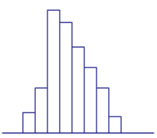
FEATURIZATIONS OF DATA AND QUERIES
Data featurization DB states X = {𝒙1, · · · , 𝒙𝑇 }
each attribute Ai is a dx-dim histogram vector
𝒙 𝑖 = [𝛽1, · · · , 𝛽𝑑𝑥 ]
scale to the range [0, 1] through a suitable affine transformation
a time stamp t
βj = the number of 𝐴𝑖 ’s values in [𝑙 + ( 𝑗 − 1) · 𝑎, 𝑙 + 𝑗 · 𝑎) for 1 ≤ 𝑗 ≤ 𝑑𝑥
u
l
a = (u - l) / dx

Slide 5

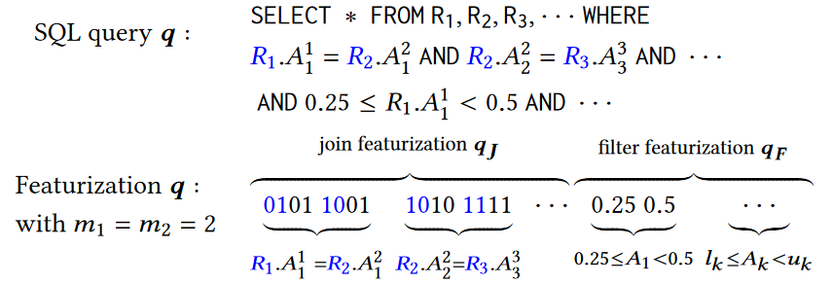
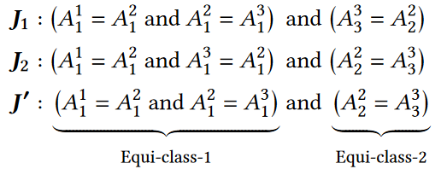
FEATURIZATIONS OF DATA AND QUERIES
Query Featurization
m = m1 + m2
2T
the featurization of filter predicates 𝒒𝑭 is a 2𝑇 dim vector composed of the boundary points of the search hyperrectangle, i.e., 𝐸𝑓 = [𝑙1, 𝑢1, 𝑙2, 𝑢2, · · · , 𝑙𝑇 , 𝑢𝑇 ]. In practice, each 𝑙𝑖 and 𝑢𝑖 will be normalized to [0, 1]

Slide 6
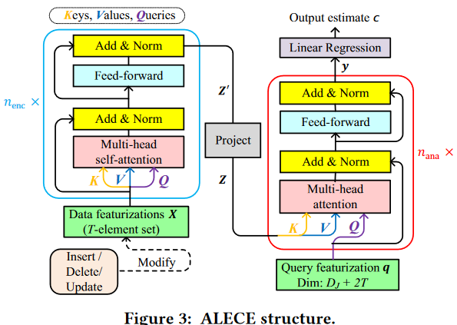
DESIGN OF ALECE
learns the implicit joint distribution information among all attributes by computing the relevance between any pairs of DB states
measure the relevance between the query featurization 𝒒 and 𝒁 , and generates an ‘answer’ vector 𝒚
maps a query and a set of key-value pairs to an output

Slide 7
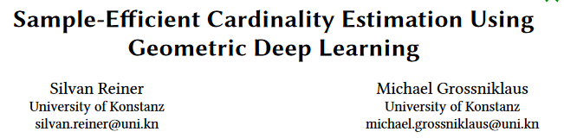

Slide 8
Model Architecture
a novel deep learning architecture called Join Graph Message Passing (JGMP) that incorporates the invariance and uniqueness properties specific to cardinality estimation.
The JGMP model has three main parts. In the first part, the sample bitmaps are used to compute embeddings for each table occurrence. In the second part, messages are passed over the edges of the join graph to learn about the structure of the query. In the third part, the table occurrence embeddings are aggregated to an embedding of the whole query, which is fed into fully connected layers to produce the final cardinality estimate. Only one model has to be trained for each database since message-passing neural networks can generalize over graphs of varying structures.
Notes:
根据样本位图计算每个表出现嵌入，通过连接图边传递信息学习查询的结构，适用跳跃连接计算最终节点的嵌入，将其与查询嵌入进行聚合，最终通过全连接层产生基数

Slide 9

Table Occurrence Embedding
Table occurrences i are characterized by their sample bitmap si and a PostgreSQL cardinality estimate ci
we employ separate weights 𝑊𝜏(i) and biases b𝜏(i) when calculating embeddings for occurrences i of tables 𝜏(i).
Node embedding

Slide 10



Message Passing
obtain the embedding g𝑘 of each edge in the join graph using a fully connected neural network based on the join encoding 𝑒
Next, we update node embeddings by applying 𝑁 custom message passing neural network layers
edge embedding
在第n层消息传递层中，计算从节点j通过边k的节点i的消息mn,j,k
更新第n层节点i的embedding

Slide 11
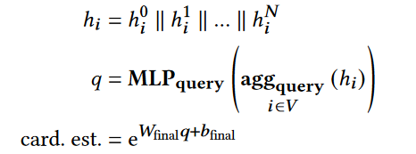

Query Embedding and Final Estimate
final node embbeding
query embedding
compute estimate
使用修改后的多头注意力聚合函数来聚合消息传递层中的信息以及聚合表征嵌入

Slide 12
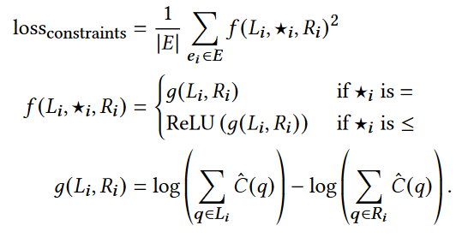

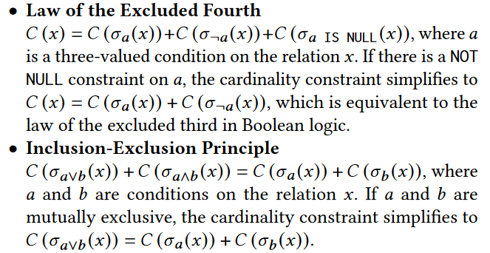
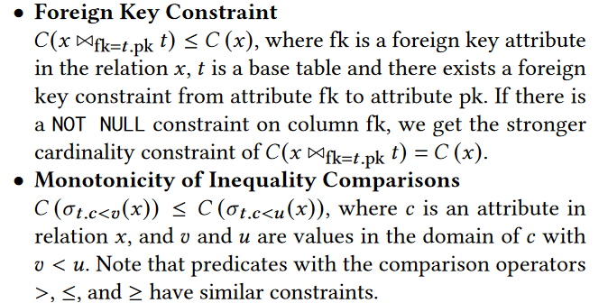

SELF-SUPERVISED REGULARIZATION
mean squared logarithmic error
Notes:
数据库查询的基数可能相差很大，有些查询结果可能只有几行，而有些可能返回数百万行。对数变换可以减少这种数量级差异的影响，使得损失函数对所有查询更加敏感。除了监督训练外，作者还引入了新的约束条件，并通过在损失函数中添加正则化项来将这些约束纳入模型。正则化项的作用是惩罚那些违反新引入约束的模型预测，从而引导模型朝着更符合这些约束的方向学习。这种方法可以提高模型在实际应用中的性能，尤其是在面对复杂查询和多样化数据集时。
正则项允许模型在没有大量标注数据的情况下也能学习到有用的信息

Slide 13
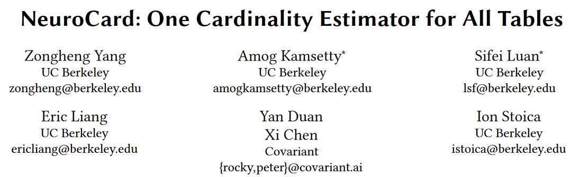

Slide 14
NeuroCard
To reduce training cost, NeuroCard samples from a join, instead of computing the join fully. --> Sampler
precompute the correct sampling weights for each key(time linear with the data size by dynamic programming)
To achieve generality, NeuroCard needs to train a single model to answer queries on any subset of tables. The basic idea behind the solution is to train the AR model on samples from the full outer join of all tables.
sufficient information to answer a query touching any subset of tables
At inference time, if a table in the schema is not present in a join query, we need to account for any potential fanout effect(downscale the probability).
To scale to large-cardinality columns while avoiding prohibitively large models, NeuroCard employs lossless column factorization.
An AR model stores one embedding vector per distinct value, so it could quickly blow up in size for columns with large numbers of distinct values
A column is decomposed into several subcolumns, each taking a chunk of bits from the binary representation of the original column values

Slide 15
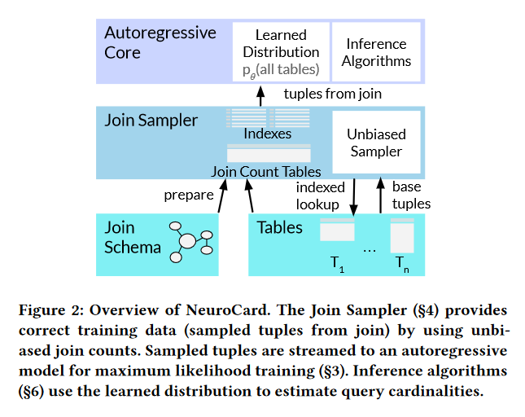
NeuroCard
Consider a set of tables, T1, . . . ,TN . We define their join schema as the graph of join relationships, where vertices are tables, and each edge connects two joinable tables. A query is a subgraph of the overall schema.
If a query joins a table multiple times, our framework duplicates that table in the schema
assume the schema and queries submitted to the estimator are acyclic, so they can be viewed as trees

Slide 16
NeuroCard
Building the estimator
prepare the join sampler by building or loading existing single-table indexes on join keys and computing the join count tables for the specified join schema.
train the deep AR model by repeatedly requesting batches of sampled tuples from the sampler, usually 2K tuples at a time. The sampler fulfills this request in the background, potentially using multiple sampling threads.
compute the cardinality estimates for given queries.
use probabilistic inference algorithms to compute the cardinality estimate by (1) performing Monte Carlo integration on the learned AR model, and (2) handling schema subsetting.

Slide 17
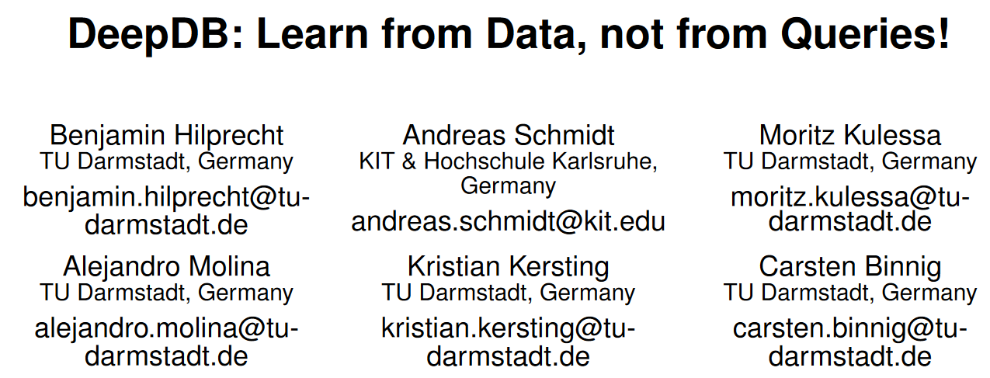

Slide 18
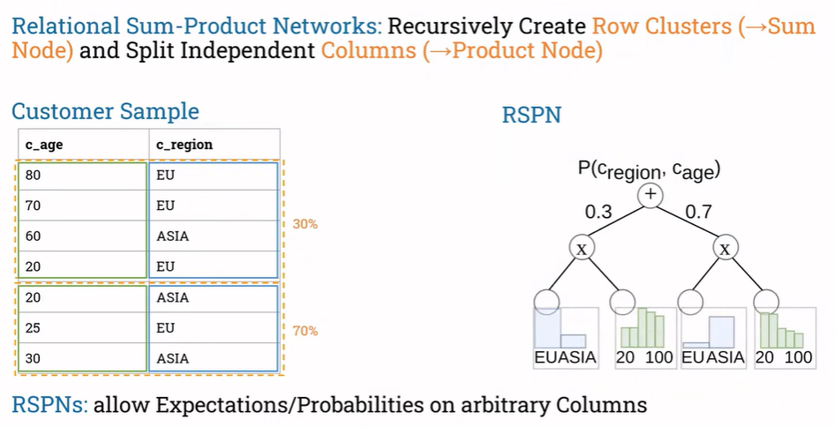
DeepDB

Slide 19
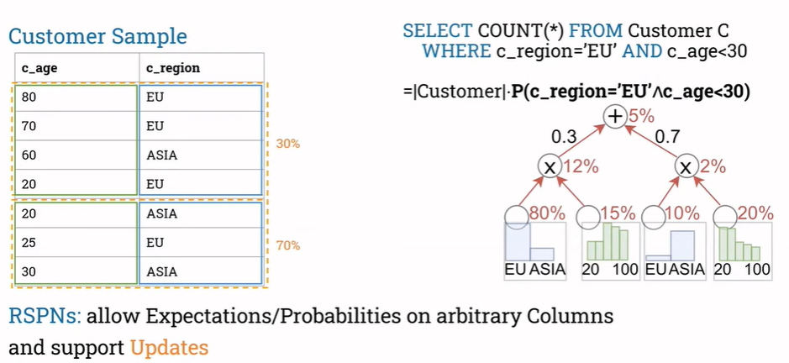
DeepDB

Slide 20
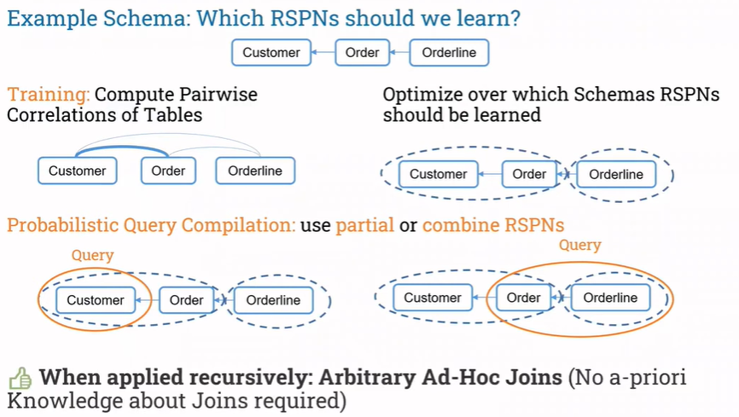
DeepDB

Slide 21
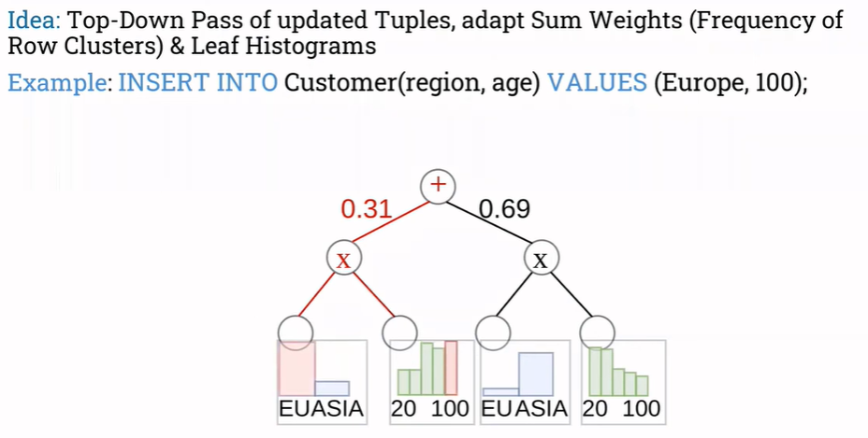
DeepDB

Slide 22
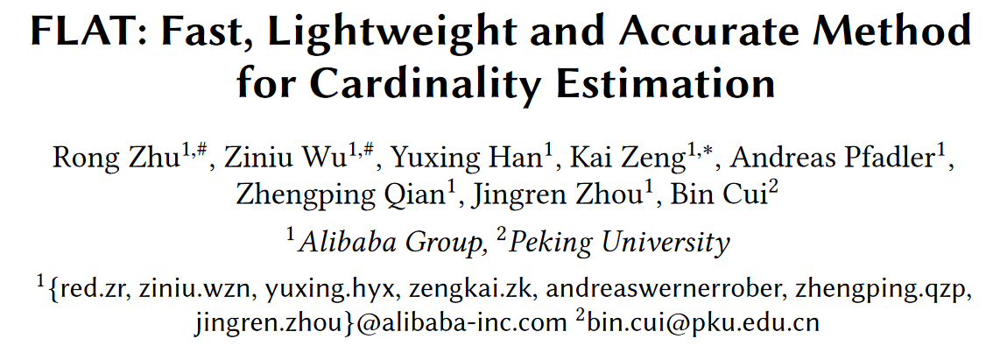

Slide 23
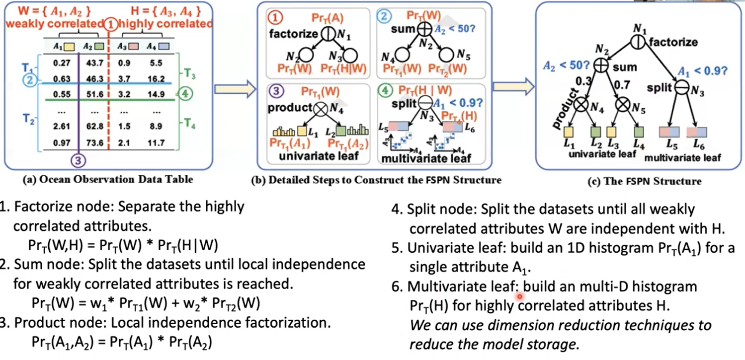
FLAT
FSPN（Factorize-Split-Sum-Product Network）

