Slide 1
REPLAY LAB
THAILAND TREND WATCH / 2026
AFTER SCHOOL
CHILDHOOD,
REMADE.
Squishies, slime and
the return to a familiar feeling.
A consumer insight.
A co-designed collection.
A business case to test.
Original pixel illustration / Concept demo and fieldwork preparation; no collected buyer results.
Notes:
0:00–0:15 | Spot the change
NARRATION
A toy can carry a memory. This project explores working adults in Thailand returning to squishies and slime. Could those memories support a more personal product? Meet REPLAY LAB.
VISUAL CUE
Open with the original pixel-art childhood desk. It illustrates the concept and is not fieldwork.

Slide 2
REPLAY LAB
01 / SPOT THE CHANGE
02
Old toys. New spending power.
EVIDENCE / SAMPHENG
25 JUN 2026
Working adults return
to childhood wishes.
A vendor described buyers using their own
income to buy toys they once wanted.
What changes?
The buyer’s spending power
and the online trigger.
S1 / Thai PBS World, 25 Jun 2026. A reported local signal; the adult market size is unknown.
Notes:
0:15–0:40 | Spot the change
NARRATION
Thai PBS World reported a toy revival at Sampheng in June twenty twenty-six. A vendor described working adults buying toys they had wanted as children but could not afford. Social reviews brought the toys back into view. This is a local signal, not a measure of the whole Thai market.
VISUAL CUE
Show the dated Sampheng account, then the change in the buyer’s situation. Source S1.

Slide 3
REPLAY LAB
01 / ORIGINAL EVIDENCE
03
Check who is actually buying.
YOUR FIELDWORK / PENDING
SECOND SIGNAL
1
Confirm recent buyers.
Mega Plaza’s buyers
were mainly children
and teenagers.
Working status, product and purpose.
2
Ask before showing the idea.
Memory and discovery, in their own words.
Thairath’s visit supports a broader revival.
It does not confirm the working-adult
segment.
3
Keep the real evidence.
Date, sample size, photo and a consented quote.
S2 / Replace the pending panel with your own evidence before submission.
Notes:
0:40–1:00 | Spot the change
NARRATION
Original fieldwork is still pending. Thairath’s Mega Plaza visit mainly found children and teenagers, so I need to confirm adult buyers directly. My questionnaire asks about actual purchases, childhood memories and social discovery before introducing REPLAY LAB.
VISUAL CUE
Replace the pending panel with your dated photo, actual interview counts and one consented quote. The second report is not personal evidence. S2.
REPLACE AFTER REAL FIELDWORK:
On [DATE], I visited [N] shops in [PLACE] and interviewed [N] working-adult buyers. [X] mentioned childhood memories; [Y] mentioned online reviews. One said, [EXACT QUOTE]. This small convenience sample [supports / complicates] the reported pattern.

Slide 4
REPLAY LAB
02 / EMOTIONAL MOTIVATION
04
The memory changes the value.
THE REPORTED ACCOUNT
EMOTIONAL
MOTIVATION
Adult income makes
a childhood wish
possible.
Memory
A familiar object has personal meaning.
Enjoyment
The texture is part of the reward.
Sampheng vendor account,
paraphrased by Thai PBS World.
Choice
The adult buyer chooses for themself.
S1 / Interpretation to test. Relaxation is a sought benefit; no medical effect is established.
Notes:
1:00–1:30 | Explain the consumer
NARRATION
Emotional motivation explains why a familiar toy can matter beyond its practical use. In the Sampheng account, adult income makes a childhood wish possible. My interpretation is that the purchase combines enjoyment, memory and personal choice. REPLAY LAB builds on this meaning by inviting buyers to contribute a childhood theme. Whether they would pay more still needs testing.
VISUAL CUE
Separate the source account from the interpretation. Use the pixel pencil case and game console as original concept objects. S1.

Slide 5
REPLAY LAB
02 / SOCIAL INFLUENCE
05
Social discovery brings the idea back.
REPORTED
INTERPRETATION
Reviews renew
attention.
Other adults can
make play feel normal.
Thai PBS World links the revival to
influencer and celebrity reviews.
Ask what triggered discovery, then ask
what motivated the purchase.
A shared design or a vote is not a paid order.
S1 / Sharing is a proposed channel for REPLAY LAB; engagement does not establish willingness to pay.
Notes:
1:30–2:05 | Explain the consumer
NARRATION
Social influence helps explain rediscovery. Thai PBS World links renewed attention to influencer and celebrity reviews. Seeing other adults enjoying toys may also make buying feel more acceptable. But discovery and motivation differ: a review may attract attention while a memory explains the spending. Shared designs could spread REPLAY LAB, but a vote or shared link is not a paid order.
VISUAL CUE
Show reported discovery, interpreted motivation and the proposed sharing feature as separate stages. Avoid invented view totals or social proof. S1.

Slide 6
REPLAY LAB
03 / FIND THE OPPORTUNITY
06
A familiar feeling. A chosen design.
STAR STICKER
PENCIL CASE
GAME BREAK
Choose a shared shape.
Personalise the colours, sensory options and story.
S2 / Rebound and scent are reported product features. These childhood themes are proposed designs.
Notes:
2:05–2:25 | Find the opportunity
NARRATION
Thairath describes slow rebound, scents and nostalgic interest. REPLAY LAB combines sensory choice with childhood themes: a pencil case, star sticker or old game controller. A small range of shared shapes keeps production manageable.
VISUAL CUE
Show example original designs. These are proposed themes, not observed customer preferences. S2 supports the sensory product context.

Slide 7
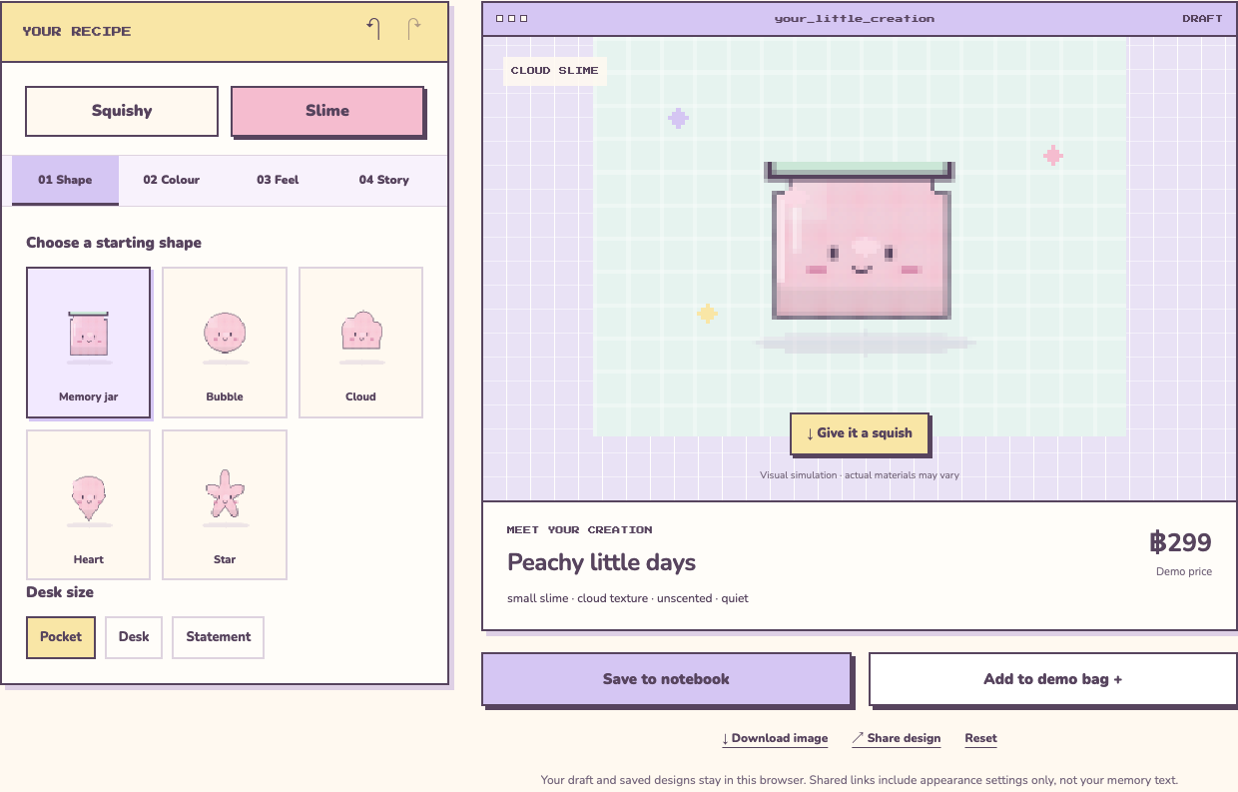
REPLAY LAB
03 / REPLAY LAB DEMO
07
Design it. Test demand. Make a batch.
WORKSHOP / INTERACTIVE DEMO
THE BUSINESS
BEHIND THE DEMO
Co-design
Develop a small collection.
Pre-order
Publish a minimum batch.
Produce or refund
Only after costs and samples are
checked.
Browser-local demo / no real payment, order, production or aggregate customer data.
Notes:
2:25–3:00 | Find the opportunity
NARRATION
Here is the website demo. Choose squishy or slime, adjust colours and sensory options, then add a name and memory. Save the design or share its appearance. In the proposed business, selected themes become small collections. Pre-orders would open after supplier costs and samples are checked. Production begins only when the minimum batch is met; otherwise buyers receive refunds. This demo takes no payments.
VISUAL CUE
Show the actual studio screenshot or record the live designer while speaking. Demonstrate colour, save and share inside this segment; do not add a separate demo. Memory text is excluded from share links. Reservations are simulated.

Slide 8
REPLAY LAB
03 / A SPECIFIC DIFFERENCE
08
Make the difference specific.
SHARED FOR THE COLLECTION
CHOSEN BY THE CUSTOMER
Childhood theme
Core shapes
Supplier process
Colours + texture
Name + memory card
Personal story
Revenue: product sales. Shared shapes help control production complexity.
S5 / Photo-custom squishies already exist. The proposed focus is Thai childhood memories and adult use.
Notes:
3:00–3:20 | Find the opportunity
NARRATION
Custom squishies already exist. Our proposed difference combines shared Thai childhood memories, adult desk use and collections chosen with customers. Revenue comes from product sales. Shared shapes limit complexity while colours, names and memory cards add personal meaning.
VISUAL CUE
Show the shared-shape versus personal-detail diagram. Cite S5 for existing custom squishies; do not claim to be the first in the world.

Slide 9
REPLAY LAB
04 / EVALUATE THE OPPORTUNITY
09
Three risks need an answer.
1
Willingness to pay
A cheaper ready-made toy may still win.
2
Production complexity
Options can add mistakes, delays and cost.
3
Continued demand
Nostalgia may prompt only one purchase.
REAL CASE / OCPB / 30 JUN 2026
Incomplete labels at some Mega Plaza sellers: check products, suppliers and information.
S4 / The inspection concerns some sellers. It does not establish that every squishy is unsafe.
Notes:
3:20–3:55 | Evaluate the opportunity
NARRATION
Three risks matter. Customers may prefer a cheaper ready-made toy. Custom options can increase mistakes, delays and costs. Nostalgia may also prompt only one purchase. Quality needs attention: the consumer protection office reported incomplete labels at some Mega Plaza sellers in June. Before real orders, the business needs approved samples, clear product information, realistic delivery dates and workable refunds.
VISUAL CUE
Use the three decision rows plus the specific OCPB example. S4 concerns some sellers, not all products.

Slide 10
REPLAY LAB
04 / BATCH ECONOMICS
10
Orders must cover a real batch.
ILLUSTRATIVE SQUISHY CASE / THB
ASSUMPTION
ASSUMPTION
ASSUMPTION
349
199
150
−
=
Base price
Variable cost
Contribution per unit
THB 4,500 ÷ THB 150 = 30 units
Actual threshold must also meet the supplier’s minimum order quantity.
All figures are assumptions, not actual supplier costs or demand. The proposed 30-unit threshold needs supplier validation.
Notes:
3:55–4:25 | Evaluate the opportunity
NARRATION
The numbers on this slide are assumptions. At a price of three hundred forty-nine baht and variable cost of one hundred ninety-nine, contribution is one hundred fifty baht. A setup cost of four thousand five hundred requires thirty units. The actual threshold must also meet the supplier’s minimum quantity. Include all costs and test willingness to pay before production.
VISUAL CUE
Show the threshold formula and distinguish demo activity from evidence. Do not present the demo counter as market demand.

Slide 11
REPLAY LAB
04 / RECOMMENDATION
11
START WITH
ONE COLLECTION.
CONTINUE ONLY IF
1
People choose it.
At a price that can work.
Interview working adults.
Test the prototype and price.
Check a supplier-made sample.
2
Quality is consistent.
The sample matches the promise.
3
The batch pays.
Orders cover cost and minimum
quantity.
Let weak results change the idea.
Demo + questionnaire: https://blimmy.github.io/replay-lab/
Notes:
4:25–4:45 | Evaluate the opportunity
NARRATION
Start with one collection. Continue only if working adults prefer the concept at a viable price, the supplier delivers consistent quality, and the batch covers its costs. Use the questionnaire to find weaknesses as carefully as enthusiasm.
VISUAL CUE
Close on the three pilot gates. If demonstrating the website live, include that time inside the five-minute limit.

Slide 12
REPLAY LAB
CREDITS / 4:45–4:50
12
Sources + prototype
S1
Thai PBS World | 25 Jun 2026
S2
Thairath English | 19 Jun 2026
S3
TrendWatching | Consumer Trend Canvas
S4
OCPB | 30 Jun 2026
S5
SquishTide | custom squishies
Original pixel art and diagrams. Published sources re-used with attribution.
Prototype activity is simulated. Personal fieldwork is pending.
Sources and limitations accompany the deck. Slide 13 is a hidden reference appendix.
Notes:
4:45–4:50 | Credits
NARRATION
VISUAL CUE
Silent source card. Slide 13 is a hidden canvas appendix and is outside the video runtime.

Slide 13
REPLAY LAB
APPENDIX / CONSUMER TREND CANVAS
13
REPLAY LAB / the logic
INSPIRATION + NEEDS
DRIVERS + EXPECTATION
S1–S2: reported revival.
Enjoyment, memory, personal choice.
Own fieldwork pending.
Income + online rediscovery.
Help me choose a toy connected
to my own childhood. Hypothesis.
FORMAT + WHO
INNOVATION + TEST
Co-designed small-batch products.
Early-career Thai adults revisiting
squishies and slime.
Personalise, share and pre-order.
Produce at a viable batch threshold.
Test demand, quality and cost.
S3 / Consumer Trend Canvas adapted from TrendWatching. Proposal and expectations require validation.
Notes:
Reference appendix. Adapted from TrendWatching; exclude from five-minute video. Original fieldwork pending.

