Slide 1
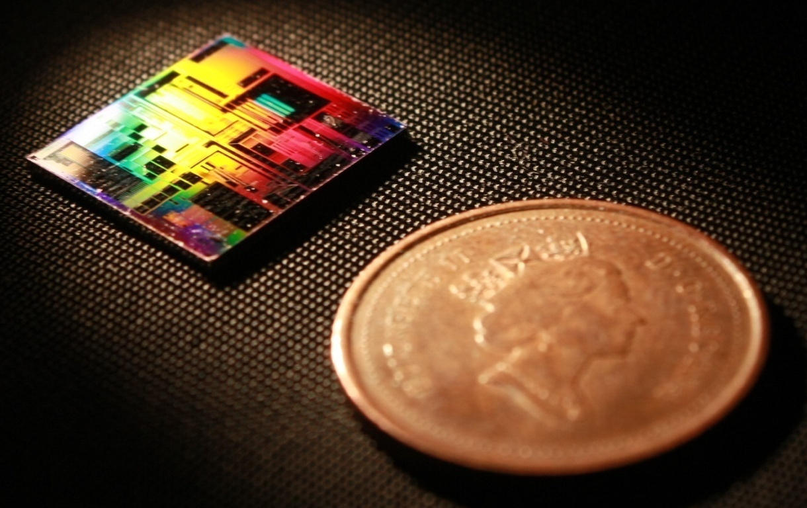
Klayout: Parameterized Cells Scripting 2020 SiEPIC Passive Silicon Photonics Workshop, Vancouver, Canada
Mustafa Hammood,
The University of British Columbia, Vancouver, Canada

Slide 2
Outline
SiEPIC EPDA Flow
What is a parameterized cell?
How to setup and start creating scripts
Define components library
Make your first parameterized cell

Slide 3
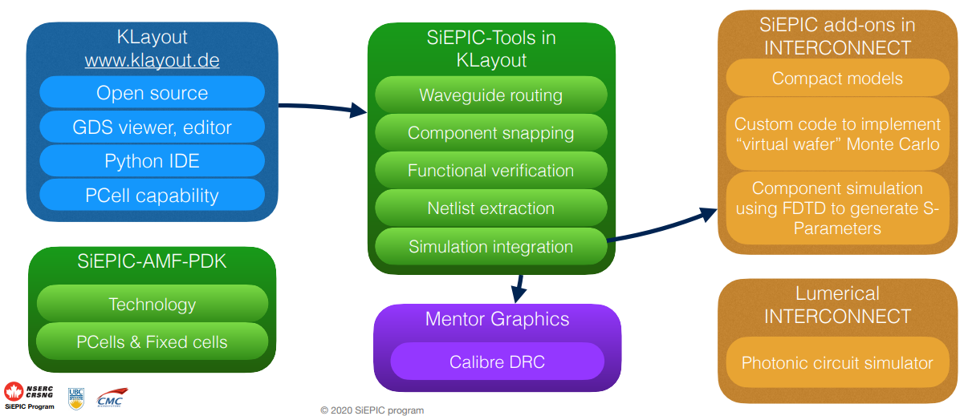
SiEPIC EPDA

Slide 4
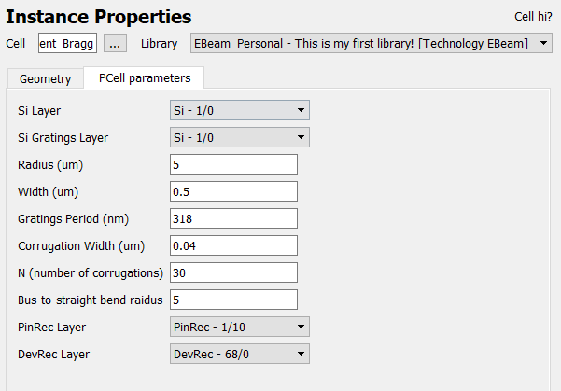
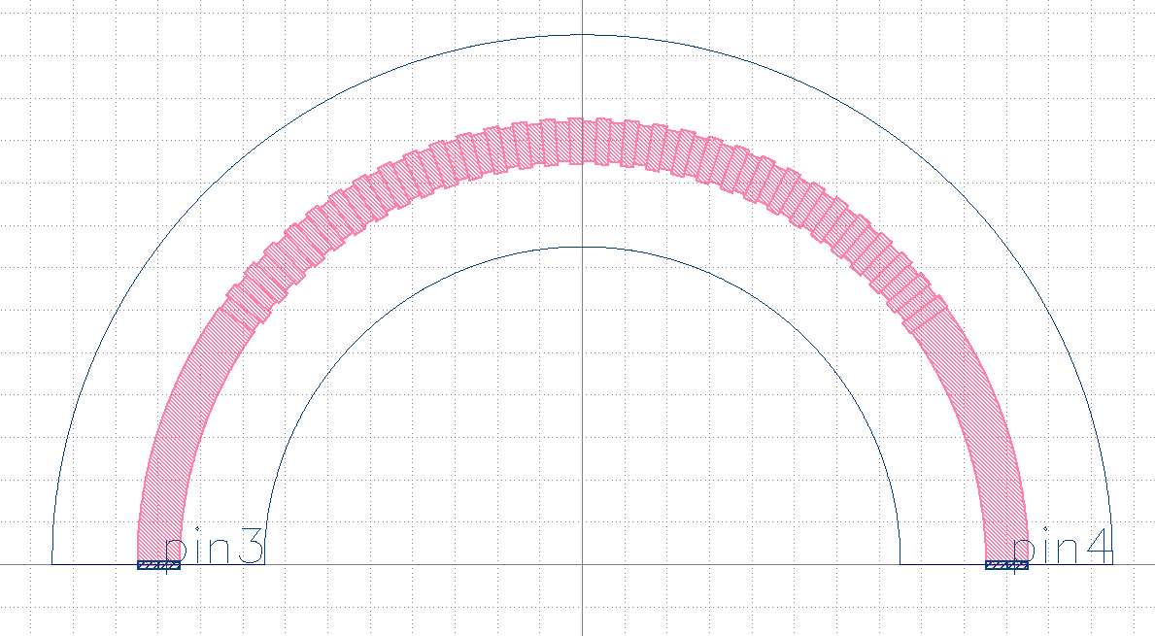
Pcell?
A method to generate the layout of a parameterized device, contains:
Physical device parameters
Ports definitions
Device region definition
Compact models (?)

Slide 5

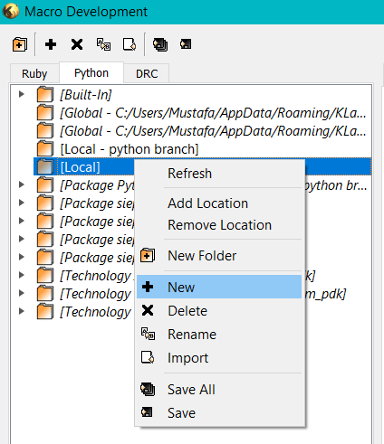
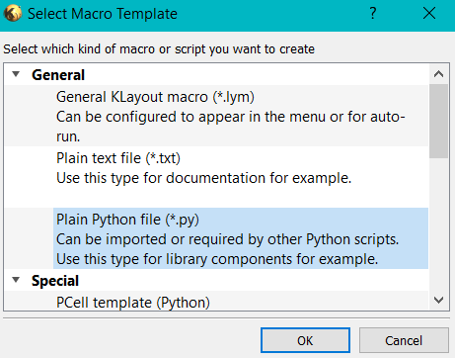
Setup
Open Macro Development
Create a new Python script in your local directory
Copy content of my_first_script.py
[1]
[2]
[3]

Slide 6
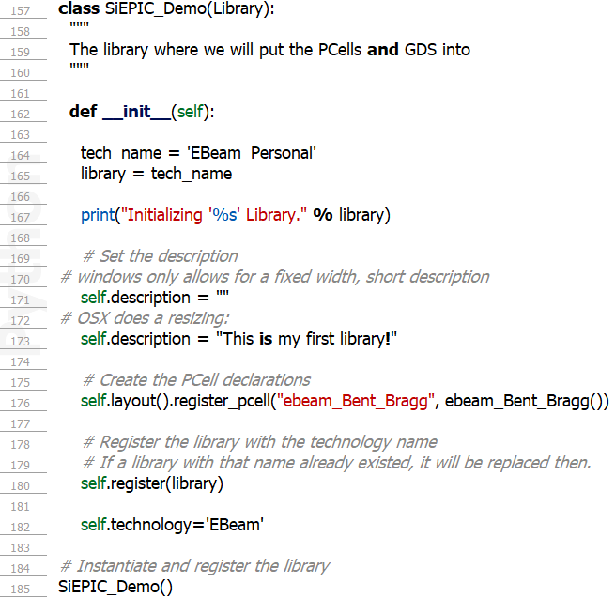
Define components library
Call it SiEPIC_Demo
Built on a technology
‘EBeam’
Register all PCells in the script
‘Ebeam_Bent_Bragg’

Slide 7
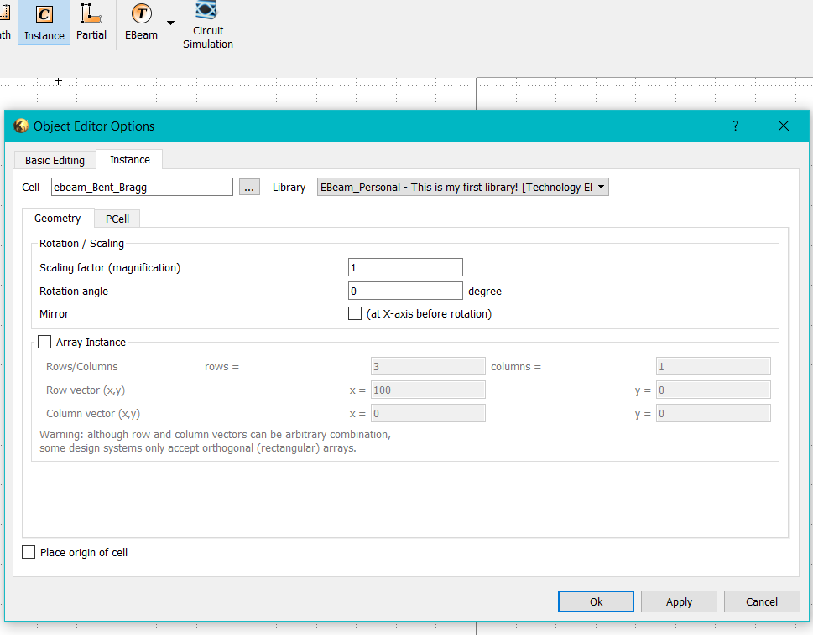
Define components library

Slide 8
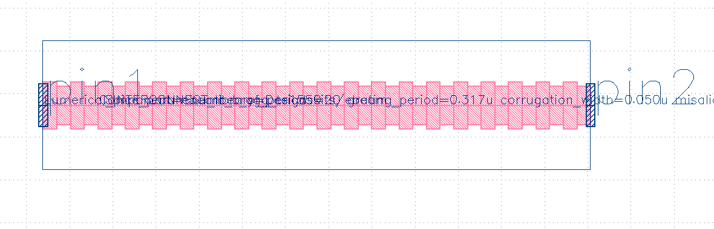
Pcell: Objective
We want to turn Bragg gratings from straight to bent over an Arc
Parameters:
Radius
Waveguide width
Bragg period
Bragg corrugation width
Number of Bragg periods
Layers

Slide 9
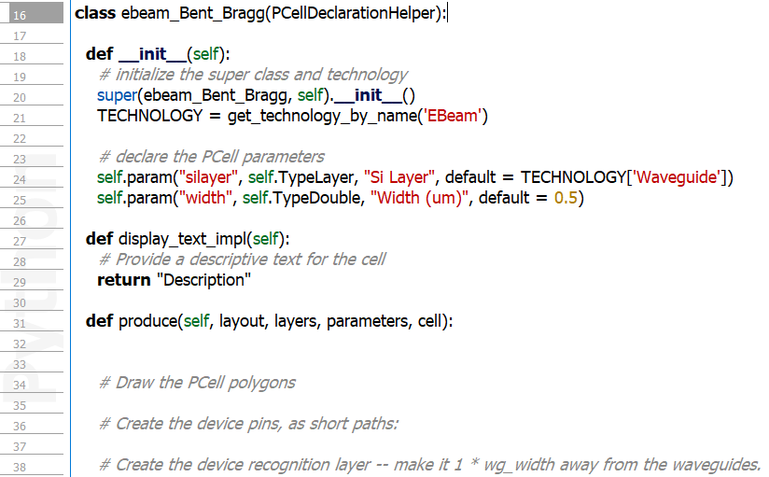
Pcell: Format
__init__: initialize technology and GUI Pcell parameters
Display_text_impl: Description of the Pcell, appears when selected
produce: Actual implementation of the Pcell (polygon drawing definition) and ports definition, and device recognition

Slide 10
Pcell: Objective
We want to turn Bragg gratings from straight to bent over an Arc
Parameters:
Radius
Waveguide width
Bragg period
Bragg corrugation width
Number of Bragg periods
Layers

Slide 11
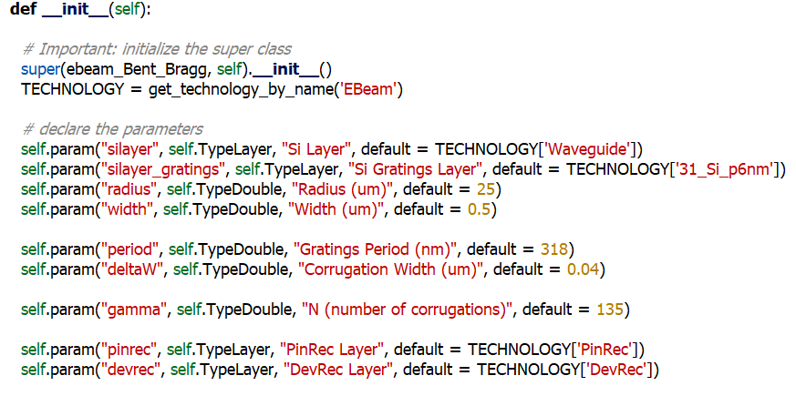
Pcell: Script Parameters GUI and tech
Method: __init__

Slide 12

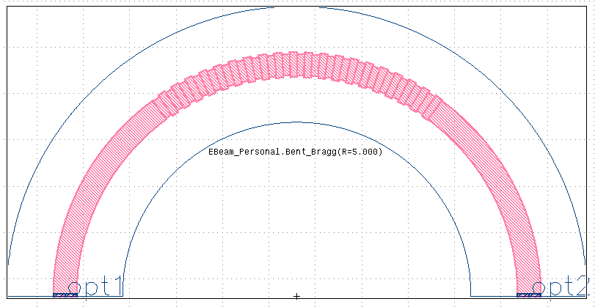
Pcell: Description
Method: display_text_impl

Slide 13
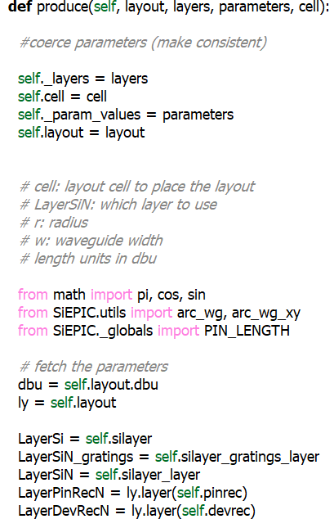
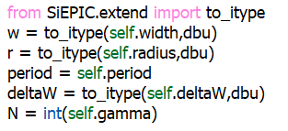
Pcell: Produce: fetch layout parameters
Method: Produce

Slide 14
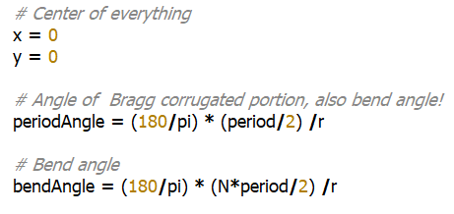
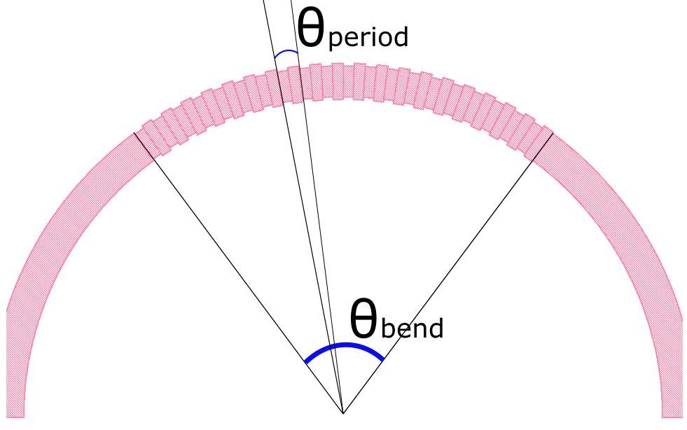
Pcell: Produce: Draw layout!
Method: Produce

Slide 15
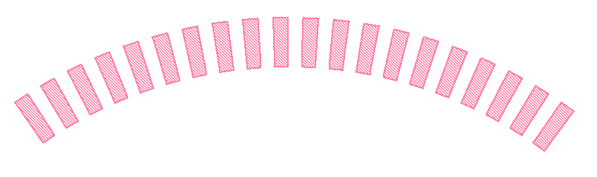
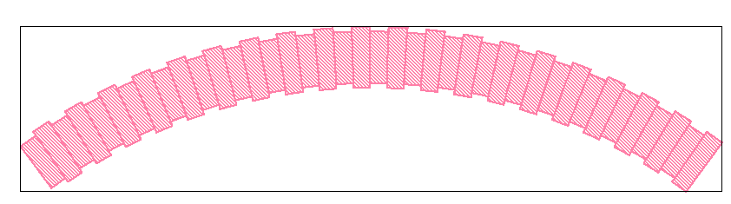
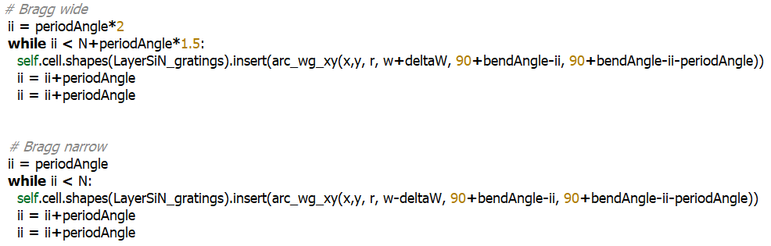
Pcell: Produce: Draw layout!
Method: Produce
Draw corrugations (wide)
Use an arc function (arg_wg_xy)
skip every other period
Draw corrugations (narrow)
Use an arc function (arg_wg_xy)
skip every other period

Slide 16
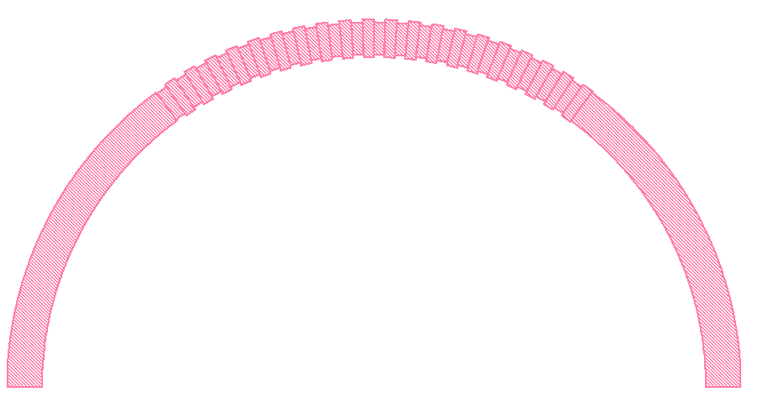
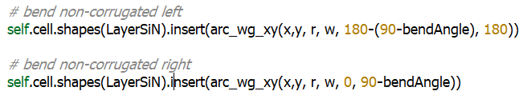
Pcell: Produce: Draw layout!
Method: Produce
Draw bend sections (uncorrugated)
Use an arc function (arg_wg_xy)

Slide 17
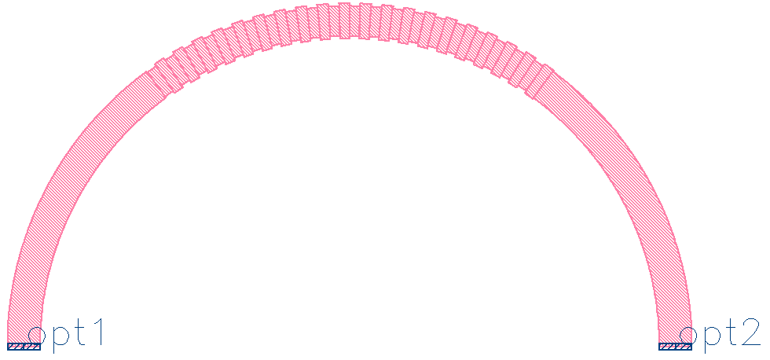
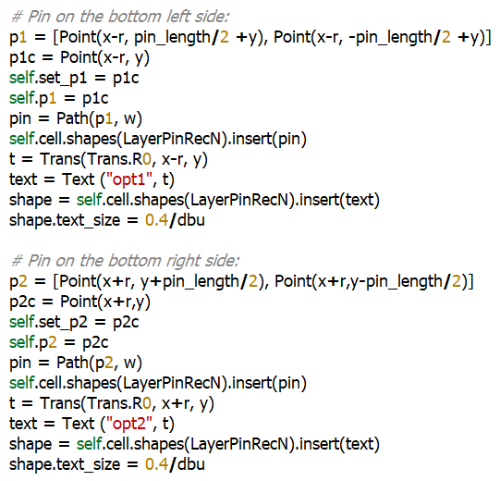
Pcell: Produce: Draw layout!
Method: Produce
Draw optical input pins
As wide as waveguides width
Be aware of orientation!
This enables component snapping
Used for connectivity/netlist

Slide 18
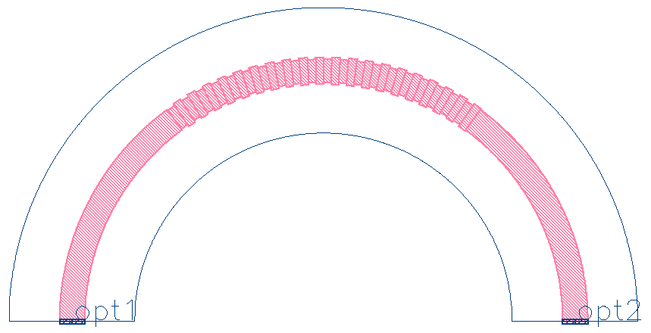
Pcell: Produce: Draw layout!
Method: Produce
Draw device recognition (bounding) box
Used for device area recognition, prevents from overlapping with other components

Slide 19
Pcell examples:
MMI
Ring Resonator
Bragg Grating
Directional Coupler
Taper

