Slide 1
习题课
第5-8次作业
赵洋洋

Slide 2
P255 3.14
DADDIU R4, R1, #800
foo: L.D F2, 0(R1)
MUL.D F4, F2, F0
L.D F6, 0(R2)
ADD.D F6, F4, F6
S.D F6, 0(R2)
DADDIU R1, R1, #8
DADDIU R2, R2, #8
DSLTU R3, R1, R4
BNEZ R3, foo
2 stalls
6 stalls
2 stalls
4 stalls
2 stalls
2 stalls
1 stall

Slide 3
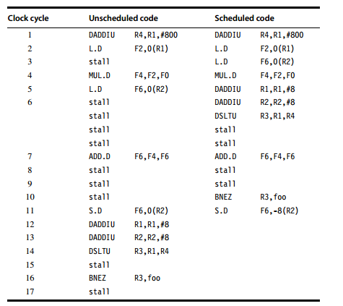
2 stalls
6 stalls
>2 stalls
4 stalls
2 stalls
2 stalls
1 stall

Slide 4
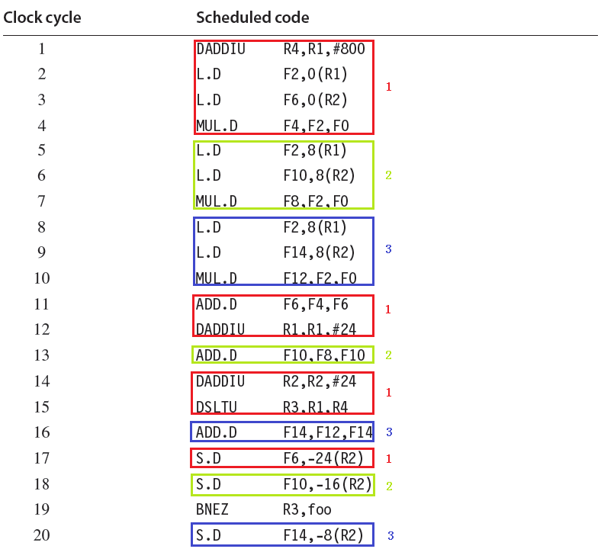

Slide 5
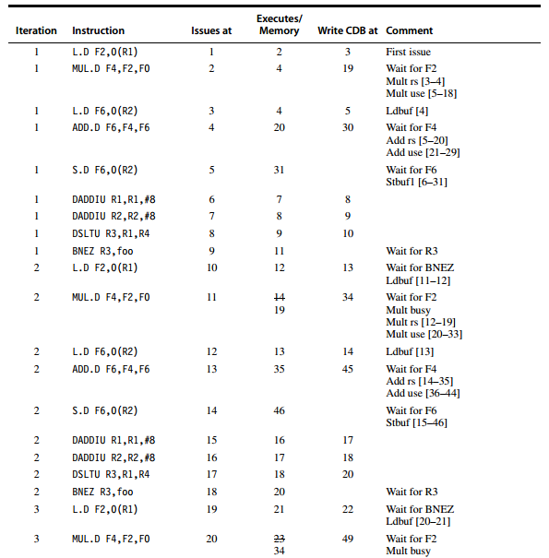
P257 3.15
20
35
35

Slide 6
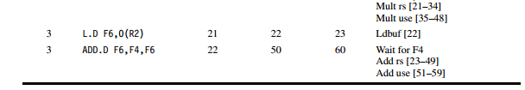
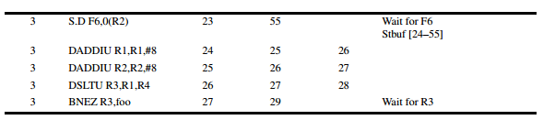

Slide 7
P259 3.19
对于非条件分支指令，其下一条指令直接存储在BTB中，因此省去了通过地址取指令的过程，因此节省了1 cycle
考虑如下指令
jmp L1
…
L: mov r1, r0
在对应5% unconditional branch，90% hit rate, 2 cycyles penalty for a buffer miss中，其性能提升为：

Slide 8
5%*(90%*(-1) + 10%*2) = -0.035
为了使得BTB帮助机器获得性能提升，即：buffer中存储的指令所带来的收益要比因buffer miss所带来的penalty要大，设hit rate = x ,那么：
x*(-1) + (1-x)*2 < 0
解得： x > 2/3 = 66.7%

Slide 9
4.9
for (i=0;i<300;i++) {
c_re[i] = a_re[i] * b_re[i] – a_im[i] * b_im[i];
c_im[i] = a_re[i] * b_im[i] + a_im[i] * b_re[i];
}
运算密度 = 浮点操作个数 / 内存访问字节数
六次浮点数操作
4 次读操作：a_re, a_im, b_re, b_im + 2 次写操作：c_re, c_im
运算密度 = 6/(6*4) = 1/4

Slide 10
4.9 cont.
b.
li $VL,44 # perform the first 44 ops
li $r1,0 # initialize index
loop:
lv $v1,a_re+$r1 # load a_re
lv $v3,b_re+$r1 # load b_re
mulvv.s $v5,$v1,$v3 # a+re*b_re
lv $v2,a_im+$r1 # load a_im
lv $v4,b_im+$r1 # load b_im
mulvv.s $v6,$v2,$v4 # a+im*b_im
subvv.s $v5,$v5,$v6 # a+re*b_re - a+im*b_im
sv $v5,c_re+$r1 # store c_re
mulvv.s $v5,$v1,$v4 # a+re*b_im
mulvv.s $v6,$v2,$v3 # a+im*b_re
addvv.s $v5,$v5,$v6 # a+re*b_im + a+im*b_re
sv $v5,c_im+$r1 # store c_im
bne $r1,0,else # check if first iteration
addi $r1,$r1,#176 # first iteration,
increment by 176
j loop # guaranteed next iteration
else:
addi $r1,$r1,#256 # not first iteration,
increment by 256
skip:
blt $r1,1200,loop # next iteration?
0
176
300
1200

Slide 11
4.9 cont.
c.
1. mulvv.s lv # a_re * b_re (assume already loaded), load a_im
2. lv mulvv.s # load b_im, a_im*b_im
3. subvv.s sv # subtract and store c _re
4. mulvv.s lv # a_re*b_im, load next a_re vector
5. mulvv.s lv # a_im*b_re, load next b_re vector
addvv.s sv # add and store c_im
6 次钟鸣
每次迭代所用的时钟数：6*64 + 15 * 6 + 8 * 4 + 5 * 2 = 516
考虑一个复数为一次结果，则产生64 个结果：516 / 64 = 8
考虑复数的实部或虚部为一次结果，则产生128个结果：516 / 128 = 4

Slide 12
4.9 cont.
e. 三条内存流水线
1. mulvv.s # a_re*b_re
2. mulvv.s # a_im*b_im
3. subvv.s sv # subtract and store c_re
4. mulvv.s # a_re*b_im
5. mulvv.s lv lv # a_im*b_re, load next a_re, load next b_re
6. addvv.s sv lv lv # add, store c_im, a_im,b_im
仍然是 6 次钟鸣，所需时钟数不受影响。

Slide 13
4.10
Vector :
execution time: 400 ms
mem access: (200MB+100MB)/(30GB/s) = 10ms
total time: 410ms
Hybrid:
execution time: 400 ms
mem access: (200MB+100MB)/(150GB/s) = 2ms
host IO: (200MB+100MB)/(10GB/s) = 30ms
latency: 10 ms
total time: 440ms

Slide 14
4.12
for (int x=0; x<NX-1; x++) {
for (int y=0; y<NY-1; y++) {
for (int z=0; z<NZ-1; z++) {
int index = x*NY*NZ + y*NZ + z;
if (y>0 && x >0) {
material = IDx[index];
dH1 = (Hz[index] – Hz[index-incrementY])/dy[y];
dH2 = (Hy[index] – Hy[index-incrementZ])/dz[z];
Ex[index] = Ca[material]*Ex[index]+Cb[material]*(dH2-dH1);
}}}}
浮点操作个数：共 8 FLOPS
内存访问字节数：10 次reads + 1 次write
运算密度： ８/ 44
可以
30 GB/s * 8/40 FLOPS/B = 6 GFLOPS/s
如果峰值性能大于 6 GFLPOS/s ，则访存受限；否则，计算受限。
d. 单个浮点数运算密度： 85/4 = 21.25 GFLOPS/s

Slide 15
4.13
a. 1.5 GHz × .80 × .85 × 0.70 × 10 cores × 32/4 = 57.12 GFLOPs/s
b.
(1) Speedup = 16/8 = 2
(2) Speedup = 15/10 = 1.5
(3) Speedup = 0.95/0.85 = 1.11

Slide 16
4.14
a.
for (i=0;i<100;i++) {
A[i] = B[2*i+4];
B[4*i+5] = A[i];
}
GCD 测试：
gcd(4, 2) | (4-5) ? 整除与被整除
所以，不存在相关。

Slide 17
4.14 cont.
b.
for (i=0;i<100;i++) {
A[i] = A[i] * B[i]; /* S1 */
B[i] = A[i] + c; /* S2 */
A[i] = C[i] * c; /* S3 */
C[i] = D[i] * A[i]; /* S4 */
}
重命名消除反相关和输出相关：
for (i=0;i<100;i++) {
A[i] = A[i] * B[i]; /* S1 */
B1[i] = A[i] + c; /* S2 */ （消除 s1-s2 关于 B[i] 的反相关）
A1[i] = C[i] * c; /* S3 */ （消除 s1-s3 关于 A[i] 的输出相关；
同时消除 s1-s3,s2-s3 关于A[i] 的反相关）
C1[i] = D[i] * A1[i]; /* S4 */ （消除 s3-s4 关于 C[i] 的反相关）
}
真相关：
S2-S1 A[i]; S4-S3 A[i];
反相关：
S1-S2 B[i]; S2-S3 A[i];
S1-S3 A[i]; S3-S4 C[i];
输出相关：
S1-S3 A[i]

Slide 18
4.14 cont.
A[0] = A[0] + B[0]
B[1] = C[0] + D[0]
--------------------
A[1] = A[1] + B[1]
B[2] = C[1] + D[1]
--------------------
A[2] = A[2] + B[2]
B[3] = C[2] + D[2]
---------------------
A[3] = A[3] + B[3]
B[4] = C[3] + D[3]
…
c.
for (i=0;i < 100;i++) {
A[i] = A[i] + B[i]; /* S1 */
B[i+1] = C[i] + D[i]; /* S2 */
}
关于 B 存在循环间依赖，因此不能并行。
修改为：
A[0] = A[0] + B[0];
for (i=1; i<100; i++) {
B[i] = C[i-1] + D[i-1];
A[i] = A[i] + B[i];
}
B[100] = C[99] + D[99];

