Slide 1

Lucke Calcutta
Software Engineering
www.luckecalcutta.com
Jake Peterson, Colin McArthur & Ben Loveland

Slide 2
What is Lucke Calcutta?
Lucke Calcutta is a mock sports betting web application built to be used at live sporting events such as rodeos.
A calcutta is a form of sports betting where bettors can bid for athletes in various events, and win money if their selected athlete wins.
Lucke Calcutta is designed to be used on the fly by event visitors - it’s sleek, efficient, and easy to use.
Notes:
Ben

Slide 3
Project Requirements
Available 24/7
As cheap as possible
Three different game modes
Easy to use for customers & event administrators
Usable on mobile & PC
Notes:
Jake

Slide 4




Development Stack
Backend - Node.js, AWS Elastic Beanstalk
Frontend - React, Bootstrap, Cloudflare
Database - AWS RDS Postgres
Notes:
Colin

Slide 5
Challenges
Changes:
Originally planned on using AWS for entire stack but pivoted to Cloudflare for frontend deployment
Ethics:
As CMU students we won’t integrate Paypal SDK or other transaction facilitators into the project - but the project was designed with real world transactions in mind
Logging to ensure any app issues won’t cause money to disappear
‘Push’ feature to refund money in case of contestant drop out
Notes:
CloudFlare offers a robust DDoS protection, Web Application Firewall (WAF) integration, and a global threat intelligence system

Slide 6
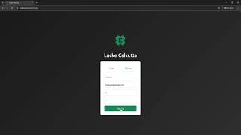
DEMONSTRATION
Notes:
Show tests here, show off website https://youtu.be/BvRaEcOzhfM

Slide 7
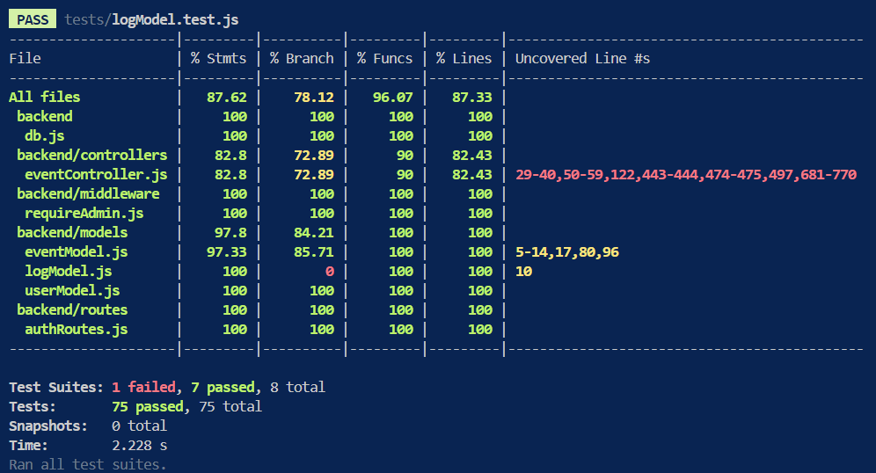
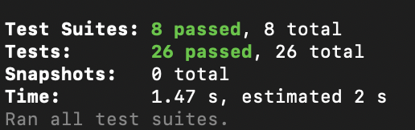
Backend Unit Tests Frontend Unit Tests

Slide 8
Next Steps
Betting interface:
Countdown for how long betting will be open
Display total pool once a minimum amount is reached
Administration:
Production version of code with variablized secrets
Full maintenance write-up
Logs stored in S3 Glacier
Notes:
Ben

Slide 9
Takeaways
Notes:
Everyone chime in

Slide 10
Questions?

Slide 11
THANK YOU
Notes:
Show tests here, show off website

