Slide 1

CreditLoop
AI FINANCE CONTROLLER · TRACK 04
The GST you’re losing, recovered before the money moves.
Indian companies quietly lose 18% GST on every employee expense — one receipt in the wrong name at a time.
Notes:
Hook: when your employee travels and the hotel bill is in their personal name, the 18% GST on it is gone — the company can never claim it. It's small each time, so nobody notices. A mid-size company loses lakhs a year.

Slide 2
THE PROBLEM
Two pipelines that never meet
The money pipeline
The tax pipeline
Knows
Priya · hotel · ₹11,800
Needs
GSTIN 27… · inv HTL/2026/4471
Speed
fast · approved in a day
Cadence
monthly · owned by a CA
Blind to
whose name the bill is in
Deadline
GSTR-2B locks the credit
No join key between them → 18% GST leaks, silently.
CreditLoop builds the join: claim → invoice → GSTIN → 2B → payout → book
Notes:
A company runs two systems that never talk. One knows a name; the other needs a GSTIN and invoice number. There's no link — so the credit leaks. CreditLoop is the missing join, and it decides before you pay.

Slide 3
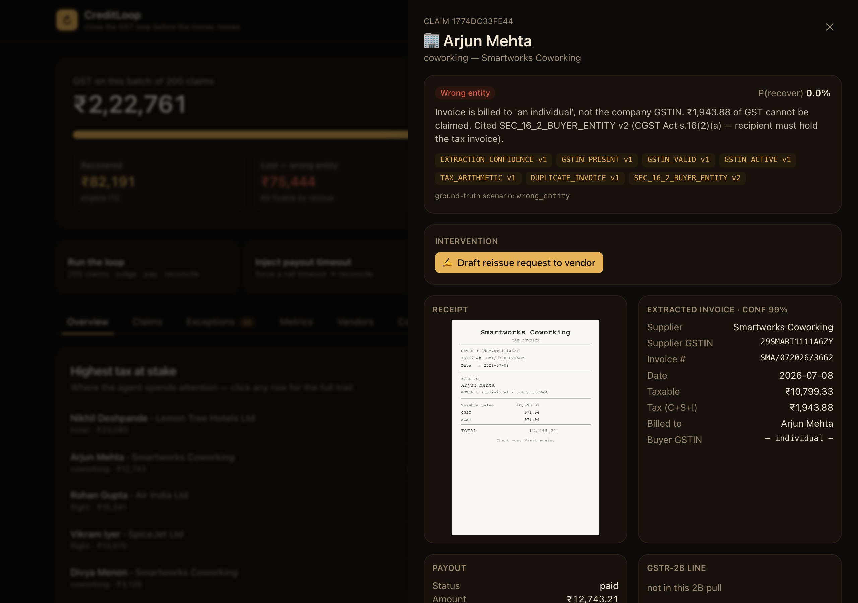
One loop, closed end to end
01
Read the receipt
A vision model (Gemini) pulls GSTIN, invoice no. and tax split off a crumpled photo — and refuses to guess when it can’t read one.
02
Judge with the law
A deterministic engine — never an LLM — decides eligibility, citing the exact rule and version. Before payout.
03
Chase · pay · reconcile
Pay on time, draft the vendor fix while it’s still possible, then match against GSTR-2B. Full audit trail.
An LLM may never change a tax verdict or move money — it reads, drafts, and proposes; the deterministic engine decides.
Notes:
Show a claim live: the receipt it read, the verdict citing the exact section of the GST Act, and a ready-to-send vendor message in English or Hinglish. And the employee still gets paid on time — the tax problem is the company's.

Slide 4
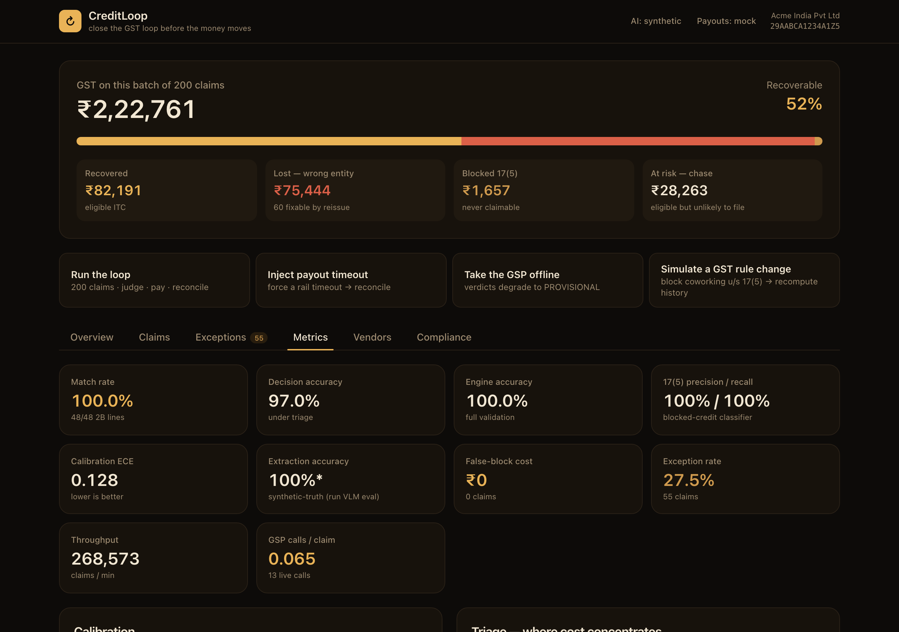
Measured on 200 hard claims
100%
100%
0.06
₹0
2B match rate
engine accuracy
API calls / claim
false-block cost
The exception rate is a feature. 27.5% of claims are refused — each with a machine-readable reason. An agent that always decides is an agent that guesses. Nothing fails silently.
Section 17(5) precision / recall: 100% / 100%
Notes:
100% match against the government's 2B statement. Receipt reading is real Gemini vision. And 0.06 live calls per claim: cheap claims cost nothing, live validation is spent only where money is at stake. The exception list is deliberate, not a gap.

Slide 5
Why it’s a company, not a demo
Free supervision, forever
A moat that compounds
Every month the government’s 2B statement tells us whether each prediction was right — a labelled signal on every transaction, at no cost.
The vendor-reliability we learn stitches across customers. The edge isn’t the tax logic — it’s the data only we collect by joining the two pipelines.
Live now → creditloop.onrender.com
read, never file · money never touched · deterministic law + calibrated prediction
Notes:
Every month reality grades us for free, on every transaction. And the vendor graph compounds across customers. That's why this is a company. It's live now — try it.

