Slide 1
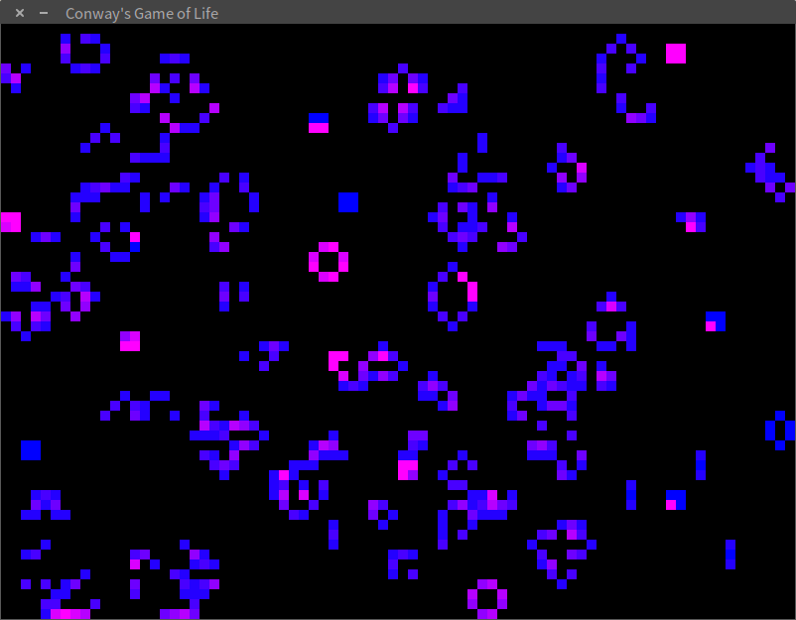
Conway’s Game of Life
Anna Blinderman
David Kraemer
Zachary Segall

Slide 2
Conway’s Algorithm
Any live cell with fewer than two live neighbors dies, as if caused by underpopulation.
Any live cell with two or three live neighbors lives on to the next generation.
Any live cell with more than three live neighbors dies, as if by overpopulation.
Any dead cell with three live neighbors becomes a live cell, as if by reproduction.

Slide 3
Conway’s Algorithm - Example
0 | 0 | 2 | 1 |  | 1 | 1 | 2 | 1
2 | 3 | 4 | 2 |  | 1 | 1 | 4 | 2
1 | 4 | 3 | 3 |  | 2 | 4 | 4 | 3
3 | 4 | 3 | 2 |  | 0 | 3 | 2 | 3
before
after

Slide 4
System Design
GUI/bitmap/grid
GPU kernels
count neighbors
determine state
CPU threads:
mouse input
keyboard input
main (update)

Slide 5
Challenging Implementation Detail
taking in and acting on user input
frequency
latency
priority
help from Lampson
“Plan to throw one away.”

Slide 6
Evaluation - Objective
responsiveness of program to user input
serial stencil vs. parallel stencil
significance of allocating/copying

Slide 7
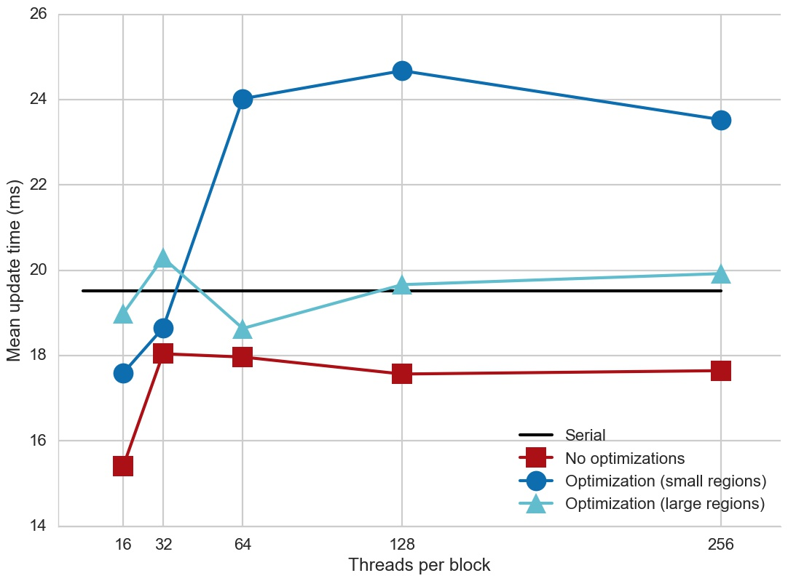
Evaluation - Figures

Slide 8
Summary
Copying is expensive
GPUs improve program speed (regardless of number of threads per block)
Threads manage user input well
Edge cases are difficult

