Slide 1
generICT
Sprint 1:
Iqbal
Endah
Umy
Hani

Slide 2
USER STORIES

Slide 3
--General User--
Mendaftar
Melihat General Home Page
Pencarian product
Rincian Product
Harga barang
Sisa kredit
Kondisi barang

Slide 4

--General User--
Mengoper Kredit
Mengambil Kredit
Verifikasi Akun
Profile
Edit profile
Seleksi barang
Input barang
Edit Barang
Status transaksi
Login
Metode pembayaran
Jadwal
Logout

Slide 5
--Tim Pengesahan--
Transaksi
Penjadwalan
Pengesahan

Slide 6
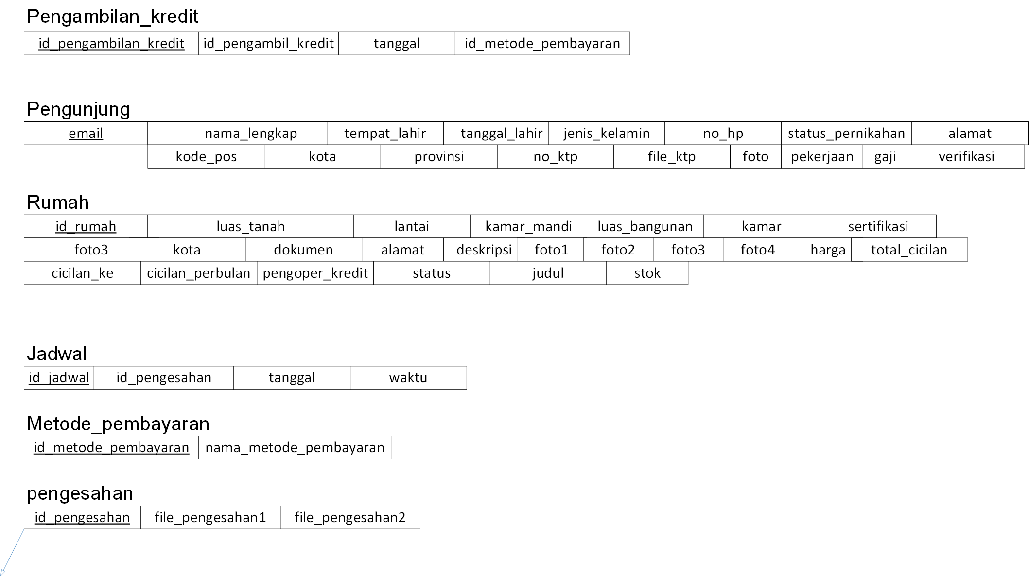
Relationship Diagram

Slide 7
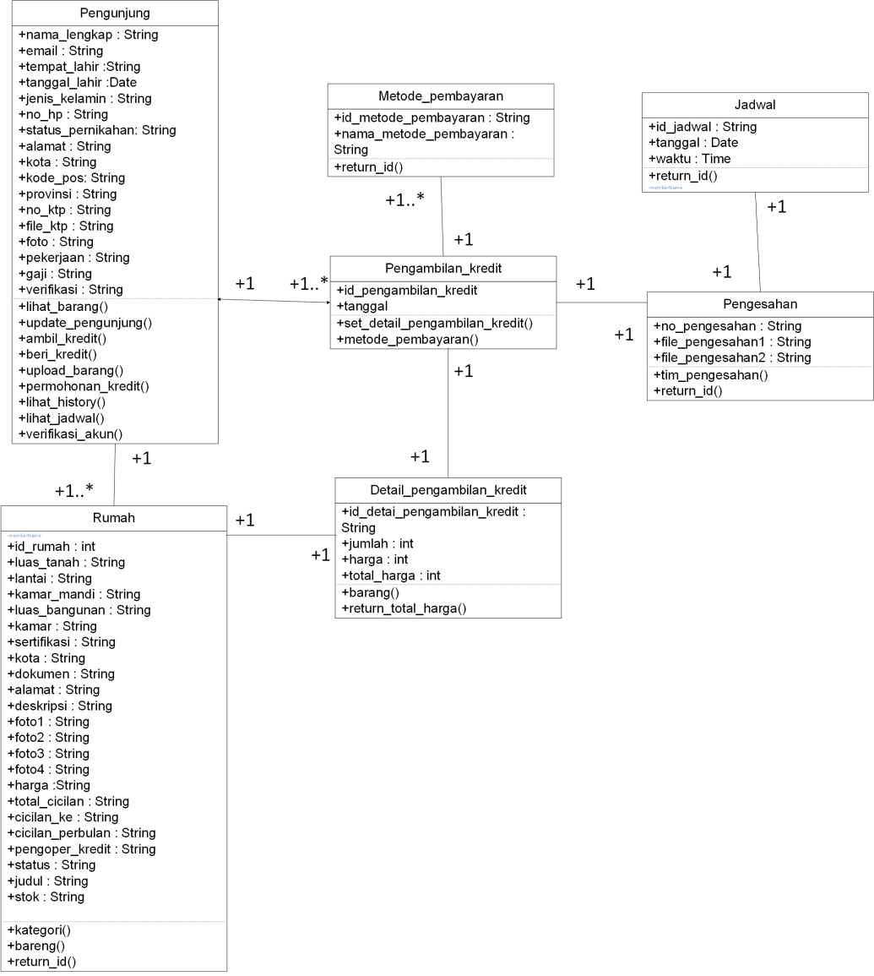
Class Diagram

Slide 8

OPERKREDIT.ID

Slide 9
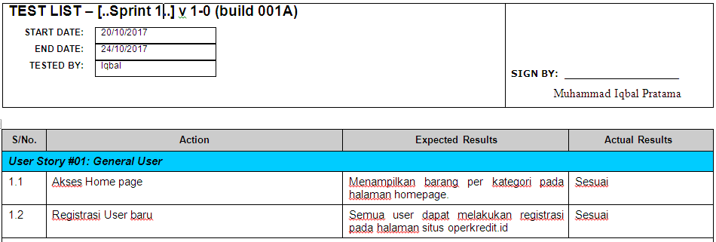
User Acceptance Testing

Slide 10
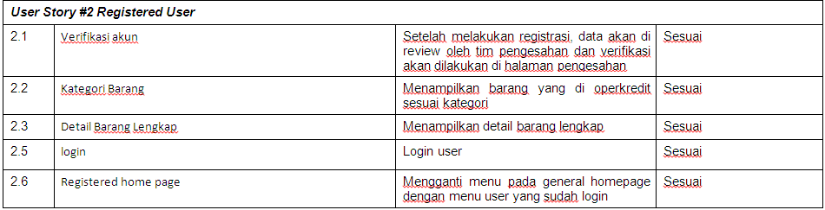
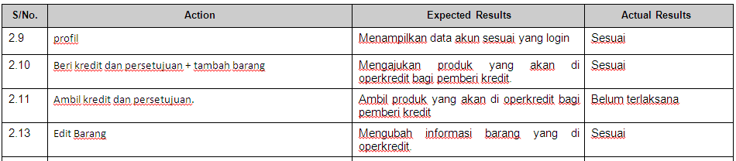
User Acceptance Testing (continue)

Slide 11
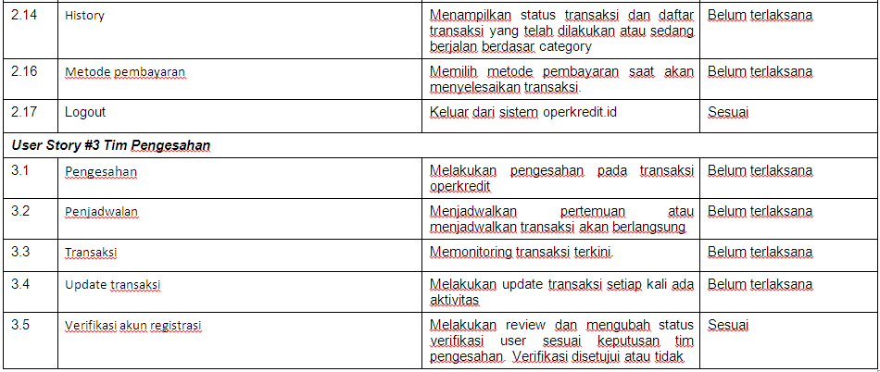
User Acceptance Testing (continue)

Slide 12
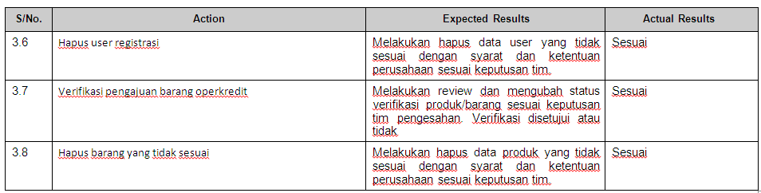
User Acceptance Testing (continue)

Slide 13
Referensi
https://github.com/blinkbink/operkredit
https://www.lucidchart.com/pages/uml/class-diagram
http://elearning2.uai.ac.id/

