Slide 1
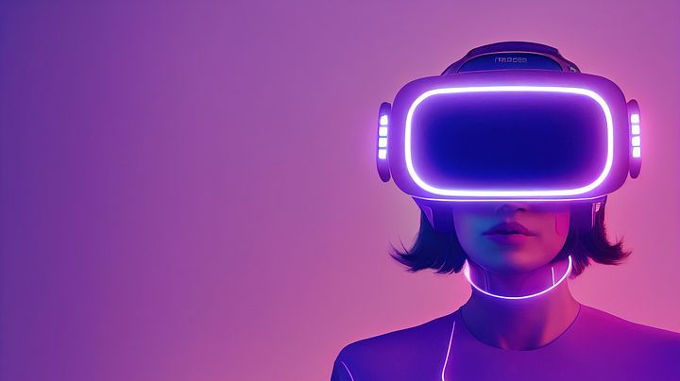
Augmented Reality

Slide 2

Why invest in make-up or trendy clothes and eyewear when Snapchat and Instagram provide filters that can make you look as wild, exotic, or beautiful as you wish, that too in a matter of seconds.
Maybe you would want just to goof around and turn into a witch or Santa, or perhaps your favorite fictional character just by adding a filter onto your face. There are hundreds of such filters, all powered by Augmented Reality (AR).

Slide 3
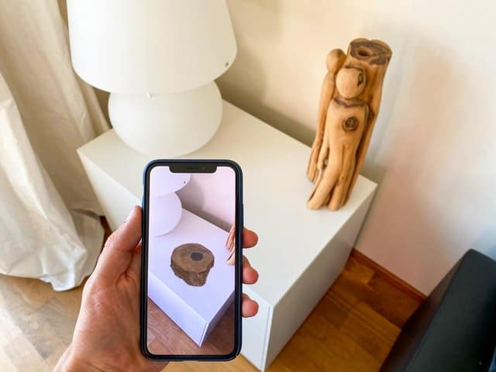
Augmented Reality (AR) is an interactive experience of a real-world environment where computer-generated digital objects can reside. It is a combination of the real-world and virtual world, whereas Virtual Reality (VR) completely replaces the real environment with a virtual one.
Thanks to the advancements in AI, you can build these seemingly magical Augmented Reality filters and run them on the most modest of hardware.

Slide 4
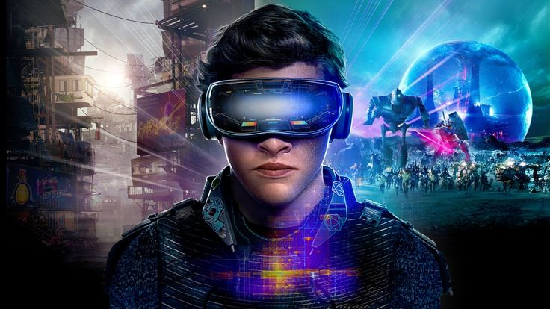
Augmented Reality has a lot of applications in different domains, such as
Gaming: We have all heard about PokemonGo. This game allows you to catch and collect virtual cartoon characters.
Retail: Imagine how seamless would be the shopping experience if you could try on clothes with a click of a button.
Marketing: Companies can create new experiences to attract the eyes of consumers.
Education: New interactive AR experiences can be designed to aid the learning process.

Slide 5
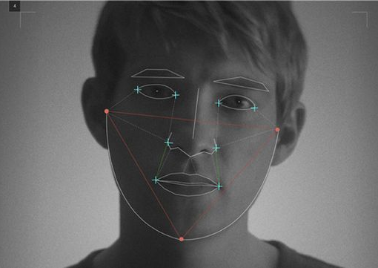
If you have heard of Metaverse, you know that Facebook is investing heavily in AR. Apple, too came out with Animojis. But by far, the most popular application of AR camera filters on social media apps like Instagram and Snapchat.

Slide 6
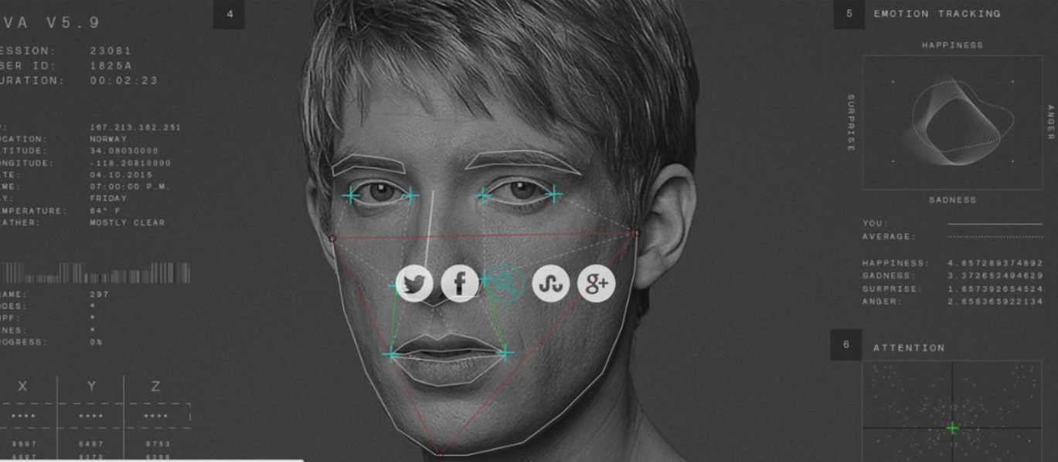
How AR filters work
Although it doesn’t seem like it, there are several technologies working together to produce a simple camera filter on your face. Let’s look at the different parts of the puzzle and how they work together.
Face detection: First and foremost, your face is detected in the camera frame. In the past, this was achieved using crude detection methods such as the Viola-Jones algorithm, Histogram of Oriented Gradients ( HOG ), etc. In the present age, with advances in machine learning and mobile hardware getting more and more powerful, it is possible to get good face detection with a significantly modest computational load.
Feature key points detection: Once the face is detected, the next step is to identify the key points of your facial features. A Facial Landmark predictor is used for this, which aligns the predefined set of feature points to your face.
Applying filter: Finally, the detected key points mesh can be morphed, or a filter can be applied on top of it to change the appearance of the face.

Slide 7

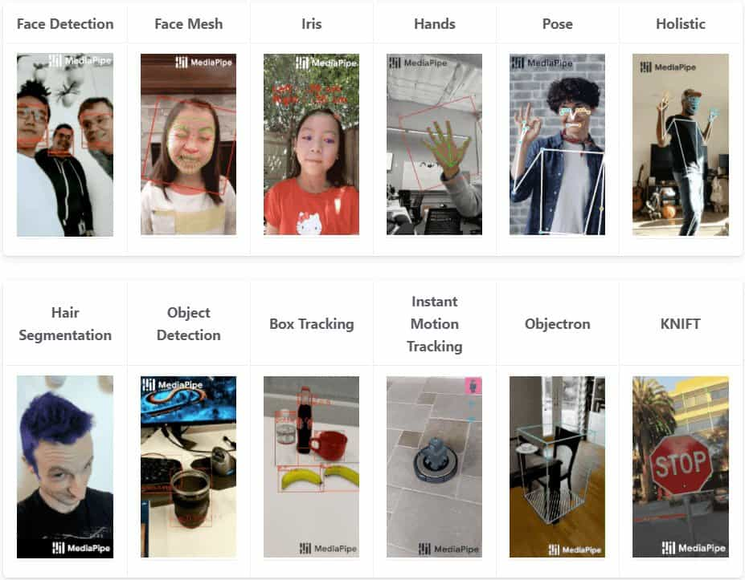
Why MediaPipe?
On top of lightweight and blazingly fast performance, MediaPipe supports cross-platform compatibility. The idea is to build an ML model once and deploy it on different platforms and devices with reproducible results.

