Slide 1
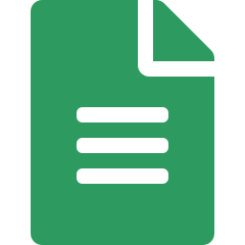























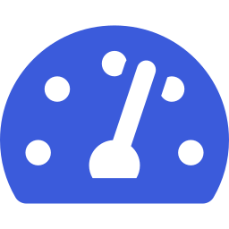


Next Phase - AI Adoption
1
Establish Baseline Processes,
Guidelines and Best Practices
2
Explore Spec-driven
Development
3
Scale Adoption
Across Teams
Current State Assessment
1. Write Spec
Team A
Team B
Process Baseline
SPEC
Guidelines
Team C
SDD
Center of
Excellence
Team D
4. Verify
2. Validate Spec
Best Practices
Team E
New Teams
Templates & Tools
Training &
Enablement
Communities &
Knowledge Sharing
Metrics &
Governance
Continuous
Improvement
3. Implement
Key Outcomes
AI Enablers
AI
Key Outcomes
AI Enablers
AI
Key Outcomes
AI Enablers
AI
Understand current state
Define standard processes
Create guidelines & best practices
Provide templates and tooling
Document Intelligence
Process Mining
Knowledge Extraction
Smart Search
Learn by doing with real use cases
Validate spec-first approach
Refine templates, guidelines and tools
Build champions and success stories
Spec Generation
Spec Validation
Test Case Generation
Code Generation
Review Assistance
Consistent adoption across teams
Shared knowledge and enablement
Measurable impact and governance
Continuous improvement at scale
AI Coding Agents
Automated Reviews
Impact Analysis
Predictive Insights
Intelligent Dashboards
AI Capabilities Across the Journey
Understand & Discover
Extract insights from documents, code and processes
Assist & Augment
Help teams write better specs, code and tests faster
Automate & Accelerate
Automate repetitive tasks and quality checks
Analyze & Improve
Measure impact, find bottlenecks and drive continuous improvement
Business Impact
Clearer
Requirements
Higher Quality
& Reliability
Faster Delivery
with Confidence
Better Collaboration
Across Teams
Scalable,
Sustainable Growth
AI-Powered
Engineering Excellence

