Slide 1






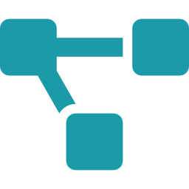




















Supply Chain MDM – AI in SDLC | Workshop Update
Deploy
Req.
AI in
SDLC
Driving AI-powered transformation across the SDLC for faster delivery and greater impact
Test
Design
Dev
What We Achieved
Business Outcomes
Delivered end-to-end AI in SDLC demo aligned to plan (Requirements → Deployment)
End-to-End AI in SDLC Demo
Validated practical AI adoption across SDLC lifecycle
Confirms real-world value and feasibility.
Showcased Rovo & GitHub Copilot agents across BRD, LLD, Dev, Test, and Deployment
Accelerates requirements-to-deployment cycle via automation
Reduces manual effort and cycle time.
Requirements
Design
Development
Testing
Deployment
Builds confidence for scaled adoption across Supply Chain domains
Demonstrated BRD generation from meeting transcripts (Store Order Cycle use case)
Enables teams to adopt AI with trust and at scale.
AI Agents in Action
Faster Delivery (30%)
Achieved strong engagement from Product (Roopali Revenkar & PO Team) and Engineering
AI-driven automation reduces cycle time by up to 30%.
Rovo
GitHub Copilot
Consistency and Standardization
Enterprise Search
& Knowledge Agent
AI Pair Programmer
& Automation Agent
Ensures uniform outputs through standard templates and governed processes.
Key Next Steps
1. Product Team
(Roopali Revenkar & PO Team)
2. Engineering Leadership
(Chris Armstrong)
3. Leadership Enablement
(Mel & HOEs)
Expand use cases: BRD from process maps, legacy docs, emails, chats, Confluence
Refine BRD templates & input/output standardisation
Create process maps in Miro
Plan phase-wise deep dive sessions (Req → Deploy)
Engage TCS AI Team (external to MDM) to deliver end-to-end demos
Conduct demo sessions to build adoption confidence
Define training, guidelines, code quality, security checks & productivity metrics
Immediate Ask
Elizabeth Rout / Chinmayee N to align with Roopali Revenkar & Chris Armstrong on availability and scheduling of next workshops & adoption roadmap.
Together, let’s accelerate AI adoption and deliver greater value across Supply Chain MDM!

