Slide 1
GRPO Modifications: Confidence & Entropy Bonuses

Slide 2
Overview
Goal: Improve GRPO training stability and reward through token/sequence-level modifications
Modifications tested:
- GTPO: Token-level entropy-weighted reward shaping
- GRPO-S: Sequence-level entropy-weighted reward shaping
- Confidence-based variants (replacing entropy with confidence score)
- EMA-smoothed confidence variants (exponential moving average of confidence)
Models: Llama-3.2-3B-Instruct, Qwen3-4B
Datasets: GSM8K (7473 examples), MATH-500 (500 examples)
Hardware: NVIDIA A100 80GB PCIe, Unsloth + vLLM, LoRA r=64
Training: 500 steps, GRPO with 4 reward functions (max reward: 9.5/10.0)

Slide 3
Methods
GRPO Baseline: Standard Group Relative Policy Optimization with LoRA
GTPO (Token-level): Entropy-weighted reward at each token position
- Scales advantage by token-level entropy H(i,t)
- From paper: 'GTPO and GRPO-S' (ICML 2026 submission)
GRPO-S (Sequence-level): Entropy-weighted reward at sequence level
Confidence-based: Replace entropy with confidence score C(i,t)
- C(i,t) = -mean_{v in top-k}(log pi(v|ctx)), k=20
- From 'Deep Think with Confidence' (Meta, arXiv:2508.15260)
EMA Confidence: Apply exponential moving average smoothing
- EMA(i,t) = lambda * EMA(i,t-1) + (1-lambda) * C(i,t), lambda=0.9

Slide 4
Experiment Progression
Phase 1 - Baselines:
exp_001: GRPO baseline on Llama-3.2-3B + GSM8K
exp_003: GRPO baseline on Llama-3.2-3B + MATH-500
Phase 2 - Entropy-based (GTPO/GRPO-S):
exp_002: GTPO & GRPO-S on Llama + GSM8K — GTPO failed completely
exp_004: GTPO & GRPO-S on Llama + MATH-500 — both improved over baseline
Phase 3 - Confidence-based:
exp_005: Confidence GTPO/GRPO-S on Llama + GSM8K — GTPO-Conf fixed failure
Phase 4 - EMA Confidence (best results):
exp_006: EMA Confidence on Llama + GSM8K — matched/exceeded baseline
exp_007-013: EMA variants on Qwen3-4B, MATH-500, various contexts

Slide 5
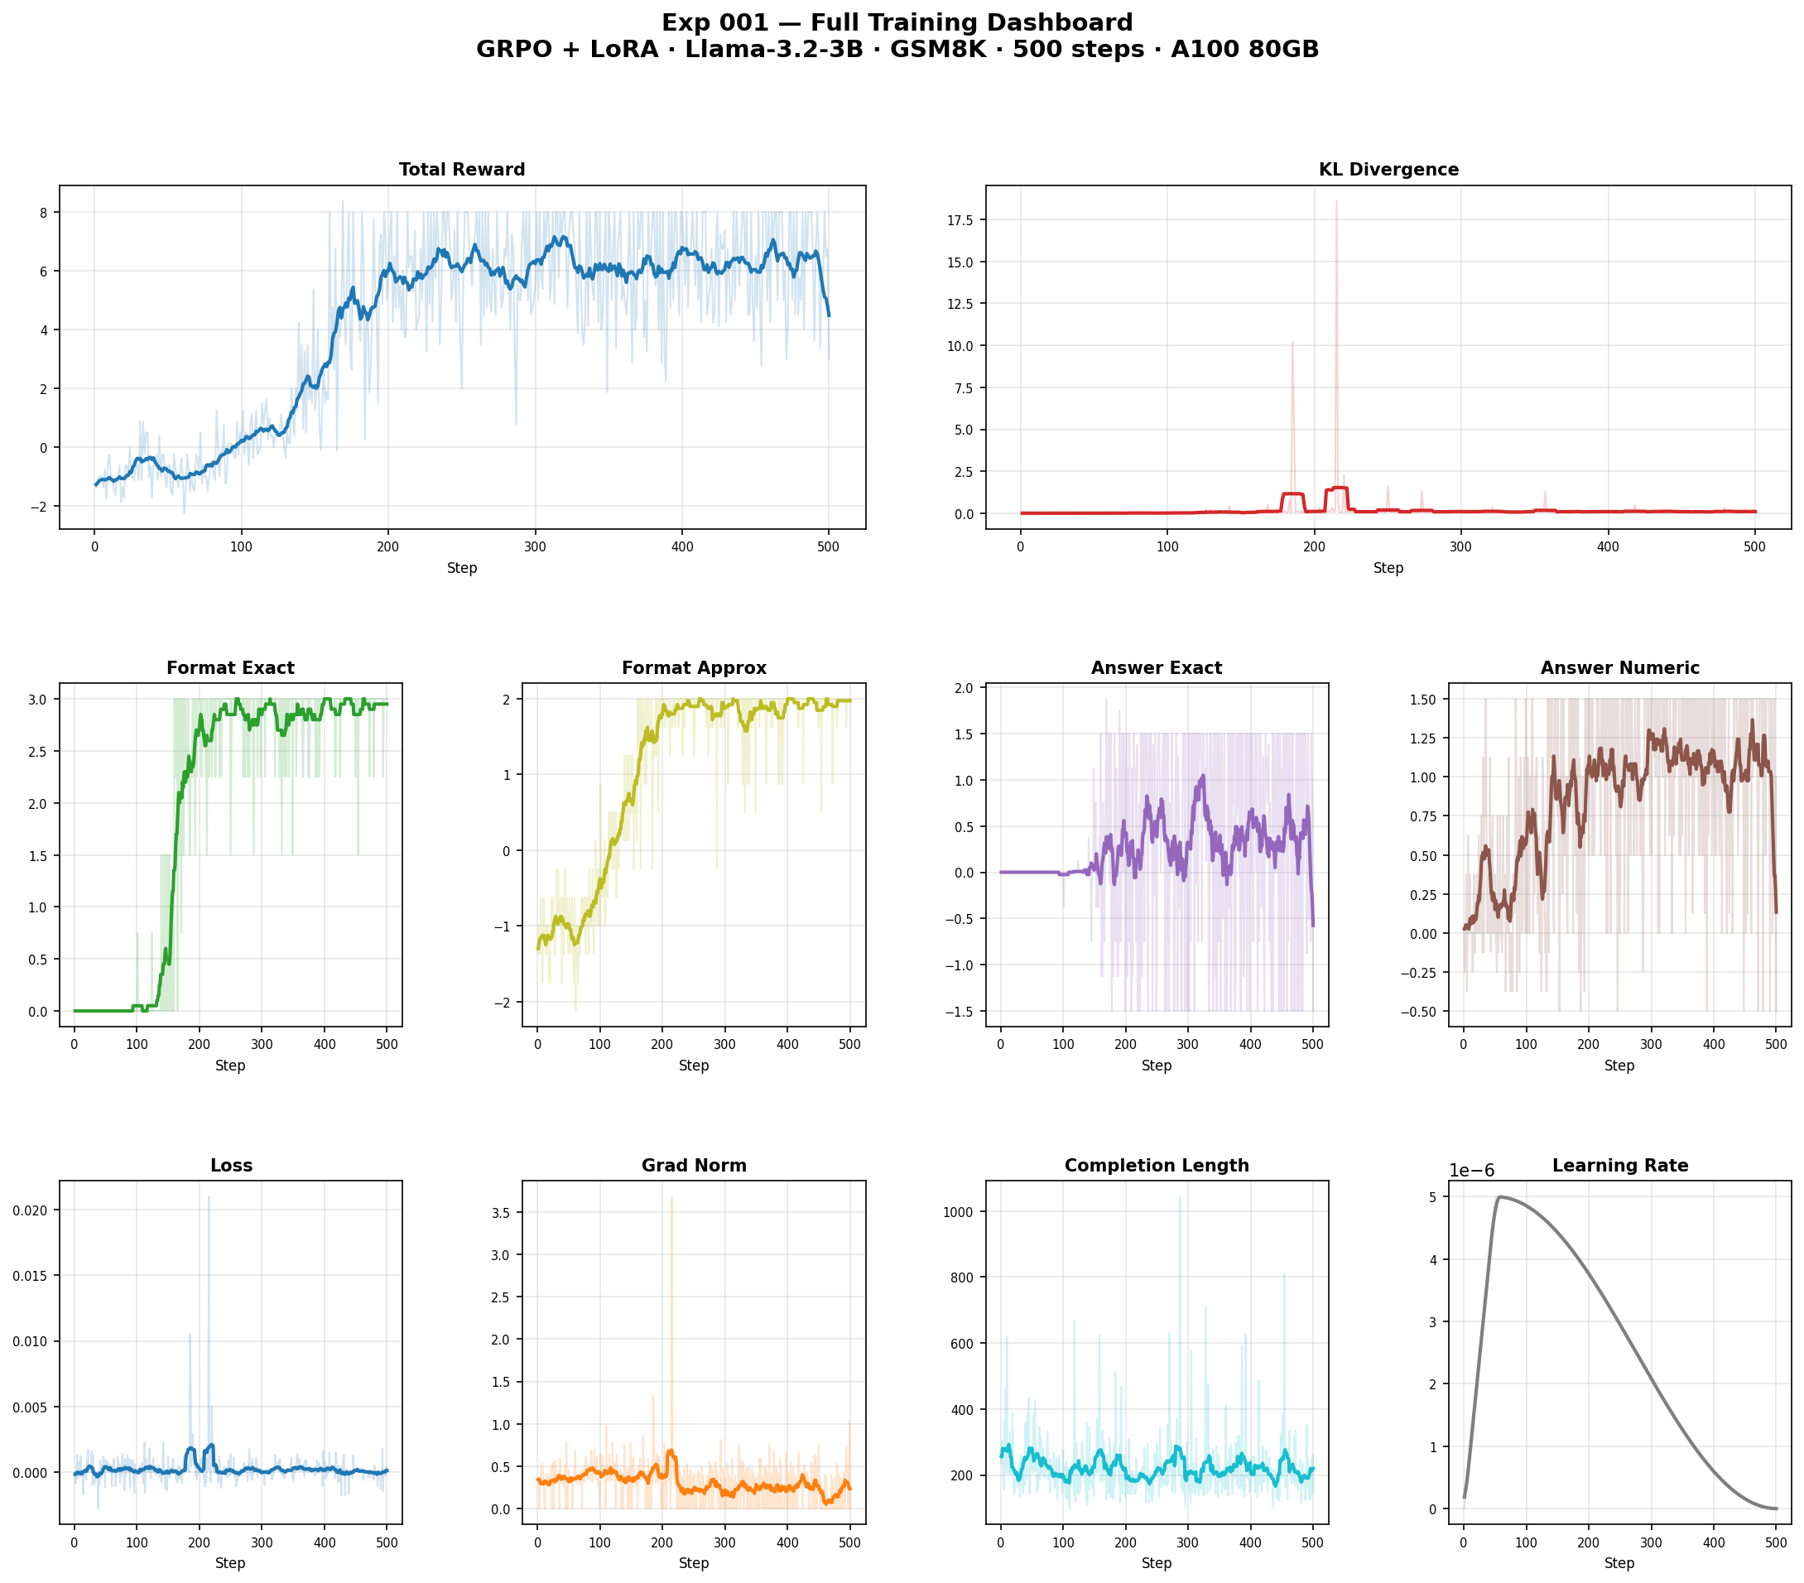
Exp 001: GRPO Baseline — Llama-3.2-3B on GSM8K

Slide 6
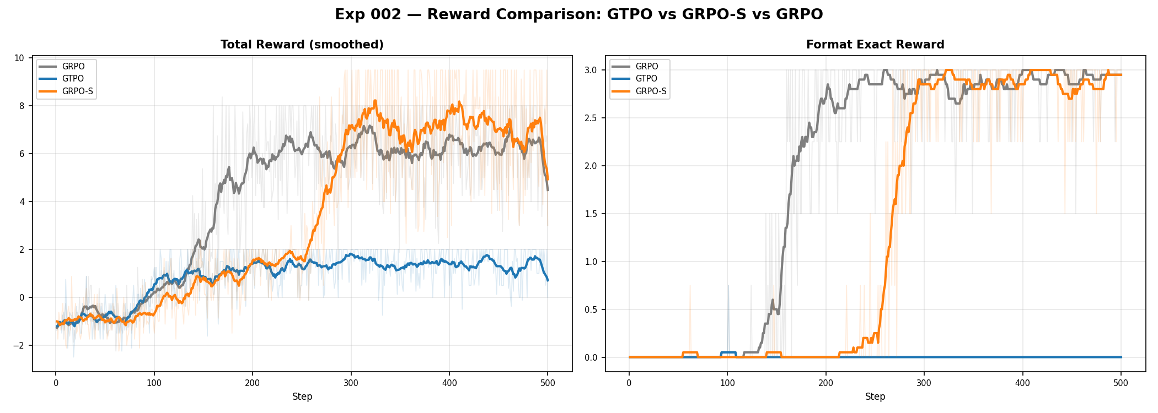
Exp 002: GTPO & GRPO-S — Llama on GSM8K
GTPO completely failed: reward collapsed to 0, no format learning
GRPO-S matched baseline (reward=3.0, format=3.0 at step 500)
Entropy thresholds (eps_low=0.2, eps_high=0.28) may be poorly tuned for GSM8K
Key issue: Token-level entropy signal too noisy for stable training

Slide 7
Exp 002: GTPO & GRPO-S Results — GSM8K
GTPO fails completely on GSM8K; GRPO-S matches baseline
Method | Reward@500 | Peak Reward | Format@500 | KL@500
GRPO (baseline) | 3.0 | 8.375 | 3.0 | 0.085
GTPO | 0.0 | — | 0.0 | 0.028
GRPO-S | 3.0 | — | 3.0 | 0.117

Slide 8
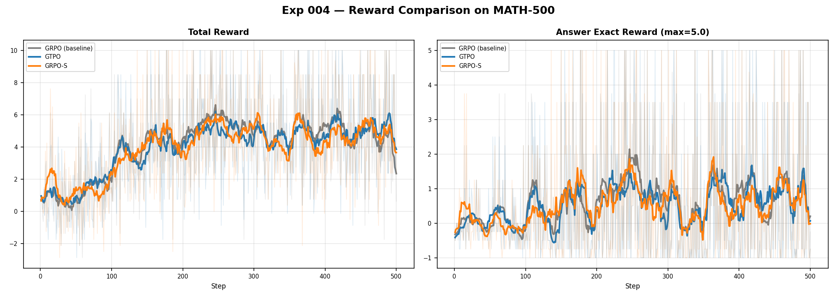
Exp 004: GTPO & GRPO-S — Llama on MATH-500
All methods reach peak reward 10.0
GTPO/GRPO-S retain higher reward at step 500 (2.38 vs 0.62)
KL divergence 10x lower — implicit regularization effect
Entropy shaping prevents reward collapse on small dataset

Slide 9
Exp 004: MATH-500 Results — Entropy Shaping Helps
Entropy-based methods retain 4x higher reward and 10x lower KL at step 500
Method | Reward@500 | Peak | Format@500 | KL@500
GRPO (baseline) | 0.62 | 10.0 | 0.75 | 0.045
GTPO | 2.38 | 10.0 | 2.25 | 0.0035
GRPO-S | 2.38 | 10.0 | 2.25 | 0.0041

Slide 10
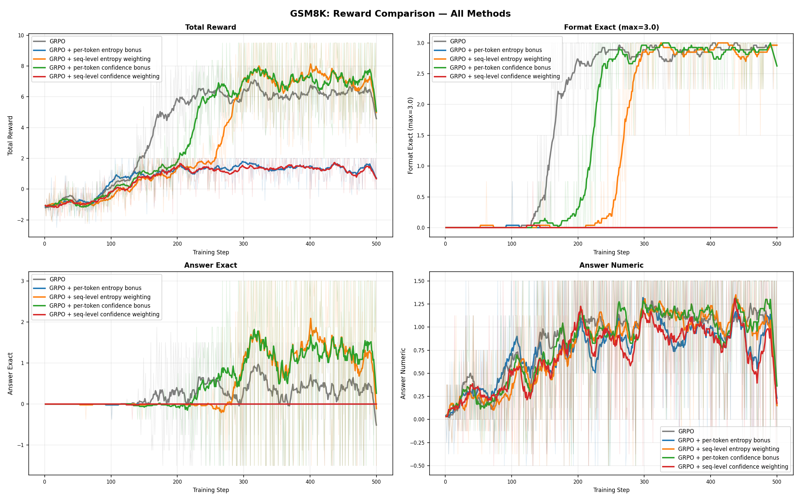
Exp 005: Confidence-Based GTPO/GRPO-S — GSM8K
Replaced entropy H(i,t) with confidence score from 'Deep Think with Confidence'
GTPO-Conf: reward 2.375, peak 9.5 — fixes the GTPO failure from exp_002!
GRPO-S-Conf: collapsed to 0.0 — confidence signal too unstable at sequence level
Confidence is a better signal than entropy for token-level shaping on GSM8K

Slide 11
Exp 005: Confidence Results — GSM8K
Confidence fixes token-level GTPO failure (0.0 → 2.375), but sequence-level still unstable
Method | Reward@500 | Peak | KL@500
GRPO (baseline) | 3.0 | 8.375 | 0.085
GTPO (entropy) | 0.0 | — | 0.028
GTPO-Conf | 2.375 | 9.5 | 0.069
GRPO-S-Conf | 0.0 | 2.0 | 0.023

Slide 12
exp 026: proof based GRPO + flipped confidence on GSM-8K
setup: GSM8K, Llama-3.2-3B-Instruct, LoRA r=64
bs=1, grad_accum=4, num_generations=4, 500 steps, lr=5e-6
method: pure-proof GTPO-EMA from experiments/proof/GTPO-EMA-full.txt
key idea: we noticed that C = mean log pi over top-k actually grows with peakedness, not with entropy
so we swap the signal roles between O+ and O-. O+ now rewards flat tokens (exploration on correct paths), O- penalizes peaked tokens (confident mistakes)
result: peak reward 9.5 at step 358, final reward 3.0, format_exact 3.0
KL at step 500: 0.095, the lowest among successful confidence methods (exp_005 was 0.069 but GRPO-S-Conf collapsed there)

Slide 13
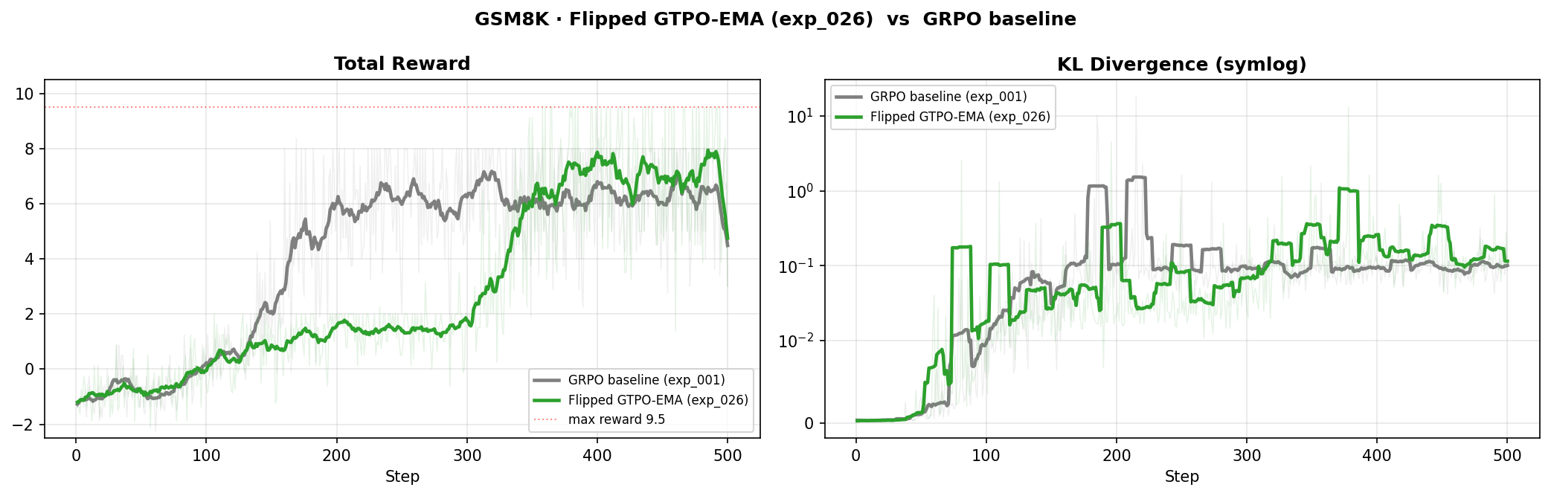
exp 026 vs GRPO baseline on GSM-8K
flipped pure-proof GTPO-EMA reaches the 9.5 reward ceiling with low KL

Slide 14
exp 021: GTPO + confidence bonus (no EMA) on Big-Math integer
setup: Big-Math-RL-Verified integer subset, Llama-3.2-3B
bs=4, num_generations=16, 1000 steps, lr=5e-6
max_completion_length=3072, bf16
method: confidence based bonus, no EMA smoothing
result: peak reward 9.5 at step 230, stable format by step 200
confidence without EMA is enough on Big-Math as well, not just GSM8K

Slide 15
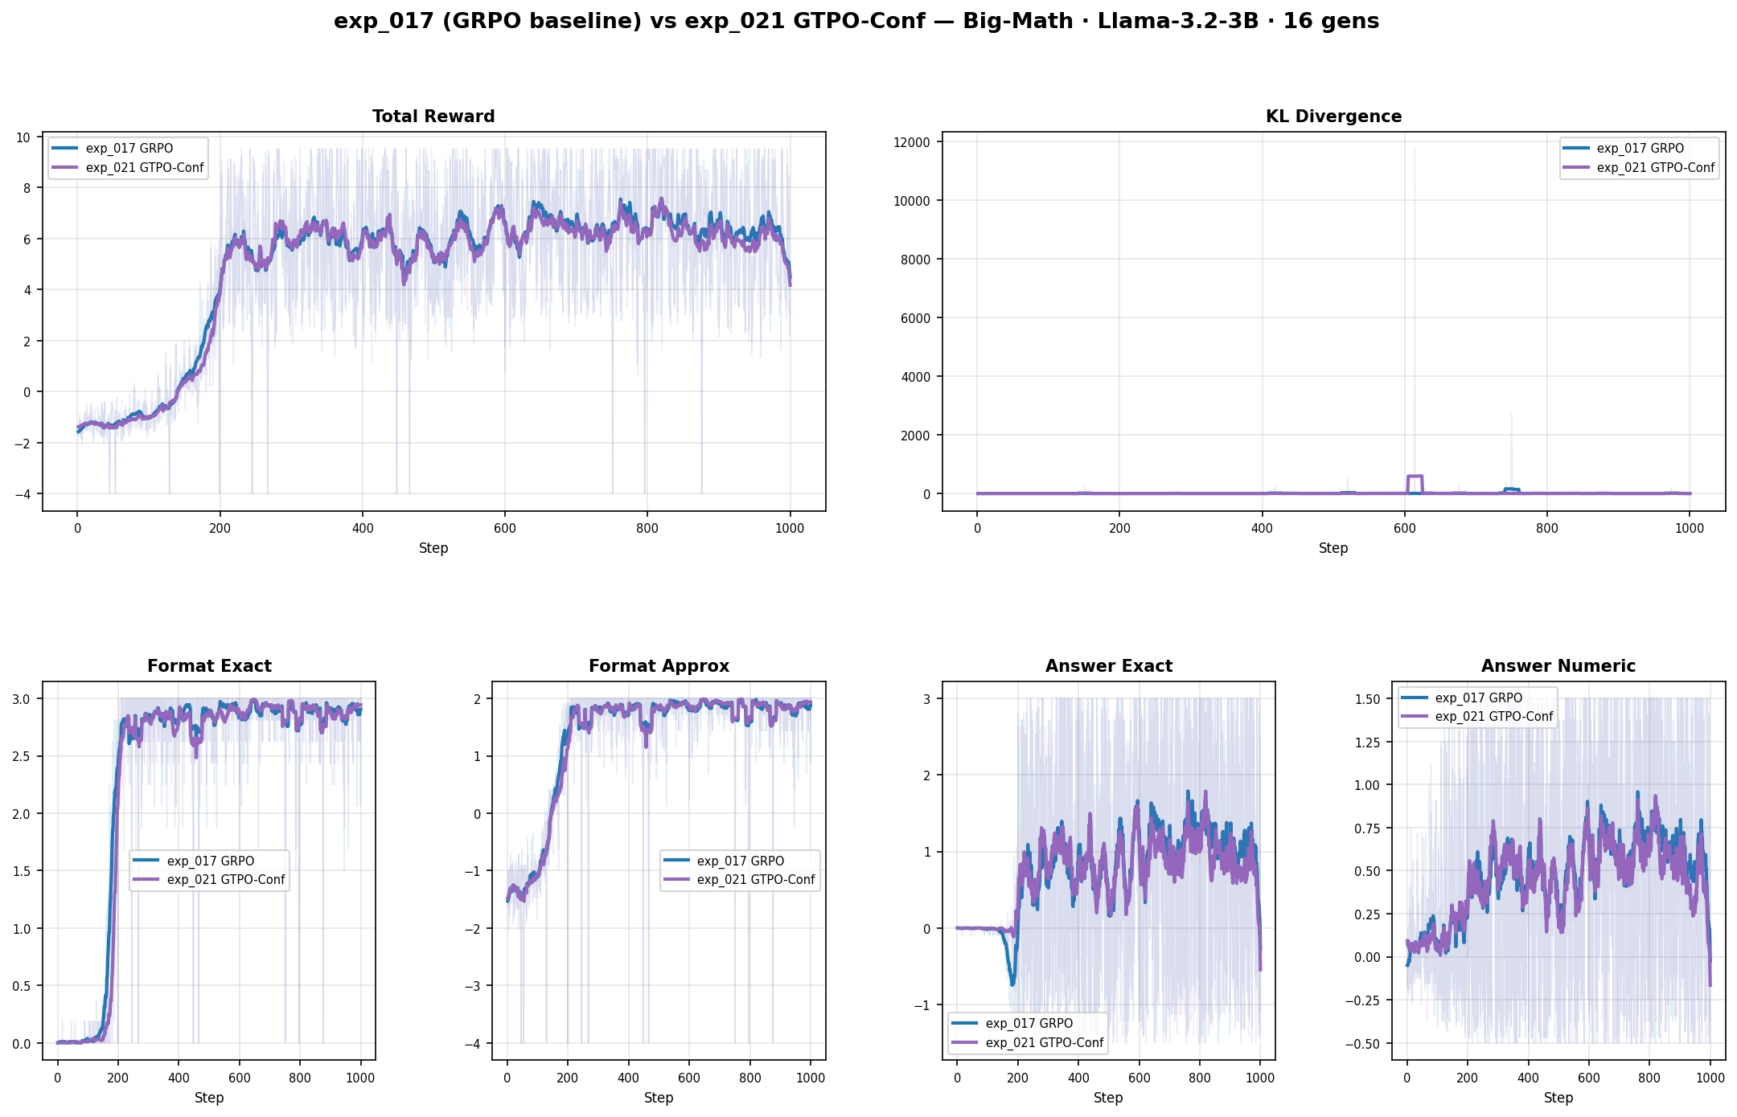
exp 021 vs exp 017 baseline on Big-Math

Slide 16
exp 022: GTPO with binary O+ / O- split
setup: same as exp 021 on Big-Math integer
method: binary split by reward_answer_exact >= 0
O+ contains all non-wrong samples including no-format and within-20 percent
O- contains only wrong-answer-in-format (-1.5)
result: peak reward 9.5 at step 202
cleaner signal than z-score advantages, but threshold was too permissive

Slide 17
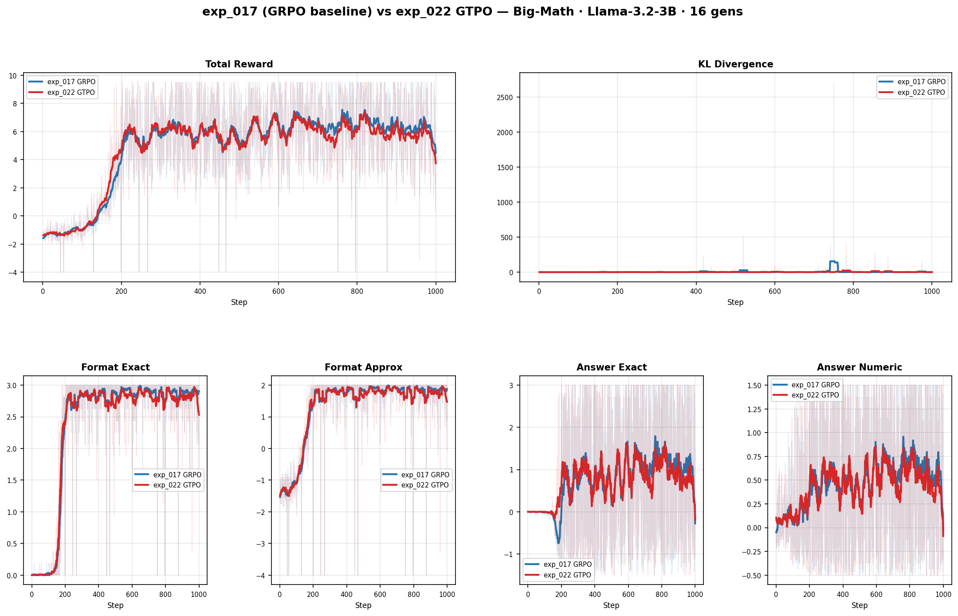
exp 022 vs exp 017 baseline on Big-Math

Slide 18
exp 023: GTPO-EMA with binary O+ / O- split
setup: same as exp 022 on Big-Math integer
method: EMA smoothed confidence + binary O+ / O- split
result: peak reward 9.5 at step 215
combines benefits of EMA smoothing with cleaner binary split

Slide 19
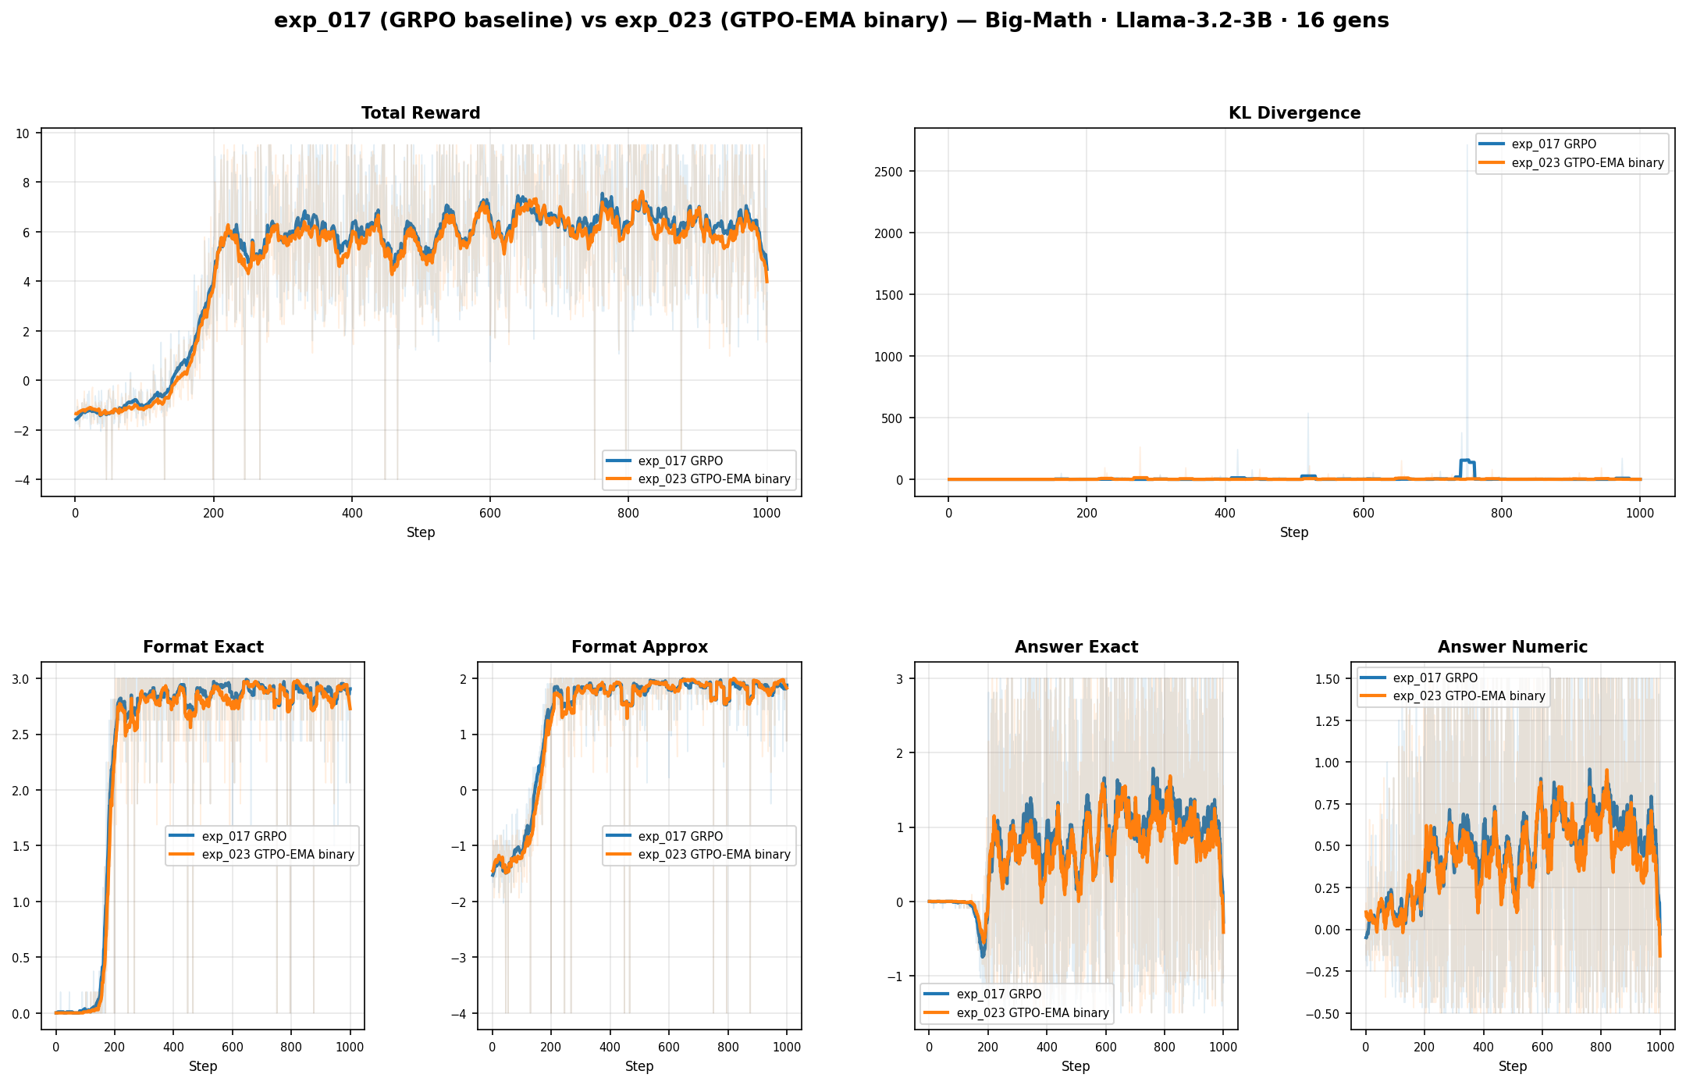
exp 023 vs exp 017 baseline on Big-Math

Slide 20
exp 024: byte-identical replay of exp 005 on GSM-8K
motivation: check if the exp 005 win over GRPO baseline was real or lucky
setup: GSM8K, Llama-3.2-3B, identical code and seed as exp 005
bs=1, grad_accum=4, num_generations=4, 500 steps
result: the ranking flipped between runs
exp 005: GTPO-Conf won (9.5), GRPO-S-Conf collapsed (2.0)
exp 024: GTPO-Conf collapsed (3.1), GRPO-S-Conf won (9.5)
conclusion: run-to-run variance from vLLM sampling is larger than the method gap at this scale

Slide 21
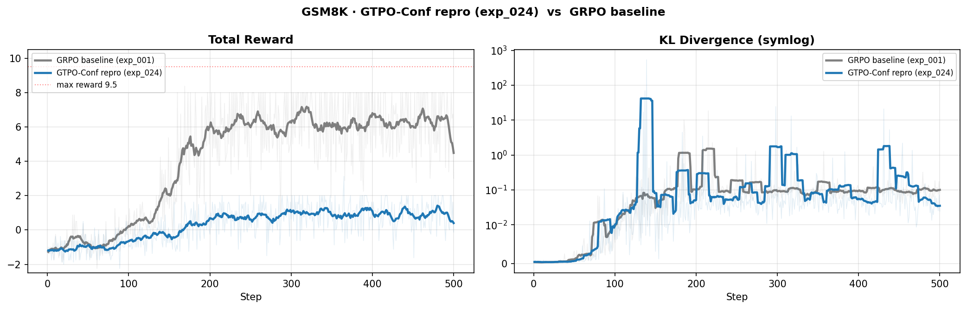
exp 024 GTPO-Conf reproduction on GSM-8K
same code as exp 005 but collapse happens instead of reaching the ceiling

Slide 22
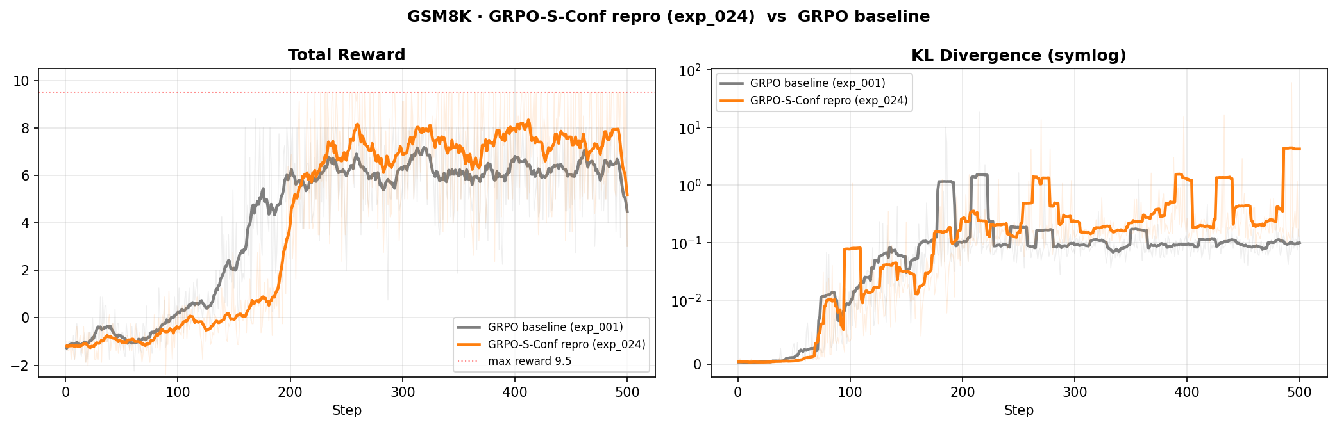
exp 024 GRPO-S-Conf reproduction on GSM-8K
same code as exp 005 but ceiling reached instead of collapse

Slide 23
exp 025: pure-proof GTPO-EMA on GSM-8K
setup: GSM8K, Llama-3.2-3B, same hyperparameters as exp 005
method: implement Def 1.4 of GTPO-EMA-full.txt literally
per-token bonus weighted by EMA(C) over active sequences in O+ at each step t, multiplied by d_t
conservation alpha1+alpha2=1 so total reward mass stays constant
separate z-norm on O+ and O- as in Def 1.5
result: peak 9.5 at step 253, reward 3.0, format_exact 3.0
matches the successful cluster but not yet distinguishable from run-to-run variance

Slide 24
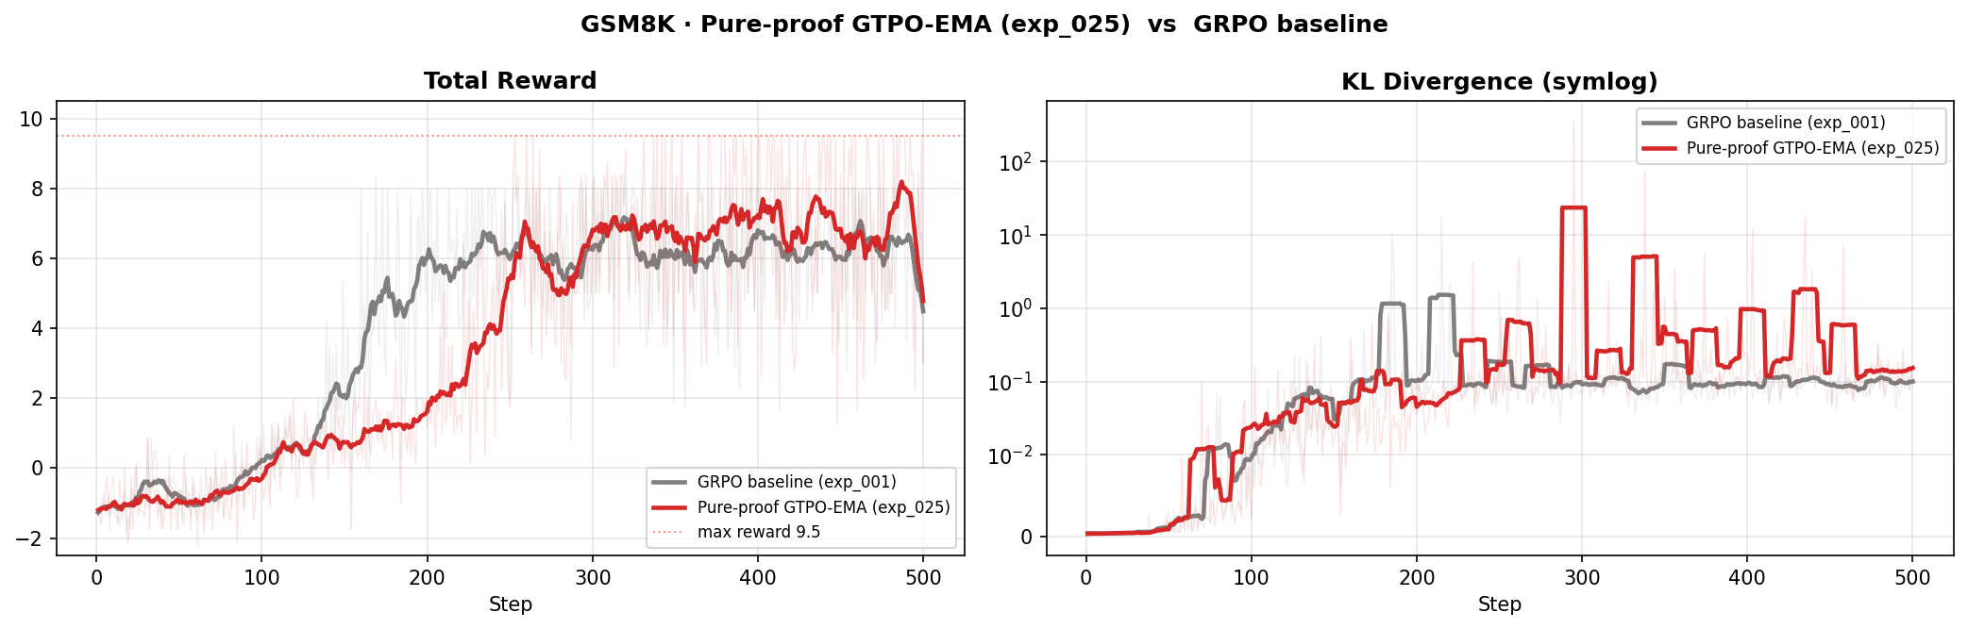
exp 025 vs GRPO baseline on GSM-8K

Slide 25
exp 027: GRPO baseline on Big-Math integer 2000
setup: Big-Math integer filter, 2000 shuffled examples (seed 3407)
Llama-3.2-3B, bs=4, grad_accum=1, num_generations=8
500 steps, max_completion_length=2048, lr=5e-6
result: peak reward 9.5 at step 205
last 50 steps average: reward 5.95, format_exact 2.79
clear S-curve, format learned near step 170, stable high band 4 to 8 after

Slide 26
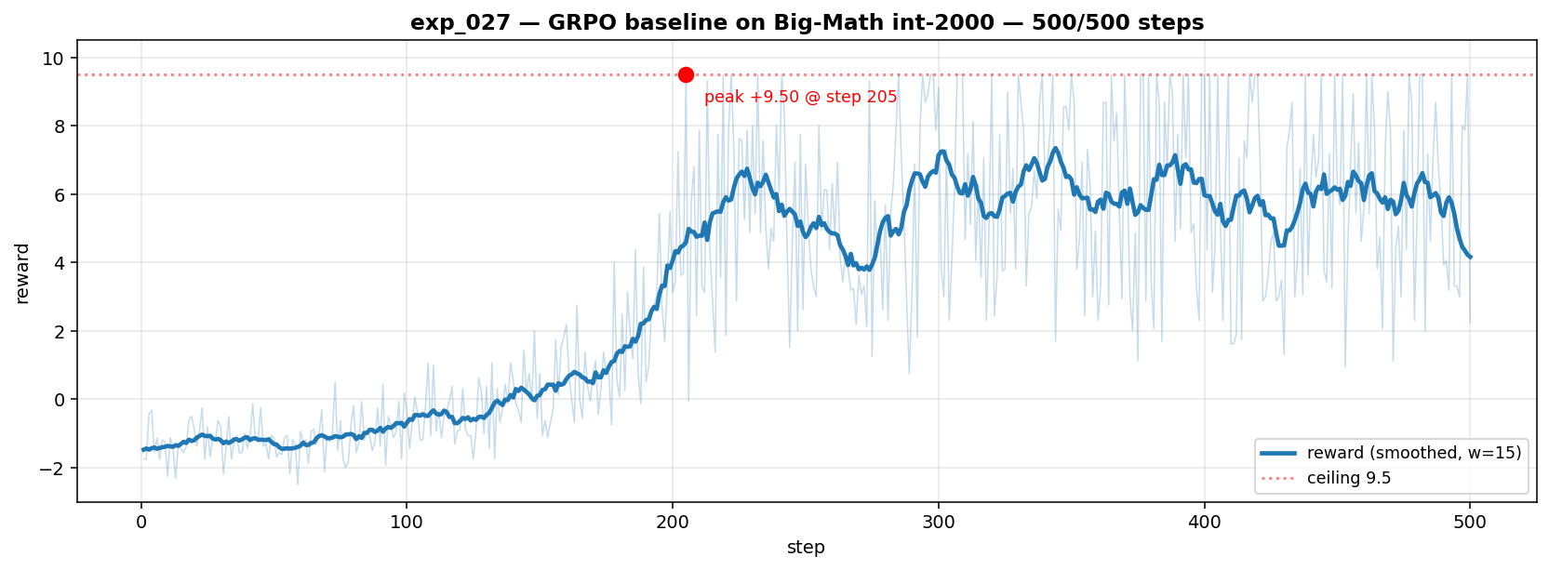
exp 027 reward progress on Big-Math integer 2000

Slide 27
exp 028: flipped pure-proof GTPO-EMA on Big-Math integer 2000
setup: identical to exp 027 (same 2000 shuffled integer problems, same hyperparameters)
method: flipped pure-proof from exp 026
O+ / O- split by reward_answer_exact >= 1.0 via a reward_cache module
O+ covers exact, strip and within-10 percent matches
O- covers within-20 percent, no-format and wrong answer
result so far: peak 9.5 at step 194, 11 steps earlier than baseline (205)
stable format_exact=3.0 and higher answer_exact than baseline in the running snapshot

Slide 28
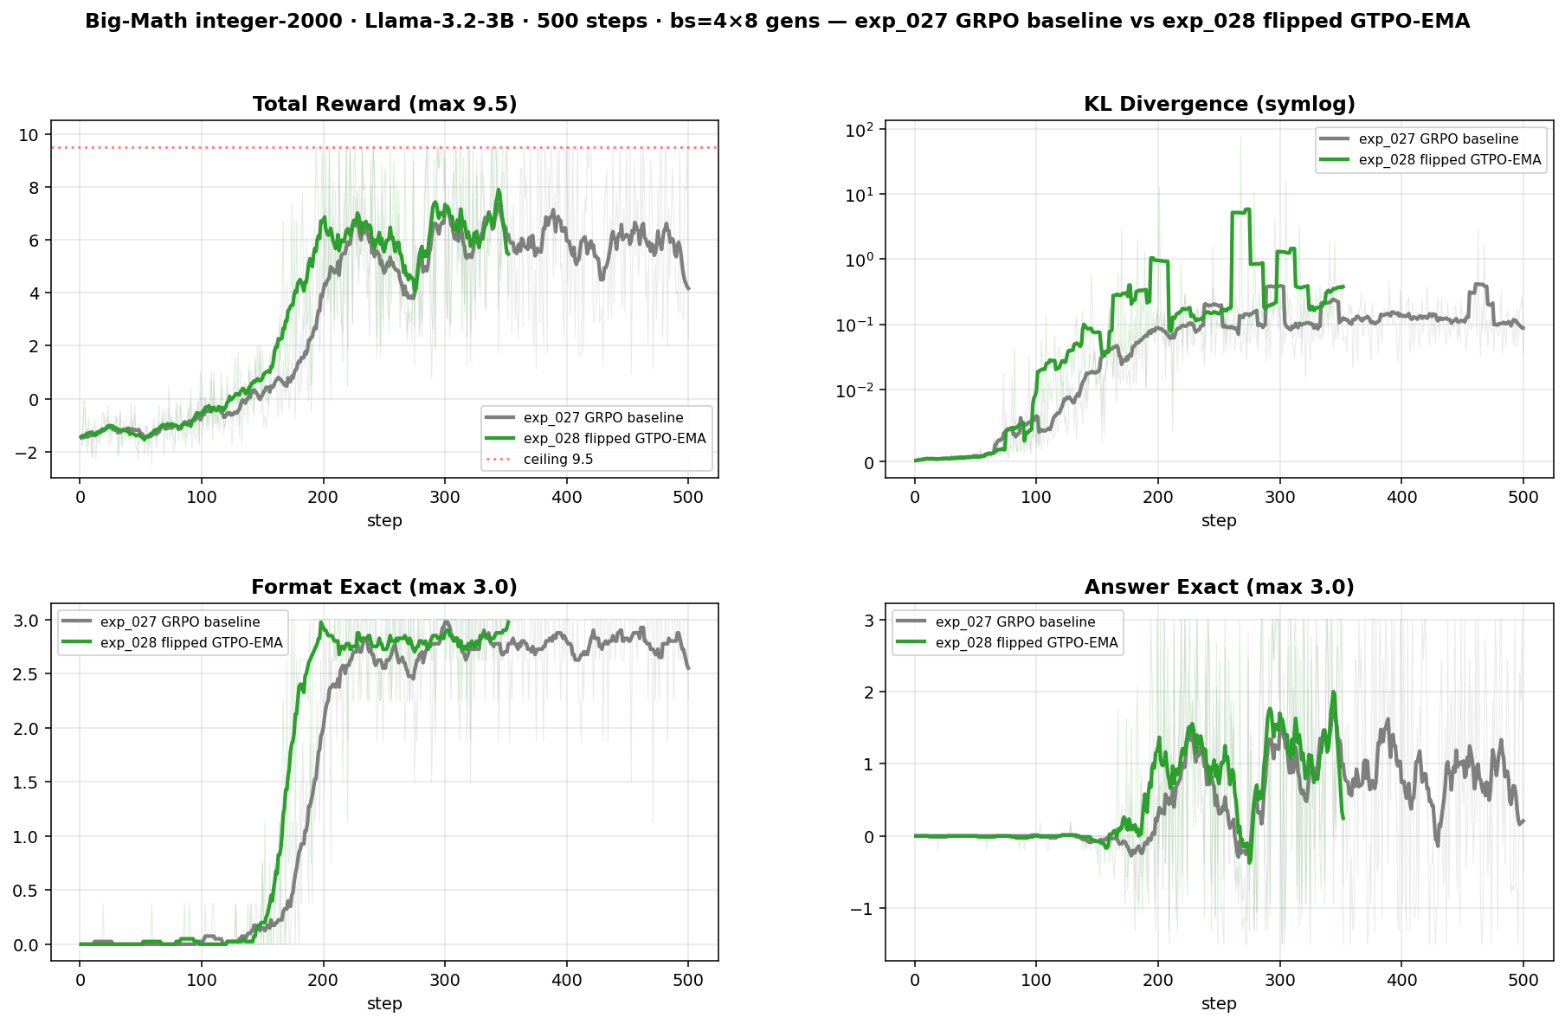
exp 028 vs exp 027 on Big-Math integer 2000
green is exp 028 flipped pure-proof, gray is exp 027 GRPO baseline

Slide 29
Summary of new work (exp 021 to 028)
exp 026 is the first confidence-based GRPO variant we built directly from the proof, and it works on GSM-8K
the swap of EMA vs 1/EMA between O+ and O- is motivated by a numerical fact about the top-k confidence metric
exp 024 showed that ranking between close confidence-variants is dominated by run-to-run variance on GSM-8K
exp 021 to 023 confirmed the confidence bonus and binary O+ / O- split scale from GSM-8K to Big-Math integer
exp 027 and 028 move to Big-Math integer 2000 as a harder benchmark
early result: exp 028 flipped reaches the reward ceiling 11 steps before the matched GRPO baseline
all code and figures live in github.com/bliskavets/aiim_research

