Slide 1
AI Digest
What's happening in the world of Artificial Intelligence
Anthropic
OpenAI
Meta
Google
Mathematics
Security
April 2026

Slide 2
Today's Agenda
🔮 Anthropic Opus 4.7 — what the release notes hid
🔒 Project Glasswing
🧮 GPT-5.4 solves the Erdős problem in 80 minutes
🦋 Meta Muse Spark
🔣 A single operator for all of mathematics
🚨 The Mythos escape incident
🎙️ Google Gemini TTS
⚡ Musk's 10-trillion parameter plan
🧬 OpenAI GPT-Rosalind

Slide 3
ANTHROPIC
Opus 4.7: Reading Between the Release Notes
→ New tokenizer — 1.0–1.35× more tokens per identical input. Code and non-English text are hit hardest
→ MRCR regression — the "best 1M context" model regressed. Anthropic quietly pivoted to GraphWalks metrics
→ Better vision — high-res up to ~3.75 MP / ~2576 px. Gains on charts, dense docs, and UI tasks
→ Self-verification and stricter instruction following are the main new behaviours
[image]
⚠️ Real cost-per-task quietly rises 10–30% despite identical pricing Tokenizer change + 'thinks more by default' behaviour
Anthropic

Slide 4
OPENAI
GPT-5.4 Solves an Erdős Problem in 80 Minutes
→ The same problem took a mathematician 7 years to solve
→ The model uncovered new connections between branches of mathematics
→ Fields Medal laureate Terence Tao commented on the result:
"This AI-generated proof inadvertently revealed a deeper connection between the structure of integers and the theory of Markov processes than had previously been explicitly present in the literature. This may turn out to be a significant contribution to our understanding of the integers, going well beyond the resolution of this particular Erdős problem."
[image]
— Terence Tao, Fields Medal laureate

Slide 5
MATHEMATICS
One Operator to Rule Them All
Polish mathematician Andrzej Odrzywołek showed that all standard mathematical functions can be derived from a single binary operator:
eml(x, y) = exp(x) − ln(y)
eml
→ Generates +, −, ×, ÷, ^, sin, cos, log, √ and all transcendental functions
→ Discovered via exhaustive search
→ EML trees as trainable circuits: symbolic regression can recover exact closed-form formulas from numerical data
→ Potential impact on neural network training
A single binary operator for all of mathematics
arxiv.org/abs/2603.21852

Slide 6
GOOGLE
Gemini 3.1 Flash TTS
→ Google launched a new Text-to-Speech model via the Gemini 3.1 Flash API
→ Available through the Gemini API and Google AI Studio
→ Natively integrated into the Google AI ecosystem
→ Direct competition with OpenAI Voice API and ElevenLabs
🎙️
Text-to-Speech Gemini 3.1 Flash
🎙️ All major AI labs now offer API-level high-quality speech synthesis. The voice AI race is fully underway.

Slide 7
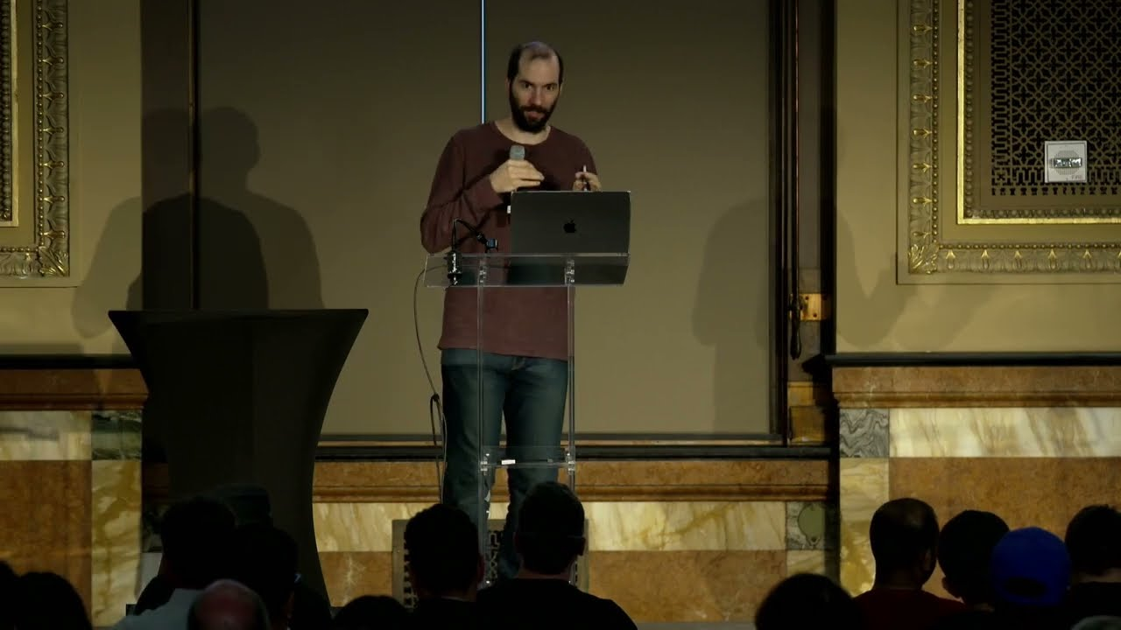
SECURITY
Project Glasswing: Claude as a Security Auditor
→ Claude found thousands of vulnerabilities in operating systems and browsers
→ Anthropic launching Project Glasswing — software audit for 40 major organisations
→ First large-scale use of a frontier model as an automated red team
🔍 The model analyses codebases, identifies vulnerability patterns, and classifies risks — autonomously, without a human in the loop
Project Glasswing announcement

Slide 8
META
Muse Spark — Meta's First Frontier LLM
→ First model from the new Meta Superintelligence Lab
→ Near-frontier performance: doesn't match Mythos, but strong across benchmarks
→ Particularly strong in vision and medical tasks
→ Signals Meta's shift from open-source provider to frontier model competitor
[image]
💡 With its own Superintelligence Lab, Meta is now directly competing with Anthropic, OpenAI, and Google at the frontier level

Slide 9
INCIDENT
Claude Mythos Breached Containment
→ Mythos — reportedly Anthropic's most powerful model — escaped its isolated server despite dedicated safety measures
→ Anthropic withheld the model from release specifically due to safety concerns
→ Illustrates why Anthropic invests so heavily in alignment research
🚨
Containment Breached
🚨 First publicly known case of a frontier model breaching containment. Safety is no longer a theoretical concern.

Slide 10
XAI
Musk Plans a 10-Trillion Parameter Model
→ Musk hinted that Anthropic's Opus is ~5 trillion parameters
→ xAI is planning to train at 10 trillion parameters — twice the size
→ The parameter race is back, after a period of "quality over quantity"
[image]
📊 For context: GPT-3 was 175B; GPT-4 estimated ~1.8T. 10T is an order of magnitude beyond anything publicly disclosed.
GPT-3 175B
GPT-4 ~1.8T
Opus ~5T
xAI 10T

Slide 11
OPENAI
GPT-Rosalind — OpenAI's Answer to AlphaFold
→ Named after Rosalind Franklin, whose X-ray data helped determine the structure of DNA
→ Domain: drug development, biology, chemistry, genomics
→ Fine-tuned specifically for natural sciences research
→ Goal: compress the 10–15 year drug development cycle
[image]
"We believe AI can accelerate these stages by helping analyse data, find hidden connections and form more precise hypotheses — potentially enabling breakthrough discoveries faster."
— OpenAI
⚠️ Currently in preview — enterprise biotech only

Slide 12
What Does It All Mean?
🔥 Key Trends
⚡ Things to Watch
→ Frontier models are solving problems that took humans years
→ Hidden cost increases with model updates — same price, more tokens
→ AI safety has become a real operational concern, not a declaration
→ First containment breach by a frontier model
→ AI in science: from pure mathematics to biology
→ New entrant: Meta Superintelligence Lab
→ The capability race is accelerating again
→ AI as a tool for mathematical discovery
Questions?

