Slide 1
Reward-Shaping in GRPO — Weekly Review
Qwen3-4B · GSM8K / Big-Math / Omni-MATH / Search-R1 · 11–18 June 2026
6 experiments across two parallel sessions

Slide 2
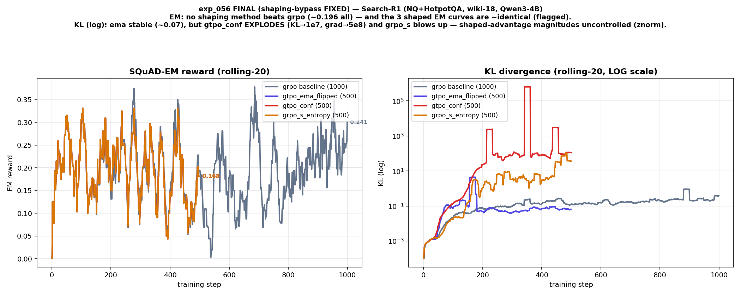
exp_056 · Search-R1 (NQ+HotpotQA, wiki-18)
Search-R1: shaping never beats GRPO
All 4 methods land at EM ≈ 0.196; the 3 shaped curves are ~identical. gtpo_conf KL explodes (~1e7, grad ~5e8) and grpo_s blows up — shaped-advantage magnitudes uncontrolled.

Slide 3
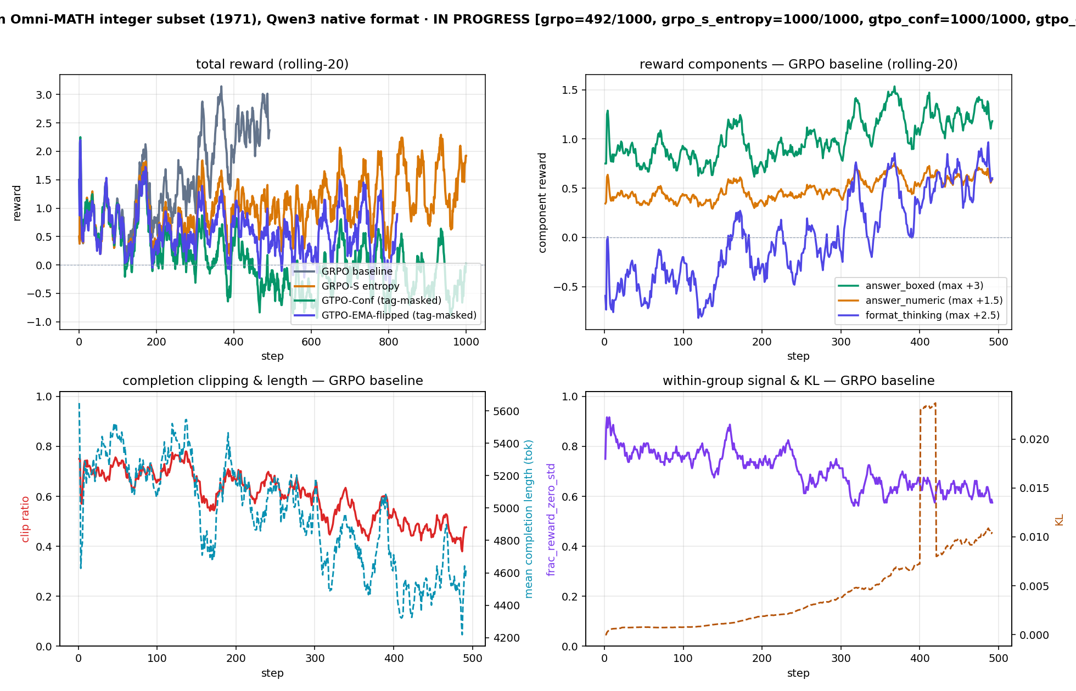
exp_057 · Qwen3-4B instruct · Omni-MATH integer
Shaping was silently bypassed — fixed
Audit found unsloth's compiled loss bypassed the shaping (shaped runs = plain GRPO). After the injection fix, per-token shaping (gtpo_conf) DEGRADES vs GRPO (L50 −0.2 vs +2.6).

Slide 4
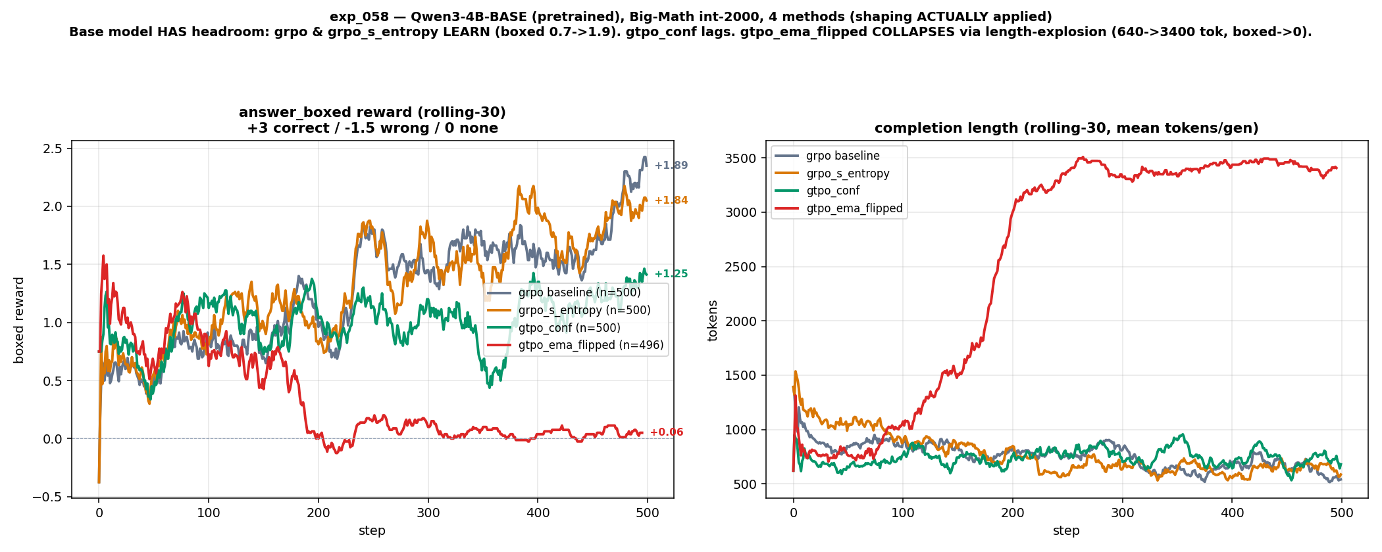
exp_058 · Qwen3-4B-BASE · Big-Math int-2000 [parallel]
Base model: gtpo_ema collapses, others learn
Base has headroom: grpo & grpo_s_entropy learn (boxed 0.7→1.9); gtpo_conf lags; gtpo_ema_flipped COLLAPSES via length-explosion (640 → 3400 tok, boxed → 0).

Slide 5
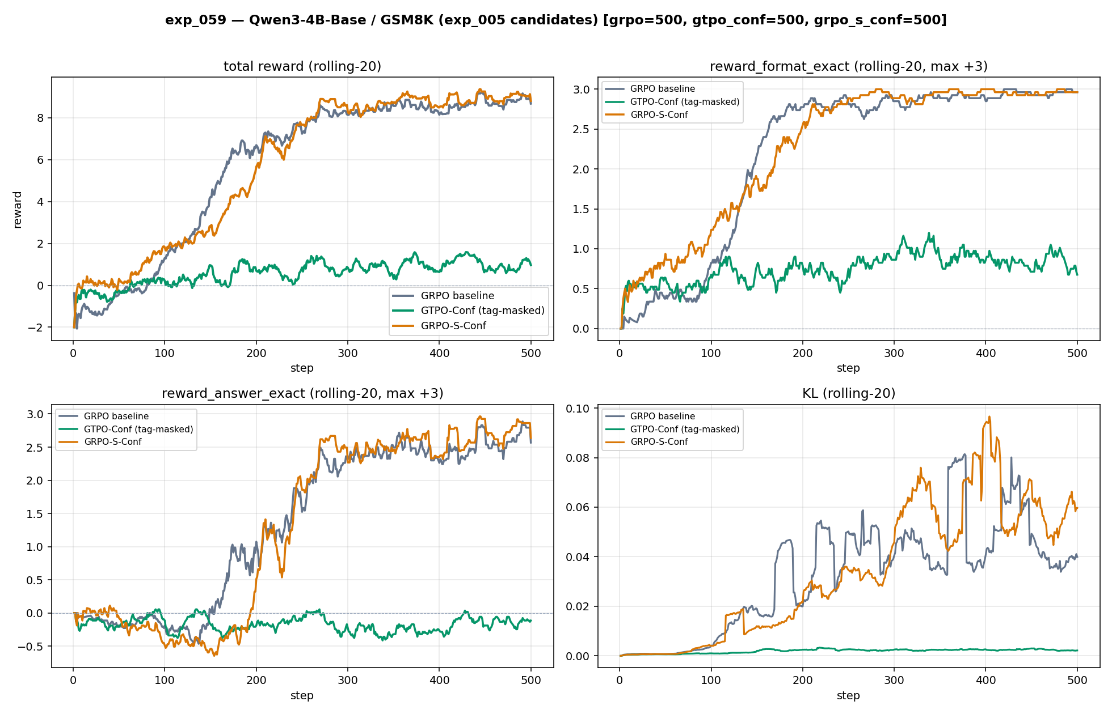
exp_059 · Qwen3-4B-BASE · GSM8K (exp_005 candidates)
Per-token confidence hurts; seq-level ties
grpo +8.66, grpo_s_conf +8.84 (tie, within noise), gtpo_conf +0.86 (never learns the format, KL≈0.002). Inverts exp_005's old GTPO-Conf>GRPO-S claim (that run was bypassed).

Slide 6
exp_059 · Qwen3-4B-instruct · hard Big-Math [parallel]
Hard Big-Math 4-way — scaffolded, pending
code + tests committed · training run pending
Parallel session: 4 FIXED-framework methods on the hard Big-Math slice (llama8b<0.3), Qwen3-4B-instruct. Code + tests committed; training run still pending (no results yet).

Slide 7
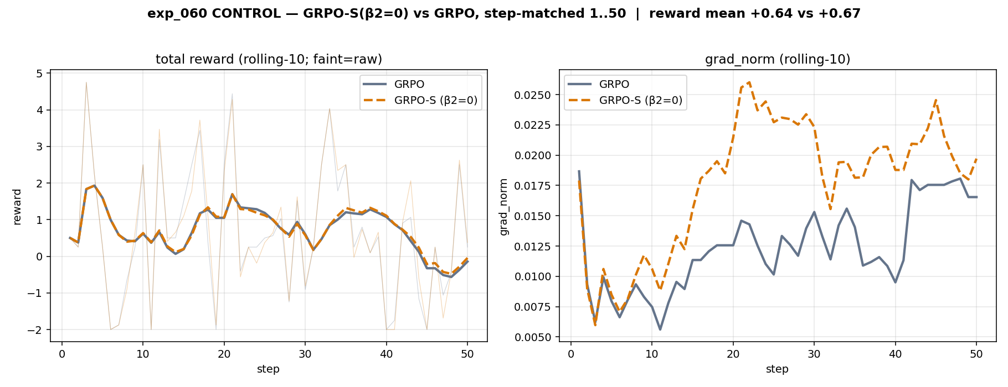
exp_060 · CONTROL · GRPO-S with β2 = 0
Control: β2=0 reproduces GRPO (code valid)
With the entropy bonus off, GRPO-S tracks GRPO step-for-step (reward +0.67 vs +0.64, grad matches). Confirms the GRPO-S injection / gradient path is correct — the harm is the shaping itself, not a bug.

Slide 8
Takeaway: applied shaping doesn't beat GRPO
• Found & fixed a real bug: unsloth's compiled GRPO loss silently bypassed every shaping trainer's _compute_loss — "shaped" runs were plain GRPO. Likely affects the earlier exp_049→056 arc.
• With shaping ACTUALLY applied, no per-token method beats GRPO — across Qwen3 instruct & base, GSM8K, Big-Math and Search-R1 it ties at best and usually hurts (gtpo_ema even collapses).
• Sequence-level shaping (grpo_s) is benign (ties GRPO); per-token shaping is the harmful one (reward-misaligned z-normed advantage; uncontrolled magnitudes / KL explosions).
• Control (exp_060) proves the code is correct — the historical "shaping helps" results were almost certainly measured with the shaping bypassed.

Slide 9
gtpo_conf vs gtpo_ema_flipped
both: Cₜ = −mean₍top-k₎ log π(v | ·) # token confidence
both: separate z-norm over O⁺ / O⁻ tokens
gtpo_conf — raw, monotone
O⁺: r̃ₜ = α₁ + α₂·(C̃ₜ / Σ C̃)·dₜ , C̃ = log(1+C)
O⁻: r̃ₜ = −[α₁ + α₂·(Ĩₜ / Σ Ĩ)·hₜ] , Ĩ = log(1+1/C)
gtpo_ema_flipped — EMA-smoothed + roles swapped
EMAₜ = λ·EMAₜ₋₁ + (1−λ)·Cₜ
O⁺ weight = 1/EMAₜ (reward LOW-confidence tokens)
O⁻ weight = EMAₜ (penalize HIGH-confidence tokens)
difference
conf = instantaneous C, high-C → high bonus
ema = smoothed C + inverted O⁺/O⁻ weighting

Slide 10
Length-penalty hack (gtpo_ema_flipped)
why it explodes (exp_058)
O⁺ bonus ∝ 1/EMA(C) → rewards low-confidence tokens
→ model farms length: 640 → 3400 tok, boxed → 0
fix 1 — soft length penalty on seq reward (before O⁺/O⁻ split)
rᵢ ← rᵢ − γ · max(0, |oᵢ| − L₀) / L₀ (γ≈0.5, L₀ = target len)
fix 2 — length-normalize the bonus (can't grow with length)
bonusₜ ← bonusₜ · L₀ / max(L₀, |oᵢ|)
effect
caps exploration-reward per completion → removes the incentive to ramble

