Slide 1
Confidence reward shaping on MATH levels 3-5
exp_039 to exp_048 — Qwen3-4B — may 2026 update

Slide 2
Where we left off (april deck)
best result on Big-Math int-2000: flipped pure-proof GTPO-EMA (exp_028)
peak reward 9.5 at step 194, 11 steps earlier than matched GRPO baseline (exp_027)
on GSM-8K (exp_005, exp_024) the ranking between close confidence variants was dominated by run-to-run vLLM sampling noise
two open questions: does the per-token confidence bonus survive on a harder benchmark, and is it a real signal or seed luck

Slide 3
This block — what we ran
exp_039, exp_040 — finish the Big-Math int-2000 sweep, add per-rollout logging
exp_041 — GRPO baseline on a harder benchmark: MATH-lighteval levels 3-5, integer answers, ~3400 problems
exp_042 — port GTPO-EMA-flipped to MATH levels 3-5 (turned out to be a silent ablation, see slide 6)
exp_043 — GTPO-Conf without EMA on MATH levels 3-5
exp_044 — GTPO-EMA-flipped properly activated (the real fix for exp_042)
exp_045, exp_046 — SCRS family: sequence-level confidence / entropy shaping
exp_047 — vectorised re-implementation of GTPO-Conf for MATH levels 3-5
exp_048 — UCAS Stage 1 from arXiv 2510.10649: multiplicative response-level confidence weighting

Slide 4
Confidence metric — quick recap
C_t = -mean over top-k log pi_v, computed at each generated token (we use top-k = 20)
intuition: C grows with peakedness of the next-token distribution, NOT with entropy
flipped split: O+ (correct rollouts) gets weight 1 / EMA(C) so flat/uncertain tokens get more credit
O- (wrong rollouts) gets weight EMA(C) so confident mistakes are penalised harder
EMA with lambda = 0.9 over the active sub-batch at each step t to denoise the per-token signal
alpha1 = 0.9 keeps the GRPO advantage as the backbone, alpha2 = 0.1 is the confidence bonus weight

Slide 5
exp_039 — GTPO-EMA-flipped on Big-Math int-2000 (full 1000 steps)
setup: Qwen3-4B, LoRA r=64, bs=4, num_generations=8, max_completion=3584, lr=5e-6
matched 1:1 against exp_038 GRPO baseline (same dataset, shuffle seed 3407)
first time the flipped GTPO-EMA finishes a full 1000-step run on Qwen3 / Big-Math
reward ceiling 9.5 hit by step 9; runtime 31371 s (8h 43m)
last-50 mean reward: 5.97, answer_exact final: 3.0, format_exact final: 3.0
matches GRPO baseline trajectory — no separation visible above the per-step noise

Slide 6
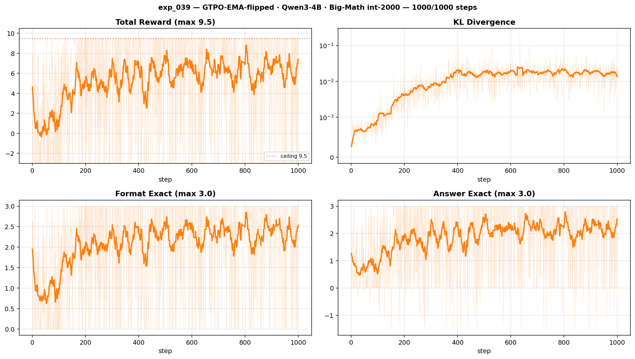
exp_039 — total reward, KL, format, answer
1000-step run, Qwen3-4B, GTPO-EMA-flipped, Big-Math int-2000

Slide 7
exp_040 — same run + per-rollout logging tooling
identical hyperparameters to exp_039, plus a RolloutLoggerTrainer that saves per-step .npz
each .npz keeps top-20 log_probs, token ids, completion mask, advantages and correctness flag
purpose: build the substrate for offline analysis of which tokens actually carry the confidence signal
last-50 mean reward: 6.07 (close to exp_039), no behaviour change from logging
the rollout viewer (viewer.py) lets us scrub through any step and inspect token-level confidence vs the per-rollout reward

Slide 8
Dataset shift — MATH-lighteval levels 3-5 (integer)
why: Big-Math int-2000 saturates at the 9.5 ceiling within ~200 steps; can not separate methods
new train set: DigitalLearningGmbH/MATH-lighteval, levels 3, 4, 5
filter: only examples whose \boxed{} answer parses as an integer (~3400 problems total)
max_completion = 3584, same prompt template, same reward stack (format exact + approximate, answer exact + numeric)
shuffle seed 3407 fixed across exp_041..exp_048

Slide 9
exp_041 — GRPO baseline on MATH levels 3-5
Qwen3-4B, bs=4, num_generations=8, 1000 step budget (run reached step 822 before container restart)
reward ceiling 9.5 first hit at step 22; format learnt cleanly around step 250
last-50 mean reward: 7.82 — substantially higher steady-state than Big-Math int-2000 baseline (exp_027 last-50 ≈ 5.95)
mean completion length decays from 3500 to ~1500 tokens as the model stops over-thinking the easy items
this is the reference curve every confidence variant has to beat

Slide 10
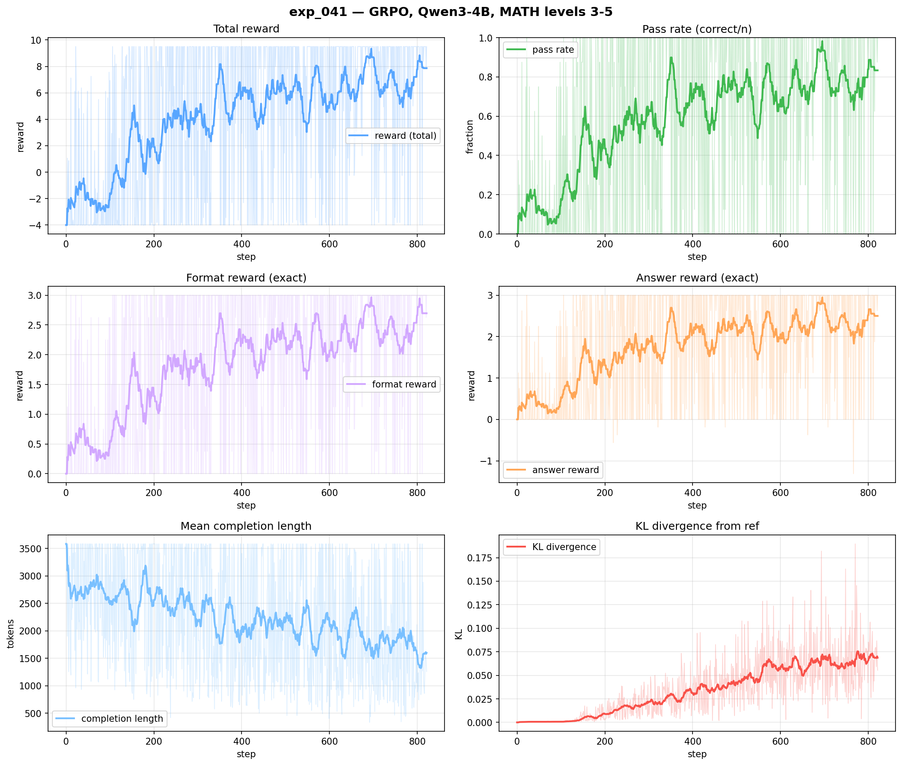
exp_041 — six-panel dashboard
reward, pass-rate, format, answer, completion length, KL

Slide 11
exp_042 — what we thought was GTPO-EMA-flipped
we ported the flipped pure-proof trainer to MATH levels 3-5 and re-ran
result was indistinguishable from the GRPO baseline at every metric: reward, pass-rate, grad norm, cumulative pass
investigation: token_advantages were computed correctly, then multiplied by 0.0 before the loss
so exp_042 is a clean ablation: GTPO advantages computed but zeroed → pure GRPO
useful negative — confirms the test harness and the GRPO backbone are intact

Slide 12
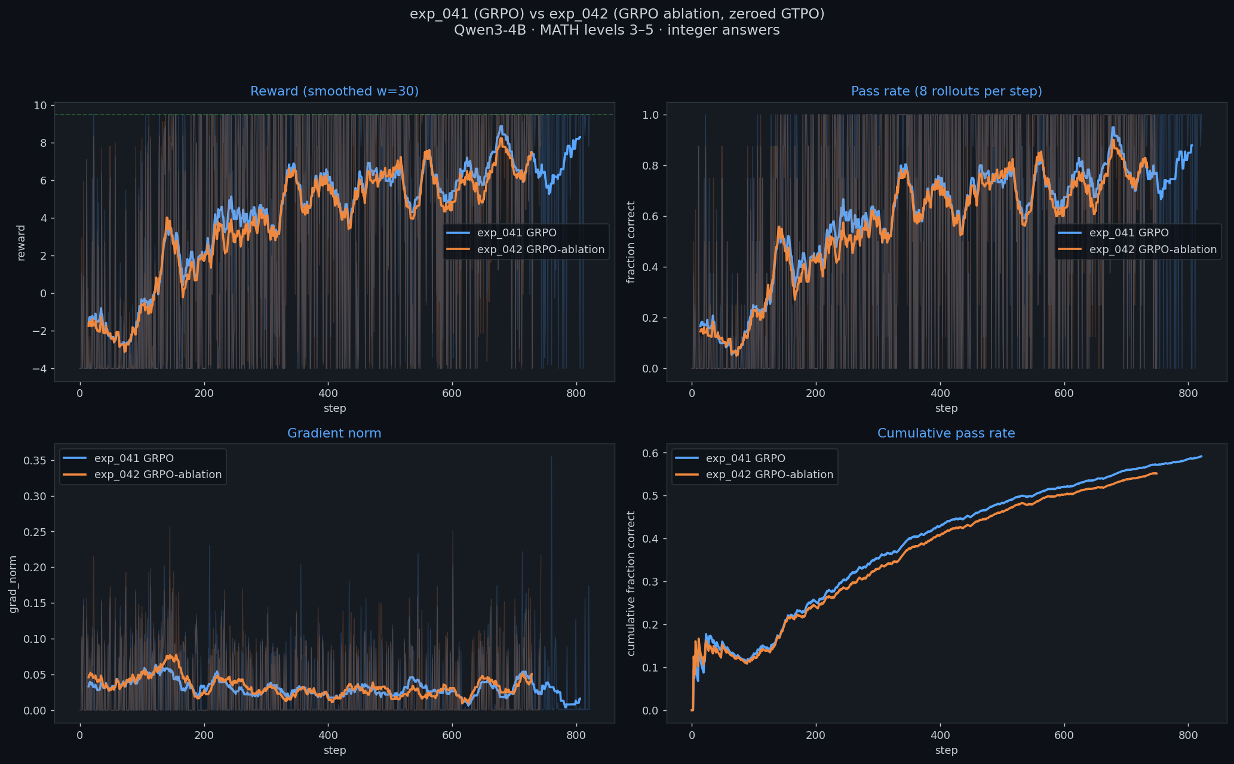
exp_042 vs exp_041 — overlapping curves confirm the zeroing
reward, pass rate, grad norm, cumulative pass — orange and blue track each other within noise

Slide 13
exp_043 — GTPO-Conf (no EMA) on MATH levels 3-5
method: column-wise per-token confidence advantage, log(1+C) on O+, log(1+1/C) on O-, no temporal smoothing
same recipe that beat GRPO on GSM-8K in exp_005
result: peak 9.5 at step 183, then collapse — last-50 mean reward = -3.70, answer_exact final 0.0
completion length explodes upward as the per-token bonus rewards each new uncertain token (length feedback loop)
first hard evidence that per-token confidence shaping without EMA does not transfer from GSM-8K to MATH levels 3-5

Slide 14
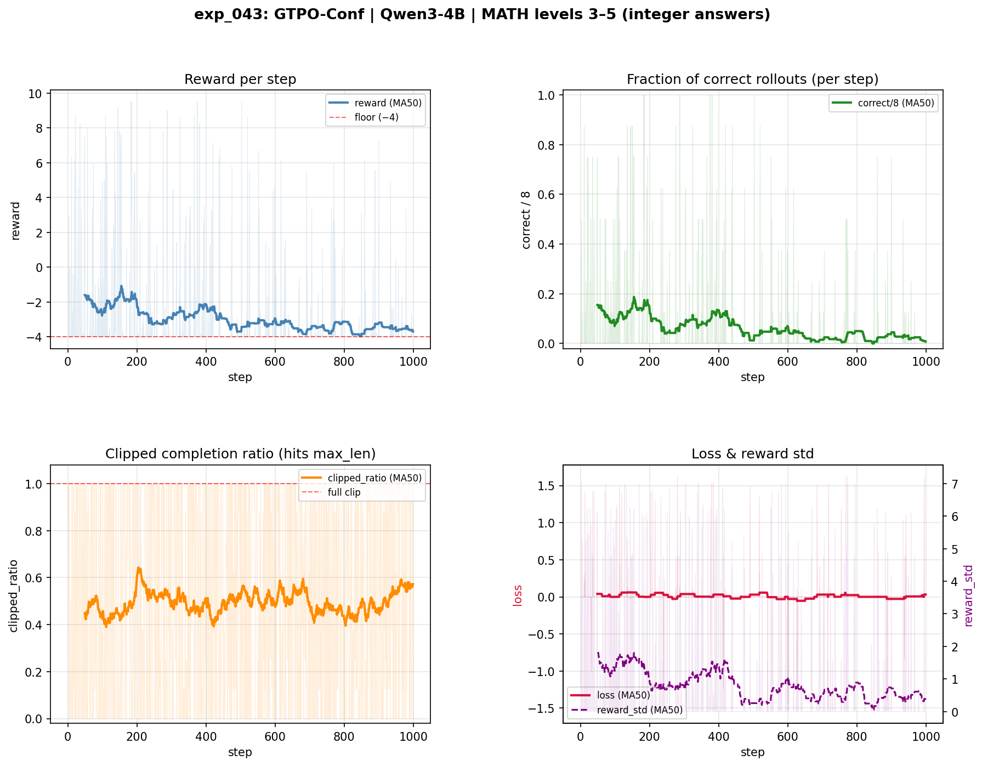
exp_043 — collapse after step ~200

Slide 15
exp_044 — GTPO-EMA-flipped, properly activated
fix for exp_042: token_advantages = gtpo_adv (no 0.0 multiplier)
EMA smoothing was supposed to neutralise the length feedback loop seen in exp_043
result: peak 9.5 at step 150, last-50 mean reward = -1.85, answer_exact final 1.125
less catastrophic than exp_043 but still well below the GRPO baseline (7.82 → -1.85)
EMA helps but does not fix the underlying issue on this benchmark — the per-token signal is unstable for long, hard-math completions

Slide 16
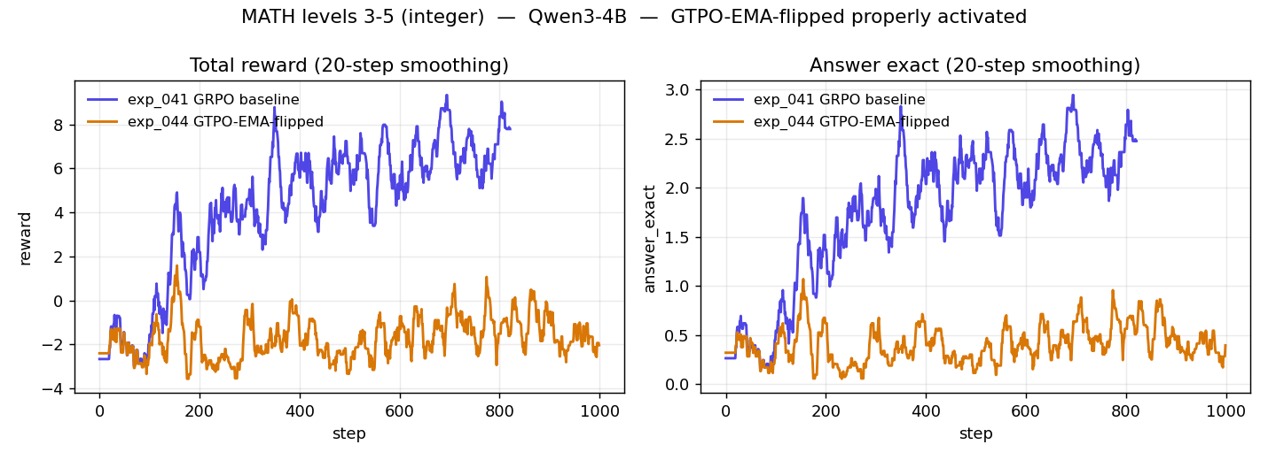
exp_044 vs exp_041 — EMA does not save it on this dataset
left: total reward, right: answer_exact — orange (exp_044) drifts below zero

Slide 17
Diagnosis — why per-token shaping fails on MATH levels 3-5
MATH levels 3-5 completions are 2-3x longer than GSM-8K ones
per-token bonus on O+ rewards each additional uncertain token → policy is pushed to generate longer, less decisive chains
per-token penalty on O- punishes peaked tokens uniformly, including the few correct decisive tokens inside a wrong rollout
EMA smooths the per-token signal but does not change its sign or remove the length pressure
decision: park per-token shaping and try sequence-level shaping instead

Slide 18
exp_045 — SCRS-Confidence (sequence-level shaping)
new family: SCRS = Sequence-level Confidence Reward Shaping
rule: shaped_adv_i = grpo_adv_i - alpha2 * z(mean_conf_i)
uncertain-and-correct rollouts get a bigger positive advantage; confident-and-wrong rollouts get a bigger penalty
no per-token accumulation → no length feedback loop
alpha2 = 0 recovers pure GRPO exactly — clean ablation switch
result: full 1000 steps, last-50 mean reward = 5.80, answer_exact final 3.0
stable but not separating from baseline yet

Slide 19
exp_046 — SCRS-Entropy
swap: replace mean confidence with mean top-k Shannon entropy H (top_k = 100)
sign flips: shaped_adv_i = grpo_adv_i + alpha2 * z(mean_entropy_i)
intuition: H is roughly the inverse of C, so adding entropy is the same direction as subtracting confidence
full 1000 steps, last-50 mean reward = 6.13, slightly above SCRS-Conf
trajectory tracks the GRPO baseline within noise — sequence-level shaping is stable, but no clear win

Slide 20
exp_047 — GTPO-Conf, vectorised, one more try
rewrite of exp_043 with vectorised per-token loops, TRL 0.23.1 compute_loss API, ghost guard for zero-variance batches
same method math: log(1+C) on O+, log(1+1/C) on O-, no EMA, alpha1=1, alpha2=0.1
hope: the previous collapse came from an implementation bug rather than the method itself
result: training aborted at step 295, peak 9.5 at step 49, last-50 mean reward = -2.89
collapse signature is identical to exp_043 — confirms the method, not the implementation, is the problem

Slide 21
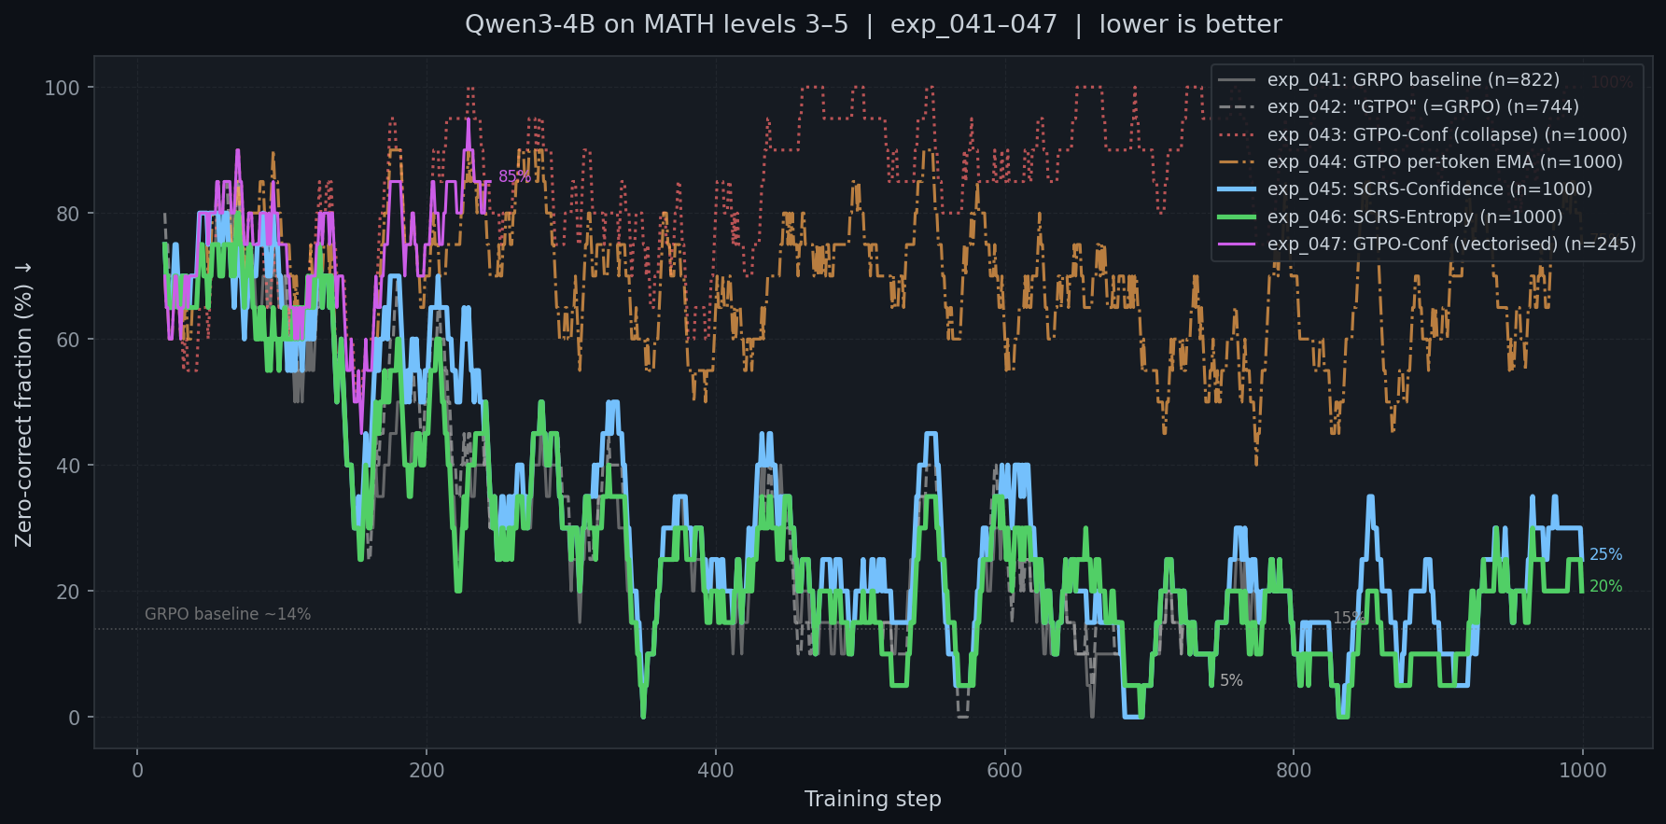
All per-token variants vs baseline on MATH levels 3-5
lower is better (zero-correct fraction); only exp_041 baseline and exp_042 ablation stay near the floor

Slide 22
exp_048 — UCAS Stage 1 (arXiv 2510.10649)
external method: uncertainty-aware advantage shaping, ACL 2026 submission
C_t = full-vocabulary -mean(log_prob); per-sequence conf = masked mean of C_t
C_hat_i = z-score within rollout group; W_i = exp(±alpha * C_hat_i), sign by sign of grpo_adv_i
shaped_adv_i = W_i * grpo_adv_i — multiplicative, preserves advantage scale (unlike SCRS additive form)
alpha = 0.25 (stable range [0.1, 0.5] per paper Table 3)
result: full 1000 steps, last-50 mean reward = 5.92, answer_exact final 3.0
stable, but again tracks GRPO baseline within step-to-step noise

Slide 23
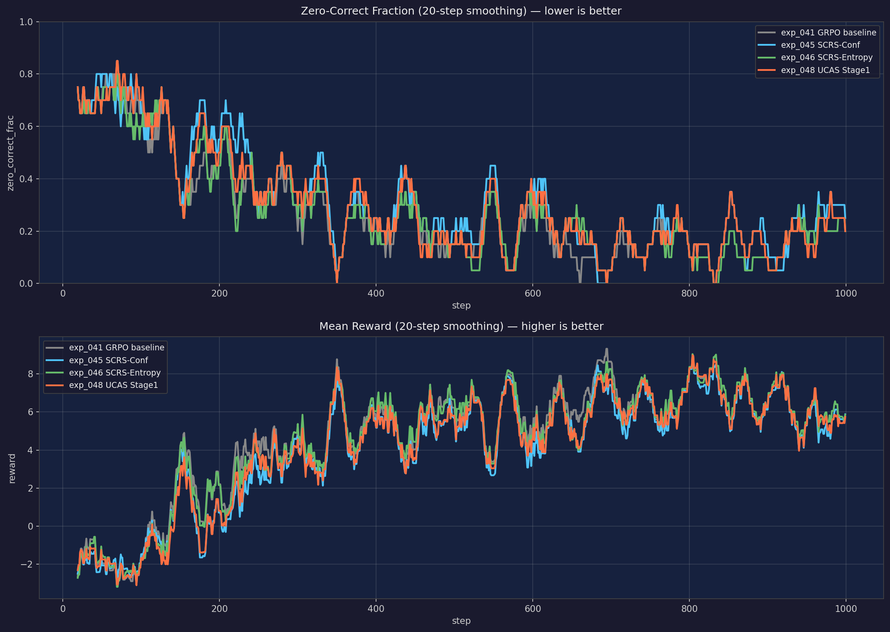
Sequence-level methods vs GRPO baseline
exp_041, exp_045, exp_046, exp_048 — zero-correct fraction (top) and mean reward (bottom)

Slide 24
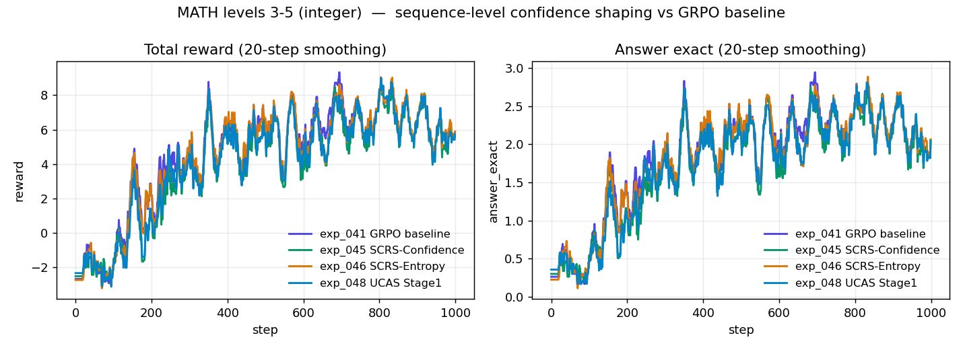
Same picture, two metrics
left: total reward, right: answer_exact — all four runs overlap

Slide 25
Results table — MATH levels 3-5
exp_041 GRPO baseline — last-50 reward 7.82 / ans 2.625 / status: ran 822 steps
exp_042 GTPO-EMA-flipped (zeroed) — last-50 reward 6.94 / ans 2.625 / status: ablation, identical to baseline
exp_043 GTPO-Conf (no EMA) — last-50 reward -3.70 / ans 0.000 / status: collapsed
exp_044 GTPO-EMA-flipped (active) — last-50 reward -1.85 / ans 1.125 / status: collapsed
exp_045 SCRS-Confidence — last-50 reward 5.80 / ans 3.000 / status: stable, no win
exp_046 SCRS-Entropy — last-50 reward 6.13 / ans 3.000 / status: stable, no win
exp_047 GTPO-Conf vectorised — last-50 reward -2.89 / ans 1.875 / status: collapsed, aborted at 295
exp_048 UCAS Stage 1 — last-50 reward 5.92 / ans 3.000 / status: stable, no win

Slide 26
Takeaways
per-token confidence shaping that wins on GSM-8K (exp_005, exp_028) does not transfer to MATH levels 3-5
all three per-token variants we tried (exp_043, exp_044, exp_047) collapse to near-zero answer accuracy
EMA temporal smoothing helps but does not fix the length feedback loop on long-context math
sequence-level shaping (SCRS family, UCAS Stage 1) is stable across 1000 steps but matches the GRPO baseline within noise — no separation yet
exp_042 turned out to be a useful free ablation — confirmed the GRPO backbone is fine and isolated the bug to the multiplier line
the per-rollout logging substrate from exp_040 will let us look at where the per-token signal actually flips sign during a long completion

Slide 27
Next
use the exp_040 rollout logs to characterise C and EMA(C) along long MATH completions — does the signal flip sign mid-chain on wrong rollouts
try a length-corrected per-token bonus: divide alpha2 contribution by sqrt(seq_len) or restrict to the first N tokens
two-stage UCAS (Stage 2: per-token conditioned on the sequence weight) on MATH levels 3-5
if sequence-level matches but does not beat baseline, run multi-seed (3-5 seeds) on the most promising variant (SCRS-Entropy) to confirm or reject the parity claim with confidence intervals
all code under github.com/bliskavets/aiim_research, experiments exp_039..exp_048

