Slide 1
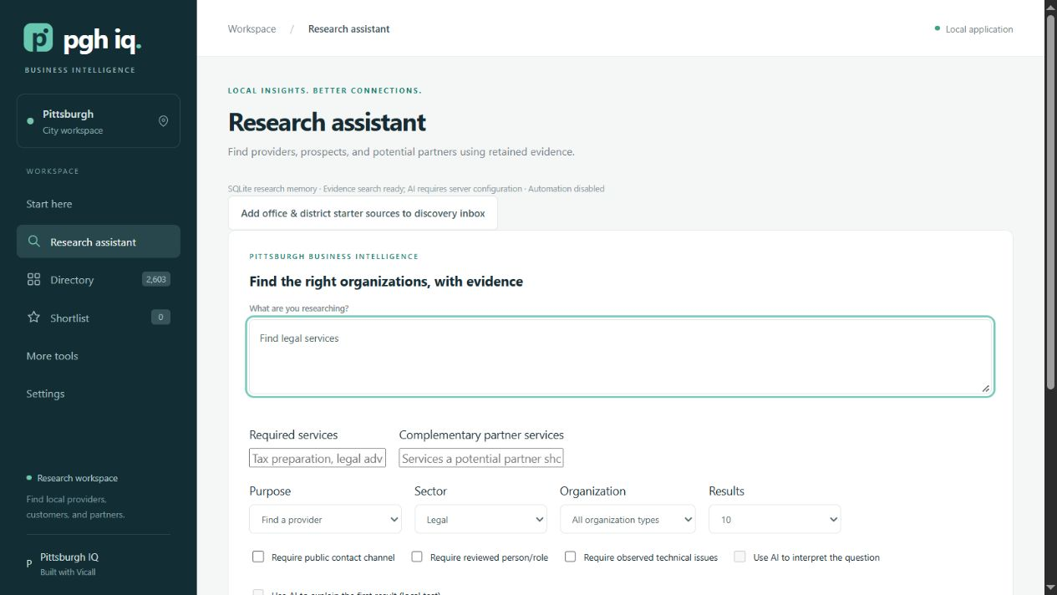
PITTSBURGH IQ
Pittsburgh IQ
AI-powered local business intelligence
Duquesne University
Vicall Hackathon · Challenge 3
Rayane El Yasti Oleg Hartman
Alexander Kearney Noah White
01
Notes:
20 seconds
Introduce the team, then move directly into the challenge.
A local business can offer an excellent service and still be difficult to discover. Pittsburgh IQ gives people a place to research local organizations and decide what to investigate next. We are Rayane El Yasti, Oleg Hartman, Alexander Kearney, and Noah White, from Duquesne University.
Sources and claim boundaries:
Team names from the supplied reference deck. Challenge 3 brief.

Slide 2
PITTSBURGH IQ
The challenge
Turn scattered business information
into actionable research with AI
A research assistant and a smart local directory
For Vicall, and for people finding customers, suppliers and partners
02
Notes:
35 seconds
State the brief clearly. Connect discovery to a real business decision.
The challenge asked us to use AI to turn scattered local business information into actionable research. For Vicall, that means finding organizations that could benefit from website and SEO services. The broader opportunity includes finding suppliers and business partners. Our response combines a searchable directory with a research assistant. The question guiding the product is simple: what does someone need to know before starting a useful business conversation?
Sources and claim boundaries:
Hackathon Plan_Info Sheet.txt, Challenge 3. Client requirements include professional offices, school districts, browser access and wider buying and selling use cases.

Slide 3
PITTSBURGH IQ
A prospect list is only the beginning
A local agency finds a promising office.
What needs attention?
Who should we contact?
What have we already checked?
Illustrative research scenario
03
Notes:
35 seconds
Tell this as an illustrative scenario, not an actual customer story.
Picture a small digital agency looking for its next customer. It finds a local office, opens the website, searches for a contact, and writes down a possible issue. Then someone asks: where did that information come from? Is it current? Has a teammate checked it already? A list of names cannot answer those questions. Our product keeps the organization, its evidence, and the next research step together, so the next person can continue the investigation.
Sources and claim boundaries:
Illustrative agency scenario, not a reported customer outcome. Persistent evidence and research workflow documented in README.md.

Slide 4
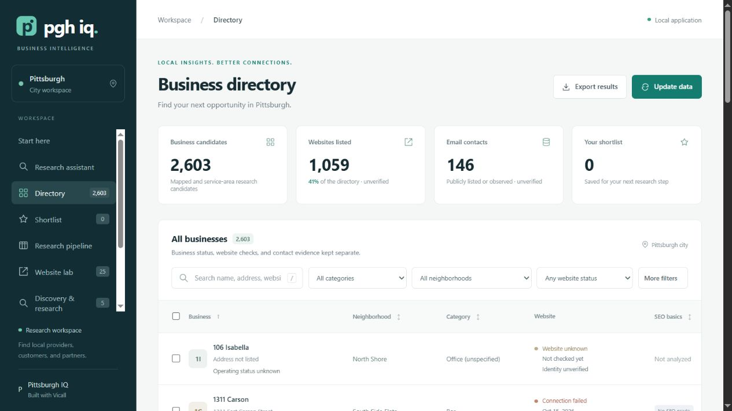
PITTSBURGH IQ
A working directory of Pittsburgh
2,603
business candidates
1,059 listed websites
146 email contacts
Saved public listings, pending review
04
Notes:
40 seconds
Point to the screenshot, then the figures. Do not read every label.
The story starts with a working directory of 2,603 Pittsburgh business candidates. Our saved snapshot includes 1,059 listed websites and 146 email contacts. A researcher can narrow that starting point by neighborhood, category, and available information. These are public listings that still need review. An empty website field is a gap in our data, rather than proof that a business has no website. The directory gives the agency a research starting point, with uncertainty visible from the beginning.
Sources and claim boundaries:
docs/presentation-screenshots/01-business-directory.jpg and 06-data-coverage.jpg. October 14, 2026 OSM snapshot. Counts describe unverified listings.

Slide 5
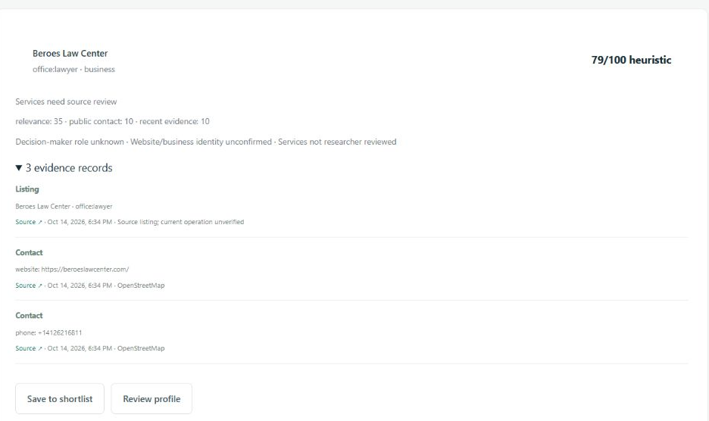
PITTSBURGH IQ
A question leads to inspectable evidence
“Find legal services”
22 candidates
0 new external requests
Sources and dates stay
with each observation
05
Notes:
35 seconds
Point to the result and its dated references.
Now the researcher asks a question. In this captured example, a search for legal services returned 22 candidates using saved evidence, with no new external page requests. A result includes public contact references, source links, and observation dates. The purpose can change from finding a provider to researching prospects or partners. The system also identifies gaps, such as an unreviewed decision-maker role. That makes follow-up research specific, and gives a teammate something they can check.
Sources and claim boundaries:
docs/presentation-screenshots/04-sourced-research-result.jpg. Legal-provider example, not evidence of an actual sales opportunity. Reference IDs and dates support inspection, not guaranteed accuracy.

Slide 6
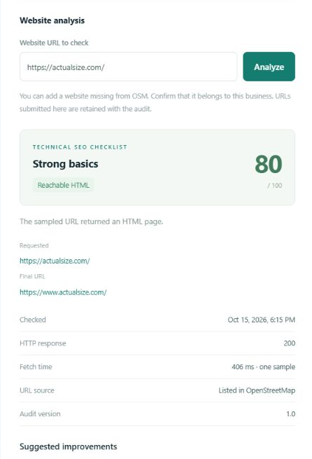
PITTSBURGH IQ
A website finding gives
the conversation context
Saved technical checks
Evidence to review before outreach
Notes, shortlists and exports
keep the investigation moving
06
Notes:
40 seconds
Show the saved check, then explain what the agency can do next.
For the agency, the next step is website research. Website Lab saves the URL, response, observation time, and technical findings. A missing heading, for example, creates a concrete question to investigate before outreach. Failed or blocked requests remain inconclusive. The score describes a static technical checklist and does not measure Google rankings. The researcher can then save notes, organize a shortlist, and export the findings. The intended value is less repeated searching and a better prepared conversation. A client pilot still needs to measure that value.
Sources and claim boundaries:
docs/presentation-screenshots/08-website-audit-detail.jpg. Actual Size static check, HTTP 200, score 80. README.md for notes, shortlist and export functionality. Time savings and business outcomes remain hypotheses.

Slide 7
PITTSBURGH IQ
AI works with collected research
01 Retrieve relevant evidence
02 Interpret with an optional model
03 Validate returned references
Local CPU prototype: 0.5B model, about 12 seconds in one test
Experimental accuracy. Sources remain available for human review.
07
Notes:
35 seconds
Explain the sequence without jargon. Keep the limitation brief and clear.
The AI workflow begins with relevant saved records. Retrieval selects a focused evidence set, an optional model interprets it, and the application checks the references it returns. Users can inspect the sources behind the answer. We also tested a small local model on an eight-gigabyte laptop, with one response taking about twelve seconds. It misread part of the evidence, so local AI remains experimental. Checking citations helps trace an answer, while human review remains necessary to judge its meaning.
Sources and claim boundaries:
intelligence.py retrieval, planning, generation and reference validation. Local Qwen2.5-0.5B Q4 test: 11656 ms including load, fictional evidence, observed misinterpretation. Cloud mode implemented but not live-tested in this session.

Slide 8
PITTSBURGH IQ
Focused retrieval, measured
4 / 4
83%
exact expected result sets
less context text
in the office-prospect test
Four synthetic scenarios. Character counts, not measured token savings.
08
Notes:
35 seconds
Emphasize what the test measured and keep the boundary clear.
We evaluated retrieval with four synthetic scenarios. All four returned the exact expected result sets. In the office-prospect scenario, the system selected 2,549 context characters from a full set of 14,897. That is about 83 percent less text for the model to consider. This measures the retrieval mechanism on a small fictional test set. It does not establish real-world prospect quality or token savings. Our next benchmark will use client-reviewed organizations and measure relevance alongside actual research time.
Sources and claim boundaries:
docs/evaluation.json: exact_set_matches 4/4. Office-prospect case 2549 versus 14897 characters, 82.889% reduction. Synthetic evaluation had no model call.

Slide 9
PITTSBURGH IQ
Research the next person
can continue
Persistent records, backups and an API
Next: evaluate 20 offices and school districts
Proposed pilot measuring relevance and research time
09
Notes:
25 seconds
Return to the agency story and finish cleanly.
The agency now has a place to find organizations, inspect evidence, and keep what it learns. SQLite storage, backups, resumable jobs, and an API provide foundations for continued use. Next comes a focused pilot with twenty offices and school districts. Pittsburgh IQ turns a starting list into research that the next person can continue, helping local businesses prepare for better conversations.
Sources and claim boundaries:
README.md and docs/implementation-status.md. Proposed pilot, not an existing commitment. Public deployment and larger-scale validation remain future work.

