Slide 1
Heart Disease UCI
Alma Berilo Litric

Slide 2
The goal of the Project was to classify patients by the presence or absence of heart disease, as well as to explore the data to see whether it is possible to find any other trends to predict certain cardiovascular events
Data provided at https://archive.ics.uci.edu/ml/datasets/Heart+Disease
The database contains 76 attributes, but all published experiments refer to using a subset of 14 of them
There are 303 instances

Slide 3
FEATUREs AND TARGET INFORMATION
age - age
sex - sex
cp - chest pain type (4 values)
trestbps - resting blood pressure
chol - serum cholesterol in mg/dl
fbs - fasting blood sugar > 120 mg/dl
restecg - resting electrocardiographic results (values 0,1,2)
thalach - maximum heart rate achieved
exang - exercise induced angina
oldpeak - ST depression induced by exercise relative to rest
slope - the slope of the peak exercise ST segment
ca - number of major vessels (0-3) colored by fluoroscopy
thal - 3 = normal; 6 = fixed defect; 7 = reversable defect
target - refers to the presence of heart disease in the patient. It is integer valued from 0 (no presence) to 1 (presence)

Slide 4
EXPLORATORY DATA ANALYSIS
No missing values
Numerical variables (age, trestbps, chol, thalach, oldpeak, slope, ca) and categorical variables that take numerical values

Slide 5
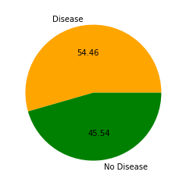
TArget distRIBUTION
Classes are balanced

Slide 6
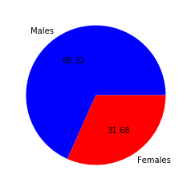
SEX FEATURE distRIBUTION
More than two thirds of males in the sample data

Slide 7
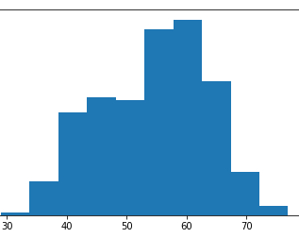
age FEATURE distRIBUTION
Most of the sample data is within 40 - 65 years range

Slide 8
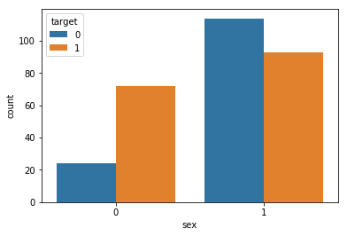
SEX type and heart disease
Among females, a great majority of samples are positive for heart disease
Among males, majority of samples are negative for heart disease

Slide 9
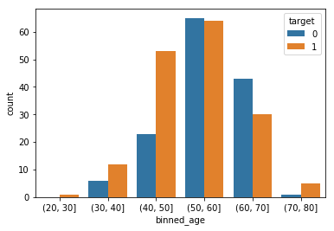
AGE and heart disease
Ages 50 -70 have more samples without heart disease
Ages < 50 and ages > 70 have more samples with heart disease

Slide 10
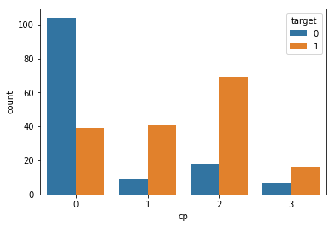
Chest pain and heart disease
Chest pain types: 0 - typical angina, 1 - atypical angina, 2 - non-angina, 3 - asymptomatic angina
Most samples with chest pain type 0 do not have heart disease
Most samples with chest pain type 1, 2 or 3 do have heart disease
Type 2 is the most common chest pain type among patients diagnosed with heart disease

Slide 11
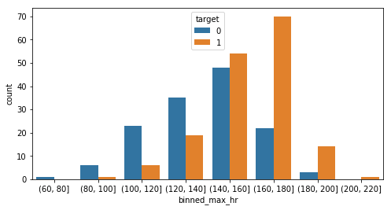
MAX HEART RATE and heart disease
Patients with maximum heart rate over 140 are more likely to be diagnosed with heart disease
This is especially true for those whose maximum heart rate is higher than 160
Further on, the higher the heart rate is, the greater is the probability of patient being diagnosed with heart disease

Slide 12
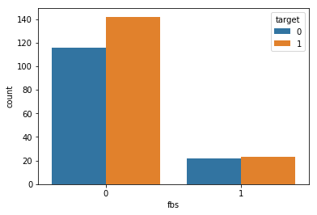
Fasting blood sugar > 120 mg/dl and heart disease
Majority of patients do not have fasting blood sugar > 120 mg/dl
Among the patients whose fbs is greater than 120 mg/dl, approximately 50% are diagnosed with heart disease

Slide 13
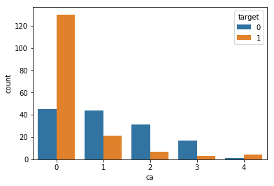
Ca (number of major vessels (0-3) colored by fluoroscopy) and heart disease
The smaller the number of major vessels colored by fluoroscopy is, the greater probability of patient being diagnosed with heart disease

Slide 14
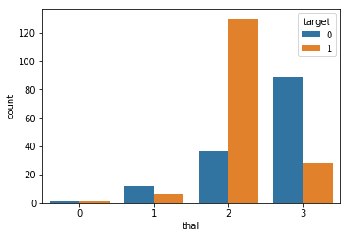
Thal (defects - 1 - normal; 2 = fixed defect; 3 = reversable defect) and heart disease
Patients with thal = 2 (fixed defect) are most likely to be diagnosed with heart disease
Patients with thal = 3(reversable deffect) and thal = 1 (normal) are less likely to be diagnosed with heart disease

Slide 15
Model Implementation and Evaluation
Categorical features converted into dummy varibles
Three models implemented: Logistic regression, KNN, Random forest
Evaluation based on classification report, confusion matrix, ROC curve and AUC score

Slide 16
Logistic Regression - Model Evaluation
Classification Report
precision recall f1-score support 0 0.86 0.68 0.76 28 1 0.77 0.91 0.83 33 micro avg 0.80 0.80 0.80 61 macro avg 0.82 0.79 0.80 61 weighted avg 0.81 0.80 0.80 61
Confusion Matrix
[[19 9] [ 3 30]]

Slide 17
FP = 7, TN = 21, FN = 3, TP = 30
Out of 28 instances with class 0, the classifier predicted correctly 21
Out of 33 instances with class 1, the classifier predicted correctly 30
Accuracy score: 0.8360655737704918

Slide 18
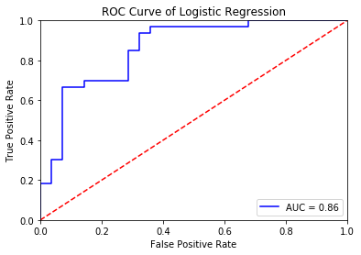
LOGISTIC REGRESSION ROC CURVE

Slide 19
K-NEAREST NEIGHBORS - Model Evaluation
Classification Report
precision recall f1-score support 0 0.63 0.61 0.62 28 1 0.68 0.70 0.69 33 micro avg 0.66 0.66 0.66 61 macro avg 0.65 0.65 0.65 61 weighted avg 0.65 0.66 0.66 61
Confusion Matrix
[[17 11] [ 10 23]]

Slide 20
FP = 11, TN = 17, FN = 10, TP = 23
Out of 28 instances with class 0, the classifier predicted correctly 17
Out of 33 instances with class 1, the classifier predicted correctly 23
Accuracy score: 0.6557377049180327

Slide 21
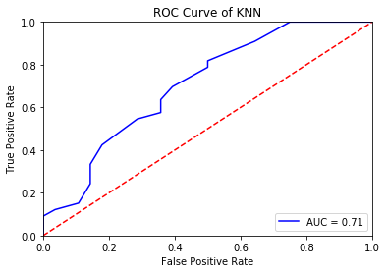
K-nearest neighbors ROC CURVE

Slide 22
Random forest - Model Evaluation
Classification Report
precision recall f1-score support 0 0.86 0.64 0.73 28 1 0.75 0.91 0.82 33 micro avg 0.79 0.79 0.79 61 macro avg 0.80 0.78 0.78 61 weighted avg 0.80 0.79 0.78 61
Confusion Matrix
[[18 10] [ 3 30]]

Slide 23
FP = 11, TN = 17, FN = 2, TP = 31
Out of 28 instances with class 0, the classifier predicted correctly 17
Out of 33 instances with class 1, the classifier predicted correctly 31
Accuracy score: 0.7868852459016393
Out of 33 sick persons, the classifier correctly identified 31 (False Negative = 2, i.e. 2 sick persons were misdiagnosed) - the lowest FN so far

Slide 24
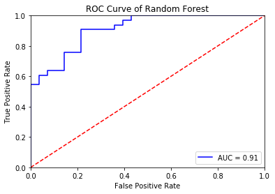
random forest ROC CURVE

Slide 25
CONCLUSIONS
Looking at all metrics, it is obvious that KNN model has very poor performance compared to other two models and in general, so the choice will be made between Logistic Regression and Random Forest models
LR model has accuracy score of 0.8360655737704918, which is better than RF accuracy score of 0.7868852459016393
However, as we are using a health dataset, and there is a high cost associated with False Negative (people with heart disease with the wrong diagnosis and consequently no treatment), the metric of choice for evaluating models will be recall

Slide 26
CONCLUSIONS
Logistic Regression Recall - 0.909, Random Forest Recall - 0.939
Considering recall, Random Forest performance looks better, which makes it the model of choice in this classification problem
The selected Random Forest Model has recall 0.939, accuracy score 0.7868852459016393, and AUC score 0.91

