Slide 1

Spotting when a pattern changes
KU SBB · TEAM BLITZICT
Me, staring at 24,000 squiggles
Four attempts at the same problem: what each one did, why it scored better, and how I had to nerf my own best model to follow the rules
01 · The task
01 / 33
Notes:
This deck assumes no machine-learning background. Every technical word is explained the first time it appears.

Slide 2

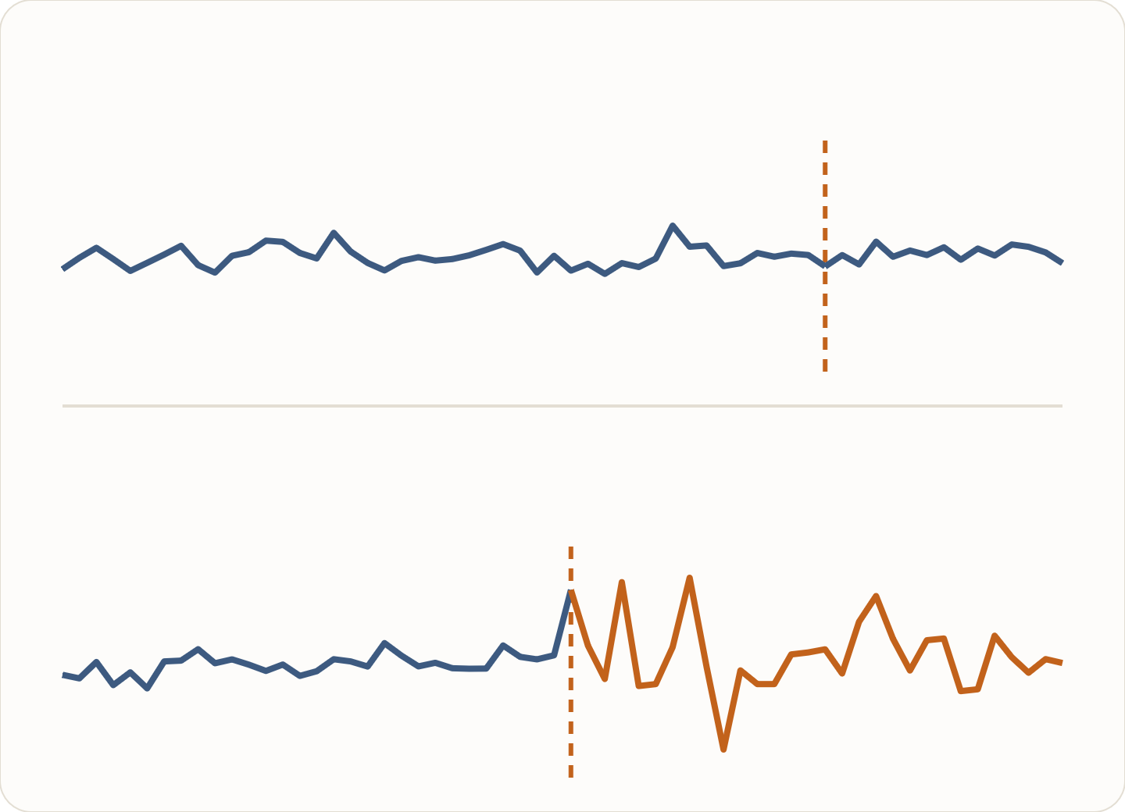
The task
BACKGROUND
Each example is a time series: a list of numbers recorded one after another, like a daily temperature or a machine’s sensor reading.
NO BREAK
Each one has a marked point. The question: did the behaviour change at that point? That change is called a structural break.
BREAK
I get 24,000 practice series with the answer, and must give a probability for 4,000 new ones.
01 · The task
02 / 33
Notes:
Top picture: no break, the series behaves the same on both sides of the dashed line. Bottom: a break, it becomes much jumpier after the line. Real cases are far subtler than this.

Slide 3


How I am scored: AUC
SCORING
Pick one series that has a break and one that doesn’t. AUC is how often my system gives the break series the higher probability.
0.50
0.88
1.00
A coin flip
My best: right 88 times out of 100
Perfect every time
Two scores appear in this deck: public is Kaggle’s score on the test series; local is my own check on the practice series.
01 · The task
03 / 33
Notes:
Near the top of the leaderboard, gains are small: going from 0.875 to 0.881 took far more work than going from 0.833 to 0.875. Treat each 0.01 as a big step.

Slide 4
The four tries at a glance
OVERVIEW
Public score (axis starts at 0.82)
try1
Compare the numbers before and after the point
0.833
try2
Also ask how the numbers were produced
0.875
try3
The full model: a large committee, then corrections
0.881 · best
try4
try3 cut down to fit the time limit
0.876 · final
try3 is my best model, but it is too slow for the time limit. So I nerfed it myself: try4 is the nerfed version, and my final model.
01 · The task
04 / 33
Notes:
Exact public scores: try1 0.83313, try2 0.87539, try3 0.88078, try4 0.87583. Local scores: 0.83835, 0.86987, 0.87910, 0.87235.

Slide 5
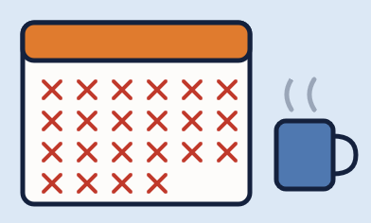
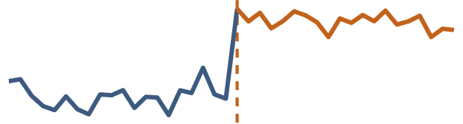
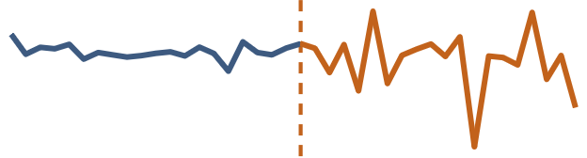
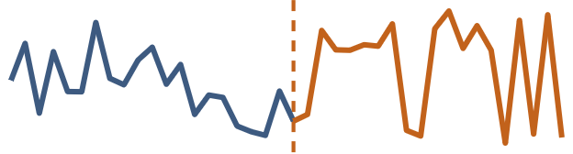
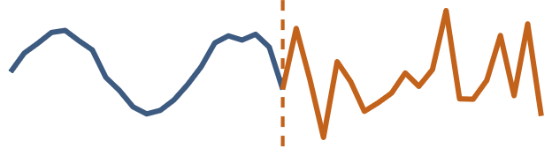
Measure both halves and compare
TRY1 · THE IDEA
Cut each series at the marked point. Describe the “before” half and the “after” half with many measurements, then look at the differences.
try1 ate my week
Level
Spread
Shape
Memory
Is the average higher or lower after the point?
Do the values swing more widely?
Do the two halves look like they come from the same mix of values?
Does today’s value still predict tomorrow’s as well as before?
02 · try1 to try3
05 / 33
Notes:
Think of comparing the weather in March and April: average temperature, how much it varied, how often there were extremes, and whether one warm day was usually followed by another. Each such measurement is called a “feature”.

Slide 6

977 measurements, two models that vote
TRY1 · HOW IT DECIDES · 0.833
01
02
03
Features
Model
Vote
977 numbers per series, each one a before-vs-after comparison like those on the last slide.
A program that learns from the 24,000 answered examples. Mine are “decision trees”: thousands of learned yes/no questions, such as “did the spread double?”
Two tree programs (XGBoost and LightGBM) each rank the series; I average their rankings.
0.833
Most of my time went into try1. It also got the lowest score of the four. A solid start, I tell myself.
02 · try1 to try3
06 / 33
Notes:
Public 0.83313, local 0.8384. Scoring the 4,000 test series from scratch takes about 2 minutes.

Slide 7
Ask how the numbers were produced
TRY2 · THE IDEA
try1 asked “do the halves look different?”. try2 also asks “did the process making the numbers change?” I fit simple descriptions of that process to each half and compare them.
01
Rhythm
02
Trend
03
Jumps
a repeating cycle that changes speed or stops
a steady climb that bends or reverses
sudden spikes appearing or vanishing
04
Calm vs stormy
05
Noise
06
Momentum
quiet and noisy periods switching
the random part getting louder or changing type
how strongly one value pulls the next
02 · try1 to try3
07 / 33
Notes:
A doctor comparing two heart recordings doesn’t just compare the average heart rate: they check whether the rhythm, the spikes and the noise changed. These are my “mechanism features”.

Slide 8
More and better measurements, one model
TRY2 · RESULT · 0.875
3,625 features per series: try1’s comparisons, the same comparisons on windows of different sizes around the point, and the new process measurements.
VS TRY1
+0.042
Fed to a single tree model (LightGBM).
over try1, the biggest single jump of the project
Lesson: describing how the data was made beats generic statistics (and beats a week of polishing try1).
02 · try1 to try3
08 / 33
Notes:
Public 0.87539, local 0.86987. Scoring the 4,000 test series took about 74 minutes on a 4-CPU Kaggle machine.

Slide 9
Simple comparisons barely beat a coin flip
TRY1 → TRY2 · WHAT THE NUMBERS SAY
Held-out AUC on the 24,000 practice series (axis starts at 0.50)
Coin flip
0.50
INVISIBLE BY EYE
Change in the average
0.62
39%
Change in the spread
0.62
of the real breaks move the average by less than 0.1 standard deviations.
try1: 977 simple measurements together
0.838
try2: + first mechanism measurements
0.870
Eyeballing: 0.62. Describing how the numbers were made: 0.87.
02 · try1 to try3
09 / 33
Notes:
Computed directly on the 24,000 practice series, no model: |mean after − mean before| / sd before gives AUC 0.620; |log(sd after / sd before)| gives 0.620. try1 (977 base statistics, XGBoost + LightGBM): 0.83835 out-of-fold. try2 (3,625 columns including the first mechanism tables, one LightGBM): 0.86987. Later, the best single column (try3’s noise volume test) reaches 0.816 alone; see slide 22. 39.5% of break series have a mean shift under 0.1 sd.

Slide 10
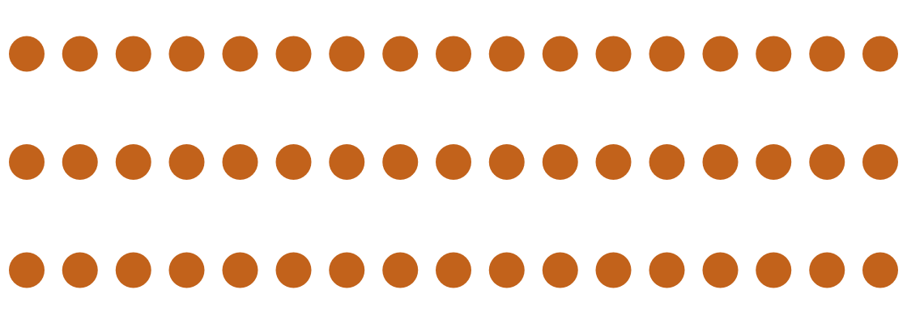
A committee of 51 experts
TRY3 · THE FULL MODEL · 0.881
One model has blind spots. try3 trains 51 different models, each with a different way of looking, and combines their opinions, like asking a panel instead of one person.
About 5,100 measurements in total. Spoiler: one of these 51 ends up doing most of the work.
51 MODELS
Tree models
Neural networks
Sequence readers
Yes/no-question models, each given a different set of measurements
Models loosely inspired by the brain, good at blending many weak signals
Networks that read the raw numbers directly, with no hand-made measurements
02 · try1 to try3
10 / 33
Notes:
try3 is everything from try2 plus many more models, more views of the data, specialist models and final corrections. Public 0.88078 (submission 58102347), local 0.87910.

Slide 11
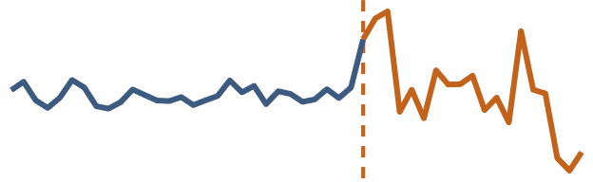
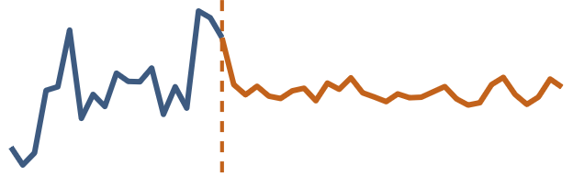
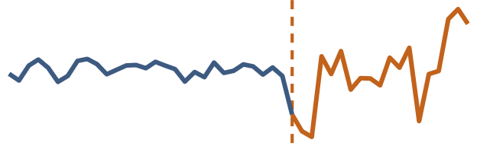
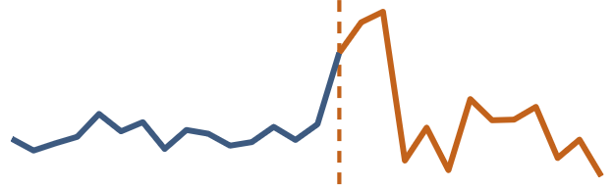
Look at each series 8 ways
TRY3 · INGREDIENT 1
A break is still a break if you play the series backwards or upside down. So I make extra copies of every series and let models learn from all of them.
Original
Reversed
Flipped
4 crops
As recorded
Played backwards
Upside down, and both
Zoomed in around the point
When scoring, these models answer for every copy and I average, like asking someone to judge a photo and its mirror image.
02 · try1 to try3
11 / 33
Notes:
Adding the 7 extra views raised my local score from 0.845 to 0.850. The crops keep 60–90% of each side of the point.

Slide 12

The specialist that carried the team
TRY3 · INGREDIENT 2
WHAT IT IS
One XGBoost model, one of try3’s 51.
ALONE, HELD-OUT AUC
0.8748
WHAT IT SEES
Mostly “how was it produced” measurements: 11 mechanism tables, all 5 jump laws, the volatility law, a compact statistics block and the 36 noise priors.
All 51 models + corrections: 0.8791. This one model gets 99.5% of the way.
EXTRA PRACTICE
Every training series also appears as 2 zoomed-in crops around the point, each with its own measurements.
FAIR TESTING
Trained 5 times on 4/5 of the data. Its noise priors are learned from those 4/5 only.
One specialist, 50 passengers
02 · try1 to try3
12 / 33
Notes:
MECH3C12V = nested crop mechanism XGBoost (pipeline/legacy_cpu/experiments/redesign/nested_crop.py). Inputs: the ns3 statistical block, the mechanism tables harmonic, ar_law, bounds, curve, noise_tests, partition, periodic, phase_law, trend, innov_v2, mixture_law, all five jump-law tables (pulse, state, nullstate, prestate, smoothvol), the volatility_law table, and 36 nested white-noise-law prior columns fitted on each fold’s training labels. Each fold’s training rows are augmented with crop views c1 and c2 carrying their own features. Scored on every view with weighted logit averaging (original ×2, crops ×0.125). Out-of-fold AUC: seeds 0.8743, 0.8746, 0.8744; 3-seed bag 0.8748. How it was built up (seed 0, held-out AUC): MECHNEST2 base 0.8713; MECHNEST3 + all 5 jump laws 0.8716; MECH3C1 + crop view c1 0.8730; MECH3C12 + crop c2 0.8733; MECH3C12V + volatility law 0.8743; 3-seed bag 0.8748. (MECH3C12RV, which also adds the reversed view, 0.8745.)

Slide 13

Combine, then fine-tune the answer
TRY3 · INGREDIENT 3
Blend: combine the 51 opinions into one, giving more weight to the experts that proved more reliable.
1
Small corrections: dozens of small adjustment steps, each nudging the blended answer using one extra signal. A step is kept only if it improves the score on data it didn’t learn from.
2
Practice on made-up data: one more neural network, trained on series I generated myself (so the answers are known), adds a final correction. This took me from 0.879 to 0.881.
3
02 · try1 to try3
13 / 33
Notes:
Steps 1 and 2 give the 0.879 ensemble (local 0.87910). Step 3, the synthetic-data neural network, gives the 0.88078 public submission.

Slide 14
What each ingredient was worth
TRY3 · WHAT EACH PART ADDED
Local score as each part was added (axis starts at 0.835)
Trees on before/after windows
0.840
BIGGEST GAIN
+ the best extra measurement groups
0.845
+0.015
+ the 7 extra copies (views)
0.850
from the specialists: the biggest jump on the ladder. One idea beat weeks of tinkering.
+ rhythm (repeating-cycle) measurements
0.859
+ specialists with noise priors
0.874–0.875
+ blending and small corrections
0.879
02 · try1 to try3
14 / 33
Notes:
Local scores recorded as each part was added during development. The made-up-data correction then lifted the public score to 0.881. Keep this table in mind: try4 keeps the specialists’ ingredients and drops most of the rest.

Slide 15
The best score is expensive to run
TRY3 · THE CATCH
473
~1 day
hours
separate steps to train it, many of which must wait for the one before
of computer time to retrain it from scratch, even with two graphics cards
to score new series. The rules allow 30 minutes on 2 processor cores with 8 GB of memory
So my best model could not be my final submission. Time to nerf my own model: how much of it do I actually need?
02 · try1 to try3
15 / 33
Notes:
My latest retrain from the raw data scored 0.87886 locally, within 0.0003 of the original 0.87910, so the recipe is reproducible, just slow.

Slide 16


try3, nerfed to fit the rules
TRY4 · 0.876 · MY FINAL MODEL
Like father, like (faster) son
THE RULE, FROM SCRATCH:
30 min
2 cores
8 GB
to score 4,000 new series
of processor
of memory
The goal: nerf it as gently as possible, so it still fits the rule. Three kinds of cuts:
Cut 1 · fewer models
Cut 2 · fewer measurements
Cut 3 · less wasted computing
03 · try4, the final model
16 / 33
Notes:
try4 was built after try3. It reuses try3’s measurement code and noise priors, so it is a smaller version of try3, not a new approach.

Slide 17
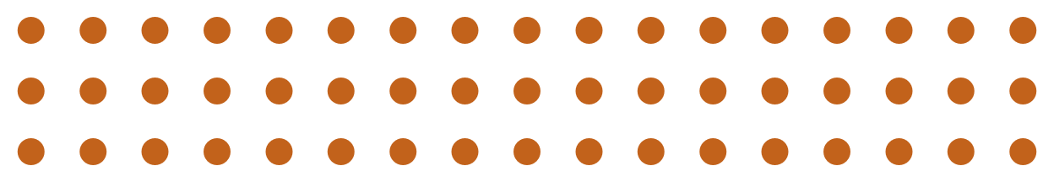
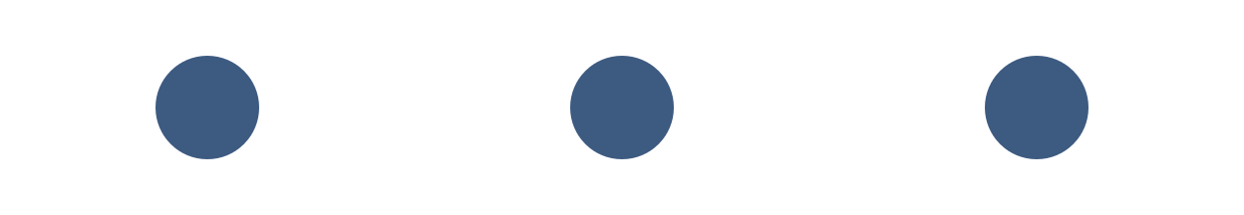


From 51 experts to 3
CUT 1 · THE COMMITTEE
TRY3
TRY4
51 models of five kinds, including slow neural networks and sequence readers, then dozens of correction steps and a made-up-data network.
Only fast tree models: 2 LightGBM and 1 XGBoost. Their rankings are averaged. No neural networks and no correction steps.
Tree models do most of the work and run in seconds. The other 48 cost hours for the last fraction of a point, so they were let go.
Bye, 48 colleagues
03 · try4, the final model
17 / 33
Notes:
In practice try4 has 15 saved models: the 3 trees trained 5 times, once per practice group, each time leaving one group out to test on. Feature choice and the noise priors are also fitted inside each round, so the test group stays unseen.

Slide 18
From about 5,100 measurements to 136
CUT 2 · THE MEASUREMENTS
100
I ranked every measurement by how much it helps and kept only the top 100. The rest add very little once the best ones are in.
+36
I kept the noise priors from try3’s specialists, its most valuable ingredient.
−4
I dropped the 4 slowest groups of measurements entirely: about 7 minutes saved for a loss of just 0.0004. A bargain.
03 · try4, the final model
18 / 33
Notes:
I tested several different counts of measurements to keep; 100 was the best balance of speed and score. The 4 dropped groups were lrz6, GARCH, bounds and the base set. Before that drop, try4 scored 0.87659 public; after it, 0.87583.

Slide 19

Only calculate what gets used
CUT 3 · WASTED COMPUTING
01
02
03
Skip unused columns
Fewer steps
Work in parallel
Each measurement group computes dozens of numbers at once. try4’s versions compute only the ones the models read, with identical results.
77 measurement steps instead of try3’s 473 training steps, because only the needed groups are built.
Steps that don’t depend on each other run at the same time on all available processor cores.
I (*diff cmd from google) checked that the trimmed calculations give exactly the same numbers as the full ones.
03 · try4, the final model
19 / 33
Notes:
Timing on Kaggle limited to 2 cores: the first try4 took 26.5 minutes; with all three cuts it takes 21.8 minutes and 2.6 GB of memory.

Slide 20
Where the 21.8 minutes go
CUT 3 · THE RESULT
Scoring 4,000 new series from raw data, Kaggle limited to 2 cores
21.8 min
8.2 min to spare
30-min limit
Processor time by step family (2 cores work in parallel)
Hidden-level and change-location laws
14.1 min
PEAK MEMORY
Mechanism laws (rhythm, trend, jumps…)
11.8 min
2.6 GB
Noise-law tables
11.2 min
of the 8 GB allowed
Window grids and change tests
3.5 min
Setup and loading
0.6 min
41 processor-minutes across 41 steps, 2 at a time, fit into 21.8 minutes. I had 8 minutes to spare. I did not spend them.
03 · try4, the final model
20 / 33
Notes:
From timing.json of the Kaggle notebook run (wall time 1306.7 s). Processor seconds per family: setup 38, window/change tests 209, mechanism laws 711, latent/boundary laws 846, white-noise laws 673. Slowest single steps: late_feature_component_moves_state_test 360s, white_feature_filtered_step 205s, late_feature_component_moves_pulse_test 144s, white_feature_boundary_state_test 131s, white_feature_boundary_pulse_test 128s. Peak memory 2.64 GB.

Slide 21
The exact columns try4 picked
INSIDE TRY4 · WHAT WAS PICKED
3,589
100
39
+36
candidate measurements
picked in each round
picked in all 5 rounds
noise-prior columns
Round 1’s 100 picks, by family
Volatility laws
12
HOW THEY WERE PICKED
Momentum (memory) laws
7
Hidden-level laws, raw
7
In each round, a LightGBM trained on that round’s 4/5 ranks every candidate by how much it helps. The top 100 stay.
Change-location laws, pulse
6
Hidden-level laws, pulse
5
Change-location laws, state
5
Noise-volume laws
4
Rhythm phase laws
4
192 different ones across all 5 rounds.
Jump laws, smoothed stream
4
Trend fits
4
+ 21 more families with 42 picks
03 · try4, the final model
21 / 33
Notes:
From try4/model/columns_fold*.json and features.json. Ranking: LightGBM gain on the fold’s training rows only (try4/train.py). The 39 picked in every round: ar_law__aggregate, bf__bf_max_full, boundary_law_pulse__any_at, curve__jump_trend, hetero_jump__common_shape, hetero_jump__split_shape, jump_law_nullstate__shape0, jump_law_prestate__shape0, jump_law_smoothvol__scale3, jump_law_state__shape0, latent_level_pulse__observed_step2, latent_level_pulse__restart_new_process, latent_level_pulse__restart_new_scale, latent_level_raw__restart_new_scale, latent_level_raw__restart_state, lm__lm_lm_ar1, lm__lm_lmsum, memory_law1__independent_memory, memory_law1__jump4, native_law_state__native_free_scale, native_law_state__standard_free_scale, noise_tests__lm_lbf_mix, partition__lag_product_coarse, periodic__phase_gain, phase_law__common_phase, phase_law__max_evidence, phase_law__mixture_evidence, phase_law__phase_bf, sn__sn_r_lvl_g, trend__confidence, trend__intervention, volatility_law__all, volatility_law__law3_memory, volatility_law__law3_null, volatility_law__memory_and_law, volatility_law__new_memory, volatility_law__new_scale, volatility_law__scale_and_law, volatility_law__scale_jump2

Slide 22
The 8 measurements that matter most
INSIDE TRY4 · WHAT THE MODEL RELIES ON
Share of the model’s decisions
AUC alone
Noise volume test · fits better if each side gets its own noise volume?
17.9%
0.82
Restart test · one hidden process, or two split at the point?
10.2%
0.76
Change at the point · any change detected right at the point
5.7%
0.79
Noise prior · how often noise like this meant a break
3.1%
0.79
Change is local · stronger at the point than far before or after
3.0%
0.80
Rhythm phase · useless alone, sharpens the others
2.4%
0.50
Restart, new volume · same process, new volume after the point
2.0%
0.76
Momentum law · did the pull from one value to the next change?
1.9%
0.78
Together, the 36 noise-prior columns make 9.9% of the decisions.
03 · try4, the final model
22 / 33
Notes:
Share of decisions = LightGBM split gain of the lgb_law model, averaged over the 5 rounds. AUC alone = the raw column’s AUC on all 24,000 practice series (law columns: each round’s own prior on its held-out rows). Exact names: native_law_state__native_free_scale 17.9% / 0.816; latent_level_pulse__restart_new_process 10.2% / 0.762; boundary_law_state__any_at 5.7% / 0.792; law__v0 3.1% / 0.788; boundary_law_state__any_far_strong 3.0% / 0.802; phase_law__common_phase 2.4% / 0.504; latent_level_pulse__restart_new_scale 2.0% / 0.761; ar_law__aggregate 1.9% / 0.775. Most are log Bayes factors: how much more likely the data is under ‘something changed at the point’ than under ‘one process throughout’.

Slide 23
One real break, explained
INSIDE TRY4 · ONE REAL PREDICTION
How each measurement pushed the score (log-odds)
A HELD-OUT SERIES · ROUND 4
Starting point (any series)
67%
Noise shape jumped
+0.67
972 points, marked point at 440
Restart test
+0.63
Average moves 0.025 SD
10-point range: before ≠ after
+0.59
Spread changes 8%
Volatility memory changed
+0.51
By eye: nothing happens.
Noise volume test
+0.45
99.97%
Momentum jumped
+0.36
Volume jumps, then clusters
+0.33
try4 says break: top 0.1% of all 24,000
Each side has its own momentum
+0.26
128 other columns
+3.63
Truth: a break ✓
Final score
8.16 → 99.97%
Each of the 8 values is higher than at least 99.9% of the no-break series in the same round.
03 · try4, the final model
23 / 33
Notes:
Chosen on purpose: a break in the top 3% of try4’s scores whose average and spread barely move, so it is invisible by eye. Explanation = LightGBM pred_contrib (SHAP-style) of the round-4 lgb_law model, in log-odds. Start 0.73 (67%), final 8.16 (99.971%). Exact columns and values: jump_law_prestate__shape0 = 28.6 (+0.67, above 99.96% of no-break series); latent_level_pulse__restart_new_process = 112.9 (+0.63, above 100.00% of no-break series); grid2__r_mrng10_cvm = 61.0 (+0.59, above 100.00% of no-break series); volatility_law__new_memory = 5.3 (+0.51, above 99.96% of no-break series); native_law_state__native_free_scale = 74.2 (+0.45, above 100.00% of no-break series); memory_law1__jump4 = 36.8 (+0.36, above 100.00% of no-break series); volatility_law__scale_cluster4 = 9.1 (+0.33, above 100.00% of no-break series); memory_law1__independent_memory = 34.5 (+0.26, above 100.00% of no-break series). The raw series is not shown because the competition data is not mine to publish.

Slide 24
Whole series in, whole series out
HOW I TESTED IT · 5 ROUNDS
I split the 24,000 series into 5 groups of 4,800 whole series. Each round trains on 4 groups and tests on the 5th, so every series is tested exactly once, by a model that never saw any of its points.
Round 1
Held out
Train
Train
Train
Train
Round 2
Train
Held out
Train
Train
Train
Round 3
Train
Train
Held out
Train
Train
Round 4
Train
Train
Train
Held out
Train
Round 5
Train
Train
Train
Train
Held out
Each box is 4,800 complete series, never pieces of one. Picking the top 100 measurements and fitting the noise priors also use only the 4 “train” groups.
04 · Testing it honestly
24 / 33
Notes:
Each row is one round; each box is a group of 4,800 complete series (seed-7 folds, law_outer7). Orange = the held-out group for that round. The test set is new series, not the future of old ones, so the unit held out is the whole series, not a time window.

Slide 25
Held out whole, fitted on training only
HOW I TESTED IT
WHOLE SERIES
The 24,000 series go into 5 groups of 4,800. A held-out series is held out whole: none of its points is ever trained on. That copies the real test, which is 4,000 brand-new series.
A LEAK I CAUGHT
0.8774
TRAINING ONLY
In each round, picking the top 100 columns, fitting the 36 noise priors and training all 3 models use the 4 training groups only. Tree counts are fixed, so the held-out group isn't even used to decide when to stop.
Picking the columns once, with every round’s labels, scored 0.8774. Too good to be true. Picked inside each round, the honest score is 0.873.
NO LABELS INSIDE
Every measurement is computed from the series itself, without labels. 2 tables that were fitted on all the labels are left out.
DID I FOOL MYSELF?
Held-out: 0.8723. Kaggle, 4,000 unseen series: 0.8758. No.
04 · Testing it honestly
25 / 33
Notes:
Folds: try4 uses the seed-7 folds stored in tune_out/weight_space/law_outer7/fold*_rows.npz, the same folds the noise-law priors were fitted on. Each fold’s prior is fitted on that fold’s training labels only (law_outer7), feature ranking is LightGBM gain on the fold’s training rows only, and the models use fixed rounds (LightGBM 720 and 1,300, XGBoost 1,100), so there is no early stopping on the held-out rows. Excluded tables: transition_odds and transport_state (priors fitted on all training labels). Why not time-ordered splits: each series is one separate example with one label, the model always sees the whole series, and the test set is new series, not the future of old ones. So the right unit to hold out is the whole series. The leak: a late experiment used the union of the 5 folds’ selected columns (192); it scored 0.8774, versus 0.873 with each fold’s own 100. The union lets a fold’s own labels choose its columns, so it was dropped. Held-out pooled AUC 0.8723; Kaggle public 0.87583.

Slide 26
Steady in every round, and on Kaggle
TEST RESULTS · 5 HELD-OUT ROUNDS
AUC (axis starts at 0.85)
Round 1
0.8696
THREE MODELS, ONE VOTE
Round 2
0.8677
LightGBM
0.8718
Round 3
0.8734
LightGBM (seed 2)
0.8717
Round 4
0.8819
XGBoost
0.8714
Round 5
0.8695
Averaged ranks
0.8723
All rounds together
0.8723
Kaggle, 4,000 unseen series
0.8758
Kaggle scored it a bit higher than I did. I’ll take it.
04 · Testing it honestly
26 / 33
Notes:
Per-round AUC of the out-of-fold blend: 0.8696, 0.8677, 0.8734, 0.8819, 0.8695. Pooled 0.8723 (recorded at training: 0.87235). Kaggle public 0.87583 (submission 58142084). Each model alone: LightGBM 0.8718, LightGBM (seed 2) 0.8717, XGBoost 0.8714.

Slide 27
When try4 is sure, it is right
TEST RESULTS · HELD-OUT PREDICTIONS
Share of real breaks in each tenth, sorted by try4’s score
100%
100%
4,790 / 4,800
88%
of the series it is most sure about (top 20%) really were breaks.
61%
44%
33%
29%
8.9%
22%
15%
of the 2,400 it is least sure about were breaks. The coin-flip rate is 50%.
9%
← most sure
least sure →
The top half of the list holds 78% of all breaks.
04 · Testing it honestly
27 / 33
Notes:
Out-of-fold rank-blend scores of try4, reproduced from the saved fold models (AUC 0.8723). Break rate by decile: 100.0%, 99.6%, 87.5%, 60.7%, 44.2%, 33.3%, 28.7%, 21.9%, 15.2%, 8.9%.

Slide 28
Where try4 gets it wrong
TEST RESULTS · ERROR ANALYSIS
SERIES LENGTH
WHERE THE POINT SITS
HOW VISIBLE THE BREAK IS
AUC (bars start at 0.75)
AUC (bars start at 0.75)
Breaks ranked in the top half
256 to 512 points
30–43% of the way in
Quiet: under 0.15 SD
0.824
0.881
57%
513 to 765 points
43–57%
Visible: over 0.15 SD
0.876
0.869
88%
766 to 1024 points
57–70%
0.908
0.866
Missed breaks are quiet: their average or spread moves a median 0.12 SD (caught ones: 0.40). False alarms are restless no-breaks: 0.22 SD (typical: 0.11).
04 · Testing it honestly
28 / 33
Notes:
All on try4’s held-out (out-of-fold) blend over the 24,000 practice series (analysis/errors.py). ‘Visible’ = the larger of |mean after − mean before| / sd before and |log(sd after / sd before)|. ‘Top half’ = above the median score. By length (thirds): 256–513 pts AUC 0.8242, 513–766 pts AUC 0.8755, 766–1024 pts AUC 0.9077. By point position (all points sit between 30% and 70% of the series): point at 30–43% 0.8812, point at 43–57% 0.8689, point at 57–70% 0.8664. By visibility, breaks in the top half: < 0.05 SD 57.7% (AUC 0.831), 0.05–0.15 56.8% (AUC 0.795), 0.15–0.5 87.0% (AUC 0.866), > 0.5 SD 88.1% (AUC 0.897). 2,594 breaks fall in the bottom half and 2,593 no-breaks in the top half. Robustness: 5 rounds 0.868–0.882, the 3 models within 0.0004 of each other, Kaggle above the held-out score.

Slide 29

The trade-off I chose
DECISION
TRY3 · BEST SCORE, BENCHED
TRY4 · NERFED, AND FINAL
0.881
0.876
Benched: too slow
51 models plus corrections. About a day to train, hours to score new series: breaks the 30-minute rule.
3 tree models, 136 measurements. About 22 minutes on 2 cores with 2.6 GB of memory. Keeps 99.4% of try3’s score.
Time to score 4,000 new series on 2 cores
30-minute limit
try3
hours
try4
21.8 min
05 · Limits, reproduction and credits
29 / 33
Notes:
0.87583 / 0.88078 = 99.4%. try4 also still beats try2 (0.87539) while running more than 3 times faster on half the processors.

Slide 30
What try4 can’t do
LIMITATIONS
Quiet breaks slip through
Short series are harder
Nerfed by the rules
43% of breaks that move the average or spread by under 0.15 SD land in the bottom half.
0.82 on the shortest third (256–512 points) against 0.91 on the longest.
The 30-minute limit costs about 0.005: 0.876 for try4 against 0.881 for try3.
Picks aren’t “the truth”
A ranking, not a probability
Built for this data
Only 39 of the 100 columns are picked in all 5 rounds. Many stand in for each other, so read rankings loosely.
The 3 models’ ranks are averaged, so the output orders series but isn’t a calibrated chance, and all test series are scored in one run.
Designed around these series, untested on other data. A 4,000-series score also wobbles by about ±0.005.
05 · Limits, reproduction and credits
30 / 33
Notes:
Numbers from analysis/errors.py and try4/model. The ±0.005 is the Hanley–McNeil standard error of an AUC near 0.876 on about 2,000 breaks and 2,000 no-breaks. The first two cards are the main failure cases from the error analysis.

Slide 31
Rerun it from the raw files with 3 commands
REPRODUCIBILITY
# 1 raw files → the 35 measurement tables and the noise priors
python try4/build_features.py --data data --work try4_run --workers 4
# 2 train and save the 15 models (3 models × 5 rounds)
python try4/train.py --work try4_run --out try4/model
# 3 score new series → submission.csv
python try4/predict.py --series data/test_series.parquet --ref try4_run --out predict_try4 --csv submission.csv --workers 2
CODE AND MODELS
SAME NUMBERS AGAIN
ON KAGGLE’S LIMITS
github.com/blitzict/ku-sbb-2026, folder try4: code, the 15 saved models, and inference.ipynb.
Rescoring with the saved models gives 0.87234 held-out (0.87235 recorded at training).
inference.ipynb scored all 4,000 test series on 2 cores in 21.8 min with 2.6 GB.
05 · Limits, reproduction and credits
31 / 33
Notes:
data/ must hold the 4 competition files (train_series.parquet, test_series.parquet, train_labels.csv, sample_submission.csv). They are not in the repo because the data is not mine to publish. Setup: pip install -r requirements-cpu-full.txt with Python 3.12+. train.py fits XGBoost with device=cuda; on a machine without an NVIDIA GPU, change it to cpu. The trimmed feature steps can be switched off with KU_TRY4_NO_SLIM=1 to check that they give identical values. The evidence scripts behind these slides are in extra/slides/evidence.

Slide 32
What it ran on, and who helped
ENVIRONMENT, SOURCES AND AI USE
01
02
03
Environment
Sources
AI use
Python 3.12 · LightGBM 4.7.0 · XGBoost 3.4.1 · scikit-learn 1.9.1 · numpy 2.5.4 · pandas 3.1.0 · scipy 1.18.1, pinned in requirements-cpu-full.txt. Trained on my own PC; scored on Kaggle with 2 CPU cores and 8 GB.
Only the competition’s training files. No outside data, no pretrained models, no test labels. try3’s correction network also used made-up series built from training no-break series.
Claude Opus 5.5 (Anthropic) turned my ideas into code, sped up training on my 2 GPUs, ported the features to a CPU-only run, and helped build these slides and the scripts behind their numbers.
05 · Limits, reproduction and credits
32 / 33
Notes:
The README has the same AI-use statement. Every number on these slides comes from scripts in extra/slides/evidence that read the saved models; no number is typed in by hand. Libraries: LightGBM and XGBoost for the trees, scikit-learn for AUC, LightGBM’s pred_contrib for the per-prediction explanation.

Slide 33
WHAT I BUILT
My contribution, and what I learned
01
02
03
Describe how it was made
One specialist
Nerf it on purpose
Mechanism measurements (noise laws, restarts, rhythm, momentum) instead of just how it looks: 0.82 for the best one alone, against 0.62 for eyeballing.
Noise priors plus zoomed-in crops: one model at 0.8748, 99.5% of the 51-model ensemble.
51 models → 3, about 5,100 measurements → 136, hours → 21.8 minutes, for −0.005.
Lesson: one good idea beat a week of tuning. Understanding how a series is made beat staring at it.
Questions?
05 · Limits, reproduction and credits
33 / 33
Notes:
Close on the three things that are mine: the mechanism measurements, the specialist with its noise priors and crops, and the deliberate cut to fit the rules. Then open for questions. Backup answers are in the Q&A prep page.

