Slide 1



BTPN Syariah Data Engineer Virtual Intership Program
Minimizing Business Loss: An Analysis of Credit Card Service Churn
Naufal Aldy Pradana
https://github.com/blitzkz23/cc-churn-analysis

Slide 2

Table of Contents
1
Business Understanding
4
Churn Analysis
2
Data Understanding
5
Summaries & Actionable
3
ETL Process

Slide 3


Bussiness Understanding
1
Problem Statement
2
Business Objective

Slide 4

Problem Statement
A certain bank is troubled by the increasing number of customers who are attriting and leaving their credit card services. To mitigate this issue, the bank intends to conduct data analysis on their customer's historical data to identify the reasons for the churn and determine the factors and attributes that may have contributed to it. This will help the bank to improve their services and retain their customers by addressing the underlying issues.

Slide 5
Business Objective
From the problem statements above, as a data engineer here are some objective that I've proposed for this project: Build data pipeline from available dataset into a data warehouse Conduct an analysis in order to determine factors and attributes that may have contributed to the service churn Give insight presentation in the form of data visualization in order to make it easy for user to understand the data

Slide 6

Data Understanding
1
Data Dictionary
2
Data Modelling

Slide 7
Data Understanding
Data are located on a single csv file, which contain information about customer historical data on the credit card service usage. Below are the data dictionary:
Avg_open_to_buy: Amount spent using the credit card in the last 12 months Total_trans_amt: Total transaction amount Total_trans_ct: Transaction frequency Avg_utilization_ratio: Average utilization ratio of the credit card Database Category_db: Category data of the credit card service used Database Education_db: Data on the customer's educational level Database Marital_db: Data on the customer's marital status Database Status_db: Data on the customer's existing/attired status
Clientnum: Client's ID number Idstatus: Description of the customer's status Customer_age: Customer's age Gender: Customer's gender Dependent count: Number of dependents of the customer Educationid: Customer's educational level Maritalid: Customer's marital status Income_category: Customer's income category Card_categoryid: Customer's credit card type Month_on_book: Period of relationship with the bank
Contacts_Count_12_mon: Total number of contacts made by the bank in the last 12 months Credit limit: Credit limit Total Revolving Balance on the Credit Card: Total balance on the credit card that is revolving
Relationship_in_count: Total number of products held by the customer Months_inactive_in_12_month: Number of months of inactivity in the last 12 months

Slide 8
Data Modelling
In order to store the previously existing data, to help organize the data in a way that is optimized for querying and reporting on the data warehouse, a Data Modelling process needs to be done. After conducting modelling schema, I decided that the best way to store the Customer Historical Data is by using snowflake schema that will be shown on the next slide.

Slide 9

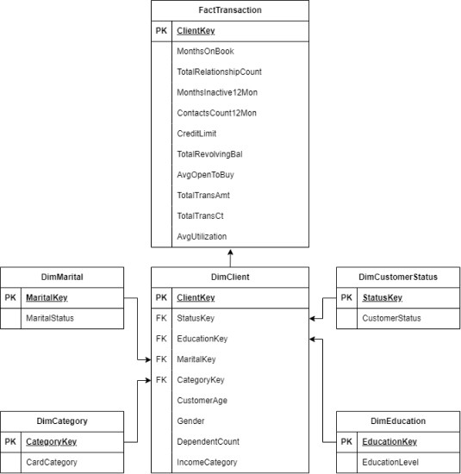
Data Modelling

Slide 10
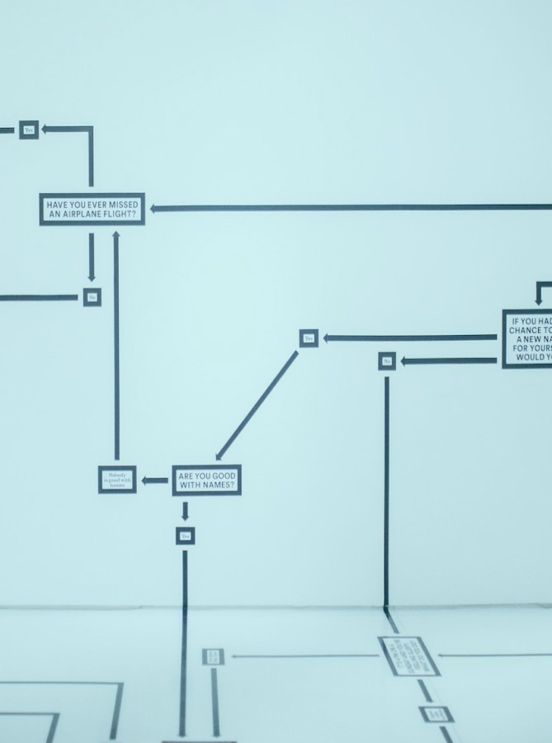
ETL Process
1
Pipeline Schema
2
DB Schema Creation
3
SSIS Package Pipeline

Slide 11
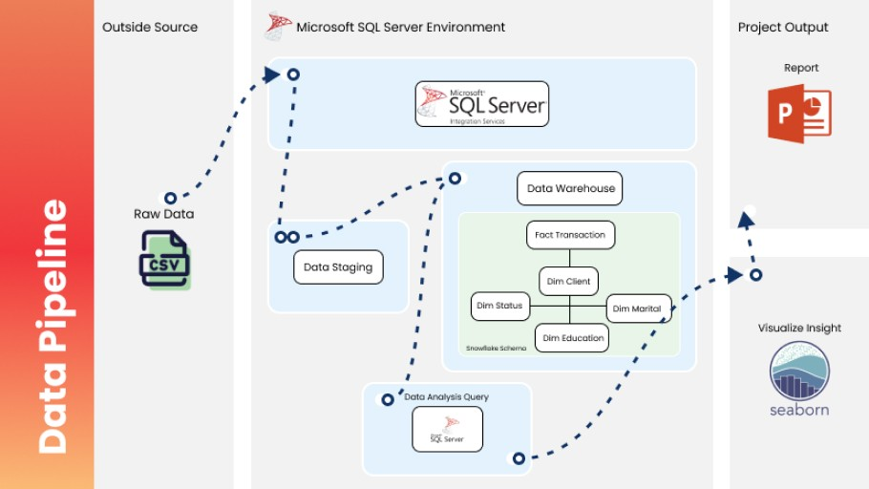
Pipeline Schema
In this pipeline data from outside source, will undergo ETL process using SSIS on Ms. SQL Server environment.

Slide 12
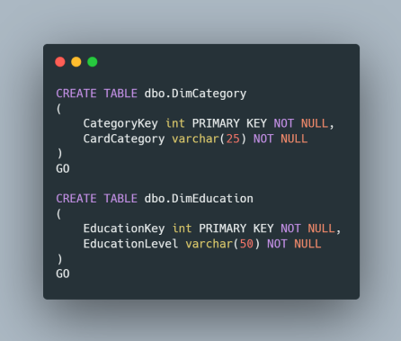
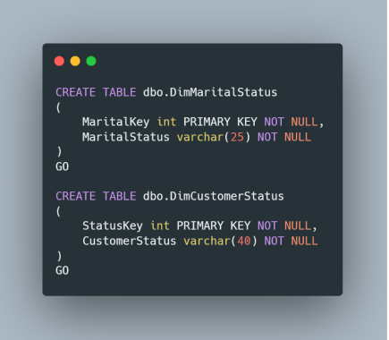
DB Schema Creation - Dim Table
Before going to ETL process, we need to establish the table itself that will store the data from the csv file. Below are queries that are used for the db creation.

Slide 13
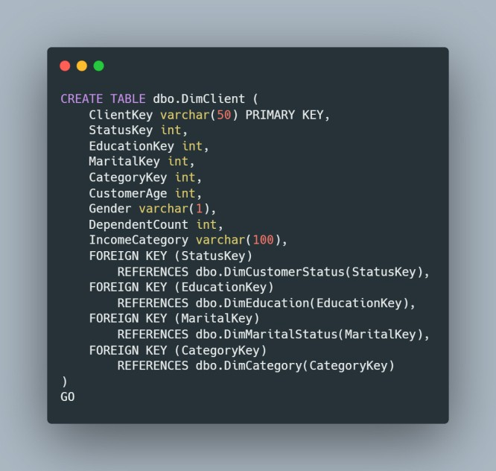
DB Schema Creation - Dim Table

Slide 14
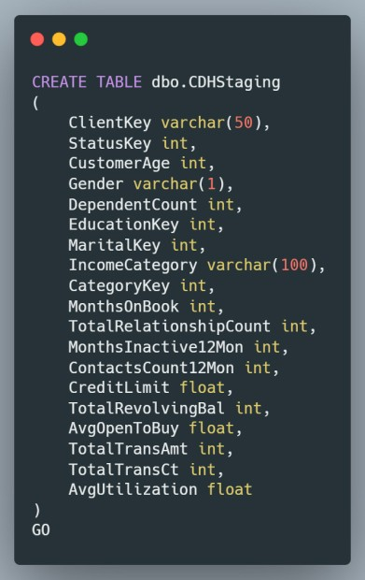
DB Schema Creation - Staging

Slide 15
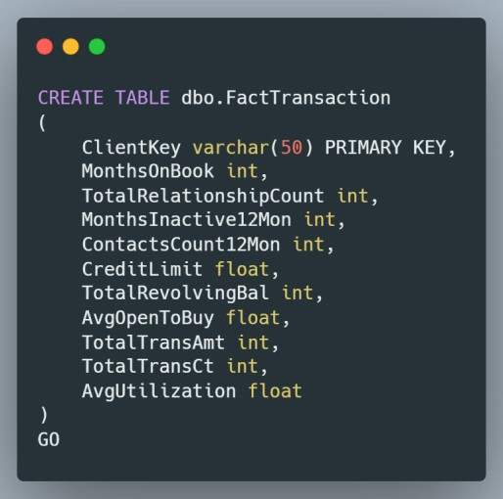
DB Schema Creation - Fact Transaction

Slide 16

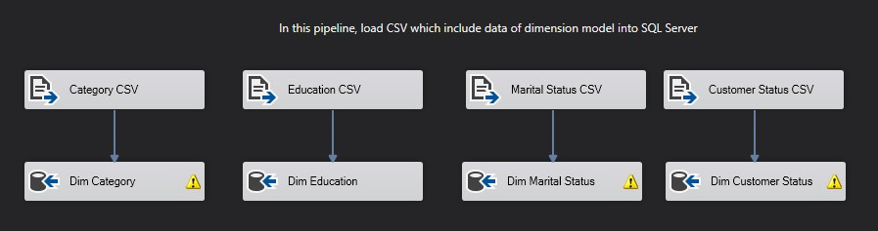
SSIS Package Pipeline - Populate Dim
After creating the database, finally I can populate it with data. The first one will be creating the dimension model because there is already existing csv from the given dataset.
Use data flow task
Data source: F1at File
Data destination: Ole DB

Slide 17

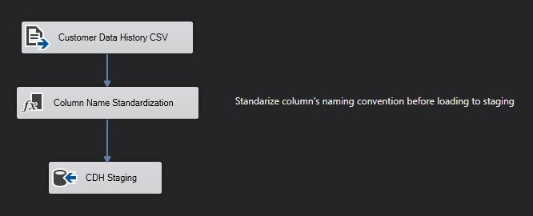
SSIS Package Pipeline - Staging
The data that are used for dim client basically come from the main Customer Data History csv file, thats why the next step is to populate the staging first.
Use data flow task
Data source: F1at File
Data destination: Ole DB

Slide 18

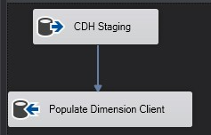
SSIS Package Pipeline - Populate Dim
Now the dim client table can be populated from the data in staging area.
Use data flow task
Data source: F1at File
Data destination: Ole DB

Slide 19
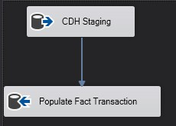
SSIS Package Pipeline - Populate Fact
Last is just populate the fact table
Use data flow task
Data source: F1at File
Data destination: Ole DB

Slide 20

Churn Analysis
1
Customer Status
2
Card Category
3
Age Group
4
Education Level
5
Income Category
6
Marital Status

Slide 21
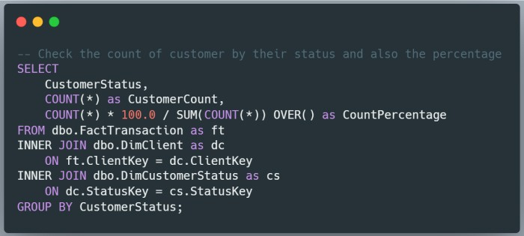
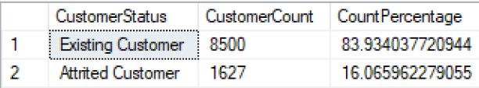
Customer Status
Before attempting other analysis, first we need to know how much exactly our customer that churned or attrited
Query result:

Slide 22
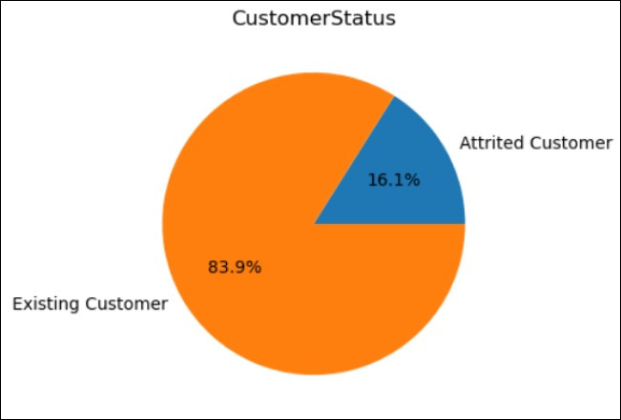
Customer Status

Slide 23
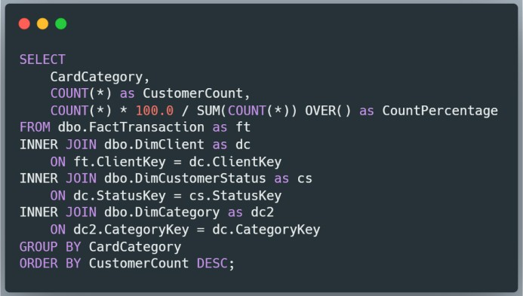
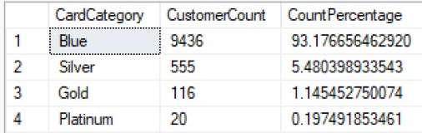
Card Category
Next let’s see our customer card category distribution
Query result:

Slide 24
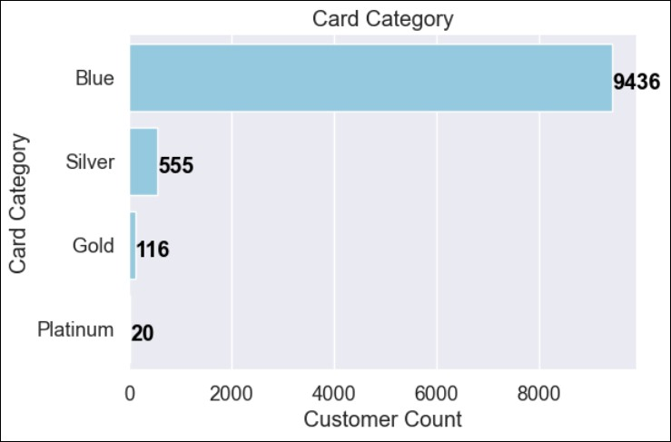
Card Category
We can see that 93% of our customer have the ‘blue’ card category. It is possible that majority of our credit car holder are relatively new to credit cards that’s why they mostly chose the blue as an entry-level credit card. Regarding this, perhaps we could promote more appeal to the next tier of credit card so more people will convert to higher tier, thus will increase our profits.

Slide 25
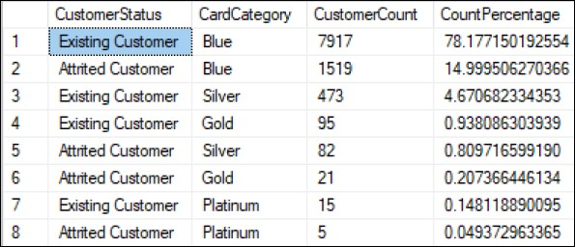
Card Category
Let’s see if there’s correlation between attrited customer and their credit card category. Using query, the result as below.
Platinum are the highest tier on our credit card, and usually are used by loyal member. But surprisingly there’s 5 out of 20, which is 25% from platinum member that have churned. We can later deep dive more to profiling as to why these customer churned. Aside from that, gold card also have the second highest churn percentage around 18%, we can also deep dive on this part to see why the highest and second highest tier have the most churning percentage.

Slide 26
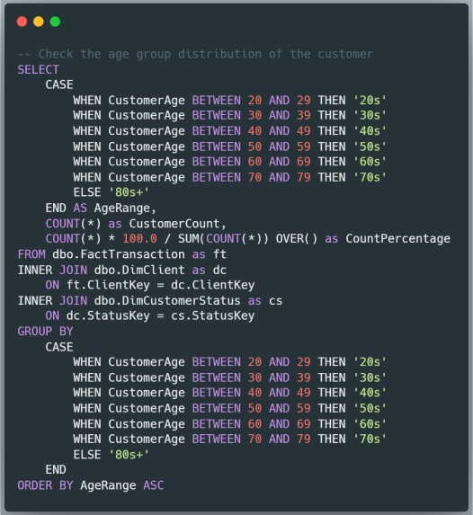
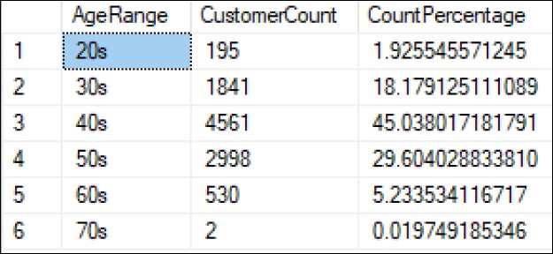
Age Group
Next let’s see our customer age group distribution
Query result:

Slide 27
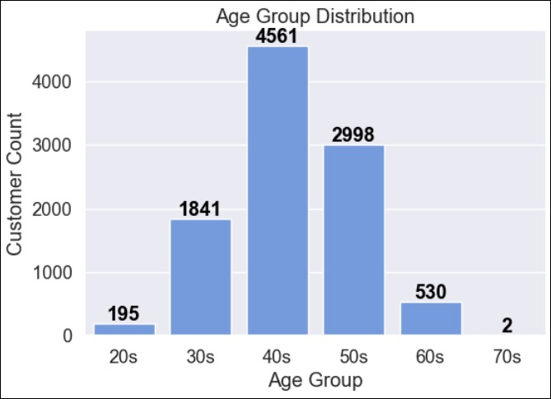
Age Group
We can see that the age group distribution of our customer is quite centric, with most cc holder on their 40s. This could be because people in their 40s are typically established in their careers and have a more stable source of income, making them more likely to qualify for and use credit cards. Additionally, people in their 40s may have different financial needs and preferences than younger or older age groups. They may have more expenses related to family and household needs, such as groceries, school tuition, or home repairs, and may be more interested in credit cards that offer rewards or cashback on these types of purchases.

Slide 28
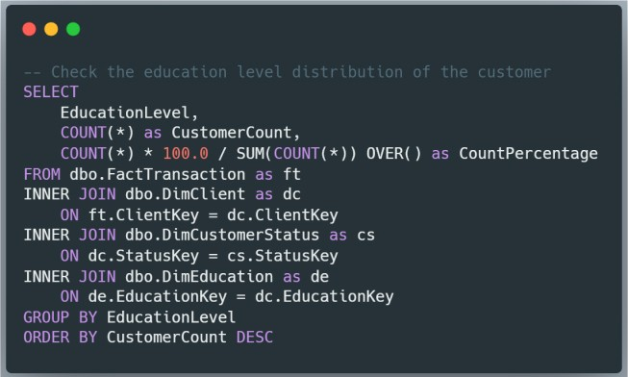
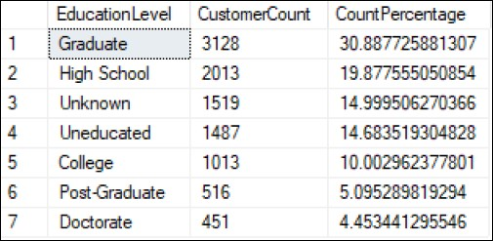
Education Level
Next let’s see our customer education level distribution
Query result:

Slide 29
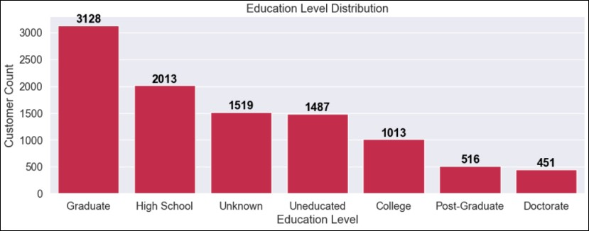
Education Level
We can see that most of our highest cc holder education level is ‘Graduate’ which can be considered high-level education. People with graduate degrees are often in higher-paying jobs, which may allow them to have more discretionary income to spend on credit cards. They may also be more likely to travel or have other lifestyle-related expenses that could be covered by credit card rewards programs. But surprisingly our cc program don’t interest people who have higher education like ‘Post-Graduate’ and ‘Doctorate’, perhaps because they may have higher levels of financial literacy and may be more cautious about taking on credit card debt.

Slide 30
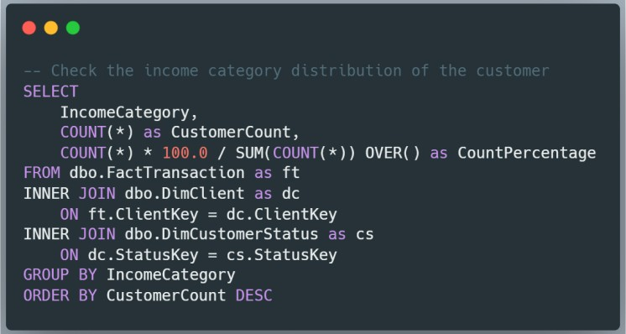
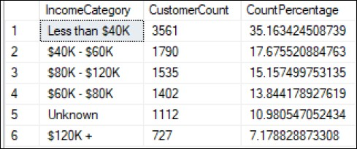
Income Category
Next let’s see our customer income category distribution
Query result:

Slide 31
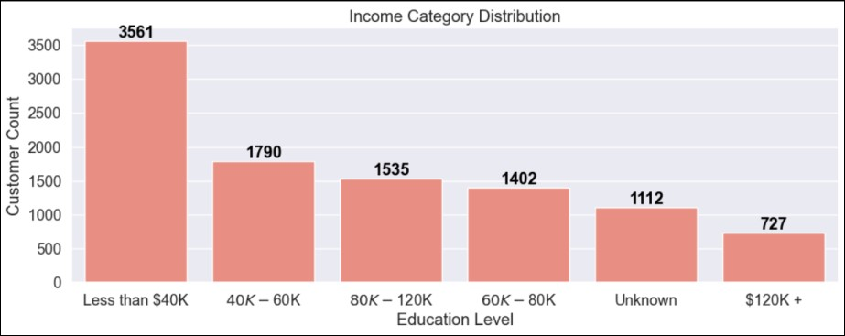
Income Category
We can see that most of our customer have income category of ‘Less than $40k’. This could also probably the reason why most of our customer choose the entry-level ‘blue’ credit card.

Slide 32
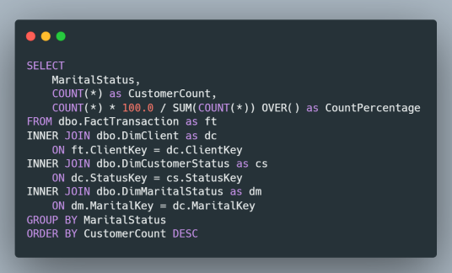
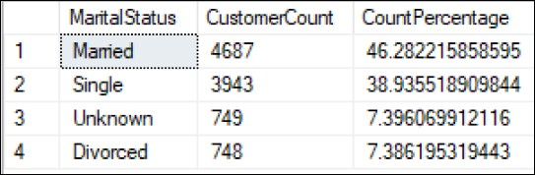
Marital Status
Next let’s see our customer marital status distribution
Query result:

Slide 33
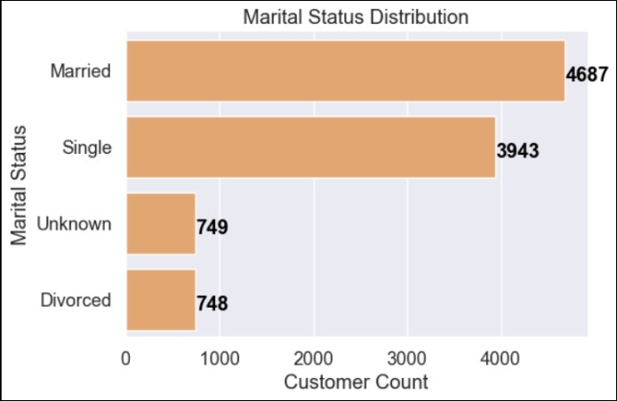
Marital Status
We can see that most of our cc holder is marriedit could indicate that the bank's credit card offerings are more attractive to households or families. This could be because married couples may have more combined expenses related to household and family needs, such as groceries, home repairs, or child-related expenses, which can be conveniently paid for with a credit card.

Slide 34

Summaries & Actionable

Slide 35
Summaries & Actionable
From the result of analysis, we can conclude few point that can improve our credit card service. Based on Customer Status analysis we found out that we have 16.1% attrition rate which can be considered quite high, so overall we need to be careful with handling this service moving onward to prevent more attrition and actually minimize the rate. Based on the Card Category analysis we found out that ‘platinum’ and ‘gold’ category actually are the top 2 most attrition rate. We need to review the overall reason for this behavior and promote more program/benefit to this category since its supposed to be targeted for our loyal customer. On other side note we need to create a program that may pique the interest of beginner/starter on credit card so they convert to higher tier category and bring us more profit. Based on the Age Group analysis we found out that most of our customer is on their 40s followed by 50s. There is also another group that is potential which is the 30s. People on their 30s should have more or less almost the same financial need and some on this age group usually also have good career already so we can tailor an advertisement/program that pique the interest of this age group.

Slide 36
Summaries & Actionable
From the result of analysis, we can conclude few point that can improve our credit card service. Based on Education Level analysis we found out most of our CC holder are ‘Graduate’ level, which can be considered high-level education. Perhaps we can focus more on the academic benefit related program on this education group for example if they want to continue their studies. Based on Income Category analysis we found out that most of our customer have yearly income less than $40k. This could also be the reason why ‘blue’ category card is popular for these income category customer. As I explained above perhaps we could make upgrading/converting to higher tier card more accessible such as smaller interest, etc, so it won’t burden them even with their income category on the lower-end. Based on Marital Status analysis we found out most of our customer is already married. This also inline with the most user age group of 40s which they usually on the age when they are already married. We can make program that are tailored with married such as bonus on honeymoon or even couple like discount on restaurant, etc in order to accommodate this group.

Slide 37

BTPN Syariah Data Engineer Virtual Intership Program
Thanks for reading!
Naufal Aldy Pradana
https://github.com/blitzkz23/cc-churn-analysis

