Slide 1
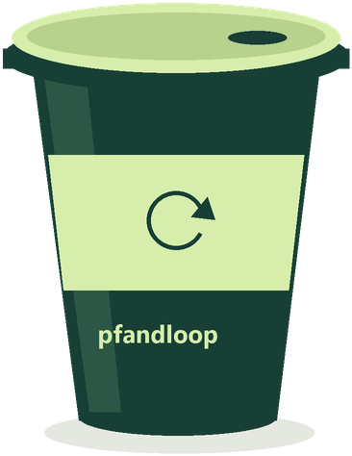
↻ pfandloop.
BUILD AN MVP WITH SOLANA AT WHU
REUSABLE CONTAINERS · SHARED RECORDS · SIMPLE RETURNS
One cup.
A more useful loop.
Borrow at one stand.
Return at another.
Keep the deposit attached to you.
A reusable-container MVP
for campus events, cafés and festivals.
WHU HACKATHON 2026
01 / 07
Notes:
Opening — 20 seconds. Imagine buying a coffee at one stand and returning the cup at another. The cup moves, but the deposit should still find its way back to the right person. PfandLoop links the customer, container and return in one simple flow. We built the working product journey and a Solana integration for independently inspectable records. The following demo uses fictional users and simulated balances.

Slide 2
↻ pfandloop.
BUILD AN MVP WITH SOLANA AT WHU
01 / A CLEAR PROBLEM · WHO NEEDS THIS?
The cup changes hands.
Who gets the deposit back?
At events with several stands, a return needs a shared answer.
01
02
03
THE CUSTOMER
THE STAFF
THE ORGANIZER
“Can I return it here?”
“Which deposit do I release?”
“Does the loop close?”
Needs a clear return point and a visible deposit balance.
Needs the container, original payer and return status.
Needs a traceable history across participating stands.
WHU HACKATHON 2026
02 / 07
Notes:
Problem — 30 seconds. Our initial target is a campus event with two participating stands. Staff need to know which registered container has come back, whether its deposit is still open, and who should receive the refund. Customers need clear acceptance rules and a balance they can understand. We are targeting that coordination problem; we have not measured its prevalence or claimed every existing system has it. Validate the pain and current reconciliation effort with organizer and staff interviews before a pilot.

Slide 3
↻ pfandloop.
BUILD AN MVP WITH SOLANA AT WHU
02 / THE SOLUTION · ONE FAMILIAR JOURNEY
Borrow here. Return there.
Close the loop.
→
→
1
2
3
BORROW
RETURN
REFUND
Stand A issues a cup
Stand B receives it
Back to the original payer
Member ID + container serial
Deposit assigned to the loan
Staff identify the container
and confirm physical receipt
Deposit released
History updated
WHU HACKATHON 2026
03 / 07
Notes:
Solution — 30 seconds. The merchant issues a uniquely identified container against a member. The customer sees the held deposit. Another participating station can accept that registered container. Staff must confirm physical receipt before the refund proceeds. The refund belongs to the stored original payer, not whoever types a new wallet address at the counter. In the default product demo these are simulated balances; the optional token adapter is custodial Devnet test USDC.

Slide 4
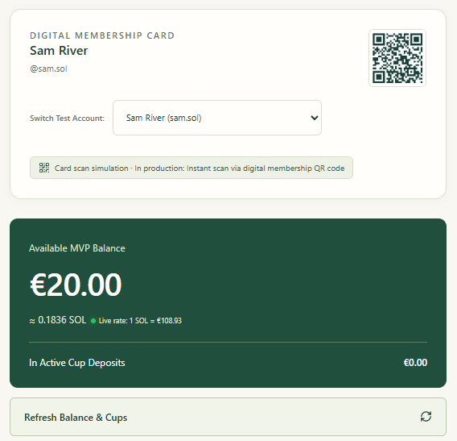
↻ pfandloop.
BUILD AN MVP WITH SOLANA AT WHU
03 / THE WORKING PROTOTYPE · BUILT FOR CUSTOMERS AND STAFF
Two screens.
One complete return flow.
CUSTOMER DASHBOARD
Balance, active containers,
transaction history and CSV export.
MERCHANT STATION
Issue by member ID; receive containers
and confirm the physical return.
WORKING PRODUCT DEMO
Actual MVP screen · fictional account · simulated balance
WHU HACKATHON 2026
04 / 07
Notes:
Prototype — 25 seconds. The customer screen shows the digital member card, balance and held deposits, plus active loans and exportable history. The merchant screen issues containers and accepts returns. We use familiar deposit amounts and explicit actions. A customer does not need to understand transaction hashes to follow the demo. The current membership QR is not proof of a legal identity; wallet onboarding and a production scanning experience remain work for a real pilot. The image is an actual repository-adjacent product recording, not a concept mockup.

Slide 5
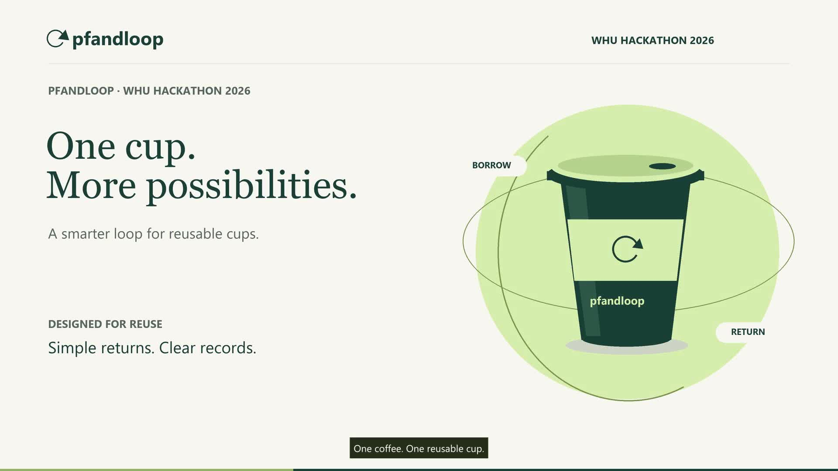
↻ pfandloop.
BUILD AN MVP WITH SOLANA AT WHU
04 / PRODUCT FILM · WATCH THE LOOP CLOSE
From issuance to return.
Product demo; Explorer footage does not establish a matching cup-specific on-chain proof.
CLICK TO PLAY
WHU HACKATHON 2026
05 / 07
Notes:
Video — play the original embedded film. PowerPoint: use Slide Show mode, then click the video. The film is a product demonstration, not independently verified settlement evidence. The current capture code can substitute a fixed unrelated mainnet transaction and mark verification true without matching the memo. Do not narrate its Explorer success screen as proof that this particular loan or refund was written on chain. If time is short, show the issuance and return portions, then move to the proof explanation. Google Slides users must reinsert the MP4 from Drive after import.

Slide 6
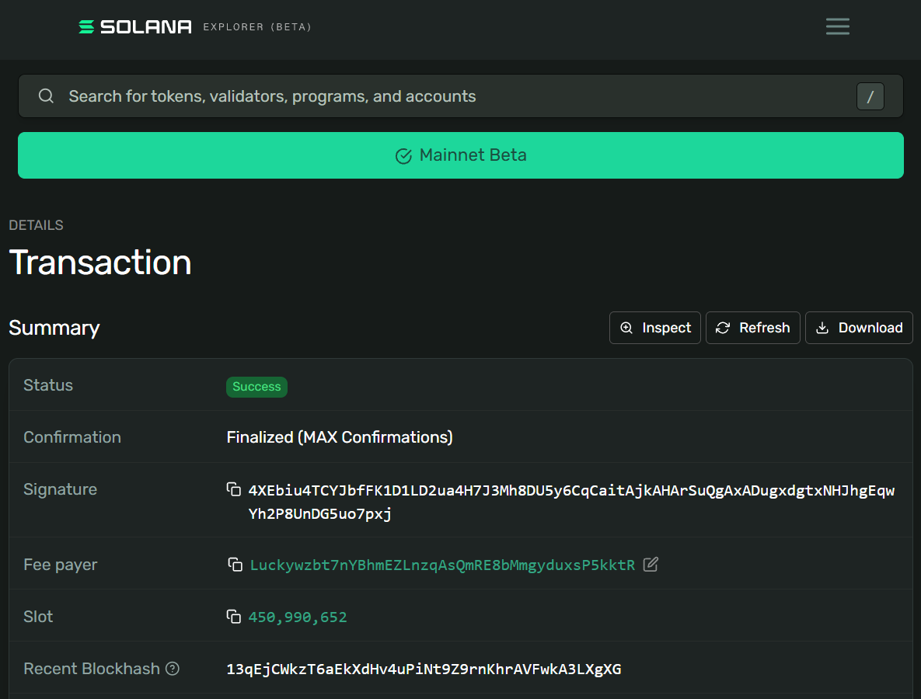
↻ pfandloop.
BUILD AN MVP WITH SOLANA AT WHU
05 / WHY SOLANA · AN INDEPENDENTLY INSPECTABLE RECEIPT
Link the event. Sign the record.
Let anyone check it.
“Proof of identity” = a signed event linked to an app user and container.
01 / LINK
02 / SIGN
03 / VERIFY
User ID + cup serial
Action + loan ID
Operator signs an SPL Memo
Solana records the transaction
Correct cluster + success
Matching memo + expected signer
WHAT IT PROVES
PAYMENTS & CURRENT EVIDENCE
The signing key approved this event record.
Staff still verify the cup; this is not KYC.
Devnet test-USDC adapter implemented.
Matching live proof remains to be demonstrated.
WHU HACKATHON 2026
06 / 07
Notes:
Solana — 45 seconds. Solana adds an independently inspectable transaction record beyond the application database. The memo integration assembles PfandLoop:proof_of_identity:<payer>:<cup>:<borrow or refund>:<loan>. Its operator key signs; a member ID in the text does not prove the member signed. To establish a valid event, open the signature on the SAME cluster used by the RPC, check the transaction succeeded, inspect the Memo instruction and compare every event field and expected signer. A generic successful transaction is insufficient. This is event provenance, not legal identity, ownership of a physical cup, or proof of handover. Separately, the implemented payment adapter transfers test USDC on Devnet, compares the exact deposit message at finalized commitment, and refunds to the original payer. It uses a central treasury, not deployed escrow. Live transfer and matching cup-specific memo evidence are still pending. Current fallback and cluster-link mismatch must be resolved before a verified demonstration. Sources: server/solana-memo.ts; server/solana.ts; https://www.solana-program.com/docs/memo ; https://solana.com/docs/core/transactions .

Slide 7
↻ pfandloop.
BUILD AN MVP WITH SOLANA AT WHU
06 / FIRST USERS · START SMALL, EARN THE NEXT LOCATION
One campus. Two stands.
A loop we can measure.
01
02
03
RECRUIT
LEARN
EXPAND
Ask a campus organizer
for two participating stands.
Run supervised returns.
Measure completion, staff time
and failed refunds.
If the workflow helps,
invite nearby cafés and
additional event stands.
Help us find the first campus pilot.
Explore the public GitHub repository ↗
WHU HACKATHON 2026
07 / 07
Notes:
Close — 30 seconds. Our next users are not an imagined nationwide network: they are two stands at one campus event. Reach them through the university entrepreneurship community and the event organizer. First observe their workflow, then run supervised tests without real-money deposits. Measure completed returns, staff time, refund failures and onboarding drop-off. Expand only if the workflow is useful. Event organizers and reuse networks are potential buyers for a later service fee; willingness to pay is not yet validated. There are no claimed partnerships or pilot agreements. The ask is an introduction to one organizer and two stands. Keep the cup in the loop.

