Slide 1
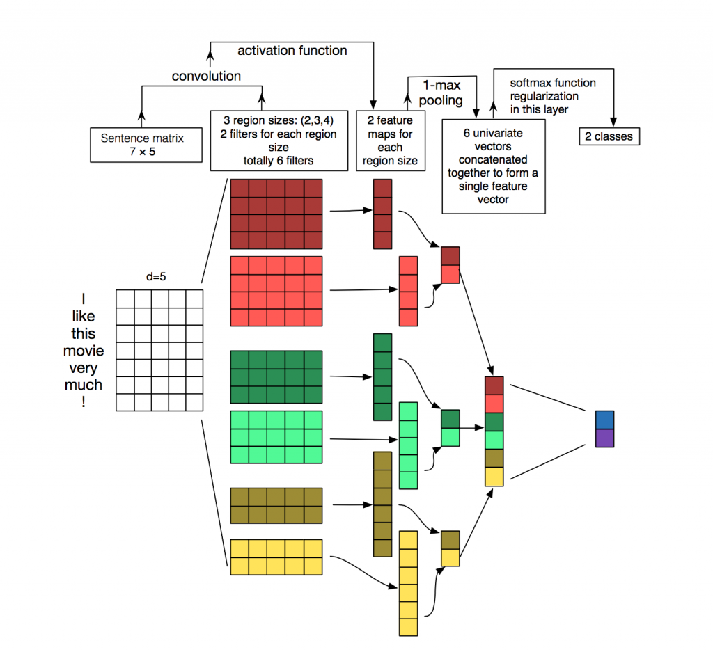
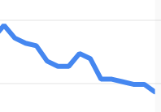

Tencent Holdings Ltd. posted its biggest weekly loss since August 2015 amid concern a recent rally was excessive.
Sentiment: -0.73
4.12%

