Slide 1

Signifly
Presentation by Simon Blixenkrone

Slide 2
Important parts
https://test-9b3bb.firebaseapp.com/signifly.html
Responsive website – works on all devices
Simplistic solution
Simplistic overview of team
Accessible (when logged in): https://test-9b3bb.firebaseapp.com/teams.html
Business values presented in carousel slide
Easily deployet by Firebase

Slide 3
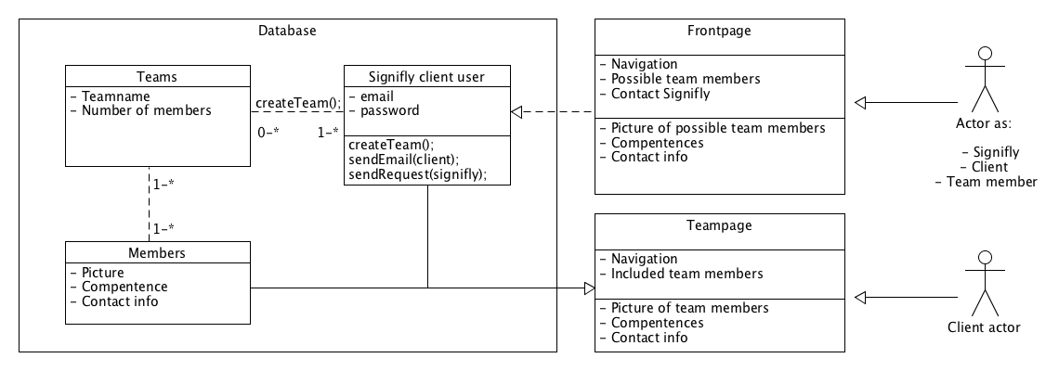
ER-Diagram

Slide 4
DIscussion
Assumptions
Navigation-bar (home, about, contact)
Log-in → Must be a registered user/”potential client” to create teams
CRUD functionality in teams for registered users/clients
Multiple teams would be added → Navbar ”team name X”
Responsive
Future aspects
Log-in backend
User data storage
Participatory design / participation by client
Whats do you think is next?

Slide 5
(OFF THE RECORD) Presentation
Minus adgang: Skifttyper findes i ID-mappen? (Fonts?).
Bedre prioritering af tid → For meget front-end
Flere // kommentarer i teams.
Hvilket serversprog? PHP? JSON → Firebase
Ikoner fra andre sites tilladte (Fontawesome)?
Stock photos = eksempel kandidat til team

