Slide 1
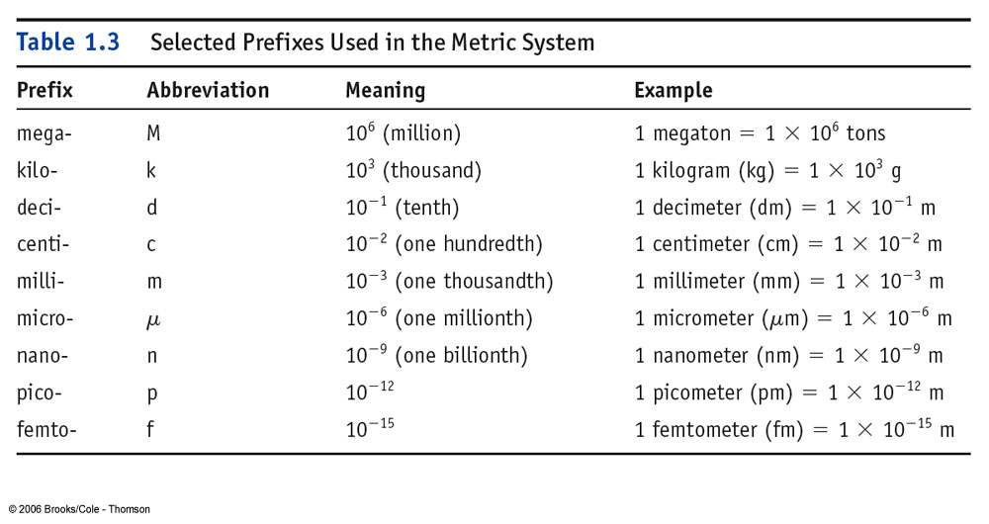
It’s a good idea to memorize these prefixes and their relationship to one another.

