Slide 1
Electronics II
EEET - 222
Lab #5
Microphone Pre-Amp
RCC-18

Slide 2
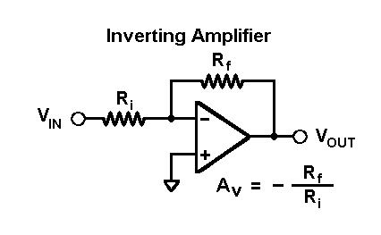
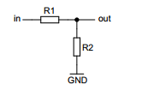
Prelab
  All weeks: 1) Read the lab. 2) Bring your smart phone or tablet. 3) Find a frequency generator app. 4) Bring your Arduino board used in Electronics I.
  Week 1
    What modern component used to be called a “condenser”?
    How long can an electret material stay charged?
    Design an inverting op-amp circuit with a gain of -220. Use any 10% standard values between 1K – 820Kohms.
    Using the resistors you picked, determine the current in Rf and Ri when
    Vin = 1V.
  Week 2
    Design a voltage divider with Vin = 5V and Vout is 2.5V. Use any 10% standard value resistors between 10K and 100Kohms. Feel free to use on-line resources like:
    http://mustcalculate.com/electronics/automaticresistivevoltagedivider.php
RCC-18

Slide 3
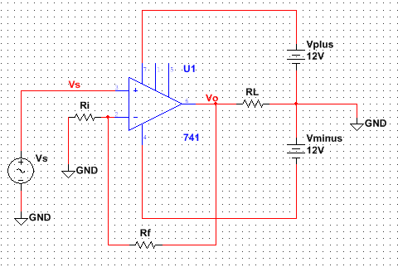
Prelab
  Week 2 - continued
    Look up the non-inverting amplifier gain.
    Given: Vs = 3V, Ri = 3.3Kohms and Rf = 5.6Kohms.
      Find Vo.
      Find the current in Rf, RL and Ri. To allow you to check your work, current in Rf is 0.91mA.
RCC-18

Slide 4
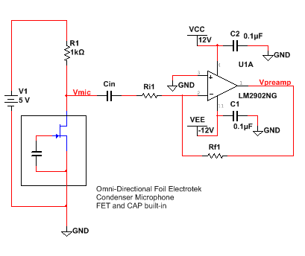
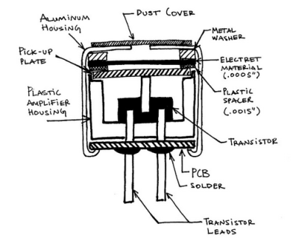
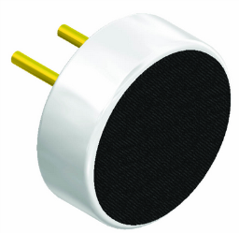
Procedure – microphone bias and pre-amp
  Build the microphone bias circuit and first amplifier stage. The microphone contains the capacitor and FET. Use the values of Ri1 and Rf1 calculated in pre-lab to generate a gain of -220. Block the DC bias voltage on Vmic using a 10uF capacitor for Cin. NEATNESS REQUIRED – SEE SAMPLE BUILD ON NEXT SLIDE.
  Note: A condenser microphone has a electret layer that sound waves vibrate. The permanently charged elecret material is placed next to a stationary metal plate forming a capacitor. Sound waves change the capacitance by bending the electret material and changing the distance between the plates. Since Q = VC (basic law for capacitors where charge=Q, capacitance=C and voltage=V) and the charge is fixed, a changing capacitance will create a changing voltage. The FET is biased by an external voltage and resistance (V1 and R1) and amplifies
  the small voltage.
+
_
+
_
Image from www.openmusiclabs.com
RCC-18

Slide 5
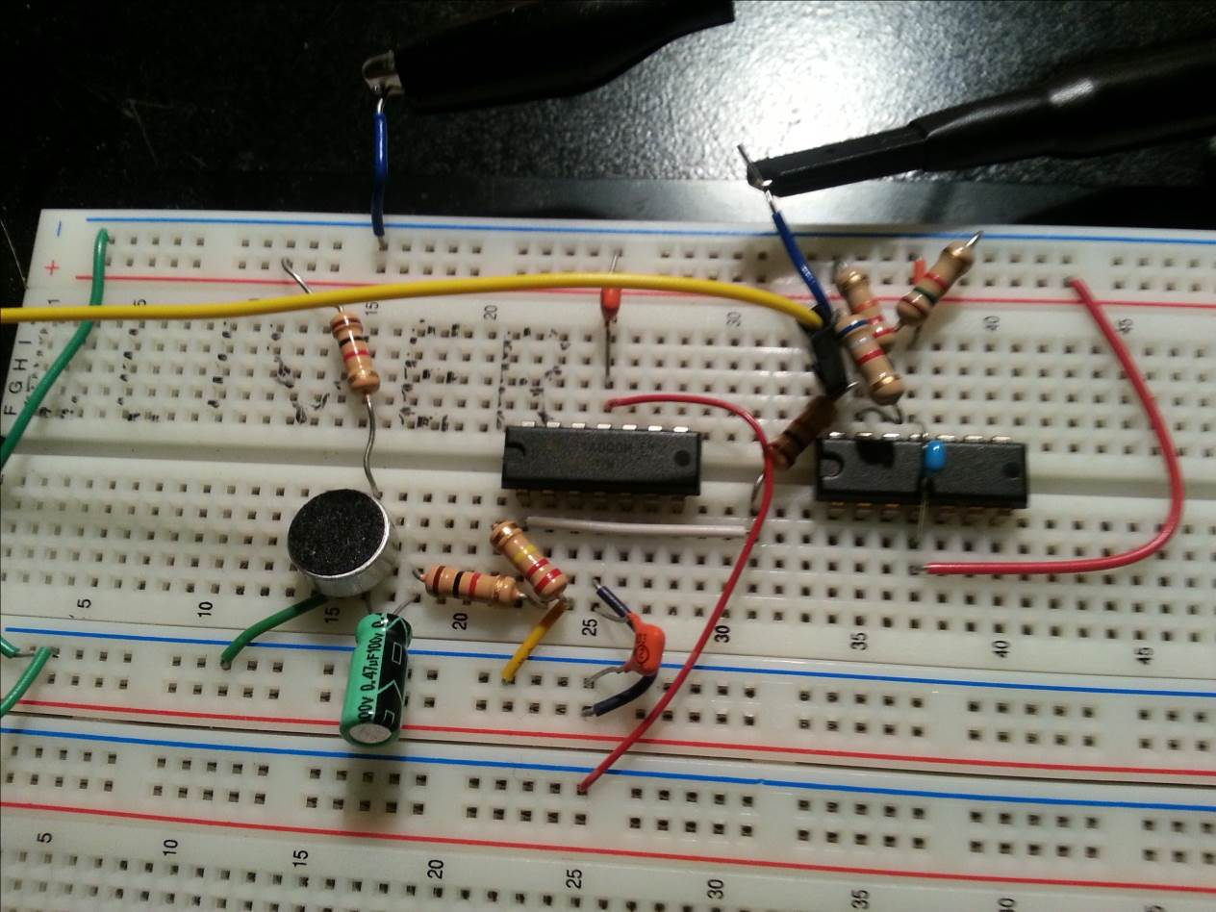
Procedure – sample build
  Neatness required for sign-off. Some of the wiring and chips in the diagram will be added later – just refer to the picture as an example of neatness.
  Note: The bi-pass capacitors (C1 – C3) reduce noise caused by fluctuations in current drawn from the power supply. To be effective they must be kept close to the IC.
  Design Rule: Each power pin has a 0.1uF or 0.01uF capacitor.
RCC-18

Slide 6
Procedure – pre-amp measurements
  Find a frequency generating app for your phone. “Signal Generator” produces a nice sine wave, has selectable frequency and is available from the Android Play Store for free.
  If you have a smart phone or tablet find a favorite song to set things up. If you have head phones you will want to use them.
  Note: Most people are familiar with terms like: bass, midrange, treble. Many people are familiar with A and middle C on a piano or a Concert B flat. It is important to know the frequency or frequency range associated each of these terms. The exact ranges can be debated but rough estimates for bass are 20Hz to 250Hz, midrange 250Hz to 2KHz and treble 2KHz to 16KHz. Middle C is at 261.626Hz, A is 440Hz and Concert B flat used by wind ensembles to tune is 466.164Hz. When building audio circuits we generally need to be concerned with frequencies from 20Hz to 20KHz.
  Verify DC voltages using the DMM (multimeter):
    Vmic is around 4.8V. Most common errors include not turning on the power supply and putting the microphone in backwards making Vmic 0V or 5V.
    +12V on pin 4 and -12V on pin 11 of U1A. Most common errors include putting the bypass capacitor in series with the power. Remember: pin 1 is to the left of the notch or small dot.
    Verify pins 2 and 3 of U1A are 0V. The inputs of an op-amp amplifier must always be equal. Mis-wiring, broken wires or a bad op-amp will cause the inputs to be different.
RCC-18

Slide 7
Procedure – stage 1 verification
  Note: Signals on the microphone are extremely small and noisy. To verify correct operation you must correlate changes in volume with changes in amplitude on the scope. In the best situation you will be able to verify the frequency of your signal with the frequency on the scope.
  Turn on the scope and place CH1 on Vmic. With the scope AC coupled, test the microphone by gently tapping on the top of the microphone. The scope signal should jump up and down as you tap on the microphone.
  Note: Tapping will change the frequency characteristics of the microphone slightly. Therefore, tapping on a professional grade microphone would be discouraged. The microphone used in this lab will not be damaged by tapping on it.
  Move CH1 and verify that tapping creates a similar response on the other side of Cin. If Cin is polarized the positive side must be on the microphone side.
  Move CH1 to pin 1 of the op-amp. Using a single frequency sound source and head phones to excite the microphone. Measure frequency with the scope. Verify that the amplitude changes as the sound intensity changes.
  For fun add an LED with 150 ohm series resistor to the output of the op-amp. When the voltage is high enough, the LED will turn on.
  Demonstrate your knowledge for a sign-off. All sign-offs are at the end of the lab.
RCC-18

Slide 8
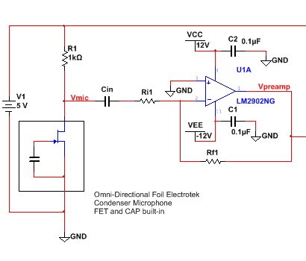
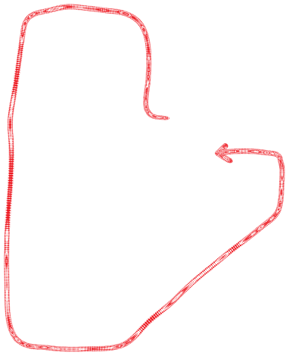
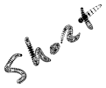


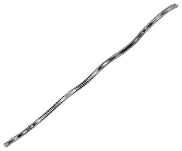





Procedure – stage 1
  Note: Cin blocks the DC voltage but let the AC (sound signal) pass through. The resistor and capacitor forms a high pass filter (high frequency signals can pass). The break frequency where the circuit switches from blocking DC to passing AC is fb. Fb = 1/(2πτ) where τ is tau, the time constant. τ = Rth * C. Finding Rth is a very important skill. The output resistance of the CS amp is R1. The input resistance of the op-amp amplifier is Ri1 because pin 2 at a “virtual ground”.
  To help visualize Rth, the resistance Cin sees, as Rth = R1 + Ri1 look at the figure on the left.
  Replace Cin with the capacitor decade box and set it to 10uF and generate a Concert B flat with your sound source. Now, while holding your phone very still, measure the signal at Vpre-amp with the scope. You can use the component clamps on your bench to hold your sound source.
  While still holding the phone still, adjust Cin until Vpre-amp decreases to 70.7%.
RCC-18

Slide 9
Procedure – stage 1
  In the previous step the capacitor was adjusted until 70.7% of the output signal was lost which is also 3dB. What this did was adjusted the capacitor until the break frequency was equal to the input signal frequency.
  Calculate the break frequency using Cin and verify that it is close to Concert B, your sound input.
  Demonstrate the loss of 70.7% of the input signal to your instructor for a sign-off.
  Design Rule: Fb = 1/(2*π*τ). Set the break frequency of a low pass filter 5x to 10x lower than your lowest signal frequency.
RCC-18

Slide 10
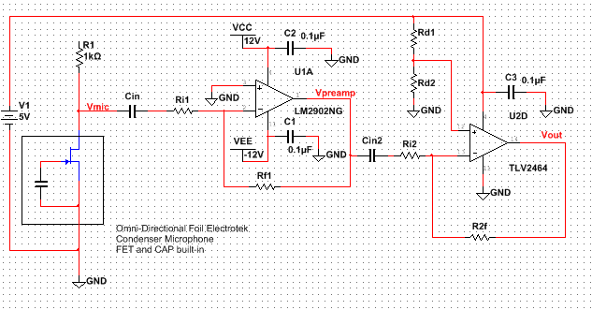
Procedure – stage 2 level shift
  Note: Now that the signal is amplified it can be conditioned and read by a microprocessor for any number of different applications including transmission, analysis and many others. To prepare the signal for the Arduino it needs to be shifted so the minimum is zero, average is 2.5V and maximum is 5V. The next op-amp does the shift.
  Use your prelab values of Rd1 and Rd2.
  To minimize offsets select R2f = Rd1 || Rd2.
RCC-18

Slide 11
Procedure – stage 2 level shift
  Select Ri2 to provide an inverting gain between 4 and 8.
  Select Cin2 so the break frequency is below 20Hz. Rth = Ri2 in this case.
  Add stage 2 to your circuit. The circuit sample at the beginning of lab shows both stages. Note that the second op-amp is a different IC made to generate a 0 to 5V signal.
  Verify DC voltages:
    +5V on pin 4 and 0V on pin 11 of U2A.
    Verify pins 12 and 13 of U2A are 2.5V.
  Verify Vout is an amplified, shifted version of Vpreamp when sound
  is applied to the microphone peaking at 5V.
  Verify Vout is close to 2.5V when no signal is applied to the microphone.
  Get sign-off.
  Apply sound to the MIC and verify the output. Vout should be an amplified Vpreamp signal shifted up 2.5V.
RCC-18

Slide 12
Procedure – stage 2 verification
  For Extra Credit: Sample a sine wave using the Arduino board and plot the data in Excel.
    Load the code into an Arduino sketch.
    Compile and download the code.
    Apply a sine wave sound to the speaker.
    Open the Serial Monitor in the Tool menu and copy the sampled data into Excel.
    Add a column numbered 1 to 100.
    Plot the index value and Arduino values.
    Verify the graph is a sine wave.
    Get a sign off for extra credit.
void setup()
{ Serial.begin( 9600);
}
void loop() {
for (int x=1;x<100;x=x+1) {
float mic_in = analogRead(0);
Serial.println(mic_in);
}
delay(200);
exit(1);
}
RCC-18

Slide 13
Report
A common task engineers face is providing instructions to others. Often these instructions are provided in Q&A form. Come up with four questions and answers relating to this lab. If possible, use questions you had and the answers you came up with. They can relate to equipment use, design calculations or any other part of the lab.
Include the sign-off sheet.
RCC-18

Slide 14
Microphone Pre-Amp
Lab 5 Sign-offs
Name _____________________________________ Pre-Amp Stage 1 frequency measured
Pre-Amp Stage 1 Cin adjusted
Level Shifted Output
 |  | / /
Signature |  | Date
 |  | / /
Signature |  | Date
 |  | / /
Signature |  | Date
Excel plot – +2/10 Extra Credit
 |  | / /
Signature |  | Date
RCC-18

