Slide 1
Electronics II
EEET - 222
Lab #7
PWM output of a micro
RCC-19

Slide 2
Prelab
  Read the lab.
  A microprocessor creates a 0V to 5V PWM output with a 25% duty-cycle. Determine the average value.

Slide 3
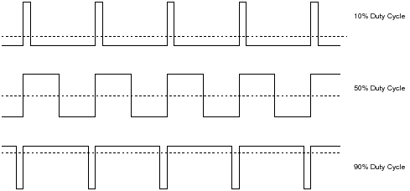
Theory
  We will program a microprocessor without analog outputs to give us different DC voltages. To do this most use PWM outputs. PWM is widely used today in many microprocessor applications including audio, motion control, telecommunications and many more. Modern cars control headlight brightness by using PWM drivers.
  Pulse Width Modulation (PWM): A PWM signal is simply a square wave with a variable pulse width or on-time. Micros produce PWM signals simply by outputting high (5V) or low (0V). The rate of repetition (frequency) is fixed and relatively high. The ratio of high to on time is changed creating different average voltage values. Three different digital pulses are shown below. The duty cycle is equal to the on time divided by the period and as can be seen below closely related to the average value.
  Example of PWM signals and DC averages

Slide 4
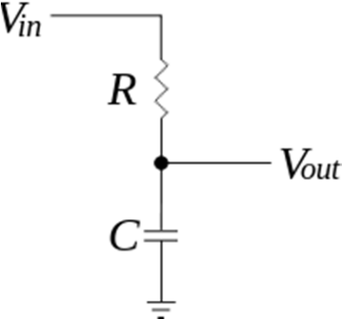
Theory
  A simple resistor and capacitor can “average” a PWM signal extracting the DC value. Some devices like lights in a car’s headlights or speakers can be driven with the PWM signal directly. The headlights or speakers are unable to react to the fast on/off of the PWM signal and instead follow the average value. In all cases, the frequency is set high enough so the capacitor, headlight or speaker cannot react to the fast pulses. In the case of the RC circuit, the capacitor charges to the average value.

Slide 5
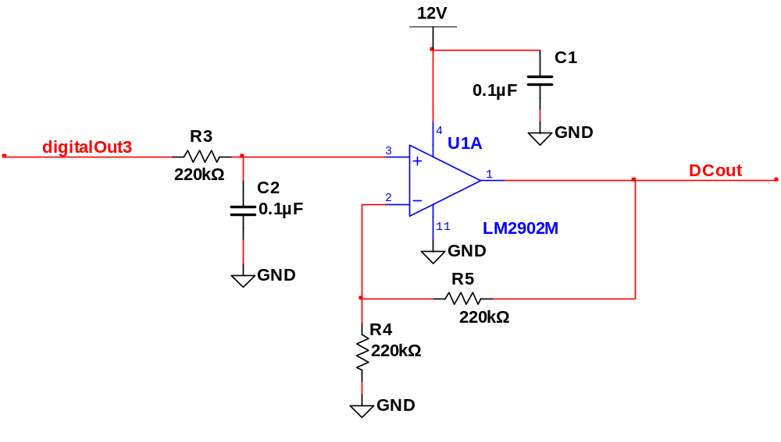
Procedure
  Build the RC amplifier circuit below. The RC values have been chosen to average the PWM signal.
  Calculate the duty cycle necessary at digitalOut3 to produce a 7V DC output from the op-amp (DC out). Do not forgot to figure in the gain of the amplifier.

Slide 6
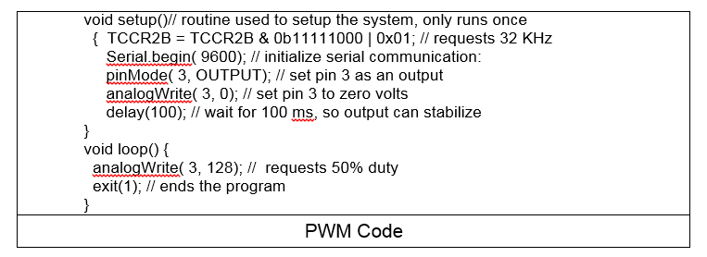
Procedure
  Program your Arduino to produce the desired duty cycle (to get 7V) at 32KHz. You can modify and use the code below. Connect the Arduino output directly to the scope an verify the square wave and duty cycle. Get a sign-off.

Slide 7
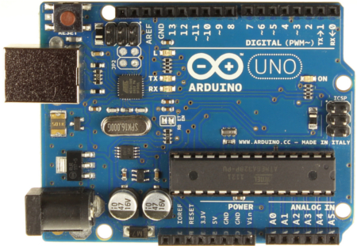
Procedure
  Put the Arduino and RC amplifier together to produce a 7V DC output voltage. Get a sign-off.

Slide 8
Report
Write a summary.
Include the sign-off sheet.

Slide 9
PWM output of a micro
Lab 7 Sign-offs
Name _____________________________________ 32KHz PWM at desired frequency
7V DC output voltage
 |  | / /
Signature |  | Date
 |  | / /
Signature |  | Date

