Slide 1
Electronics II
EEET-222
Lab #6
A Four-Bit Analog-to-Digital Converter
Simulation
RCC-19, JPG-13

Slide 2
Objectives
Simulate an Analog to Digital Converter, ADC.
Simulate a Digital to Analog Converter, DAC.

Slide 3
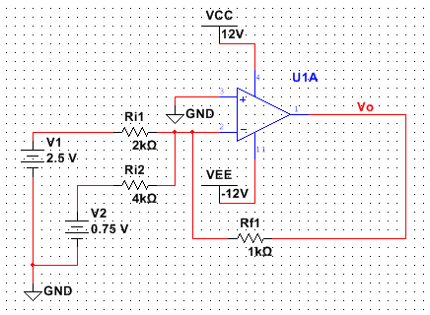
Pre-lab
Read the lab
Week 1 only!
  Find a datasheet for the 74161N counter and study its operation. Predict the Q outputs (Qd – Qa) under each of the following input conditions. Assume the initial state of Qd = 1, Qc = 1, Qb = 0 and Qa = 0. Each set of conditions is completely independent from all other conditions and no order is assumed.
    clear = 0, load = 1, D = 1, C = 0, B = 1, A = 1, enable P = 0, enable T = 0 and clock has a rising edge.
    clear = 1, load = 0, D = 1, C = 0, B = 1, A = 1, enable P = 1, enable T = 1 and clock has a rising edge.
    clear = 1, load = 1, D = 1, C = 0, B = 1, A = 1, enable P = 1, enable T = 1 and clock has a rising edge.
  Determine v_{o}, v₋ (voltage at pin 2), current in R_{i1}, R_{i2} and R_{f1} for the circuit below.
Figure P1

Slide 4
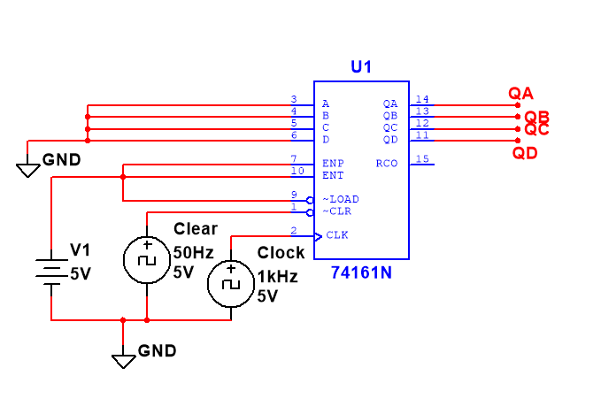
Pre-lab
I recommend simulating the counter circuit.
  The 74161N can be found in the TTL library. The clock and clear are CLOCK_VOLTAGE and can be found in the Sources group; SIGNAL_VOLTAGE_SOURCES Family.
Figure P2

Slide 5
Circuit Description – Theory of Operation
Figure 1 shows the overall block diagram of the ADC (analog to digital converter). It contains a DAC (digital to analog converter) where each digital count output is amplified with different gain and then added. This type of converter is called a “Counter A/D Converter” and is described in section 10-4 of your text. It is similar to the “Successive Approximation A/D Converter”, the most common ADC, also described in 10-4.
The block diagram shows an 1) Binary Up Counter, 2) DAC and 3) Comparator. Each of these elements is described below.
  Binary Up Counter (74161N Synchronous 4-bit Counter). The Binary Up Counter has four outputs that represent a binary number from 0000 to 1111. Each of these counts will be converted into an analog voltage. See table #1 for a conversion from binary to decimal. The counter can work in three different modes.
    The first mode is “Clear”. When the CLR~ (clear) signal is low (0V) the outputs will all change to zeros (0000). None of the other inputs matter when clear is low. Only when CLR~ is high (5V) are the other modes are allowed. This mode is used to reset between conversion.
    The second mode is “Count”. If load is high, a rising edge occurs on the CLK input and the count enables ENP and ENT are high (5V) the output will count up. For example, if the count is 0111 (7) before the transition (edge) it will be 1000 (8) after the edge. A through D do not matter when counting.
    The last mode is “Disable”. If load is high and either count enable signals are low (0V) the counting is stopped and the outputs will not change. The ADC will use disable mode when the analog to digital conversion is completed.

Slide 6
Circuit Description – Theory of Operation
  DAC (Digital To Analog Converter). The DAC portion of this design is basically a summing amplifier as shown in Circuit #1. The analog inputs to this op-amp circuit are the outputs of the 74161N counter. The counter goes from 0 to 15 (2^4 - 1) so the DAC will divide the voltages in 16 increments over 12V (12V/16 = 0.75V/step).
  The outputs of the counter are either 1 or 0. When the outputs are 1 they will be typically around 3.4V and can source 0.4mA each. When they are 0 they are close to zero volts. You will use the techniques shown in class to derive an equation for V_{OUT} as a function of Q_{D}, Q_{C}, Q_{B} and Q_{A}.
  Q_{D} is the most significant bit and Q_{A} is the least significant bit. You will design a summing amplifier that does the following:
  when Q_{D} - Q_{A} equals 0001 the DAC outputs a 0.75V.
  when Q_{D} - Q_{A} equals 0010 the DAC outputs a 1.5V.
  This means Q_{B} is amplified twice as much as Q_{A}. It follows that the gain for Q_{C} is twice Q_{B} and Q_{D} is twice Q_{C}. Remember that each counter output can only source 0.4mA. This DAC design should produce voltages similar to Table #1.

Slide 7
Counter Analog To Digital Converter (ADC)
Binary Up Counter
DM74161N
V_{IN}
Comparator
LM393N
Count_Enable
ENT
And
ENP
RST/
Clear
QD (MSB) – QA (LSB)
Q_{D}
Q_{C}
Q_{B}
Q_{A}
V_{O}
741 Summing Amplifiers
Shown in Circuit #1
Digital To Analog Converter
Figure 1

Slide 8
Circuit Description – Theory of Operation
  Comparator (Voltage Comparator). To understand the function of the comparator the ADC operation must be understood. The analog to be converted to a digital value is put on one comparator input. The analog count is put on the other input. As long Vin is less than the analog count the counter is allowed to increase. The comparator stops the counter when the input voltage is exceeded by the analog count value. Note that the LM393N, voltage comparator has open-collector outputs, so an external pull-resistor needs to be used.
  Figure 2 shows a stepping analog count increasing until it exceeds Vin. In this example Vin is converted to a digital value of 0111.

Slide 9
Illustration of ADC in operation
(V)
Q = 0111, Clear = 1, Count_Enable = 0
Vin
Q = 0110, Clear = 1, Count_Enable = 1
Q = 0101, Clear = 1, Count_Enable = 1
Q = 0100, Clear = 1, Count_Enable = 1
Q = 0011, Clear = 1, Count_Enable = 1
Q = 0010, Clear = 1, Count_Enable = 1
Q = 0001, Clear = 1, Count_Enable = 1
Q = 0000, Clear = 0, Count_Enable = X
Time (s)
Figure 2

Slide 10
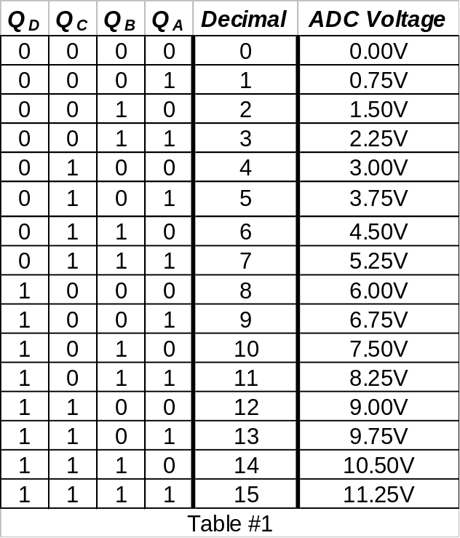
Counter and DAC Output

Slide 11
Circuit #1 – Digital To Analog Converter
(DAC)
Q_{D}
V_{D}
R_{D}
Q_{C}
V_{C}
R_{C}
Rf
Rk1
1
3
Counter
Q_{B}
V_{B}
R_{B}
C4
2
C3
74161N
0.01uF
v2
Q_{A}
V_{A}
4
U1
0
0.01uF
15
R_{A}
uA741
U2
0
2
-
V-
OS1
1
Rk2
4
uA741
741
6
2
V-
1
OUT
-
741
OS1
3
+
V+
OS2
5
OUT
6
Vout
7
3
+
V+
OS2
5
v1
0
C1
7
C2
15
0
0.1uF
0
0.01uF
0
0
Figure 3

Slide 12
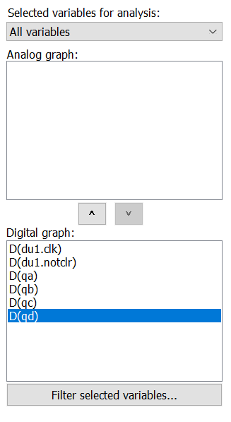
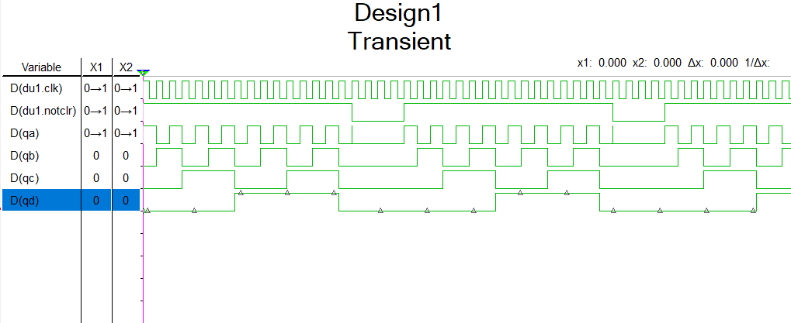
Week 1 – Counter Design – working alone
  The first two weeks of this lab will be done individually. Plan on working with a lab partner in the third week.
  Simulate the 161 counter.
    The “Data Inputs” A-D are not used so they should be tied to 0V. “Load” is also not used, so connect it to 5V to prevent loading.
    ENP and ENT enable inputs both connect to 5V to allow counting.
    Use the CLOCK_VOLTAGE for the clock (CLK) input. A 0-5V square wave with a 1 millisecond period is recommended (1 KHz).
    Use the CLOCK_VOLTAGE for the clear (CLR) input. A 0-5V, 80% duty cycle, square wave with 20 millisecond period is recommended (50 Hz).
    Simulate and confirm counting as shown in the transient analysis below (Q_{A}, Q_{B}, Q_{C} and Q_{D} toggling) with when clear is not active (high). Note: Q_{A} – Q_{D} are low when clear (CLR) is low. Simulation end time (TSTOP) should be set to 0.02 seconds. Submit a transient plot with the digital outputs: clk, clr, qa, qb, qc and qd.

Slide 13
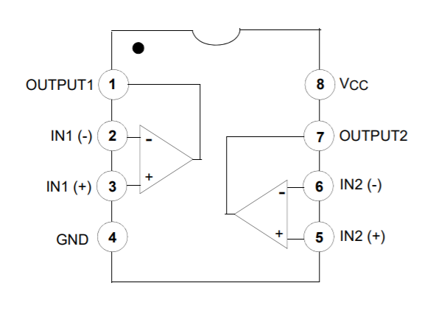
Week 1 – Comparator Design – working alone
  Draw and simulate the comparator circuit diagram.
    Find the LM393N comparator in the Analog group, Comparator family.
    Find the datasheet for a LM393 comparator. Findchips.com is a great resource for finding datasheets and distributors of many electronic parts.
    Power pins for the LM393N voltage comparator are Vcc (pin 8) and GND (pin 4). Connect Vcc to +18V and GND to 0V (ground).
    The LM393N output is an open-collector output which allows Vcc can be very low (saving power) or very high (allowing large voltages to be compared). A pull-up resistor is used to create the output high voltage (5V in this case). A external 1KΩ pull-up resistor is connected to the output (pin 1) to create the +5V output voltage. The video https://www.youtube.com/watch?v=sGZe0aJsqBQ explains pull-up resistors and open-drain outputs. The open-drain applies to a FET and is the same as open-collector in a BJT.
    Remove the ENP and ENT connections to 5V in the previous simulation and replace it with the output of the pulled-up LM393N.
    Connect each comparator input (pins 2 and 3) to a separate DC power supplies. The supply voltages can be any value between GND and Vcc.
    Verify that when the inverting input is larger than the non-inverting input, the output of the LM393N is 0V and the counter stops. Verify that the output of the LM393N is high when the non-inverting input is larger than the inverting input and that in this condition the counter is enabled. Submit a transient plot showing both condition.

Slide 14
Week 2 – DAC Design – working alone
  The DAC uses a summing amplifier. Please watch https://www.youtube.com/watch?v=c8N9T06U9Mg for a better understanding of summing amplifiers.
  DAC Design. Find values for R_{A}, R_{B}, R_{C}, R_{D}, R_{f}, R_{K1}, R_{K2} to meet the specifications given in the design notes.
    Choose R_{A} – R_{D}. To avoid overloading the TTL outputs, R_{A} – R_{D} must be greater than 10K. I_{OH} (maximum output current when the output is high) was given for the 74161N.
    The second stage is to be designed so that an analog count 1111 is 11.25V. If you are able to obtain -11.25V with the first stage, a gain of -1 is fine for the second stage (R_{K1} = R_{K2}). R_{K2} in Figure 3 is shown as a potentiometer, allowing adjustable resistance (potentiometer or pot). A fixed (normal) resistor can be used for R_{K2}.
  Draw and simulate the DAC Circuit.
  Testing advice:
    Before the DAC is connected to the counter, it is best to attach four power supplies. Verify each counter combination produces the expected output voltage as shown in Table 1. When a supply is set to 5V, it is the same as a counter 1. 0V is the same as a counter 0. It is often easiest to test 0001, 0010, 0100 and 1000 input combinations first.
    Connect the counter outputs to DAC inputs as shown in Figure 3. The DAC output (Vout) should look very similar to Figure 2.
  Submit a simulation results showing your DAC design (similar to figure 2). Simulate to verify that
    V_{OUT} is zero when V_{A}, V_{B}, V_{C} and V_{D} all are zero
    V_{OUT} is 0.75V when V_{A}= 5V and V_{B}, V_{C} and V_{D} are zero
    V_{OUT} is 6V when V_{D}= 5V and V_{A}, V_{B} and V_{C} are zero.

Slide 15
Week 3 – Analog To Digital Converter – Bringing it together
  Bring the two designs together as shown in Figure 1.
    The final design is to be shown in one simulation.
    V_{IN} in Figure 1 is provided with a DC power supply.
    Test the operation of the combined circuits. The counter should increase until the DAC voltage exceeds Vin causing the counter to stop. The “digital output” is read from the counter.
  Capture waveforms showing the conversion. Submit the plots.

Slide 16
A2D Converter
Lab 6 Submission
Submit:
Week 1: Transient plot of counter, counter/comparator circuit counting and counter/comparator not counting
Week 2: Simulation results showing V_{OUT} = 0V, 0.75V and 6V.
Week 3: Transient plots showing the final analog to digital conversion.
Weeks 1 and 2 are done by everyone, individually. Week 3 is done by each group with each group submitting one report.

