Slide 1


SignalGraph – A Matlab based deep learning toolkit
XIAO Xiong
xiaoxiong@ntu.edu.sg
Senior Research Scientist
Temasek Laboratories @ NTU
Nanyang Technological University, Singapore.

Slide 2
Outline
Deep learning and applications
Existing deep learning toolkits
SignalGraph
Examples
Summary

Slide 3
What is Deep learning?
Deep learning is a hot topic nowadays.
But what is deep learning all about?
Use deep models, e.g. neural network with many layers.
Use a lot of data to train the model for your task, e.g. millions of images
Use GPU for fast training, otherwise the training will be painfully slow.
Outcome: state-of-the-art results in many tasks (see the list below).
Why deep learning works?
Bengio, Yoshua. "Learning deep architectures for AI." Foundations and trends in Machine Learning 2.1 (2009): 1-127.
Deep learning book: www.deeplearningbook.org
Many deep learning resources can be found at:
deeplearning.net
http://deeplearning.stanford.edu/wiki/index.php/UFLDL_Tutorial
Search deep learning or machine learning in Coursera.com

Slide 4
Deep learning applications
Gameplay (e.g. AlphaGo)
Image recognition (CNN is now the de facto model for image recognition)
Speech recognition (DNN/LSTM dominates the speech recognition in just 5 years)
Machine translation (neural network based translation now outperforms statistical translation).
Signal processing (beamforming, source localization, speech enhancement, source separation, fast developing areas)
Auto-piloting vehicles
Many more to come…

Slide 5






Existing deep learning toolkits
All toolkits support GPU computing through CUDA library.
TensorFlow from Google
Mainly Python wrapper plus C++ core
Support multiple platforms, such as Android, Linux, MacOS, etc
CNTK from Microsoft
Scripts plus C++ core
Fast speed
Caffe
Popular in computer vision applications.
Torch
Theano
Python based
Chainer
Python based
Many others…
They are all good toolkits! You should try them!

Slide 6
SignalGraph - Why another toolkit?
Why create a new toolkit when there are already so many?
Reason 1: there is no general purpose deep learning toolkit on the Matlab platform yet.
Matlab is an important platoform for prototyping signal processing systems
Matlab is easy to use and debug, and rich in signal processing libraries
There are a large amount of users of Matlab in the world.
Reason 2: we already have one.
In fact, we started building a deep learning toolkit back in 2013, earlier than many other toolkits were released.
We published our toolkit this year on GitHub.
We give it a name SignalGraph, aiming for signal processing with graph structure.

Slide 7
SignalGraph History
Started with deep feedforward network and interface to speech tasks (2013)
Applied to speech dereverberation/enhancement task (late 2013)
Applied to direction-of-arrival (DOA) estimation (2014)
Support for directed acyclic graph (DAG, 2015)
Applied to beamforming (2015)
Applied to detection of synthetic speech (2015)
Applied to text topic modeling (2015)
Support LSTM and temporal convolution network (2016)
Applied to speech search (2016)
Applied to speaker verification and language identification (2016)
Support expectation-maximization (EM) (2016)
Published on GitHub (Jun 2016)
…
https://github.com/singaxiong/SignalGraph

Slide 8
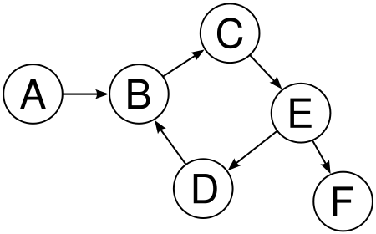
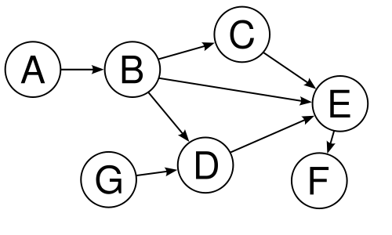
SignalGraph – Directed Acyclic Graph (DAG)
In SignalGraph (and many other deep learning toolkits), a neural network is represented by a directed acyclic graph (DAG)
Directed: the link between nodes has direction.
Acyclic: no loop allowed between nodes
Will support loop (genera graph) in the future.
Many information (signal) processing systems can be represented as graphs (with or without loop).
No Loop
Has Loop

Slide 9
SignalGraph – Nodes: Atomic Units of Graph
A graph contains a set of nodes and directed arcs that connect the nodes.
A node in the graph represents one layer in neural network.
A node is an atomic processing step, SignalGraph now supports more than 40 types of nodes (still growing).
The directed arcs show the directions of information/signal flow.
By connecting the nodes, the designers can build very powerful graphs for signal processing.
LSTM
FFT
enframe
Affine transform
Sigmoid
softmax
Mean square error
SISO
MISO
MIMO

Slide 10


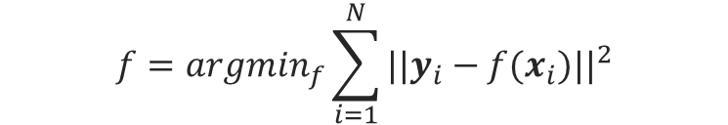


Example 1 – Regression
$$x_{i}$$
$$y_{i}$$
Problem definition: Map input vectors to target vectors for i=[1,…,N] through a nonlinear function f():
In this example, we use a DNN to fit the input to target.
The affine transforms contain parameters that can be adjust by the network to reduce mean square error.
$$f=arg\min_{f}\sum_{i=1}^{N}{||y_{i}−f(x_{i}){||}^{2}}$$
Load target vectors
Input
$$y_{i}$$
Input
Affine transform
Sigmoid
Affine transform
Sigmoid
Affine transform
Mean square error
Load input vectors
Nonlinear transformation of inputs by a 3 hidden layer DNN
Compute the cost function
$$x_{i}$$

Slide 11












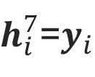







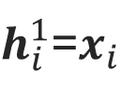




Example 1 – Regression – forward and backward passes
In the forward pass, information flows in the direction of the green arcs.
In the backward pass (also called backpropagation), gradient of cost function w.r.t. variables (data or network parameters) flow in the direction of red arcs.
$$h_{i}^{2}$$
Input
$h_{i}^{7}$=$y_{i}$
is the output at layer 2
$$θ^{2}$$
$$θ^{4}$$
$$θ^{6}$$
$$||h_{i}^{6}−y_{i}{||}^{2}$$
Input
Affine transform
Sigmoid
Affine transform
Sigmoid
Affine transform
Mean square error
$h_{i}^{1}$=$x_{i}$
$$h_{i}^{2}$$
$$h_{i}^{3}$$
$$h_{i}^{4}$$
$$h_{i}^{5}$$
$$h_{i}^{6}$$
Input
$${∇y}_{i}$$
$${∇θ}^{2}$$
$${∇θ}^{4}$$
$${∇θ}^{6}$$
$$||h_{i}^{6}−y_{i}{||}^{2}$$
Input
Affine transform
Sigmoid
Affine transform
Sigmoid
Affine transform
Mean square error
$${∇x}_{i}$$
$${∇h}_{i}^{1}$$
$${∇h}_{i}^{2}$$
$${∇h}_{i}^{3}$$
$${∇h}_{i}^{4}$$
$${∇h}_{i}^{5}$$
$${∇θ}^{2}=∂||h_{i}^{6}−y_{i}{||}^{2}/∂θ^{2}$$
$$θ^{2}←θ^{2}+α{ ∇θ}^{2}$$
Gradient descent

Slide 12
Example 1 – Regression – Code in SignalGraph
The following code shows how to train the vector to vector mapping described in previous slides.
para.IO.nStream = 2; % Two data streams in the network, one for input and one for target
para.NET.batchSize = 256; % (optional) Minibatch size
para.NET.learning_rate = 1e-2; % global learning rate (most important hyperparameter to set)
para.NET.L2weight = 3e-4; % (optional) weight of L2 regularization on the parameters
para.useGPU = 0; % Whether to use GPU
% Call task dependent function to load training and cross validation data.
% Data_tr is for training and Data_cv is for cross validation. Both are arrays of cell arrays.
[Data_tr, Data_cv, para] = LoadData(para);
% define the network layer sizes
inputDim = 257; % dimension of input vectors
hiddenLayerSize = [512 512 200 500]; % define the hidden layer sizes
outputDim = 257; % dimension of output vectors
cost_function = 'mse'; % use mean square error as cost function
% generate the graph structure. Layer is a linked list (represented by cell array).
layer = genNetworkFeedForward_v2(inputDim, hiddenLayerSize, outputDim, cost_function);
% train the network using stochastic gradient descent
trainGraph_SGD(layer, Data_tr, Data_cv, para, []);
See the follow link for a working example:
https://github.com/singaxiong/SignalGraph/blob/master/examples/regression/TrainMappingDNN.m
Type ParseOptions2 for all options of para.

Slide 13







Example 2 – Classification
$$x_{i}$$
$$c_{i}$$
Problem definition: Classify input vectors to one of classes for i=[1,…,N] through a nonlinear function f():
where is the posterior probability of the correct class
given the input vector
$$f=arg\max_{f}\sum_{i=1}^{N}{p(c_{i}^{∗}{|x}_{i}) }$$
$$p(c_{i}^{∗}{|x}_{i})$$
$$c_{i}^{∗}$$
$$x_{i}$$
Load label
$$c_{i}^{∗}$$
Input
Input
Affine transform
Sigmoid
Affine transform
softmax
Cross entropy
Load input vectors
Nonlinear transformation of inputs by a 2 hidden layer DNN
Compute the cost function
$$x_{i}$$

Slide 14
Example 2 – Classification – Code in SignalGraph
The following code shows how to train the classification network described in previous slide. Red lines show the differences between the classification and regression examples.
para.IO.nStream = 2; % Two data streams in the network, one for input and one for target
para.NET.batchSize = 256; % (optional) Minibatch size
para.NET.learning_rate = 1e-2; % global learning rate (most important hyperparameter to set)
para.NET.L2weight = 3e-4; % (optional) weight of L2 regularization on the parameters
para.useGPU = 0; % Whether to use GPU
% Call task dependent function to load training and cross validation data.
% You need a different LoadData from that in the regression example.
[Data_tr, Data_cv, para] = LoadData(para);
% define the network layer sizes
inputDim = 257; % dimension of input vectors
hiddenLayerSize = [512 512 200 500]; % define the hidden layer sizes
outputDim = 100; % assume we have 100 classes
cost_function = ‘cross_entropy'; % for classification task, we usually use cross entropy
% generate the graph structure. Layer is a linked list (represented by cell array).
layer = genNetworkFeedForward_v2(inputDim, hiddenLayerSize, outputDim, cost_function);
% train the network using stochastic gradient descent
trainGraph_SGD(layer, Data_tr, Data_cv, para, []);
See the follow link for a working example:
https://github.com/singaxiong/SignalGraph/blob/master/examples/classification_framewise/TrainPhoneRecognizerDNN_AU4.m

Slide 15
Publications based on SignalGraph
Xiong Xiao, Shengkui Zhao, Duc Hoang Ha Nguyen, Xionghu Zhong, Douglas L. Jones, Eng Siong Chng, Haizhou Li, "Speech dereverberation for enhancement and recognition using dynamic features constrained deep neural networks and feature adaptation", EURASIP Journal on Advances in Signal Processing, 2016(1), pp. 1-18.
Xiong Xiao, Shinji Watanabe, Hakan Erdogan, Liang Lu, John Hershey, Michael L. Seltzer, Guoguo Chen, Yu Zhang, Michael Mandel, Dong Yu, "Deep beamforming networks for multi-channel speech recognition", in ICASSP 2016.
Zeyan Oo, Yuta Kawakami, Longbiao Wang, Seiichi Nakagawa, Xiong Xiao and Masahiro, "DNN-based Amplitude and Phase Feature Enhancement for Noise Robust Speaker Identification", accepted by INTERSPEECH 2016.
Xiaohai Tian, Zhizheng Wu, Xiong Xiao, Eng Siong Chng, Haizhou Li, "Spoofing detection from a feature representation perspective", in ICASSP 2016.
Xiaohai Tian, Zhizheng Wu, Xiong Xiao, Eng Siong Chng, Haizhou Li, "An investigation of spoofing speech detection under additive noise and reverberant conditions", accepted by INTERSPEECH 2016.
Jia Yu, Xiong Xiao, Lei Xie, Eng Siong Chng and Haizhou Li, "A DNN-HMM Approach to Story Segmentation", accepted by INTERSPEECH 2016.
Xiong Xiao, Shengkui Zhao, Xionghu Zhong, Douglas L. Jones, Eng Siong Chng, Haizhou Li, "Learning to Estimate Reverberation Time in Noisy and Reverberant Rooms", in proceedings of InterSpeech 2015.
Xiong Xiao, Shengkui Zhao, Xionghu Zhong, Douglas L. Jones, Eng Siong Chng, Haizhou Li, "A learning-based approach to direction of arrival estimation in noisy and reverberant environments", in ICASSP 2015.
Steven Du, Xiong Xiao, Eng Siong Chng, "DNN feature compensation for noise robust speaker verification", in proceedings of ChinaSIP 2015.
Xiong Xiao, Xiaohai Tian, Steven Du, Haihua Xu, Eng Siong Chng, Haizhou Li, "Spoofing Speech Detection Using High Dimensional Magnitude and Phase Features: the NTU Approach for ASVspoof 2015 Challenge", in proceedings of InterSpeech 2015.
Guangpu Huang, Chenglin Xu, Xiong Xiao, Lei Xie, Eng Siong Chng, Haizhou Li "Multi-View Features in a DNN-CRF Model for Improved Sentence Unit Detection on English Broadcast News”, accepted by APSIPA 2014.
Chenglin Xu, Lei Xie, Guangpu Huang, Xiong Xiao, Eng Siong Chng, Haizhou Li, "A Deep Neural Network Approach for Sentence Boundary Detection in Broadcast News", in proceedings of Interspeech 2014.
Xiong Xiao, Shengkui Zhao, Duc Hoang Ha Nguyen, Xionghu Zhong, Douglas L. Jones, Eng Siong Chng, Haizhou Li, "The NTU-ADSC systems for Reverberation Challenge 2014", in Reverberation Challenge Workshop 2014.

Slide 16
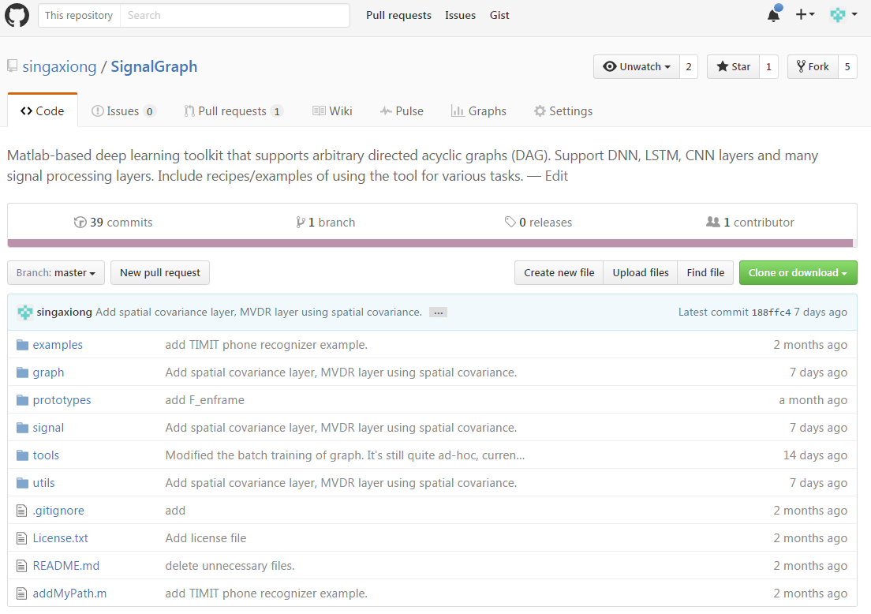
Tour of the SignalGraph folders in Github
https://github.com/singaxiong/SignalGraph

Slide 17
Summary
SignalGraph is a pure Matlab based deep learning toolkit
Speed is reasonably fast with GPU card installed
No other software required.
Over 40 node types supported, especially those for signal processing
Successfully applied to many speech and language tasks.
Download from Github and try today!
https://github.com/singaxiong/SignalGraph
Send an email to me xiaoxiong@ntu.edu.sg if you encounter any problem.
Collaboration is most welcomed.
Think about your tasks in the deep learning way
Many problems can be think of as a deep learning problem.
Human brain is a powerful deep learning machine.
We are happy to discuss on potential collaborations.
We can discuss together on how to solve your existing tasks in a deep learning manner and implement in SignalGraph.

Slide 18
Thank you!

