Slide 1
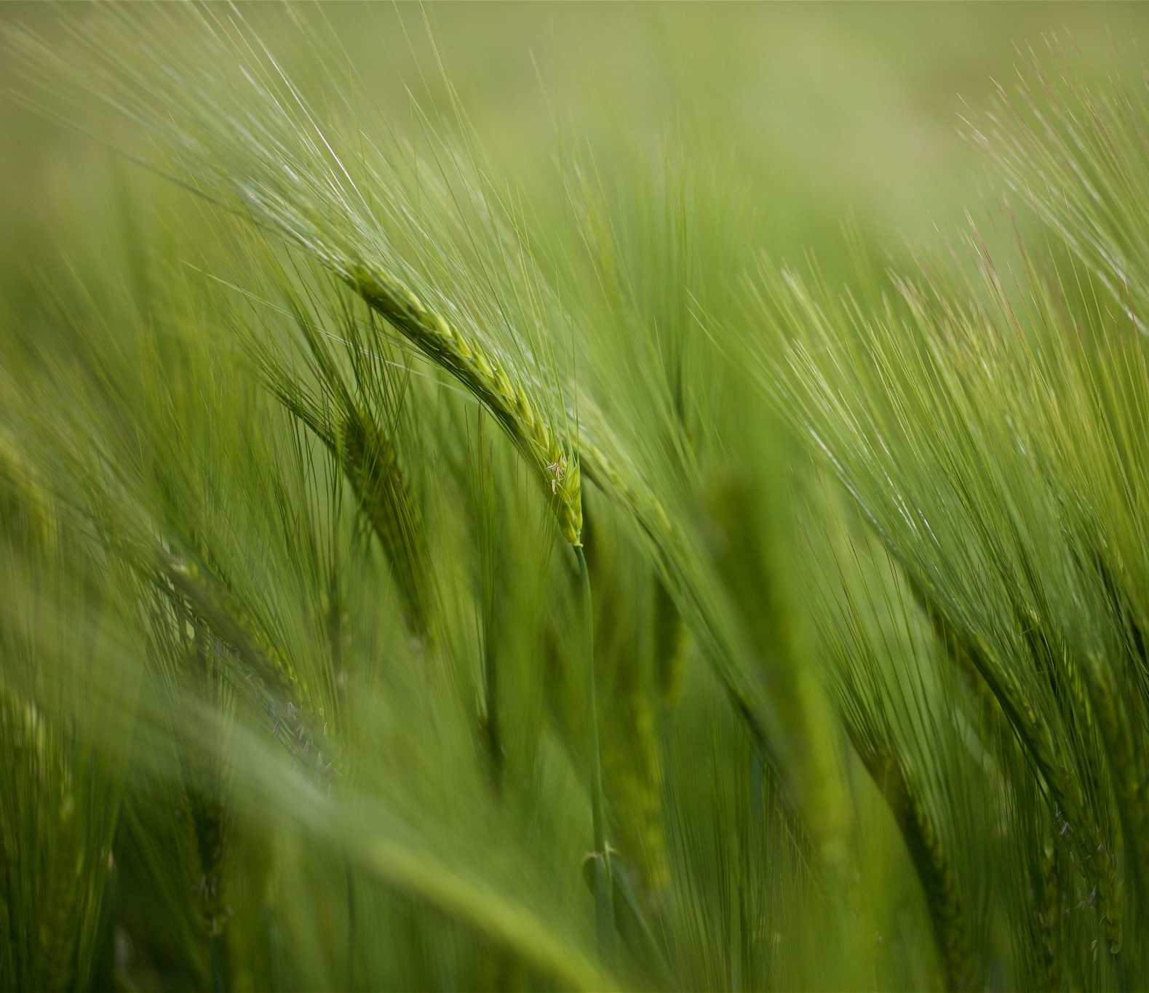
Land Use Land Cover Classification using Machine Learning Approaches

Slide 2
Introduction
Land-use Land-cover Classification by Machine Learning Classifiers for satellite observations, conducted by a group of researchers on February 25, 2020, was conducted to find out which classification algorithm is the best for determining the rate of land use/land cover (ULUC).
In this project, we will do the same application for a different purpose. Climate change has become a serious threat to humanity. We are going to generate by using a limited number of training samples. Gibraltar is selected as a study area as there are wide variety of land cover types.

Slide 3
Data Use
We use following datas in this project:
Training data: S2A_MSIL1C_20220516_TrainingData.tif
Training labels: S2A_MSIL1C_20220516_Train_GT.tif
Test data: S2B_MSIL1C_20220528_Test.tif
We use 11 classes which have map code, LCCS code and color code.

Slide 4
Algorithms
We used 6 algorithms to find the best result.
Random Forest Algorithm: Random Forest is a popular machine learning algorithm that belongs to the supervised learning technique.
Naive Bayes Algorithm: Naïve Bayes algorithm is a supervised learning algorithm, which is based on Bayes theorem and used for solving classification problems.
Decision Tree Algorithm: Decision tree is a Supervised learning technique that can be used for both classification and Regression problems, but mostly it is preferred for solving Classification problems.

Slide 5
Logistic Regression: Logistic regression is one of the most popular Machine Learning algorithms, which comes under the Supervised Learning technique.
Kernel-SVM Algorithm: SVM algorithms use a set of mathematical functions that are defined as the kernel.
One-vs-Rest Classifier Algorithm: One-vs-rest (OvR for short, also referred to as One-vs-All or OvA) is a heuristic method for using binary classification algorithms for multi-class classification.

Slide 6
Algorithms score table
Algorithm Name | Elapsed Time | Accuracy | Kaggle Score
Random Forest Algorithm | 32,758671 | 90,82% | 0,35293
Naive Bayes Algorithm | 13,038256 | 83,77% | 0,23288
Decision Tree Algorithm | 0,0259284 | 85,87% | 0,30257
Kernel-SVM Algorithm | 0,6519923 | 86,95% | 0,25146
Logistic Regression Algorithm | 0,5044579 | 86,12% | 0,32386
One-vs-Rest Algorithm | 2,5562357 | 88,84% | 0,25246

Slide 7
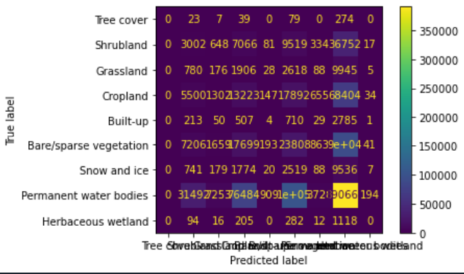
Random Forest Algorithm
Parameters: n_estimators=100, n_jobs=-1

Slide 8
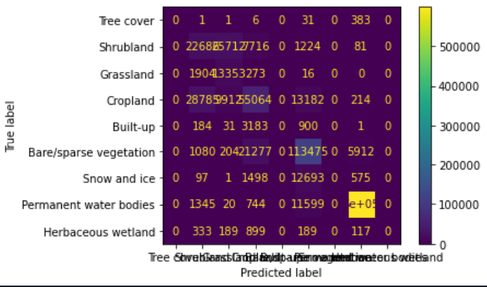
Naive Bayes Algorithm

Slide 9
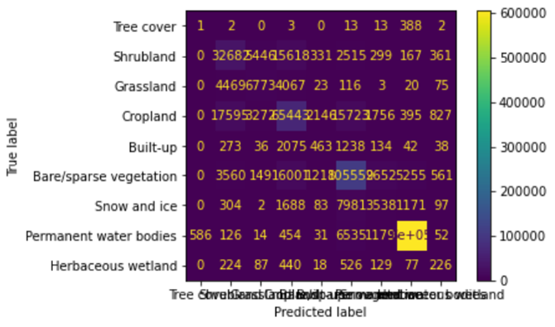
Decision Tree Algorithm

Slide 10

Kernel-SVM Algorithm
Parameter: kernel='linear'

Slide 11
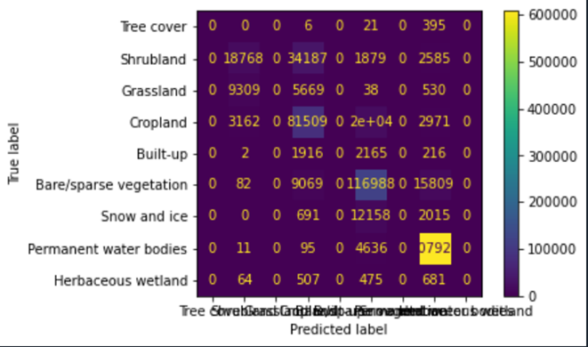
Logistic Regression Algorithm

Slide 12

One-vs-Rest Algorithm

Slide 13
Thanks For Listening
Mert Korkut Çoban 18050111012
Muhammet Balıkçı 18050161005

