Slide 1

How to Go from Responding to Hunting with Sysinternals Sysmon
HTA-T09
Mark Russinovich
CTO, Microsoft Azure
Microsoft Corporation
@markrussinovich

Slide 2
Hunting Attackers
When attackers or malware get on your network, you need to hunt them down
What was their entry point?
Did they spread between systems?
What happened on a particular system?
Built-in Windows tooling make it hard to answer these questions:
Limited information captured for process creates and DLL loading
Network connection information simultaneously too limited and verbose
No way to capture common attacker behavior (e.g. thread injection)

Slide 3
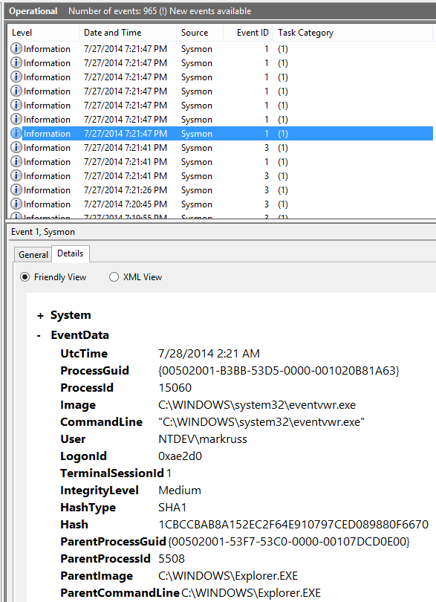
Sysinternals Sysmon (System Monitor)
Free download from Sysinternals.com
Background system monitoring utility
Record system events to the Windows event log
Can be used for system anomaly detection
Forensics can trace intruder activity across the network
I wrote it for use within Microsoft corporate network
To understand attacker behavior and tools
Contributions from Thomas Garnier, David Magnotti, Mark Cook, Rob Mead and Giulia Biagini

Slide 4
Announcing Sysmon v6
Schema output
“Friendly” registry key names
Named pipes
Sysmon configuration change logging
Status for revoked and expired signatures

Slide 5
Agenda
Sysmon Basics
Architecture and Advanced Filtering
A Look at New Events
Crafting a Configuration File
Determining an Exploit Vector
Hunting

Slide 6
Sysmon Basics

Slide 7
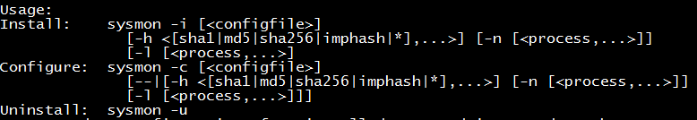
Sysmon Command-Line Usage
Windows service and device driver (~2 MB total)
Single binary includes 32-bit and 64-bit versions of both
Service doubles as command-line frontend
Installation: sysmon -i -accepteula [options]
Extracts binaries into %systemroot%
Registers event log manifest
Enables default configuration

Slide 8
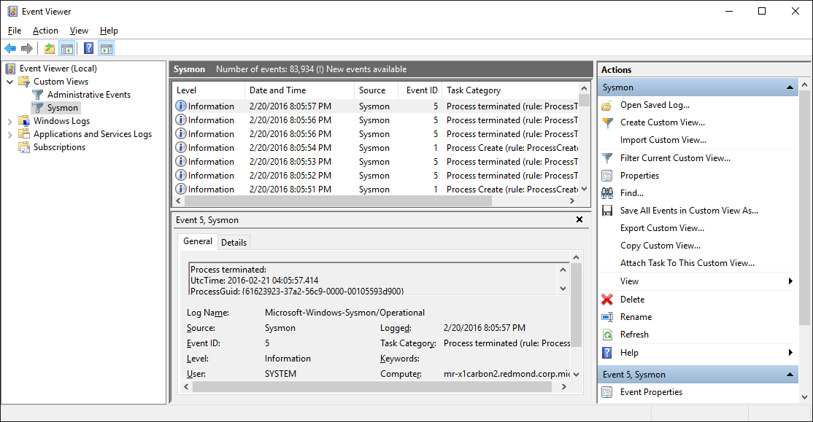
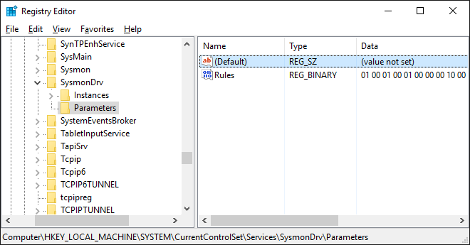
Sysmon Architecture
Sysmon (Cmd)
Sysmon (Service)
User Mode
Kernel Mode
SysmonDrv

Slide 9
Other Sysmon.exe Control Options
Viewing and updating configuration: sysmon -c [options]
Updates take effect immediately
Options can be basic options or a configuration file
Register event manifest for viewing logs only: sysmon -m
Uninstall: sysmon -u

Slide 10
Sysmon Events
Category | Event ID
Sysmon Service Status Changed | 0
Process Create | 1
File Creation Time Changed | 2
Network Connection | 3
Sysmon Service State Change | 4
Process Terminated | 5
Driver Loaded | 6
Image Loaded | 7
CreateRemoteThread | 8
RawAccessRead | 9
Category | Event ID
Process Access | 10
File Create | 11
Registry Object CreateDelete | 12
Registry Value Create | 13
Registry Object Rename | 14
File Create Stream Hash | 15
Sysmon Configuration Changed | 16
Pipe Created | 17
Pipe Connected | 18
Error | 255
v6

Slide 11
Basic Configuration Options
Installing with no options logs all the following with SHA1 hashes where applicable:
Process create, Process terminate, Driver loaded, File creation time changed, Sysmon service state changed, Sysmon configuration changed
Additional basic options:
Option | Description
-h [SHA1] [MD5] [SHA256] [IMPHASH] [*] | Hash algorithm(s)
-n [process,…] | Logs network events
-l [process,…] | Logs image load events
-- | Restores default configuration (-c only)

Slide 12
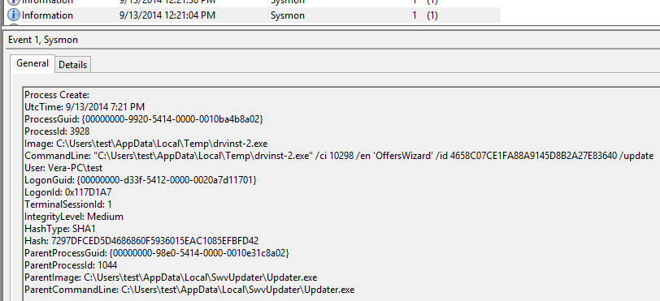
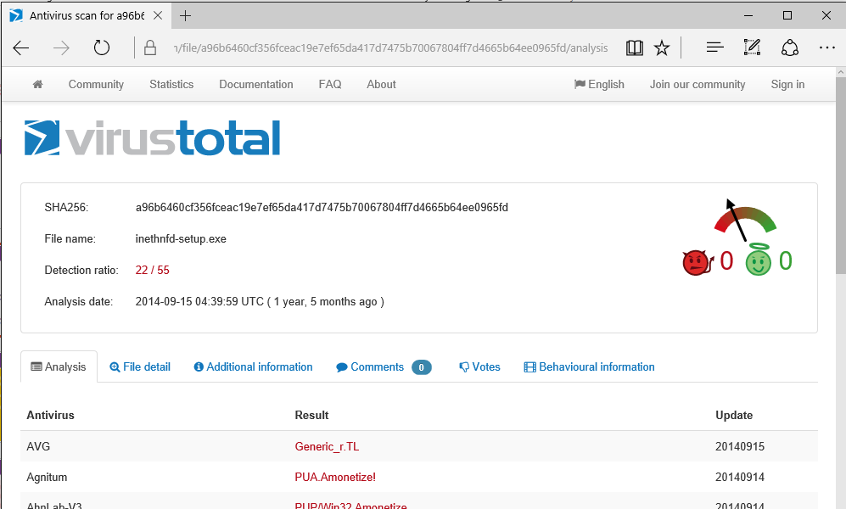
Hashes and VirusTotal
You can extract a hash and paste it into VT search for a report:

Slide 13
Configuration
Basic options are limited:
Cannot disable events via basic options (e.g. CreateRemoteThread, RawAccessRead)
Advanced filtering not possible (e.g. process name filters)
Sysmon configuration file supports all configuration options: install: sysmon -i -accepteula c:\SysmonConfig.xml update: sysmon -c c:\SysmonConfig.xml

Slide 14
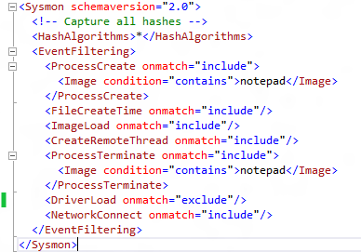
Configuration Top-Level Tags
Schema version: current is 3.3
HashAlgorithms:
Applies to all events
‘*’ for all hash types
CheckRevocation:
Controls cert revocation checks (default: no)
EventFiltering:
Flexible filtering rules
If event type not specified, default capture rule applies

Slide 15
Event Tags
Each event is specified using its tag
To see all tags, dump the full configuration schema:
sysmon -s
Onmatch can be “include” or “exclude”
Include and exclude refer to filter effect
Filters described later…
<tag onmatch=“include”>
<include filter/>
…
</tag>
<tag onmatch=“exclude”>
<exclude filter/>
…
</tag>

Slide 16
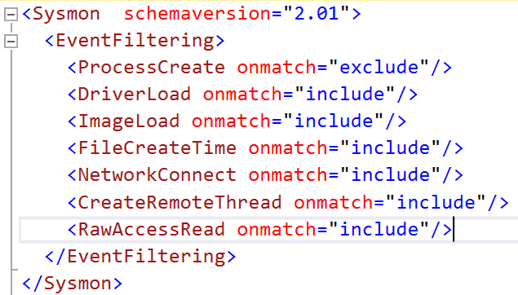
Event Tags With No Filters
Useful for enabling specific event types
If no filter, onmatch has opposite effect:
Include: don’t log any events
Exclude: log all events of the tag type
This configuration enables the following:
ProcessCreate: because of onmatch exclude
ProcessTerminate: because it is omitted and by default enabled

Slide 17
Filter Conditions
Filters are specified as event field conditions:
Field is any field in event schema
Condition types can be used with any field
Combine include and exclude filters
ConditionType
is
Is not
contains
excludes
begin with
end with
less than
more than
image
<eventtag onmatch=“include”> <field condition=“conditiontype”>value</field> … </eventtag>

Slide 18
Filter Examples
Include only Google Chrome network activity:
<NetworkConnect onmatch=“include">
<Image condition="contains">chrome.exe</Image>
</NetworkConnect >
Include thread injections into winlogon and lsass:
<CreateRemoteThread onmatch="include">
<TargetImage condition="image">lsass.exe</TargetImage>
<TargetImage condition="image">winlogon.exe</TargetImage>
</CreateRemoteThread >
Exclude all Microsoft-signed image loads:
<ImageLoad onmatch="exclude">
<Signature condition="contains">microsoft</Signature>
</ImageLoad>

Slide 19
A Look at the New Events

Slide 20
Sysmon Configuration Change
ProcessAccess
UtcTime
Configuration
ConfigurationFileHash
Logs configuration file updates
Name of configuration file
Hash of configuration file’s contents
Cannot be filtered (neither can Sysmon service status)

Slide 21
Process Access
Useful for detecting credential dumping
Will detect process monitors (Taskmgr, Procexp)
Should focus on sensitive processes (Lsass, Winlogon)
Generated from ObRegisterCallbacks
ProcessGuid, LogonGuid uniquely identify process (PID and LogonId can be reused)
ProcessAccess
UtcTime
SourceProcessGuid
SourceProcessId
SourceThreadId
SourceImage
TargetProcessGuid
TargetProcessId
TargetImage
GrantedAccess
CallTrace

Slide 22
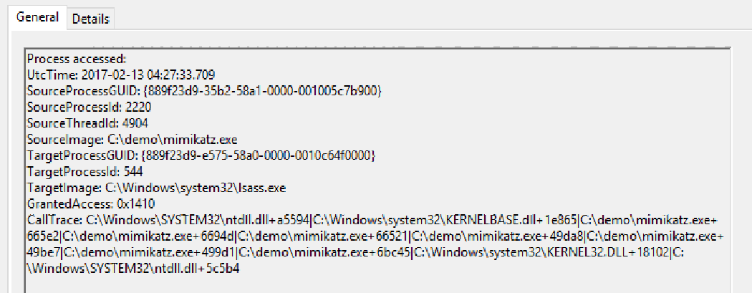
Tracking Mimikatz
I recommend always including lsass.exe process access:
Mimikatz request 0x1410:
0x1000: PROCESS_QUERY_ LIMITED_INFORMATION
0x0400: PROCESS_QUERY_ INFORMATION
0x0010: PROCESS_VM_READ
Exclude GrantedAccess of 0x1000, 0x1400, 0x400
<ProcessAccess onmatch="include">
<TargetImage condition="is">C:\windows\system32\lsass.exe</TargetImage>
</ProcessAccess>

Slide 23
File Create and File Create Stream Hash
FileCreate
UtcTime
ProcessGuid
ProcessId
Image
TargetFileName
CreateUtcTime
FileCreateHash
UtcTime
ProcessGuid
ProcessId
Image
TargetFileName
CreateUtcTime
Hash
Generated from file system mini-filter
File create is useful for detecting autostart drops
File create stream hash detects browser drops (MOTW – Mark of the Web)
MOTW: Zone.Identifier
Hashes default data stream (main file)
Logged for any matching create of an alternate data stream

Slide 24
Registry
Captured by CmRegisterCallback
Three sub-events:
Registry object (key or value) create/delete
Registry value set
Registry object rename
‘Friendly’ names for schema > 3.2
Useful for watching:
Critical system configuration
Autostart locations
Object Create/Delete
Value Set
Object Rename
RegistryEvent
EventType
UtcTime
ProcessGuid
ProcessId
Image
TargetObject
Details
RegistryEvent
EventType
UtcTime
ProcessGuid
ProcessId
Image
TargetObject
NewName
RegistryEvent
EventType
UtcTime
ProcessGuid
ProcessId
Image
TargetObject

Slide 25
Named Pipes
Captured by file system minifilter
Two sub-events:
Named pipe create
Named pipe connect
Useful for watching inter-process malware communication
Pipe Create
Pipe Connect
PipeEvent
UtcTime
ProcessGuid
ProcessId
Pipe
Image
PipeEvent
UtcTime
ProcessGuid
ProcessId
Pipe
Image

Slide 26
Crafting Configuration

Slide 27
What’s a Good Configuration?
One that doesn’t overwhelm your systems
Excessive resource usage
Excessive log volume
Crafting is iterative:
Exclude known sources
E.g. OneDrive for file time stamp changes
Include sensitive targets:
E.g. Lsass.exe for credential theft
When investigating likely breach, bias for data
Edit Configuration
Deploy and Assess

Slide 28
Basic Event Recommendations
Category | Recommendation
Process Create | Log all
File Creation Time Changed | Exclude known processes
Network Connection | Log all non-browser activity
Process Terminated | Enable when investigating a breach
Driver Loaded | Log all non-Windows and non-Microsoft
Image Loaded | Enable when investigating a breach
CreateRemoteThread | Exclude known processes
RawAccessRead | Exclude known processes

Slide 29
Basic Event Recommendations (Cont)
Category | Recommendation
Process Access | Include sensitive targets
File Create | Include autostart entry points
Registry Object CreateDelete | Include autostart entry points
Registry Value Create | Include autostart entry points
Registry Object Rename | Include autostart entry points
File Create Stream Hash | Include MOTW names
Pipe Created | Enable for targeted investigation
Pipe Connected | Enable for targeted investigation

Slide 30
Example: Identifying Known Drivers
Set this filter and reboot (assuming system is clean):
Query log for loaded drivers:
Make exclude filters from the list:
<DriverLoad onmatch="exclude"/>
Get-WinEvent -LogName "Microsoft-Windows-Sysmon/Operational"| Where-Object { $_.Id -eq 6 } | ForEach-Object { $_.Properties[4].Value } | Sort-Object -Unique
<DriverLoad onmatch="exclude">
<Signature condition="is">Alps Electric Co.</Signature>
<Signature condition="is">Conexant Systems</Signature>

Slide 31
SwiftOnSecurity’s Configuration
@SwiftOnSecurity (Securitay) has published a Sysmon configuration
Has been using Sysmon for over a year
Deployed across thousands of systems
Commented configuration explains rationale
Additional analysis from Lennart Koopman
https://github.com/SwiftOnSecurity/sysmon-config/blob/master/sysmonconfig-export.xml
https://medium.com/@lennartkoopmann/explaining-and-adapting-tays-sysmon-configuration-27d9719a89a8#.rwt51mfrg

Slide 32
Hunting

Slide 33
Splunk
Splunk enables collection and rich queries of Sysmon data
Configuring Splunk for Sysmon: https://github.com/splunk/TA-microsoft-sysmon
Install Splunk universal forwarder on Sysmon systems
Install Splunk Sysmon TA on search heads
Set Sysmon configuration to exclude Splunk binaries
<Image condition=“contains">splunk</Image>
<Image condition=“contains">streamfwd</Image>
…

Slide 34
Demo: Hunting a Phishing Email

Slide 35
Operations Management Suite
System monitoring and configuration for Windows and Linux systems (VMs, physical, cloud, etc.)
Includes support for agent that can forward arbitrary logs to Operational Insights service
Logs can be used for:
Standing dashboard queries
Visualization
Ad-hoc exploration

Slide 36
Demo: Credential Exfiltration

Slide 37
Conclusion

Slide 38
Best Practices and Tips
Install it on all your systems
Proven at scale
Data will be there when you need it for DFIR
Configure all event types for maximum visibility
Filter out noise, especially uninteresting image loads
Test overhead on mission-critical systems
Make sure event log is large enough to capture desired time window
Forward events off box
To prevent deletion by attackers
For analyzing aggregate network behavior
For tracing activity between systems (e.g. pass-the-hash)

Slide 39
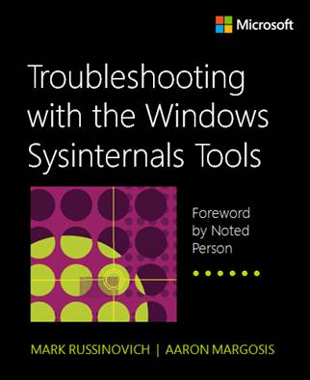
Summary
Sysmon can give you deep insights into intrusions and infections
Send cases, tips and feature requests to me:
mark.russinovich@microsoft.com @markrussinovich
Sysmon and other Sysinternals tools are documented in “Troubleshooting with the Sysinternals Tools”

