Slide 1
Specialist Clinic Management Platform
* Telemedicine: Leverage electronic information and telecommunication technology to improve access to care and communication between patients and healthcare providers.
* Objective: Enhance online booking, improve healthcare accessibility, and preserve human expertise in the medical field.

Slide 2
Slide Title
Systems Investigation
Research and System objects are centered around:-
Usability of telemedicine digital apps
Requirements and preferences of the three user groups (Patient. Doctor, Clinic Admin)
Curating a digital solution that can accommodate high volume of users handling separate requests.
Testing thoroughly to ensure the product provides an acceptable level of satisfaction amongst users.
Technology in Healthcare
Automated reminders
Microcontroller sensors that track vital health data
Remote prescription delievery
Unobstrusive Surgery

Slide 3
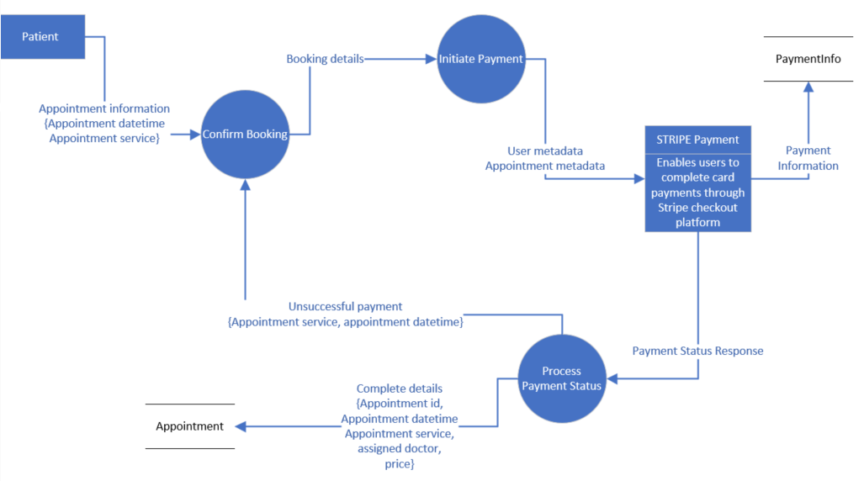
DFD Design

Slide 4
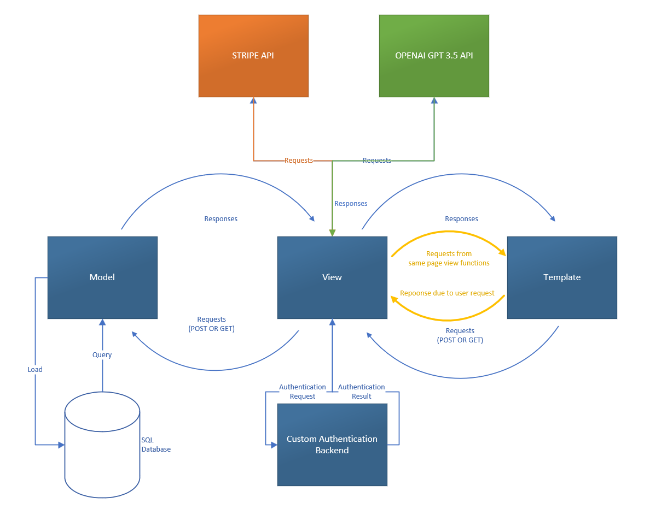
High-level Architectural Design

Slide 5
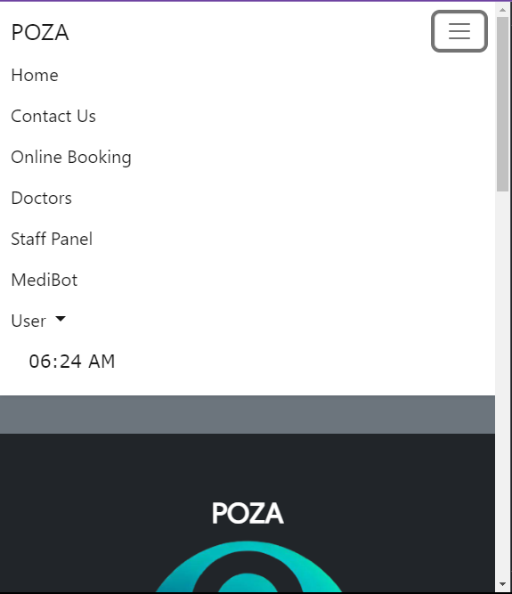
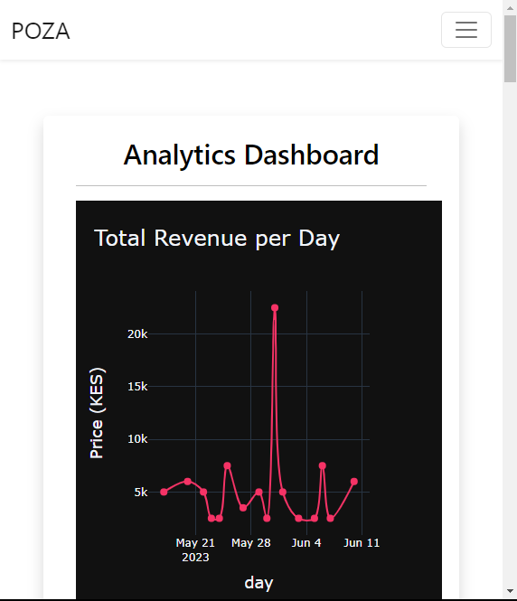
US
E
R
I
N
T
E
R
F
A
C
E
S
Product B
Feature 1
Feature 2
Feature 3

Slide 6
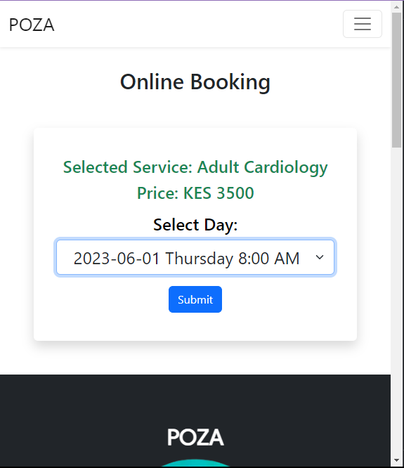
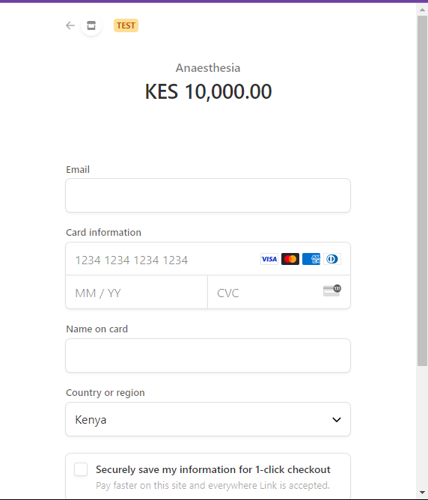
US
E
R
I
N
T
E
R
F
A
C
E
S

Slide 7
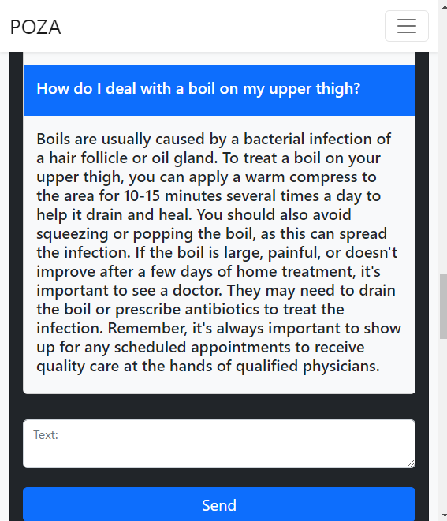
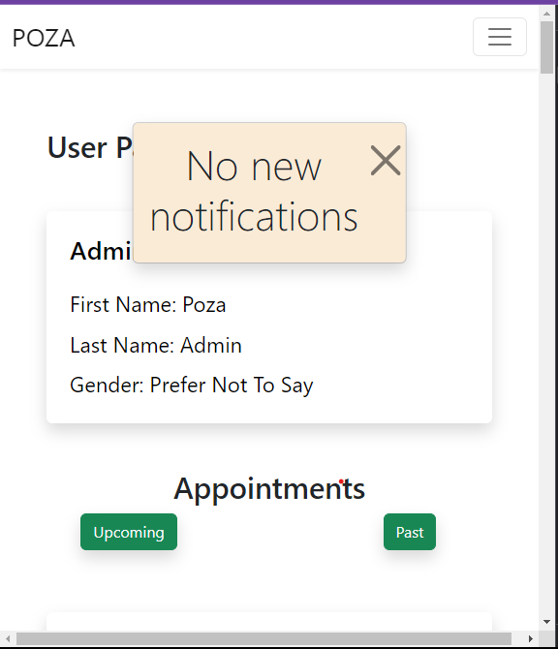
US
E
R
I
N
T
E
R
F
A
C
E
S

Slide 8
Conclusions
Key Results
Patient-centric approach is vital for telemedicine products.
Centralized storage of vital clinic data and in-house analysis.
Automated and tracked billing.
Conclusions
Future Enhancements
Direct-to-chat features for patients and doctors.
Mobile application development for improved accessibility.
Patient portal for uploading and updating medical records.

