Slide 1
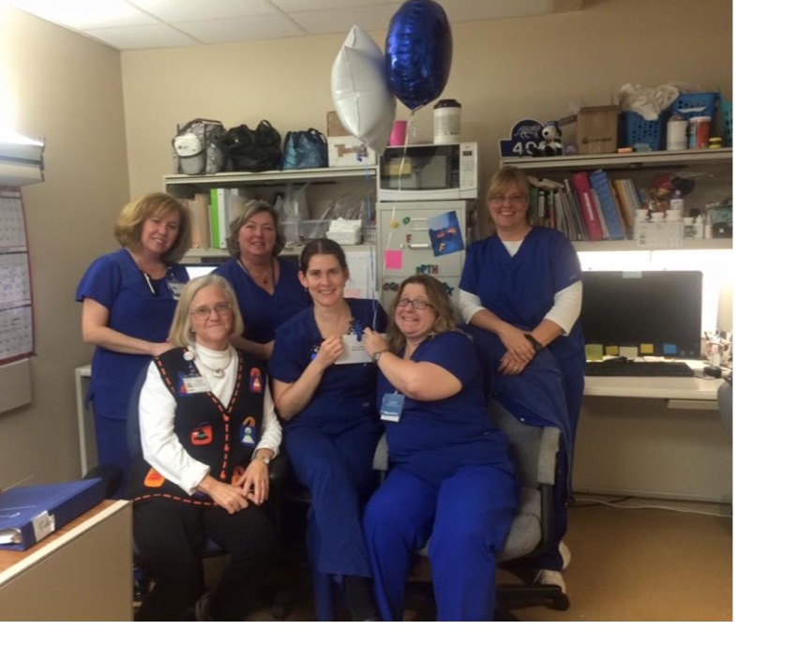
Strategies to Promote Civility in the Workplace
March 20, 2017
Nora Warshawsky, RN, CNE, NEA-BC, FAAN
Email: nwa229@uky.edu
Notes:
NOTE:
To change the image on this slide, select the picture and delete it. Then click the Pictures icon in the placeholder to insert your own image.

Slide 2
Poor interpersonal relationships at work: Bullying, Incivility, Disrespect, Horizontal Violence (Porath, 2016)
Healthcare costs are 46% higher for Workers who are stressed, compared with non-stressed workers.
Top source of workplace stress—difficult relationships!
Of those who have been bullied:
48% intentionally decrease work effort
38% intentionally decreased work quality
80% lost work time worrying about incident
12% left their organization because of uncivil behavior
25% reported taking frustration out on the customer

Slide 3

Measures

Slide 4
Nurse Incivility Scale (Guidroz et al., 2010)
40 items
5 point rating (Agreement)
Strongly Disagree to Strongly Agree
8 Subscales
General
Nurse
Supervisor
Physician
Patient & Visitor
Sample items
People blame others for their mistakes or offenses.
Other nurses on my unit claim credit for my work.
My direct supervisor ideas not respond to my concerns in a timely manner.
Physicians are condescending to me.
Patients and families make insulting comments to nurses.

Slide 5
Negative Acts Questionnaire-revised (Einarsen et al., 2009; Evans, 2017)
22 items
5 point rating (Frequency)
Never to Daily
3 Subscales
Work-related bullying
Person-related bullying
Physical intimidation bullying
Sample items
Someone withholding information which affects your performance.
Spreading gossip and rumors about you.
Persistent criticism of your work and effort.

Slide 6

Nurse to Nurse Interaction (NDNQI Nurse Survey)
Items:
Nurses that I work with count on each other to pitch in and help when things get busy.
There is a good deal of teamwork among RNs I work with.
RNs I work with support each other.
4-point scale
1 = Strongly Disagree to 4 = Strongly Agree

Slide 7
Civility, Respect, Engagement at Work (CREW) (Osatuke et al., 2009)
8 items
5 point scale (Agreement)
Strongly Disagree to Strongly Agree
Subscales
Respect
Cooperation
Conflict Resolution
Coworker Personal Interest
Coworker Reliability
Antidiscrimination
Value Differences
Supervisor Diversity Acceptance
Sample items:
People treat each other with respect in my work group.
Managers/Supervisors, Team leaders work well with employees of different backgrounds in my work group.

Slide 8
Civility Index-Revised (Clark, 2013)
20 items
5-point scale
1 = Never 5 = Always
Add scores
90-100 Very civil
80-89 Moderately civil
70-79 Mildly civil
60-69 Barely civil
50-59 Uncivil
<50 Very uncivil
Sample items:
Assume goodwill and think best of others.
Communicate respectfully and really listen
(Clark Workplace Civility Index, 2013)

Slide 9
Clark Healthy Workplace Inventory (Clarke, 2015)
20 items
5-point scale
1 = Never 5 = Always
Add scores
90-100 Very healthy
80-89 Moderately healthy
70-79 Mildly healthy
60-69 Barely healthy
50-59 Unhealthy
<50 Very unhealthy
Sample items
Employees are viewed as assets and valued partners within the organization.
Teamwork and collaboration are promoted and evident.
The organization attracts and retains the “best and the brightest.”

Slide 10

Strategies to build civility

Slide 11

General Strategy (Clark et al., 2011; Clark, 2013; Moore et al., 2017; Porath, 2016)
Develop shared vision
Establish code of conduct
Hire for civility
Role model, educate, coach, suggest, role play!
Reinforce positive behavior: Reward Civility
Discipline PRN

Slide 12
CREW Model (Osatuke et al., 2009, 2013)
Discovery
Dream
Design
Destiny
Appreciative Inquiry approach
What’s working now?
Recreate successful, satisfying work experiences. Build on team strengths.
Find opportunities to further promote civility.

Slide 13
Example using CREW (Laschinger, et al, 2012 p. 320)
GOAL | PROCESS | SAMPLE STRATEGIES
Promote respectful interactions among staff on unit. | Weekly meetings to choose strategies either from CREW Toolkit or their own ideas. | 1. Share and discuss CREW Toolkit Civil and Respectful behavior list.
 |  | 2. Use “Colors Analysis” to explore individual differences in interpersonal communication styles.
 | Huddles at beginning of shift. | Reminders to team members to pay attention to the quality of their interactions on the unit.
Develop skills in conflict management. | Discussion in CREW meetings. | Role-play scenarios dealing with difficult interactions.
Teambuilding on unit | Develop teambuilding exercises to try in team meetings. | Use “icebreakers” to start each meeting to transition from work to CREW activities…

Slide 14

Crucial Conversations (VitalSmarts.com)
Communications training to promote open dialogue
Speak persuasively
Foster teamwork
Build acceptance
Resolve individual and group disagreements

Slide 15

Value & Build Teamwork (Kalisch, 2015)
Dimensions of team work:
Team leadership, team orientation, back-up behaviors, shared mental models, trust.
Role model teamwork!
Hire team members.
Interview panels—who’s at the table?
Behavior-based interview questions.
Team training.
Recognize and reward team performance.
Team notes, spot recognition, annual awards, etc.

Slide 16
Civility Toolkit available at StopBullyingToolkit.org
Policy
Institutional Culture
Interpersonal Relationships
Individual
Built Environment
Social-Ecological Model
Truth
Wisdom
Courage
Renewal

Slide 17
Additional Resources
American Association of Critical Care Nurses available at Healthy Work Environments
American Nurses Association available at Incivility, Bullying, and Workplace Violence
Anti-bullying resources available at StopBullyingNurses.com
Civility, Respect, and Engagement at Work (CREW) available at the VA National Center for Organizational Development CREW Resource Page

Slide 18
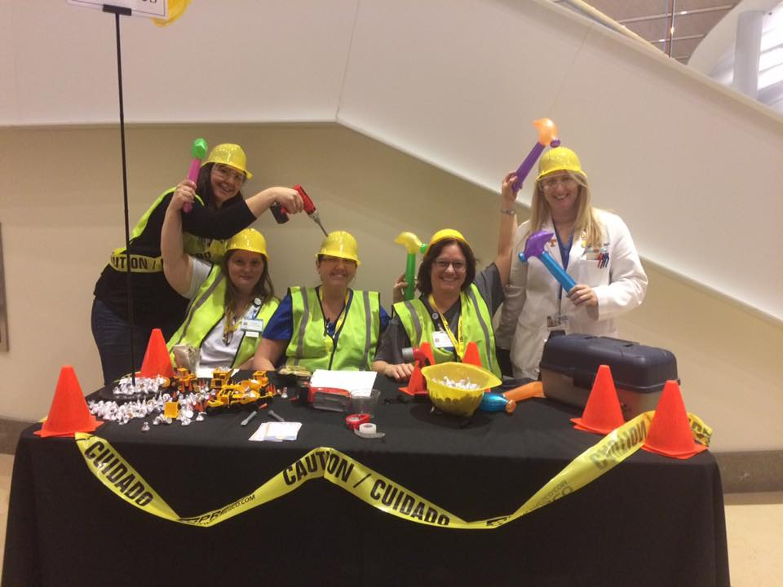
Heal Thyself! (Porath, 2016)
Spend time with energizers.
STOP ruminating!
Craft job to be meaningful.
Safe guard your health:
Exercise
Diet
Sleep

Slide 19
References
American Association of Critical-Care Nurses. Healthy Work Environments. https://www.aacn.org/nursing-excellence/healthy-work-environments/hwe-resources
American Nurses Association. Incivility, Bullying, and Workplace Violence. http://www.nursingworld.org/Bullying-Workplace-Violence
American Nurses Association. (2013) NDNQI Nurse survey with job satisfaction scales.
Civility Tool-kit. Available at http://stopbullyingtoolkit.org
Clark, C (2015). Conversations to inspire and promote a more civil workplace. American Nurse Today. 10: 18-23.
Clark C. (2013). Creating and sustaining civility in nursing education. Sigma Theta Tau International: Indianapolis.
Clark, C (2011). Fostering civility in nursing education and practice. Journal of Nursing Administration. 41: 324-330.
Einarsen S, Hoel H, Notelaers G. (2009). Measuring exposure to bullying and harassment at work. Work & Stress. 23: 24-44.

Slide 20
Evans D (2017). Categorizing the magnitude and frequency of exposure to uncivil behavior. Journal of Nursing Scholarship. Published ahead of Print.
Guidroz A, Burnfield-Geimer J, Clark O, Schwetschenau H, Jex S. (2010). The nursing incivility scale. Journal of Nursing Measurement. 18: 176-200.
Kalisch, B. (2015). Errors of omission: How missed nursing care imperils patients. American Nurses Association: Silver Spring, MD.
Laschinger HS, Leiter M, Day A, Gilin-Oore D, Mackinnon S. (2012). Building empowering work environments that foster civility and organizational trust. Nursing Research. 61: 316-325.
Moore LW, Sublett C, Leahy C. (2017). Nurse managers speak out about disruptive nurse-to-nurse relationships. Journal of Nursing Administration. 47: 24-29.
Osatuke K. Moore SC, Ward C, Dyrenforth SR, Belton L. (2009) Civility, respect, engagement in the workforce (CREW). Journal of Behavioral Science. 45: 384-410.
Osatuke K. Moore SC, Ward C, Dyrenforth SR, Belton L. (2013) Civility, respect, engagement in the workforce (CREW)
Porath C. (2016). Mastering civility: A manifesto for the workplace. Grand Central Publishing: New York.
StopBullyingNurses Available at http://www.stopbullyingnurses.com
US Department of Veterans Affairs. Civility, respect, and engagement in the workplace (CREW). Available at https://www.va.gov/ncod/crew.asp
VitalSmarts. Crucial Conversations. Available at https://www.vitalsmarts.com/crucial-conversations-training/ Accessed March 10, 2017.

