Slide 1
Verification of ID Documents using Computer Vision and Image Processing
Adam Titouah
Institute of Information & Communication Technology

Slide 2
Defining our goals
- To attempt to effectively and efficiently identify ID cards in an image and perform data extraction through image processing techniques
- Investigate the possibility of using techniques outlined to automate verification requirements in industry

Slide 3
Hypothesis and Research questions
The implementation of the YOLOv5 model, with its architectural improvements and optimizations, will yield superior object detection performance, particularly with regard to precision, recall, and mAP scores.
Is Tesseract an appropriate and effective tool for our goals?
Would it be possible to implement an accurate method of verifying documents for a professional setting?

Slide 4
YOLO - Literature
Original YOLO model had limitations due to grid system, this set the stage for improvements in the overall performance.
Paper by Redmon et al. – YOLO
Yolov3 improved detection of small objects using multi-scale predictions and various level kernels.
Paper by Bochkovskiy et al- YOLOv4
Performance Metrics:
mAP (IoU=0.5:0.95): 43.5% on the COCO dataset
mAP (IoU=0.5): 65.7% on the COCO dataset
Chosen for its balance between speed and accuracy
Notes:
YOLOv1:
First version, proposed a new approach for object detection by treating it as a single regression problem.
Significant speed improvements, but had difficulty detecting small objects.
Used a single scale for detection and predicted a fixed number of bounding boxes per grid cell.
YOLOv2 (YOLO9000):
Introduced "Darknet-19", a more efficient feature extractor.
Added anchor boxes for more precise bounding box predictions.
Implemented multi-scale training to handle different object sizes.
Trained on a combined dataset (ImageNet and COCO) to detect over 9000 object classes.
YOLOv3:
Enhanced the detection of small objects by using three different scales for prediction.
Utilized three anchor boxes per grid cell for each scale, improving bounding box prediction.
Introduced a new network architecture, Darknet-53, for a better trade-off between detection accuracy and speed.
YOLOv4:
Introduced CSPDarknet53 feature extractor, PANet, and SAM block for improved feature integration.
Incorporated new object detection techniques like CIOU loss, Mish activation, and DIoU-NMS for non-maximum suppression.
Achieved better accuracy and speed compared to previous versions.
YOLOv5:
Focused on making the framework more practical, usable, and efficient.
Smaller model size with better performance.
Easier to train on custom datasets and improved integration with PyTorch.
Note: Not an official release from original YOLO authors.

Slide 5
Tesseract - Literature
Developed by HP between 1984 and 1994. It was initially conceived as a tool to improve OCR accuracy for HP's flatbed scanners after a joint project between HP Labs Bristol and HP's scanner division.
Tesseract has limitations when dealing with shadowed images of text. A method to mitigate this issue has been proposed by H. Lu et al., where they suggest generating binary images with less noise before inputting them into Tesseract. This process involved a local adaptive threshold processing and the use of a double filter to remove the noise from the binary image, effectively enhancing Tesseract's accuracy.
ElasticSearch used in system Proposed by Tao M. et al, showing integration capabilities.
Notes:
Tesseract has limitations when dealing with shadowed images of text. H.Lu.
Elasticsearch was incorporated into Tao M. et al.'s system to manage recognized documents. This shows the potential of Tesseract to be effectively integrated with other software tools for comprehensive OCR solutions.

Slide 6
Methodology Custom Data Set Generation
Privacy-First Dataset: Real-life ID card images with sensitive details obscured were used to create the dataset, safeguarding individuals' privacy. Use of Author’s ID as template due to privacy-concerns.
Dataset Functionality: The dataset is designed for combined use of YOLOv5 (for ID card detection) and Tesseract OCR (for detail extraction), optimizing efficiency and accuracy.
Image Annotation: Images are annotated using LabelImg to indicate ID cards. Despite being time-consuming, accurate annotation is crucial for effective model training.
Notes:
Train Test 80/20 split

Slide 7

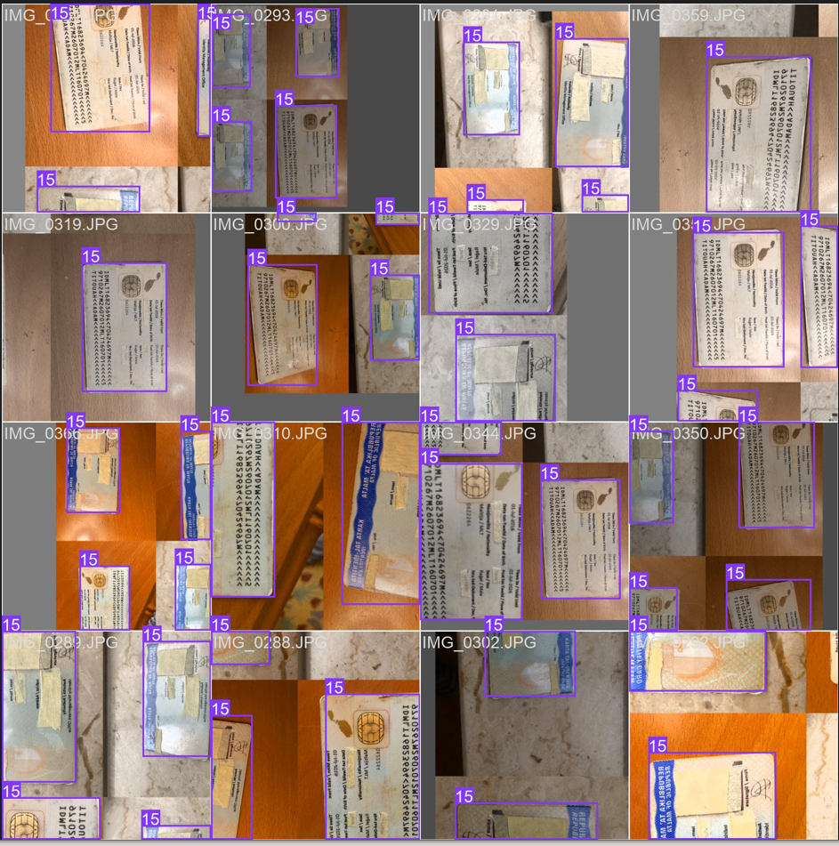
Methodology – Yolo
Real-Time Performance and Robust Detection: YOLO, with its single-pass detection strategy, provides fast detection speeds while maintaining competitive accuracy. Its design allows efficient detection across various ID card designs, layouts, and imaging conditions.
End-to-End Training and Evaluation: The methodology included careful dataset preparation, YOLO model selection, model training, and evaluation using metrics like AP, mAP, and IoU. The performance on the validation set during training helped fine-tune model parameters.
Integration and Post-Processing: The trained YOLO model was seamlessly integrated with Tesseract OCR for efficient text extraction. Post-processing techniques like non-maximum suppression and confidence filtering enhanced the detection results, reducing duplicates and false positives.
Notes:
Once data was prepared, yolo was installed and the images were resized for yolo standard, batch of 16, epochs 50, yolov5s model chosen due to computational loan is lower and depth multiple is lower which is less taxing.
Once done, the training would begin on custom data made. Once training is complete, weights are generated and results.

Slide 8
Methodology- Tesseract
Integration of Tesseract OCR: The Tesseract OCR engine, interfaced through the pytesseract Python library, is a central part of the methodology, responsible for extracting text from the detected ID cards in images.
Image Preprocessing for OCR Enhancement: Essential image preprocessing steps such as converting images to grayscale are performed using OpenCV. This preprocessing phase increases Tesseract's speed and accuracy, facilitating efficient text extraction and storage.
Tesseract Configuration Optimization: Specific configurations of Tesseract, including OCR Engine Modes and Page Segmentation Modes, are fine-tuned to enhance the accuracy of text extraction, making it a dependable tool for our research.
Notes:
Used weights from trained yolo model and loaded onto the device using pytorch
Created a verify_information function to check if the extracted data matches that of the ground truth(id data)
Took the image and resized, normalized and reshaped it and then used yolo weight to perform id detection, applies NMS and then extracts id location
Extracted id then is converted to grayscale, binarized and median filtering applied to reduce noise, and OCR is performed on the modified image
Removed all non-text characters before Nru. And printed extracted values onto txt file
verify_info function is called to check whether the data needed is there and valid

Slide 9
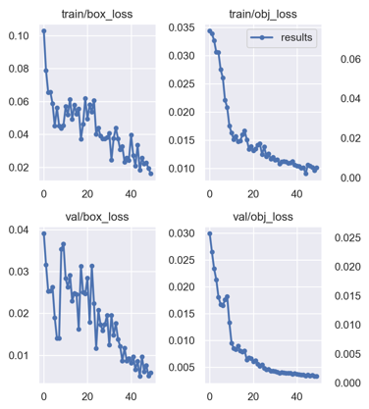
Result Analysis
Hyperparameter Tuning: Key hyperparameters were adjusted, such as learning rate (initially 0.001), batch size (16), momentum (0.9), and weight decay (0.0005) to optimize the model during its 50-epoch training. These were chosen after encountering long processing times and slow training efficiency.
ID Card Localization Improvement: Initial box loss was 0.10289, indicating difficulties in locating ID cards. However, by the 49th epoch, box loss decreased significantly to 0.016131, demonstrating enhanced localization ability.
Prediction and Classification Confidence Enhancement: The model started with an object loss of 0.034338, but by the 49th epoch, it had dropped to 0.01013, indicating increased confidence in object prediction. Similarly, class loss decreased from a high initial value to 0.0021032, showing improved proficiency in classifying detected objects as ID cards.
Notes:
Box loss and object loss are decreasing over epoch training showing localization ability increase for the box loss and increased classification confidence for the object loss

Slide 10
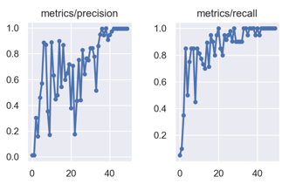
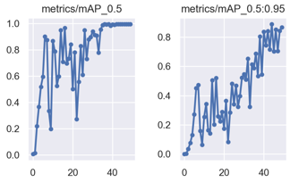
Result Analysis
Metrics After 49 Epochs:
Precision: 0.99618
Recall: 1
mAP_0.5: 0.995
mAP_0.5:.95: 0.86737
Accuracy of YOLOv5 in detecting Maltese ID cards can be seen from the resulting metrics, proving to be a successful endeavor.
YOLOv5 performs better on CPUs than YOLOv8 which is the most recent.
Notes:
Precision: This score tells us what proportion of identified objects were correctly classified. A higher precision means that when the YOLO model identified an object, it was likely correct. A lower precision could indicate that the model is generating false positives.
Recall: Also known as sensitivity what proportion of actual objects were correctly identified by the YOLO model. Higher recall means that the model is good at finding all the objects of interestF1-score: The F1 score is the harmonic mean of precision and recall. It provides a single metric that balances both precision and recall. A higher F1 score indicates that both the precision and recall of the model are high.
Mean Average Precision (mAP): This is a popular metric for measuring the accuracy of object detectors like YOLO. The mAP calculates the average precision (AP) for each class in your dataset and then calculates the mean of these averages. A higher mAP means that your model has high precision and recall across all classes. It's particularly useful in cases where you have unbalanced data or multiple classes.

Slide 11
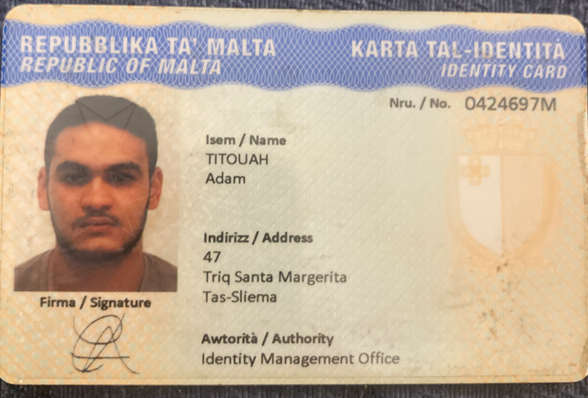
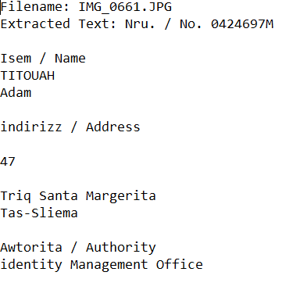
Tesseract Results
Successful Initial Results: The initial extraction of data using Tesseract OCR proved to be successful. This demonstrated the capability of the tool to effectively identify and extract text from ID cards, laying a strong foundation for further improvement and refinement of our approach.
Building a Robust System: The positive outcome of the first-pass extraction provided a practical proof of concept. It confirmed the feasibility of our approach and allows the future focus of building a more robust system capable of handling a variety of ID card types, layouts and conditions.
Basis for Improvement: While the first pass provided promising results, it also highlighted areas for improvement. Future efforts will aim to refine the extraction process to handle more complex cases and ensure accurate results consistently. The experience gained from this initial extraction will be instrumental in guiding these enhancements.

Slide 12
Results - Discussion
Successful ID Card Detection: Our custom YOLO model achieved high efficiency in detecting ID cards within images, with substantial improvements across epochs. This includes decreasing losses and increasing precision and recall values, highlighting the model's enhanced ability to identify and classify ID cards accurately.
Initial OCR Challenges: While Tesseract OCR showed promise in extracting data from detected ID cards, it faced initial challenges with character misinterpretations and handling of complex backgrounds, closely positioned characters, and non-textual elements.
Impact of Preprocessing and Post-processing: The implementation of preprocessing methods for image enhancement, as well as post-processing techniques for focusing Tesseract on the relevant sections of the ID card, considerably boosted OCR results, demonstrating their crucial role in an effective OCR pipeline.

Slide 13
Conclusion
YOLO and Tesseract Integration: We successfully combined YOLO, an object detection model, with Tesseract OCR for data extraction from ID cards. YOLO enabled us to accurately locate the ID cards in images, and Tesseract extracted the textual data. The project revealed the complexities of this task and the need for a specialized system that can adapt to diverse inputs and layouts.
Preprocessing and Fine-Tuning Boost Performance: Image preprocessing techniques and Tesseract parameter fine-tuning played critical roles in improving the accuracy of OCR. Techniques such as grayscale conversion, resizing, binary thresholding, and median filtering significantly enhanced the clarity of the text, leading to more accurate character identification by Tesseract. Fine-tuning the OCR parameters within Tesseract also improved the relevance and order of the extracted data.
Future Scope and Optimizations: There are several areas for future research and optimization. These include sophisticated preprocessing techniques for low-quality images, integration of machine learning models for discerning different ID card types, extraction of non-textual elements, and the development of a more nuanced evaluation method for assessing OCR performance. The project also highlighted the potential for a hybrid OCR system leveraging the strengths of multiple OCR tools, which could further enhance performance and efficiency.

Slide 14
Thank you
Feel free to contact if there are any questions.

