Slide 1

Mapping the Intersection:
Average Wait Time for Housing Vouchers in Relation to Minority Household Percentage
Bert Melix, Megan Skowronski and Pratik Mahajan
This research is supported in part by funding from the Partnership Grant Program of the Social Sciences and Humanities Research Council of Canada for the Consortium on Analytics for Data-Driven Decision-Making (CAnD3) (#895-2020-1013; PI: Amélie Quesnel-Vallée).
Notes:
Good afternoon. My name is Megan Skowronski, and I'm here today presenting work in collaboration with my colleagues Bert Melix and Pratik Mahajan. I’ll be discussing our findings on the demographic variation in wait times to receive housing vouchers in the United States.
The United States Department of Housing and Urban Development provides crucial housing assistance through vouchers to low-income individuals and families. Leveraging data from the 2023 Picture of Subsidized Households, which is based on 2020 Census data, we aimed to visually demonstrate which counties experience the longest wait times, thereby highlighting areas with higher rates of housing insecurity.

Slide 2
Variation in Wait Times by County
35 years & 6 months
1 year & 4 months
1 month
Longest Average Wait Time
Shortest Average Wait Time
Mean Average Wait Time
Notes:
To provide some context on the average wait times for vouchers, across all US counties the shortest average wait time is roughly month; the total average is one year and four months and the longest average wait time, which is Jefferson county Louisiana, 35 and a half years.
Notably Jefferson county consists of 40% minority populations.
Understanding minority household density per county is crucial for effective policy implementation, particularly for HUD's housing voucher program, which has 58% minority participation. This knowledge allows for targeted resource allocation, addressing disparities, and promoting equity.

Slide 3
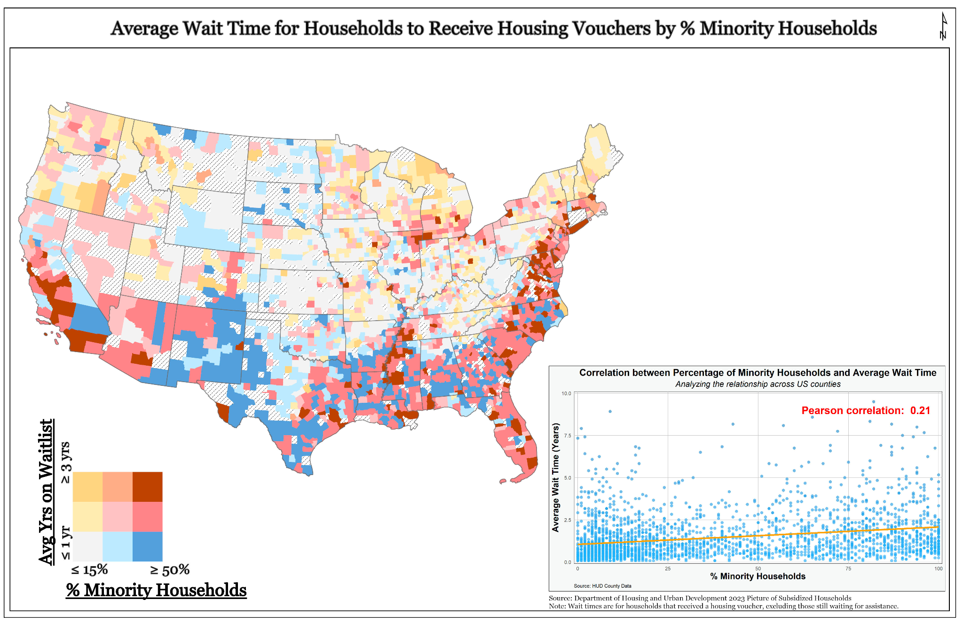
Notes:
So, here we have produced a bivariate map of the United States, illustrating the average wait time for households to receive housing vouchers, overlaid with the percentage of minority households using county level data.
You’ll notice as the percentage of minority households increases, there's a slight tendency for the wait time to also increase.
In our visualization, we deliberately chose not to control for population density to highlight the impact of minority density in urban areas. By doing so, we aim to accurately portray the correlation between minority population and wait times for housing vouchers, without diluting the influence of urban demographics on this relationship.
As you can see, there's a graph to the bottom left which indicates a relationship between the average wait time for housing vouchers and the density of minority household. While this general trend may be weak across the nation, here we have identified the spatial distribution of inequities.
It clear that coastal regions, encompassing both the western and eastern coasts, demonstrate a significant clustering of prolonged average wait times and notable densities of minority households. These regions call for specific focus and increased investment in supplementary housing support measures, namely in the supply of available housing units.
***
Thank you!

Slide 4

To view our github repository please scan the QR code!
Thank you!

