Slide 1
ACM ICPC 2008 Aizu
Yoshihisa Nitta （Chief Judge)
Tsuda College
Notes:
I’m Yoshihisa Nitta, chief judge of this year.
Now, I will explain problem set of today’s contest.

Slide 2
Problem Set
No | Title | Domain | Level
A | Grey Area | Specification | 1
B | Expected Allowance | Specification | 1
C | Stopped Watches | Combination | 2
D | Digits on the Floor | Graph | 2.5
E | Spherical Mirrors | Geometry | 2.5
F | Traveling Cube | Route search | 3
G | Search for Concatenated Strings | String Match | 3.5
H | Top Spinning | Geometry & Simulation | 4
I | Common Polynomial | Formula manipulation | 4
J | Zigzag | Geometry | 4
Notes:
This is the list of problem set of today’s contest.
We prepare 10 problems which are contained in various problem domains.
We planned difficulty levels of each problem like this, at first.
But the difficulty level is changed while the details of each problem are determined.
I think you have different impressions to the problem level.
Perhaps, your impression is more accurate than our first planned level.

Slide 3
Plan to prepare problems
Each team will solve at least one problem.
Each problem will be solved by at least one team.
No team will solve all the problems.
×
△
○

Slide 4
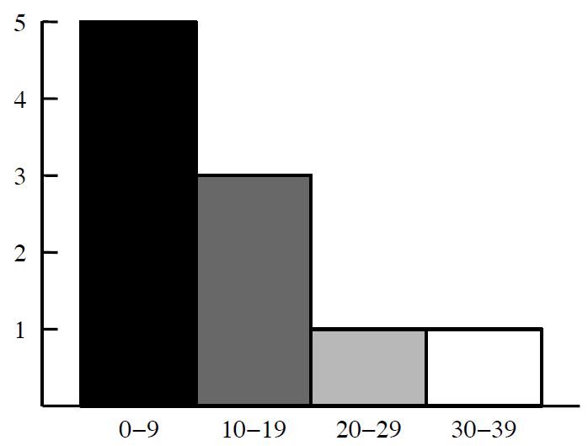
Problem A: Grey Area
Correct team | 34
Submit | 48
Estimate ink consumption for printing histogram
Each bar is drawn monotonically
Darkness of each bar is decreased from left to right
Histogram
Notes:
Problem A.
XX teams solved.
Submit number is XX.
This problem is planned to be easy, but not too easy.
The fact is supported by the number of correct team.
In this problem, you are requested to estimate ink consumption.

Slide 5
A: How to Solve
2 pass processing required
Bar’s darkness
Count up and Classify
Number of Categories are determined
Estimate ink consumption
Notes:
To solve this problem, 2-pass data processing is needed.
A bar is drawn monotonically, but the darkness of each bar is changed.
To determine the darkness of bar, number of categories is needed.

Slide 6
A: Example
Data
Table of Frequency Distribution
Interval=10
1 2 3 4 5
16 17 18
29
30
Category | Quantity | Darkness
0-9 | 5 | 1.0
10-19 | 3 | 0.66667
20-29 | 1 | 0.33333
30-39 | 1 | 0.0
Histogram

Slide 7
Problem B: Expected Allowance
Correct team | 32
Submit | 35
Count up occurrence of each sum of pips of n dice.
Pip of dice is between 1 and m
Calculate

Slide 8
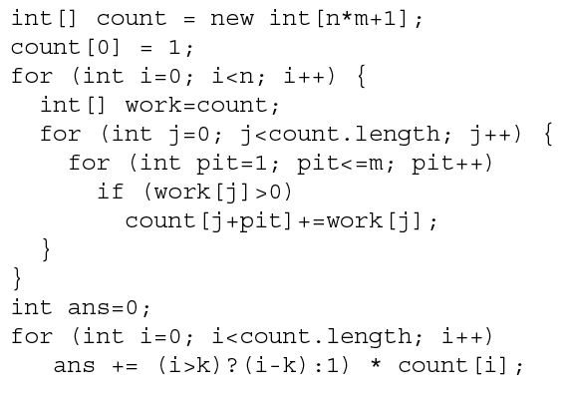
B: Count up occurrence

Slide 9
B: Count up Occurrence
0 die
Sum | 0 | 1 | 2 | 3 | 4 | 5 | 6 | 7 | 8 | 9 | 10 | 11 | 12
Occurrence | 1 | 0 | 0 | 0 | 0 | 0 | 0 | 0 | 0 | 0 | 0 | 0 | 0
1st die:pim=
1
2
3
4
5
6
1 die
Sum | 0 | 1 | 2 | 3 | 4 | 5 | 6 | 7 | 8 | 9 | 10 | 11 | 12
Occurrence | 0 | 1 | 1 | 1 | 1 | 1 | 1 | 0 | 0 | 0 | 0 | 0 | 0

Slide 10
B: Count up Occurrence
1st die
1 die
Sum | 0 | 1 | 2 | 3 | 4 | 5 | 6 | 7 | 8 | 9 | 10 | 11 | 12
Occurrence | 0 | 1 | 1 | 1 | 1 | 1 | 1 | 0 | 0 | 0 | 0 | 0 | 0
+
2nd die:pip=1
2 dice
Sum | 0 | 1 | 2 | 3 | 4 | 5 | 6 | 7 | 8 | 9 | 10 | 11 | 12
Occurrence | 0 | 0 | 1 | 1 | 1 | 1 | 1 | 1 | 0 | 0 | 0 | 0 | 0
2nd die:init
Sum | 0 | 1 | 2 | 3 | 4 | 5 | 6 | 7 | 8 | 9 | 10 | 11 | 12
Occurrence | 0 | 0 | 0 | 0 | 0 | 0 | 0 | 0 | 0 | 0 | 0 | 0 | 0

Slide 11
B: Count up Occurrence
1st die
1 die
Sum | 0 | 1 | 2 | 3 | 4 | 5 | 6 | 7 | 8 | 9 | 10 | 11 | 12
Occurrence | 0 | 1 | 1 | 1 | 1 | 1 | 1 | 0 | 0 | 0 | 0 | 0 | 0
+
2nd die:pip=2
2 dice
Sum | 0 | 1 | 2 | 3 | 4 | 5 | 6 | 7 | 8 | 9 | 10 | 11 | 12
Occurrence | 0 | 0 | 1 | 2 | 2 | 2 | 2 | 2 | 2 | 0 | 0 | 0 | 0
2nd die:pip<=1
Sum | 0 | 1 | 2 | 3 | 4 | 5 | 6 | 7 | 8 | 9 | 10 | 11 | 12
Occurrence | 0 | 0 | 1 | 1 | 1 | 1 | 1 | 1 | 0 | 0 | 0 | 0 | 0

Slide 12
B: Count up Occurrence
1st die
1 die
Sum | 0 | 1 | 2 | 3 | 4 | 5 | 6 | 7 | 8 | 9 | 10 | 11 | 12
Occurrence | 0 | 1 | 1 | 1 | 1 | 1 | 1 | 0 | 0 | 0 | 0 | 0 | 0
+
2nd die:pip=3
2 dice
Sum | 0 | 1 | 2 | 3 | 4 | 5 | 6 | 7 | 8 | 9 | 10 | 11 | 12
Occurrence | 0 | 0 | 1 | 2 | 3 | 3 | 3 | 3 | 3 | 1 | 0 | 0 | 0
2nd die:pip<=2
Sum | 0 | 1 | 2 | 3 | 4 | 5 | 6 | 7 | 8 | 9 | 10 | 11 | 12
Occurrence | 0 | 0 | 1 | 2 | 2 | 2 | 2 | 2 | 2 | 0 | 0 | 0 | 0

Slide 13
Problem C: Stopped Watches
Correct team | 20
Submit | 23
Search the appropriate interpretation of watches.

Slide 14
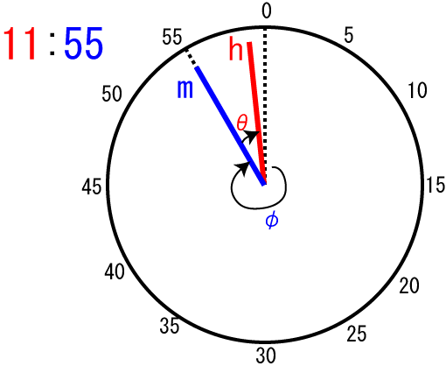
C:Relations between h and m
Notes:
The h hand goes at every 12 minutes.
So, the relation between h and m is expressed by this equation.

Slide 15
C: Search Space
Permutations of (s,t,u) equals 3! = 6
For each permutation of (s,t,u), (h,m,second) is assigned and checked.
for given h and m, only 12 ways of i
between 0 and 59 satisfies
ways interpretation
(for each clock)

Slide 16
C: search
earliest clock ≦ disaster time ≦latest clock
Suppose
Time span
Clock | Time1 | Time2 | Time3 | … | Time72
Clock1
Clock2
…
Clockn
-
+12:00(if minus)
Suppose
max
Clock | Time1 |  | Time3 | … | Time72
Clock1
Clock2
…
Clockn
min
.
.
.
min

Slide 17
C: time span table
earliest clock ≦ disaster time ≦latest clock
Time span
Shortest
Select Minimum
Clock | Time1 | Time2 | Time3 | … | Time72
Clock1 | Span1,1 | Span1,2 | Span1,3 |  | Span1,72
Clock2 | Span2,1 | Span2,2 | Span2,3 |  | Span2,72
…
Clockn |  |  |  |  | Spann,72
Minimum value of time span table indicates the answer.

Slide 18
Problem D: Digits on the floor
Correct team | 9
Submit | 20
Recognize numbers with line segments.

Slide 19










D: How to recognize
Figure
[1] | 4 | 1 | 5 | 4 | 3 | 5 | 5 | 3 | 5 | 4
[2] | 4 | 2 | 6 | 6 | 5 | 6 | 6 | 4 | 6 | 5
[3] | 0 | 0 | 0 | 1 | 1 | 0 | 1 | 0 | 2 | 1
[1] Number of lines
[2] Number of points
[3] Number of points on mid-Line

Slide 20
D: How to distinguish 2 and 5
a
a
b
b
Cross product of vector a and b
a×b < 0
a×b > 0

Slide 21
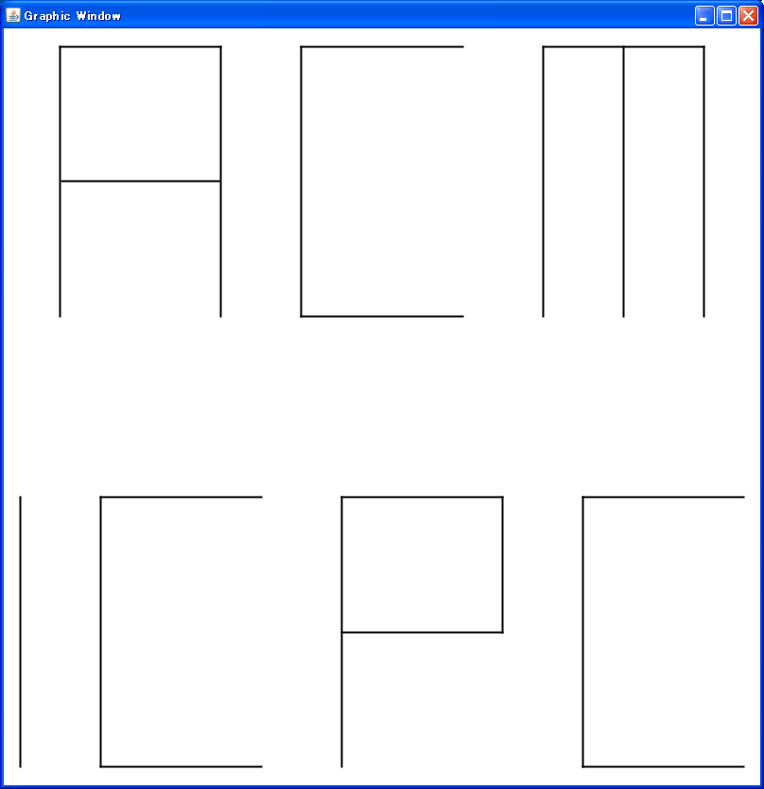
D: Judge Data

Slide 22
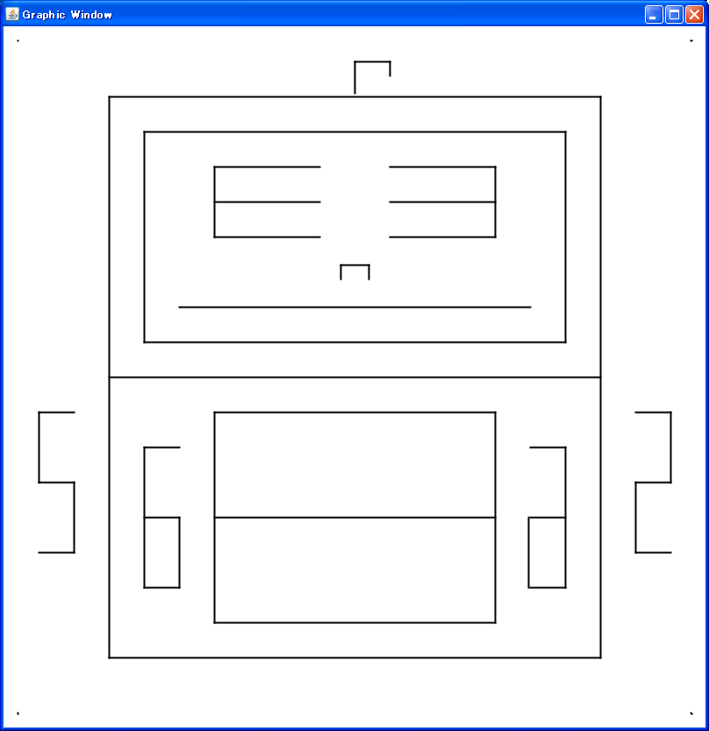
D: Judge Data

Slide 23
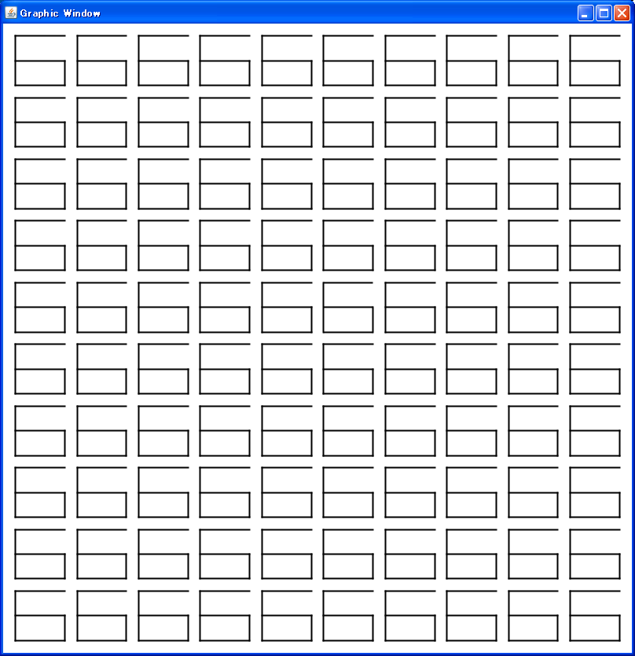
D: Judge Data

Slide 24
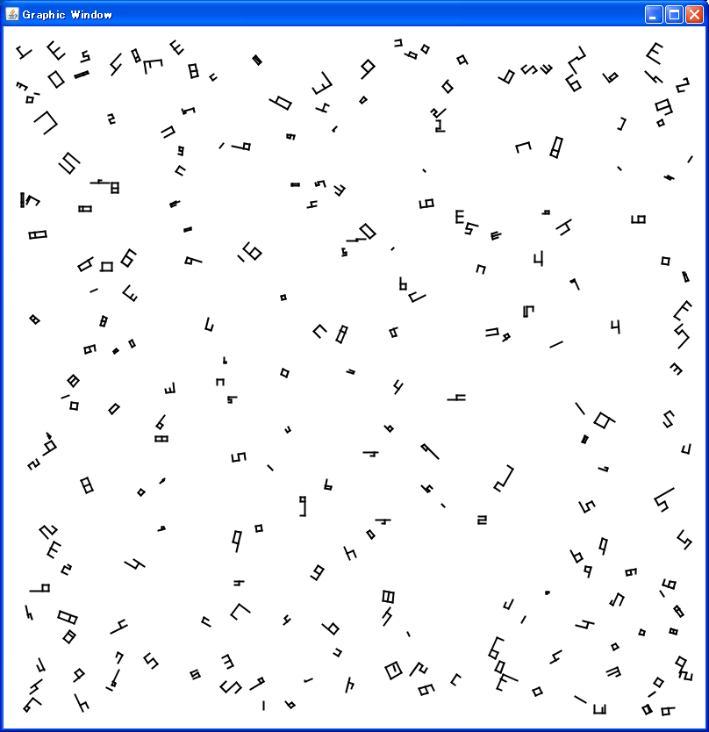
D: Judge Data

Slide 25
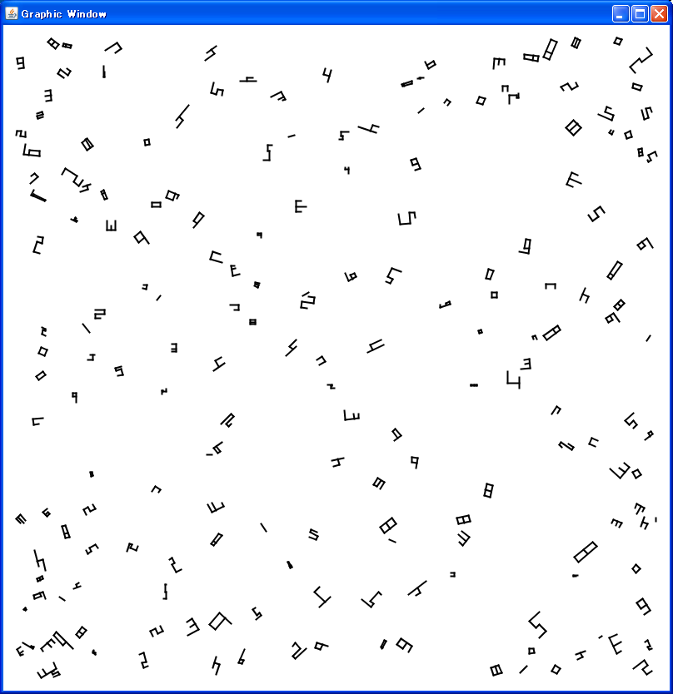
D: Judge Data

Slide 26
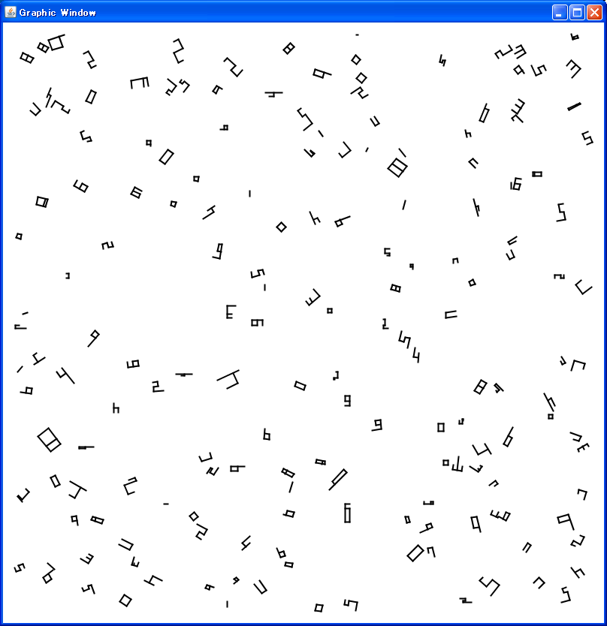
D: Judge Data

Slide 27
E: Spherical Mirrors
Correct team | 10
Submit | 12
Ray tracing
Easy problem in the geometry domain
Answer the last mirrored point

Slide 28
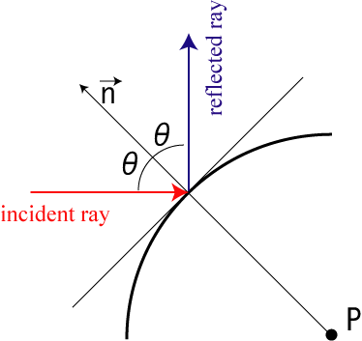
E: reflection

Slide 29
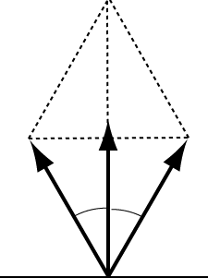
E: reflection
cosθ
Notes:
Between the reverse vector of incident ray [a] and reflection vector [b], the equations holds.

Slide 30
E: Intersection of Line and Sphere
Line l:
Sphere u:
Intersection:
This quadratic equation for t can be solved easily.

Slide 31
E: select appropriate t
Minimal Positive t means the reflection point.
Greater
×
○
×
Minus

Slide 32
Problem F: Traveling Cube
Correct team | 14
Submit | 18
Colored cube rolls on square tiles.
On colored tiles, the top face of cube should be colored the same.
Cube must visit the colored tile in the specified order.

Slide 33






F: Cube on a Square Tessellation
#
1
3
2
5
4
6

Slide 34
F: Search Space
State of dice: top color 6, north color 4
Size of tiles: w*d
Number of targets: 6
Node of the graph: 6 * 4 * w * d * 6
Search the graph with Dijkstra

Slide 35
G: Search of Concatenated String
Correct team | 9
Submit | 55
Search concatenation of all patterns.
aabccc
aacccb
baaccc
bcccaa
cccaab
cccbaa
aa
b
ccc
Concatenation of all patterns
aabccczbaacccbaazaabbcccaa

Slide 36
G: Wrong Answer (naive algorithm)
Concatenated
pattern
text
aabccczbaacccbaazaabbcccaa
aabccc
aabccc
aacccb
aacccb
baaccc
baaccc
bcccaa
bcccaa
cccaab
cccbaa
cccbaa

Slide 37
G: Wrong Answer
Complexity: n! × Text length
12! × 5000 = 2395008000000
Too Large to Solve
Example of judge data:
text
aaaaaaaaaaaaaaaaaaaaaaaaaaaaaa…a
patterns
a, a, a, a, a, a, a, a, a, a, a, b

Slide 38
G: Acceptable Algorithm
P1,P3
P2,P3
P3
P1
P2
Text
P1
P2
P3
For each point of target string, remember the matched pattern sequence.

Slide 39
G: To express matched patterns
For n patterns, n bits are needed to express which patterns are matched.
P1
P2
P12
000000000000
000000000001
・・・
111111111111
patterns
To express these bits pattern simultaneously, 4096 bits needed.
1001000000000000000000000……………………………………………………………………………0
O(2^{n}×Text length) of memory needed.

Slide 40
H: Top Spinning
Correct team | 0
Submit | 1
Find the center of a top to make it spin well.
Determine whether the center of a top is on the part of the cardboard cut out.

Slide 41
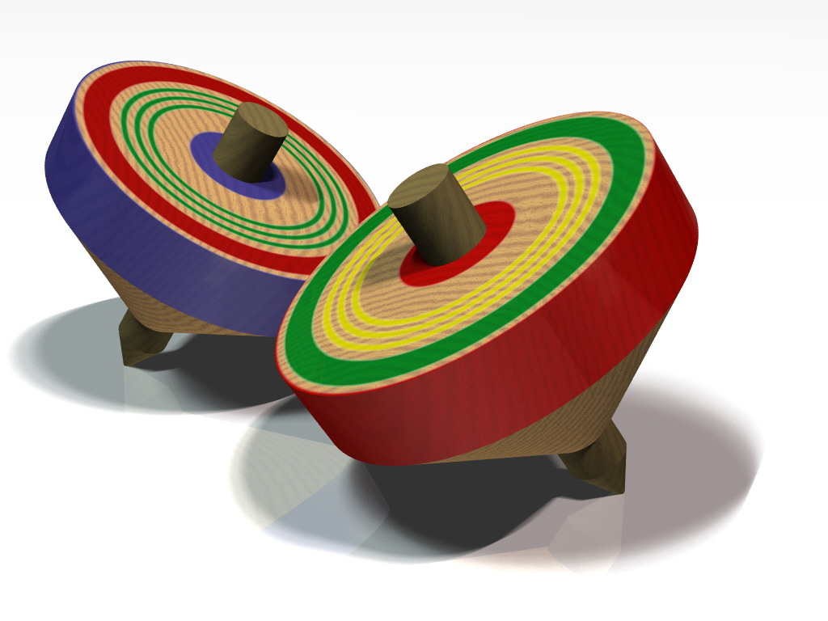
H. Top Spinning

Slide 42
Approximation of a Cicular Segment by a Series of Line Segments
As the accuracy requirement is not so severe,
it might be a good idea to approximate
circular segments by a series of line segments

Slide 43
Computing the Barycenter
Triangulation
The area can be partitioned into triangles.
The center of mass can be computed based on
areas and mass centers of these triangles.
Notes:
One possible way to compute the center of mass is triangulation. The figure is partitioned into triangles and the mass and the mass center of each of the triangles are computed.

Slide 44
Computing the Barycenter
Positive and Negative Integration
Another possible way is to intepret the paｔｈ
as a graph and compute the integral of the graph.
When a segment goes leftwords, the area
can be considered negative.
Notes:
Another possible way is to assume paths as a graph segments and compute the integral of the graph. When the path above the X-axis goes to the right right, the area between the graph and the X-axis is positive; if it is below the X axis or goes to the left,the area is considered to be negative. When the path comes back to the original position, the sum of those positive and negative areas will be the area of the original figure.

Slide 45
Telling Whether the Barycenter is
Inside the Area or Not
Summing up angles of
the barycenter and
two ends of segments is
2π iff it is inside.
But approximating an
arc with a single line
segment may lead to
a wrong decision!

Slide 46
Telling Whether the Barycenter is
Inside the Area or Not
Whether the number of
crosses with a ray
starting from the
barycenter is even/odd
can tell outside/inside.
Here too, approximating
an arc with a line seg. is
dangerous!

Slide 47
Telling Whether the Barycenter is
Inside the Area or Not
Direction of the path segment closest to the
barycenter can tell whether or not it is
inside the area.

Slide 48
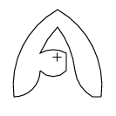




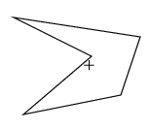
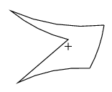
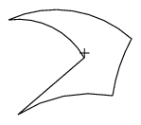
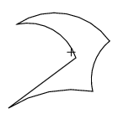
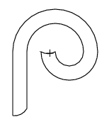
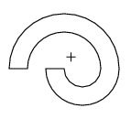


Judge Data

Slide 49
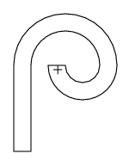

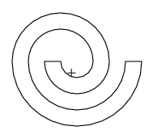
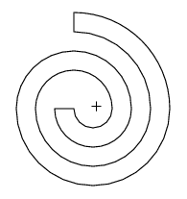
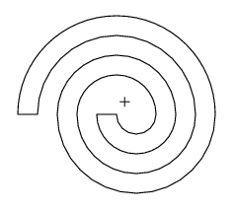
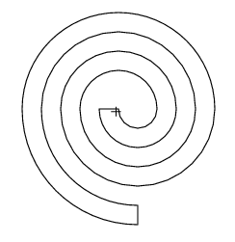
Judge Data

Slide 50
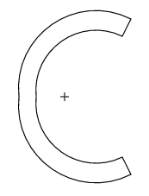


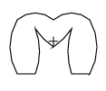





Judge Data

Slide 51
I: Common Polynomial
Correct team | 2
Submit | 2
To calculate GCM,
the previous divisor be the dividend,
the previous remainder be the divisor.
When remainder is 0, then the divisor is GCM.
dividend
divisor
remainder
a ÷ b … c
b ÷ c … d
…
e ÷ f … 0
GCM

Slide 52
I: Common Polynomial
x² +10x+25
[1]-[2]
x² +10x+25
…[1]
-
x² +6x+5
x² +6x+5
…[2]
4x+20
x+5
…[3]
Subtract less degree polynomial from greater degree polynomial
after making highest degree’s coefficients to the same.
[2]-[3]×x
x² +6x+5
-
x² +5x
x+5
…[4]
[3]-[4]
x+5
-
x+5
Common Polynomial
0

Slide 53
J: Zigzag
Correct team | 0
Submit | 00
P₁
P₂
Generate all the lines which pass through two or more points.
I₁
I₂
Find all the intersections of lines.

Slide 54
J: Zigzag
Generate all the line segments between each pair of (Pi,Pj),(Pi,Ij),(Ii,Ij) which pass at least two points.
×
P₁
P₂
I₁
I₂
For each points P_{i}, suppose it as a start point, and
search with Dijkstra.

