Slide 1
Doesn’t Keep Appointments Davey Wong (UCLA/KP)
How we chose our model
What our best model tells us
The next step

Slide 2
Predictive models
Performance and validity

Slide 3
Introduction
We examined various models.
The models differ on regression modeling strategies.
The overall goal is to recommend a model that balances the highest levels of performance and practicality.
A global sensitivity analysis was performed to identify the biggest impact areas (i.e., where is the biggest bang for the buck).

Slide 4
Key terms
Predictive model: A regression model that calculates predictions of the outcome, adjusting the impact of various variables.
Calibration: The reliability of a model, meaning the ability of the model to predict future observations as well as it appeared to predict the responses at hand.
Discrimination: How well a model assigns higher risk to patients with higher risk of the outcome.

Slide 5
Model variables
Predictors
age | visit_provider_group
age2 | specialty
gender | med_center
language | Prior_dka_rate
copay | Prior_dka_rate2
copay2 | prior visits
weekday | prior visits2
hour | age*gender
hour2 | weekday*hour
days_wait | dka*
days_wait^2 | race*
* Variables used only in the multiple imputation. Outcome is DKA.

Slide 6
Model approximation
Deleted X | Proportion of remaining R2 | Total Remaining R2
age2 | 1.0000000000 | 0.237
vst_pri | 0.9999998000 | 0.237
gender | 0.9999984000 | 0.237
vst_pri2 | 0.9995935000 | 0.236904
copay2 | 0.9991274000 | 0.236793
copay | 0.9990607000 | 0.236777
weekday | 0.9984463000 | 0.236632
hour | 0.9977642000 | 0.23647
hour2 | 0.9974693000 | 0.2364
language | 0.9960991000 | 0.236075
med_ctr | 0.9937943000 | 0.235529
visit_prov_group | 0.9902274000 | 0.234684
age | 0.9761841000 | 0.231356
days_apt_bk2 | 0.9604290000 | 0.227622
days_apt_bk | 0.9551189000 | 0.226363
dkart_pri2 | 0.9337603000 | 0.221301
dkart_pri | 0.8045697000 | 0.190683
specialty | 0.0000000000 | 0
The reduced (quadratic) model retains 96% of the full model’s R2.

Slide 7
Comparing model validation results
Model variables
The Full linear model is the gold standard.
 |  | Discrimination |  | Calibration
Model | Model C-index | C-index | R2 | MAE | MSE
Full (linear) | 0.806 | 0.805 | 0.217 | 0.008 | 0.00031
Full (interactions) | 0.806 | 0.805 | 0.217 | 0.008 | 0.00036
Full (non-linear) | 0.820 | 0.819 | 0.247 | 0.002 | 0.00003
Full (quadratic) | 0.813 | 0.812 | 0.237 | 0.002 | 0.00002
MI Full (linear) | 0.805 | 0.786 | 0.188 | 0.008 | 0.00026
MI Full (interactions) | 0.805 | 0.786 | 0.188 | 0.008 | 0.00026
MI Full (non-linear) | 0.820 | 0.814 | 0.237 | 0.002 | 0.00002
MI Full (quadratic) | 0.813 | 0.812 | 0.237 | 0.002 | 0.00600
Winning model (reduced) | 0.806 | 0.805 | 0.227 | 0.003 | 0.00002
Note: The total R2 and C-index of the complete model used to develop the approximated model is 0.237 and 0.813. The predictors of the reduced model are prior DKA rate, prior DKA rate^2, days wait, days wait^2, and specialty. Bootstrap Validation, split-sample, and ten-fold cross-validation resulted in similar model assessment values (e.g., C-index= 0.81). Subsequently, cross-validation was used throughout the analysis. The full linear, full non-linear, and full quadratic models were all significantly different based on a likelihood ratio test (p < 0.0001). The full linear model and the full reduced model are not significantly different.
MAE: Mean absolute error (mean [Y - Y hat])
MSE: Mean squared error (mean (Y - Y hat)^2)
Imputation impacts calibration more, non-linear terms helps discrimination and calibration. The best model uses both.
The reduced (quadratic) model performs as well as the full linear model.

Slide 8
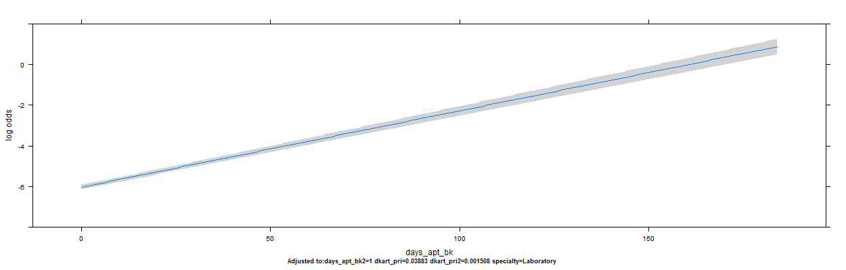
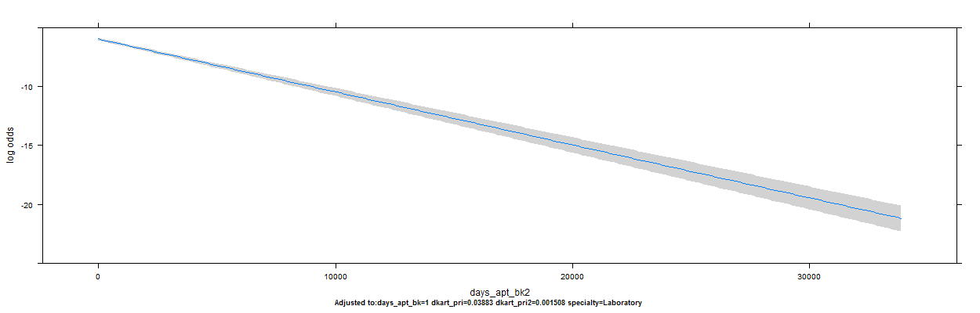
Number of days wait and squared term
Reduced model partial effects plots.

Slide 9
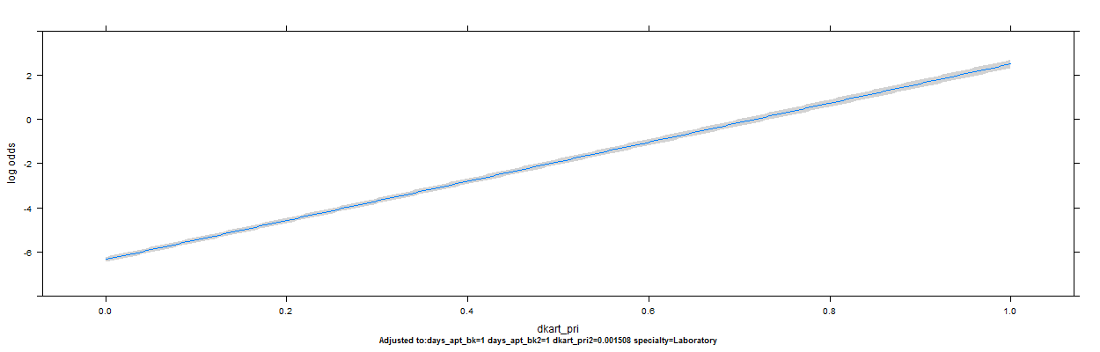
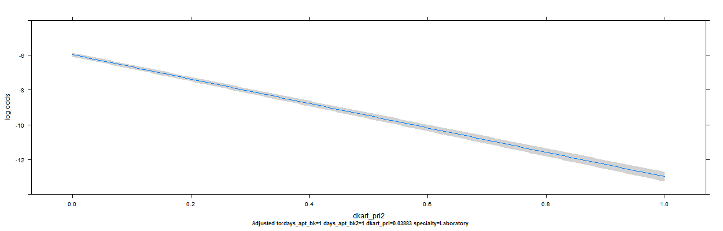
Prior DKA rate and squared term
Reduced model partial effects plots.

Slide 10
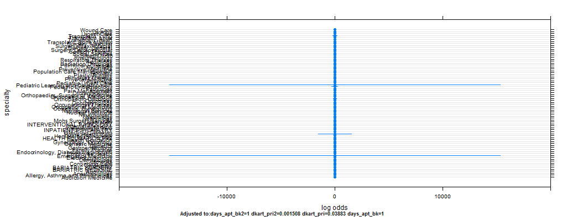
Specialty
Reduced model partial effects plots.

Slide 11
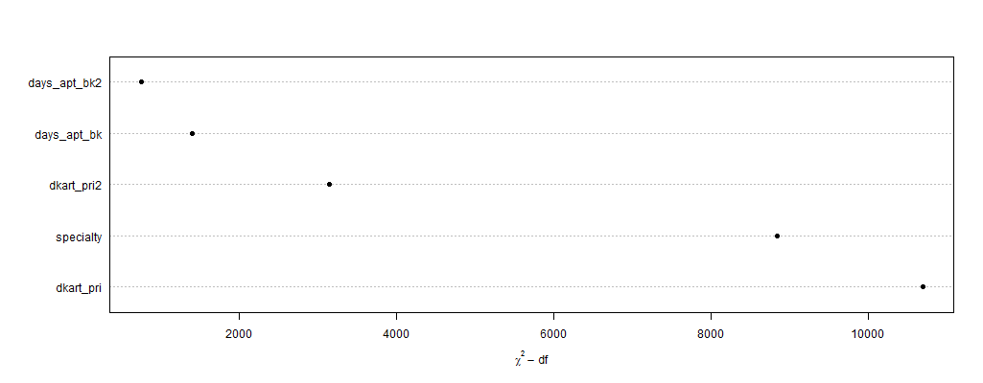
Predictor importance

Slide 12
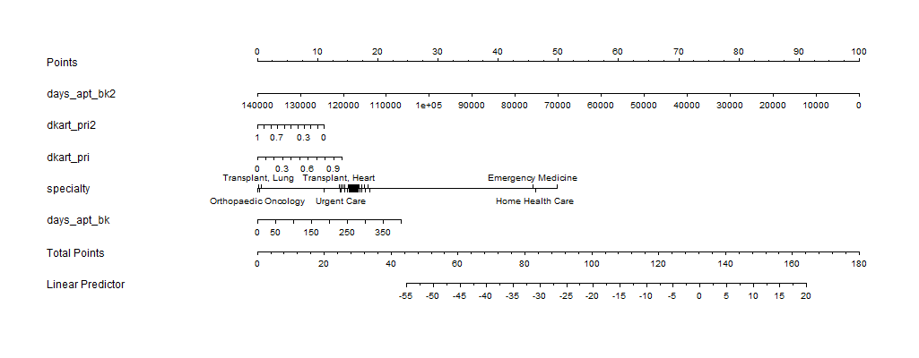
Nomogram

Slide 13
Global Sensitivity Analysis
Monte Carlo simulation that provides actionable information

Slide 14
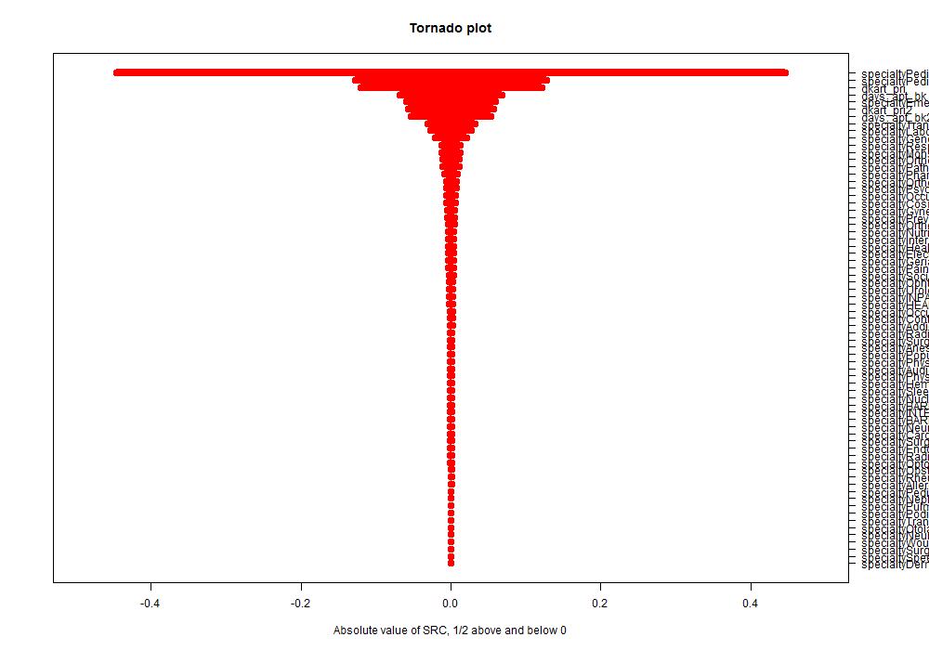
Tornado Plot
This shows which predictors the DKA outcome is most sensitive to. The width of the bar indicates importance.
Generally, DKAs are most sensitive to prior DKA rate and days wait. However, DKA is very sensitive to some specialties while being not very sensitive to other specialties.

Slide 15
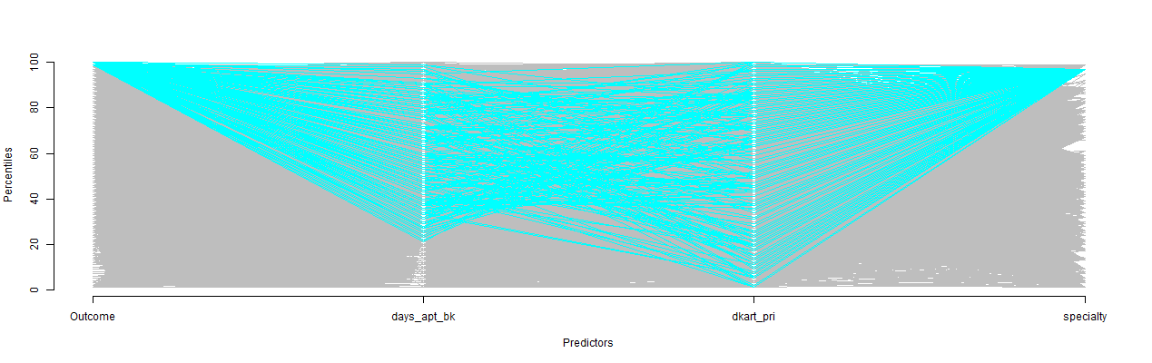
Cobweb Plot: Top 1% predicted scores
Those most likely to DKA are psychiatry visits, have longer waits, and to a lesser degree, have a higher prior DKA rate.

Slide 16
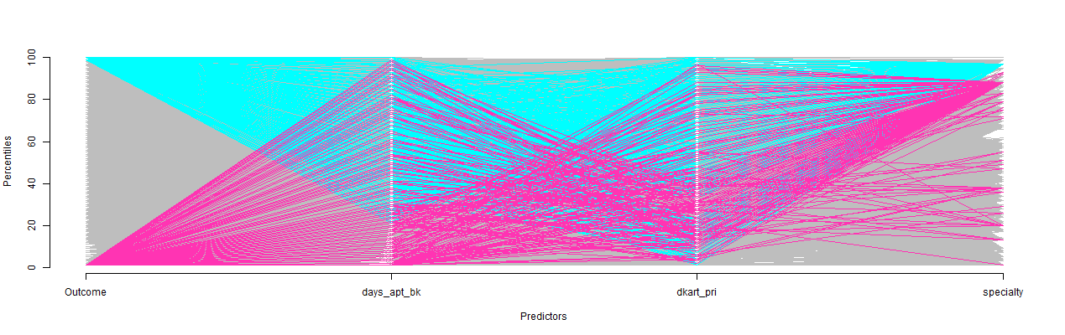
Cobweb Plot: Top 1% and bottom 1% predicted scores
Those least likely to DKA have a slightly greater concentration in their prior DKA rate than their days wait and they are found in multiple specialties.

Slide 17
Summary
Nonlinear terms helped the most.
Multiple imputation impacted calibration more so than discrimination but gave more precise standard errors and lower optimism levels that non-imputed models. Keep in mind it's from single imputed data and we benefit from using missing data.
Interactions helped the least but interacting predictors with specialty might help (as seen in global sensitivity analysis).
Model approximation helps find the most efficient model.
Use more sensitive calibration and discrimination measures (MSE, R2).

Slide 18
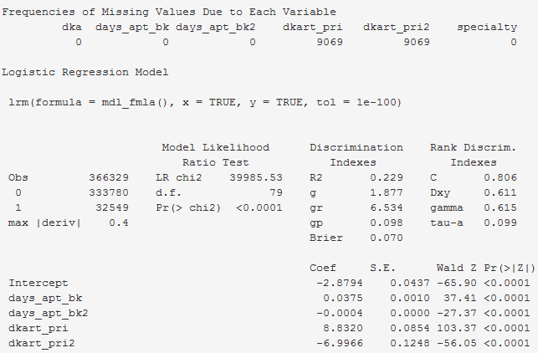
Appendix A: Regression results

Slide 19
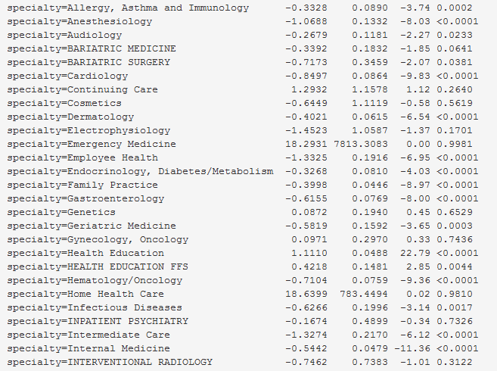
Appendix A: Regression results (cont.)

Slide 20
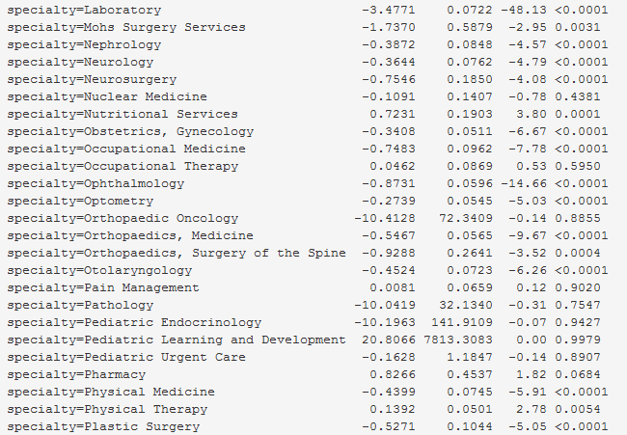
Appendix A: Regression results (cont.)

Slide 21
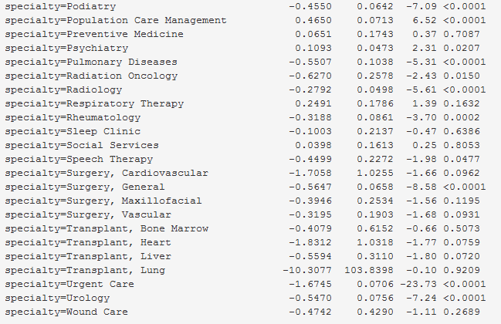
Appendix A: Regression results (cont.)

