Slide 1
MYSTERY DOORS
-the beauty of intelligence
Project Associates:
Mr. Harish Patil 2BV09IS034
Mr. Pavankumar B. L. 2BV09IS062
Mr. Pradeep N. C. 2BV09IS067
Ms. Priyanka Patil 2BV09IS075

Slide 2
PROBLEM DEFINITION
To develop an game application which will push the users intelligent level to its best. Different levels of puzzles are taken with some interesting constraints imposed on the user and will challenge the user to answer those questions to reach the final goal .

Slide 3
ABSTRACT
This is a puzzle-base game, with a catchy story-line and interesting scenarios.
We have four characters in this game- Alex, Maya, Dhaka and David.
The conversations in this make it more interactive and addictive.
There will be 5 levels in this game, each level with increased complication than the previous one.
A bonus for the player after each level solved will keep him surprised and interested .

Slide 4


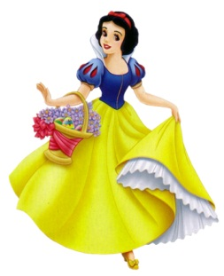
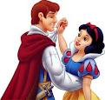
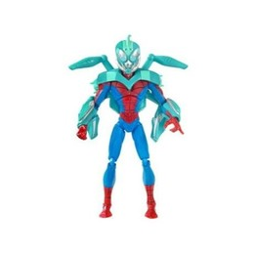
5 mystery doors

Slide 5
ABSTRACT CONTD.
This application helps us increase our reasoning skills.
The estimated paid downloads per day would be 15/day.
The estimated clicks would be more than 40/day.
The estimated paid downloads would be 450/month.
The estimated clicks would be more than 1200/month.

Slide 6
SUBJECT RELEVANCE
C# for coding, DBMS to store the Character images and story files, DAA to follow the algorithm while writing the game procedure, Software Engineering for testing the app.

Slide 7
THANK YOU

