Slide 1
Location based information of hotels
SUBMITTED BY:
MR.TEJRAJ L 2BV08IS113
MS.PRIYANKA K DAMBAL 2BV09IS076
MR.ALOK JOSHI 2BV10IS400
MR.KARTHIK V 2BV10IS407

Slide 2
PROBLEM DEFINITION
To develop location based application which specifies the location and information about the nearest hotels through GPS. The main goal of the application helps the person to know the location of the hotels and the menu with details of dishes prepared there and their respective prices.

Slide 3

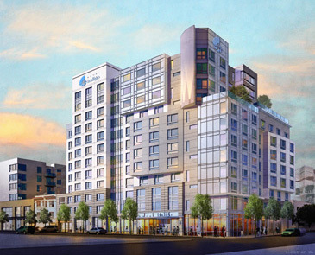
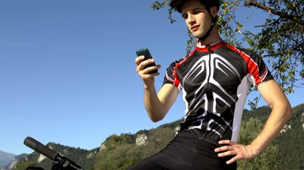
COFFEE DAY
HANS HOTEL
A man tracking the hotels with LBS APP

Slide 4
ABSTRACT
We have all seen the explosive growth of mobile apps in recent years. One category of apps that is very popular is location-based services, commonly known as LBS.
LBS apps track your location, and may offer additional services such as locating amenities nearby, as well as offering suggestions for route planning, and so on.
Of course, one of the key ingredients in a LBS app is maps, which present a visual representation of your location.

Slide 5
ABSTRACT CONTD
Google Maps is one of the many applications bundled with the Android platform. In addition to simply using the Maps application, we can also embed it into our own applications and make it do some very cool things.

Slide 6
COMPARISON WITH GOOGLE MAP
Google maps provide the locations of the hotels present in the city but it doesn’t provide the information about the dishes and their prices in the map.
Our application provides the information of the dishes and their prices of the respective hotel located in the map.
This application helps the person to know the hotels location and even helps the person to know the path to hotel in which he is interested.

Slide 7
DIFFERENT ACTORS USING THE APPLICATION
This application is very helpful to new visitors to city in finding their affordable hotel.
This application is helpful for the persons in finding their favorable dishes in diff hotels.
This application is helpful for the persons who are not familiar with the location of the hotels.

Slide 8
SOFTWARE REQUIREMENT
The application has to be developed in ECLIPSE
Application platform used : Android
Tool: Droid draw
Database:SQLite
Android Smartphone
HARDWARE REQUIREMENTS

Slide 9
STATUS OF APPLICATION AFTER DEPLOYMENT IN THE MARKET
This app would be successfully downloaded in the city with the city the app is concerned.
The estimated paid downloads per day would be 8downloads per day.
The estimated clicks would be more than 19clicks per day.
The estimated paid downloads per month would be 240downloads per month.
The estimated clicks would be more than 570clicks per month.

Slide 10
THANK YOU.

