Slide 1

Image

Slide 2
Project Associates:
Guide:
Mrs. Ranjini S.
Team: Roll No
Harish Patil 12
Pavankumar B. L. 23
Pradeep C. 26
Priyanka Patil 29

Slide 3
Problem Definition
To develop a game application which will push the user’s intelligent level to its best. Different levels of puzzles are taken with interesting constraints imposed on the user. And will challenge the user to answer the questions to reach the final goal.

Slide 4
ACTIVITY DIAGRAM

Slide 5
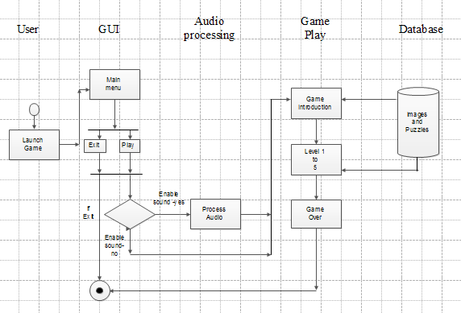
click
click

Slide 6
Functional Requirements - GUI
The welcome screen or main menu screen must consists of two buttons. PLAY and EXIT. If user clicks on EXIT button the game must terminate.
When user clicks on PLAY button, he/she must be given an option to enable or disable sound.
If user enables sound then background audio need to be played using background audio player agent.
back
Screen shots

Slide 7
Functional Requirements- Game-play
When user clicks on PLAY button the game must navigate to next page showing the introduction to game using motion of characters. Characters are moved using motion of images(.gif to enable animation).
During gameplay different set and type of questions need to displayed on screen and answers must be validated before proceeding to next step.
Different set and type of questions and all the solutions must be stored in an isolated file storage medium i.e. mobile’s flash memory. At a different level’s of game suitable type of question must be fetched from file and displayed on screen.
back
Screen shots

Slide 8
Non-Functional Requirements
Our app requires maximum of 10Mb memory.
Reliability- This app runs 99% of the times.
Response time- This app’s response time is 0.5s.
Speed- Depends on the mobile’s main memory.
Portability- Meets out all the requirements of the customer.
Performance- The performance is better if the user downloads the app properly.

Slide 9
THANK YOU…

Slide 10
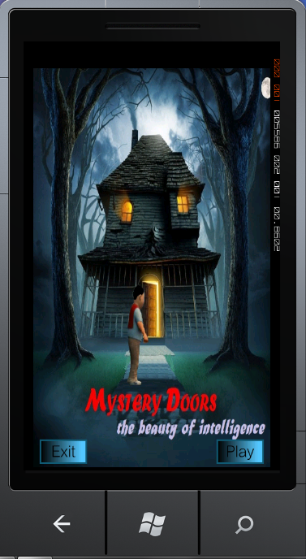
back

Slide 11

back

Slide 12
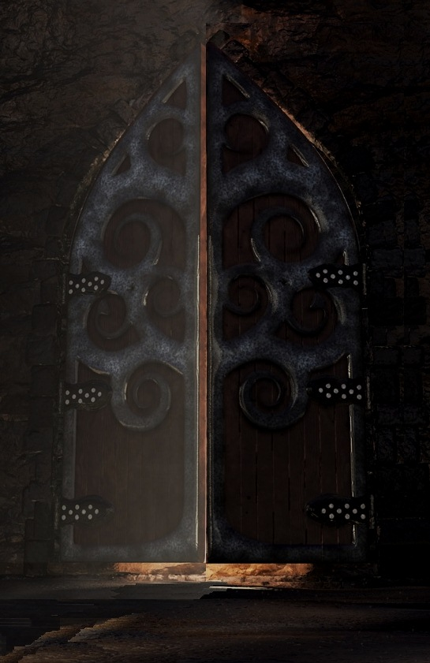

back

Slide 13


back

Slide 14
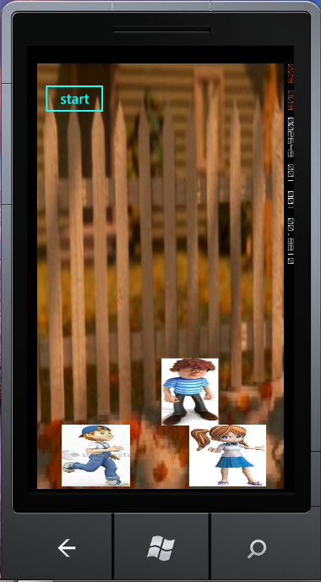
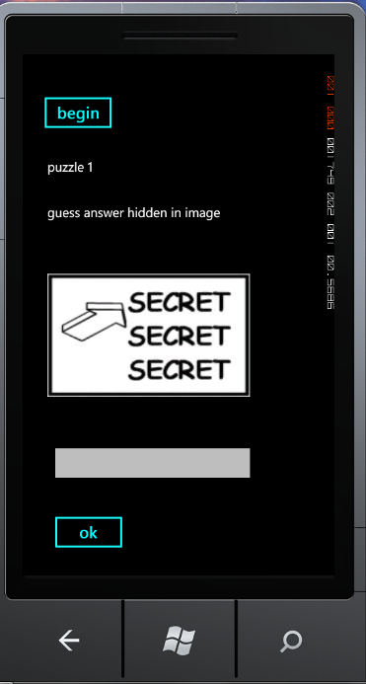
back

Slide 15
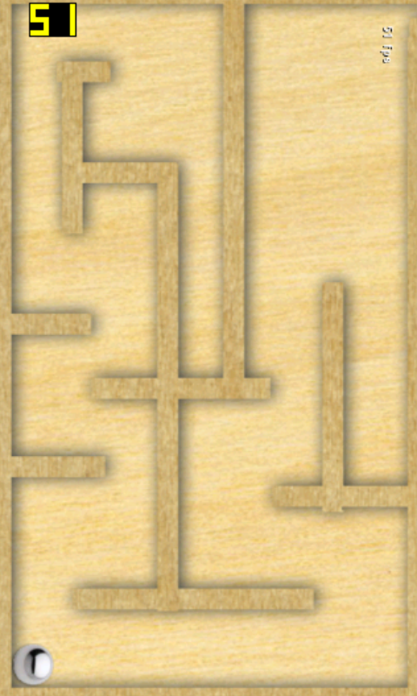
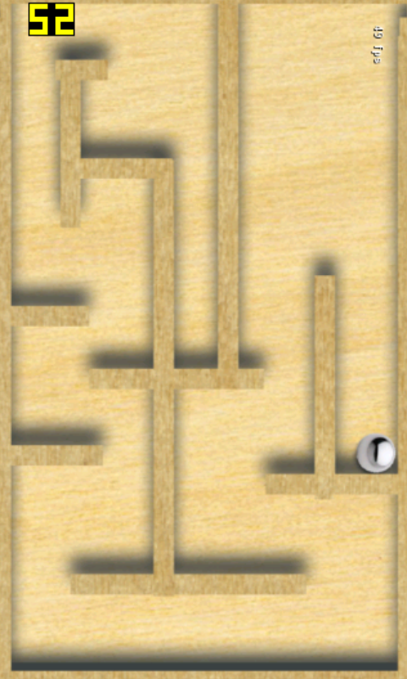
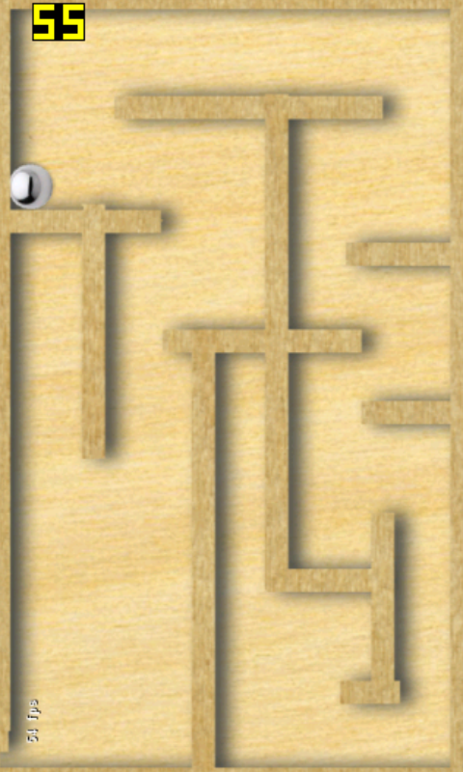
back

