Slide 1
GeoData WS2023-2024 Group – B
-Ökkes Yasar Ata (33841)
-Shardul Mishra (27241)

Slide 2
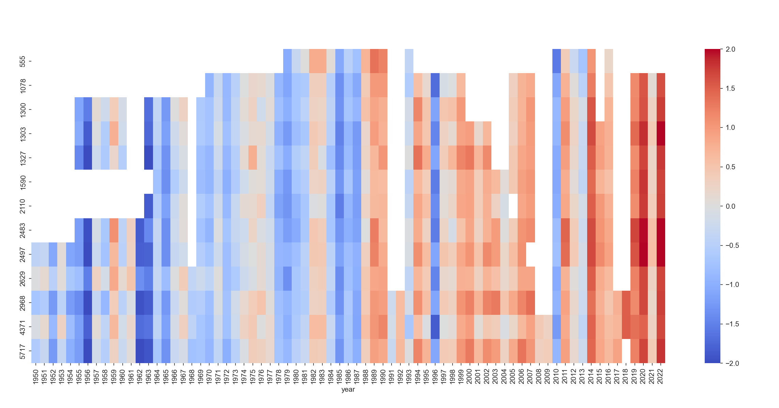
1. Warming Stripes
Following Prof. Becker's instructions, we discovered 13 stations even though only 12 were requested; the 13th station was discovered as a result of the data update in 2023.
The values were coded using the following equation: df_temp_diff = (df - mean) The temperature was below average, as indicated by the negative figures. The values were coded using the following equation: df_temp_diff = (df - mean) The temperature seemed blue since the negative figures indicated that it was below the typical mean. mean, and as a result, blue in color.

Slide 3
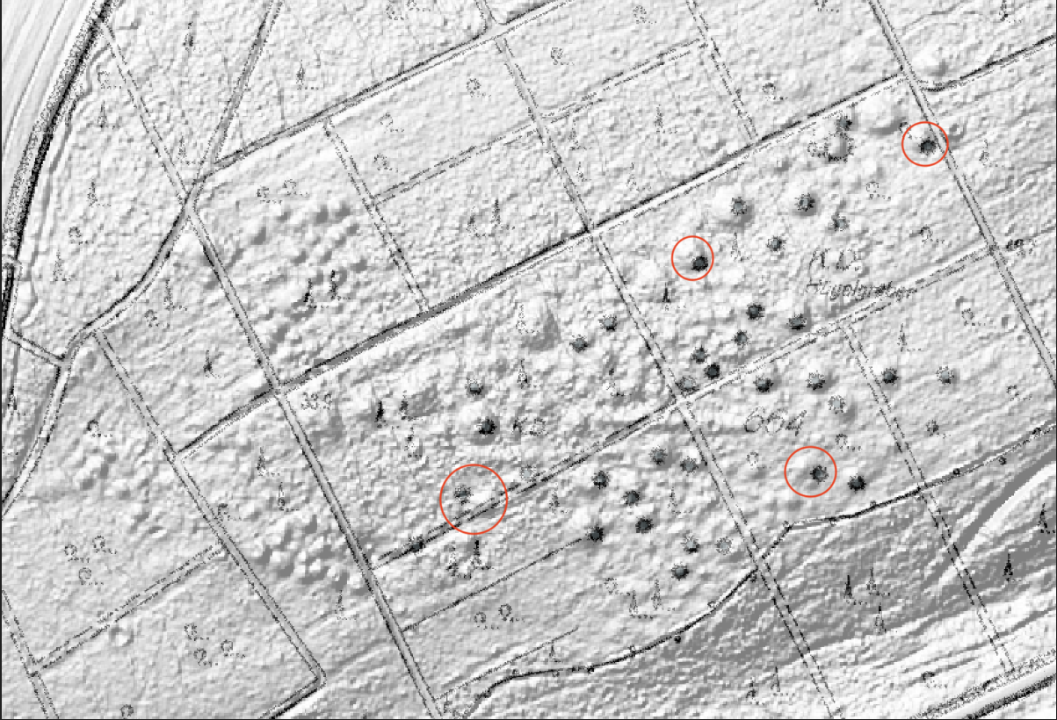
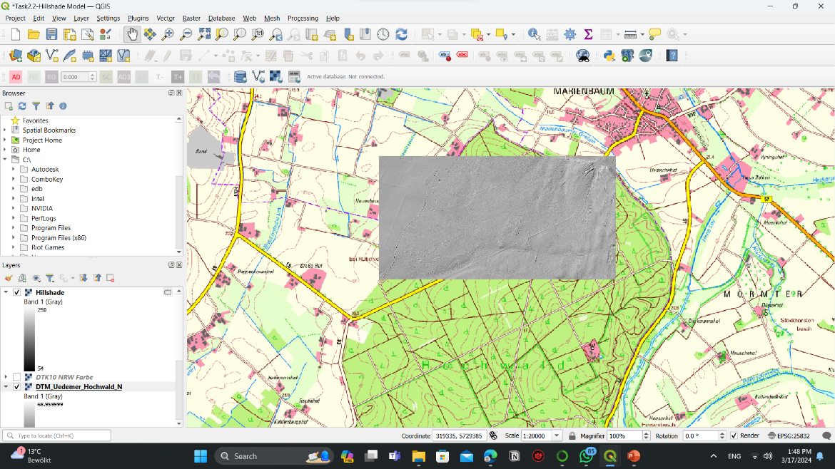
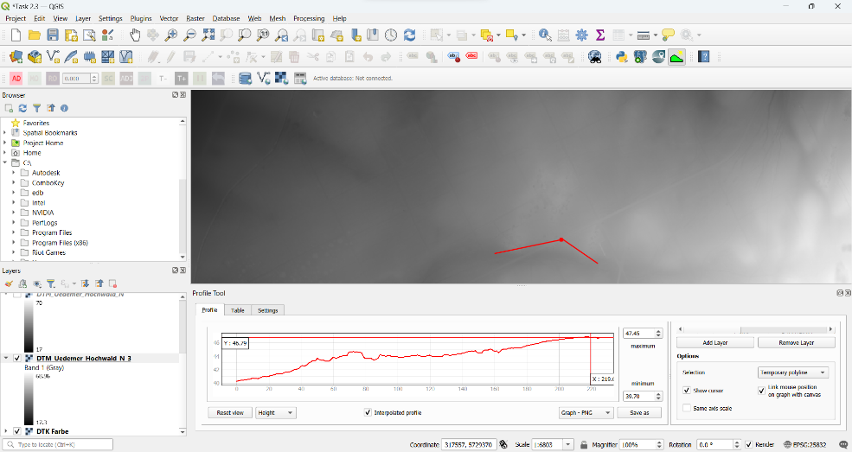
2. Digitization: Burial Mounds in Uedemer Hochwald

Slide 4
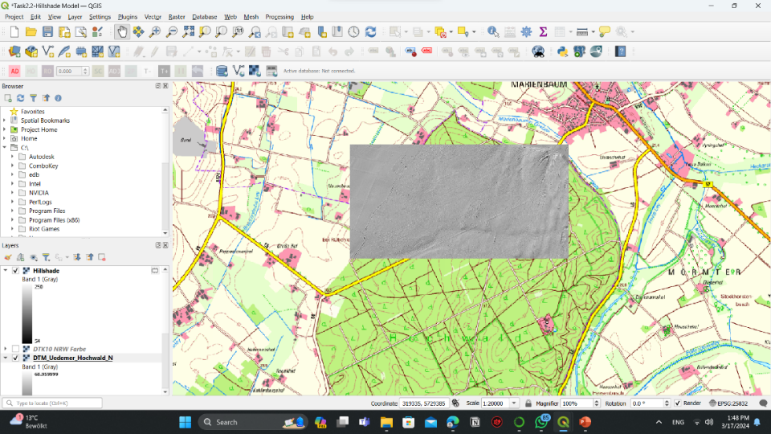
Digitization: Burial Mounds in Uedemer Hochwald
Using QGIS on the DTK10 layer, the map was georeferenced using real coordinates to identify landmarks such as woodland trails and intersections. The "Add Point" tool was used to add 16 points, and then the procedures were performed.
Not all burial mounds are covered by the grey dots; however, the georeference map is accurate, and most of the mounds are covered by the grey dots, including the ones that have a red circle around them.
The Z factor was increased to 10 to exaggerate the raster elevation, and the transparency was then set to 50% for the DTM layer, which was the subsequent input.
Hillshade model significantly provided more detail and information than georeferenced map. Espacially for geostructure of the area.

Slide 5
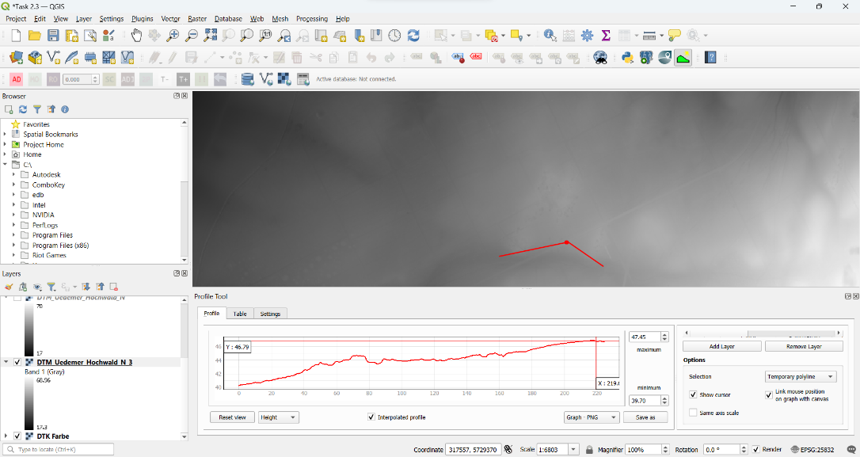
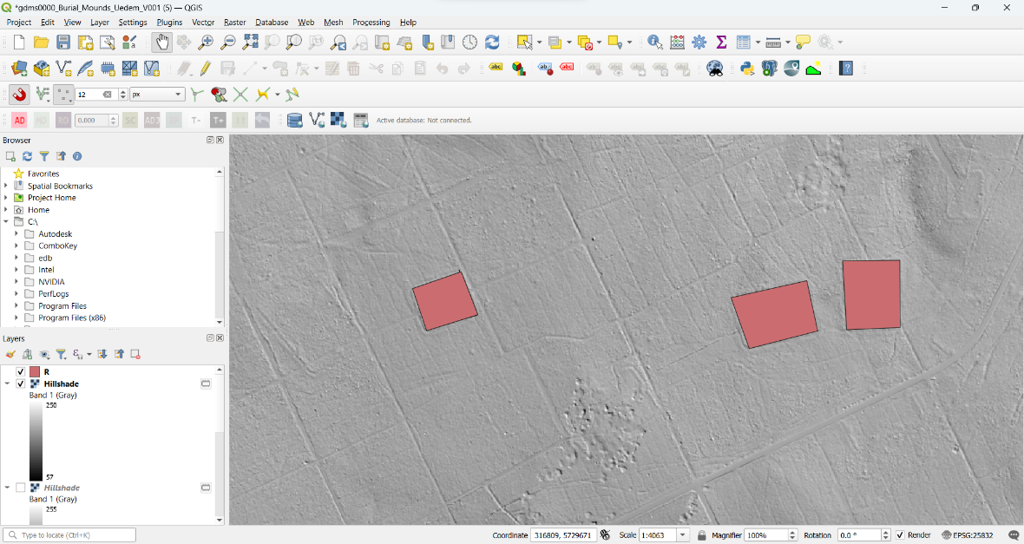
Digitization: Burial Mounds in Uedemer Hochwald
We found the typical elevation as 1.80, 1.53 and 1.65.
To able to draw something or spot a place in QGIS we need to first create a new Geopackage layer and then edit it. By this way we can create spot these places.
We saw 3 unnatural rectangular places, since this place is old and we researched the area on internet we are believing these places can be Roman Forts.

Slide 6
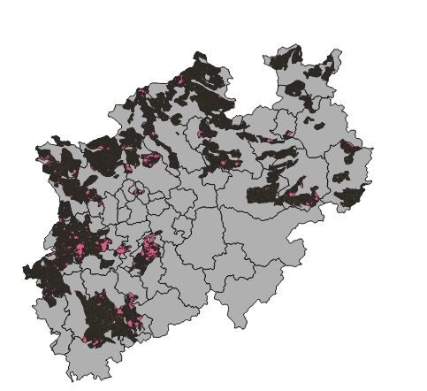
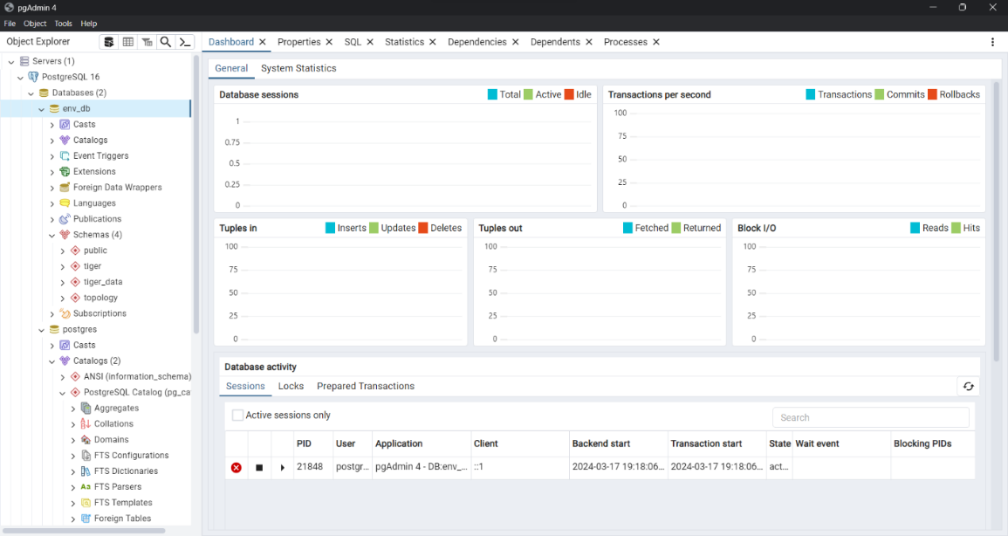
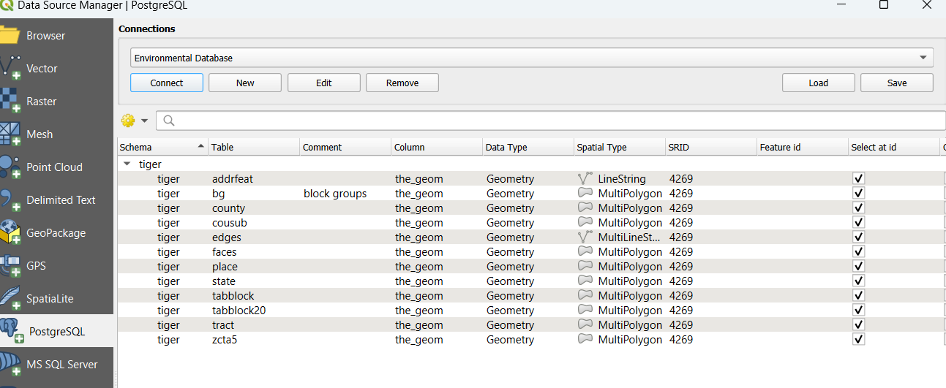
3. OpenHygrisC Nitrate Data: Create a Movie with the QGIS Temporal Controller Connected to PostgreSQL / PostGIS

Slide 7
OpenHygrisC Nitrate Data: Create a Movie with the QGIS Temporal Controller Connected to PostgreSQL / PostGIS
Sadly we could not complete this task. However we were able to make some important tasks such as cloning the files, creating Sql based database and use it in qgis as well as creating temporal controller video.

Slide 8
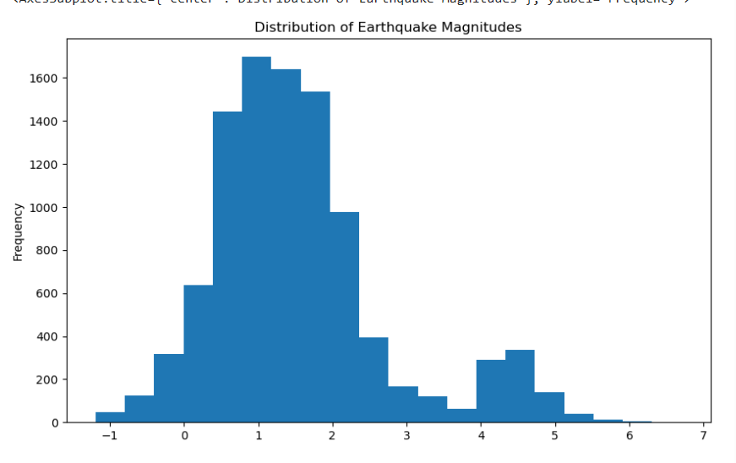
4. FREE EXERCISE
Our project centered around visualizing earthquake data, and we employed a combination of Pandas, Geopandas, and Folium libraries to enhance our analysis. Initially, we gathered earthquake data from the United States Geological Survey (USGS), leveraging Pandas' read function for efficient data acquisition. Subsequently, we processed the data by converting latitude and longitude coordinates into points, facilitating geospatial analysis. Using Geopandas' geodataframe function, we organized the data into a structured DataFrame, which served as the foundation for our analysis. With Folium, we created an interactive map to visualize earthquake occurrences. Additionally, we computed statistical summaries to extract insights from the dataset and employed plotting functions to visualize earthquake magnitudes, providing a comprehensive understanding of seismic activity trends.

Slide 9
<33841>: Your Personal View
Biggest challenges?
I found Task 3 a bit complicated.Also communication between group friends was a bit hard. Finding the places that needs to be referenced was also challenging.
Lessons learned?
. For Task 3 Though my attempt was unsuccesful i have learned many thing.
. It improved my communication skills.
. Currently I can make data visulaziation easily, I became a powerful user of Qgis.
. I will attend the future courses more regularly. ☺
Whatever you want to say related to course,
I believe the most succesfull part of the course was the sources of self-learning material, with these sources I can develop my skills further.

Slide 10
<27241>: Your Personal View
Biggest challenges?
Connecting QGIS and python Task 3; ‘Create a Movie with the QGIS Temporal Controller connected to PostgreSQL /PostGIS
Lessons learned?
Geospatial Data Handling with GeoPandas
Data Manipulation with Pandas
Interdisciplinary Skills
Whatever you want to say related to course,
It was a good expierience working on the project

Slide 11
<33841>: Self-Assessment, Part 1
What is your role in the group?
I had roles in every task
Which (sub)tasks are you responsible for?
All of the task including Task1,Task2,Task3,Task4 as well as documentation and making presentation
With whom have you been cooperating?
Shardul Mishra (helped for sources and corrected my mistakes)

Slide 12
<33841>: Self-Assessment, Part 1
What is your role in the group?
To help with the subtasks and find relevant content that helps us learn how to do the tasks
Prepare the presentation
Which (sub)tasks are you responsible for?
Most of them except task 3
With whom have you been cooperating?
Okkes Yasar Ata

Slide 13
<33841>: Self-Assessment, Part 2 (On a scale from 1 (poor) to 5 (very good))
What is your personal knowledge gain?
5
How do you rate your commitment?
5
How difficult is your task?
4

Slide 14
<27241>: Self-Assessment, Part 2 (On a scale from 1 (poor) to 5 (very good))
What is your personal knowledge gain?
5
How do you rate your commitment?
5
How difficult is your task?
3

