Slide 1
B’Lock
v5
by B’lock team, #hackthevalley
Thomson Reuters Hackathon 2017
Amine Ouafi Jean-Luc Lor Jose Luu
Paul Groenewoud Richard Ulrich

Slide 2
A blockchain enabled padlock
Trade finance projects on the blockchain will take care of the paperwork, will make it unforgeable
What about the physical goods ?
  they need the blockchain enabled lock

Slide 3
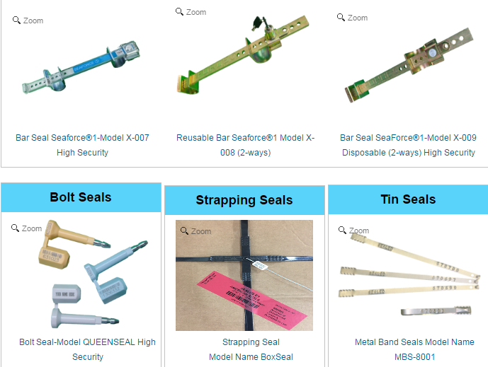
Current container seal technology

Slide 4
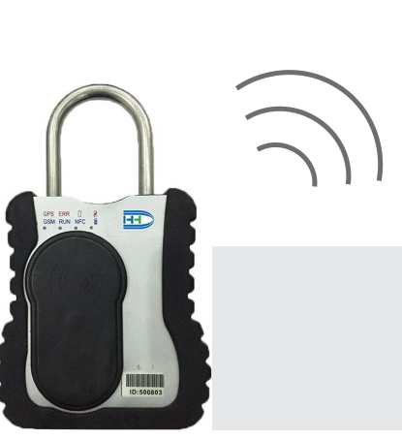
Smart lock do exist
They are not blockchain enabled

Slide 5


Operation
Blockchain
Lock
Wallet / UI
Lock
Unlock

Slide 6



Operation summary
Multisig “OR” transaction created
Authorized users

Slide 7
Summary lock operation
Blockchain side
Wallet / UI
Lock side
List of users
LockID
lockLock(list of users)
Hidden secret for unlocking
<list of encryptions of secret, one per user, salt>
hasBeenLockedTX(<list es>)
TX = {
transactionID,
publicLockID,
allowedUserGroup1PK,
allowedUserGroup2PK,
allowedUserGroup3PK,
<list of encrypted (secret,salt)>,
GPS coordinates}
doConfirmLock
Actual Locking happens

Slide 8
Summary unlock operation
Blockchain side
Lock side
Wallet / UI
LockID
Operating user’s private key
getLockTransaction(lockID)
TX
unlockLock(encrypted secret)
Validates secret
endTransaction(TXID)
success
doConfirmUnlock
Actual Unlocking happens

Slide 9
Prototype
Blockchain
Wallet / UI
Lock
Web UI
Java object
Hyperledger

Slide 10
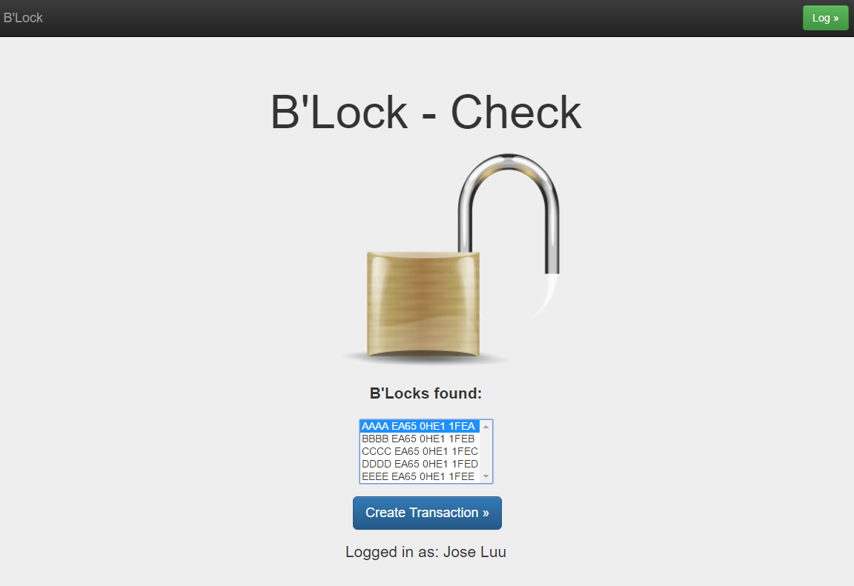

Slide 11
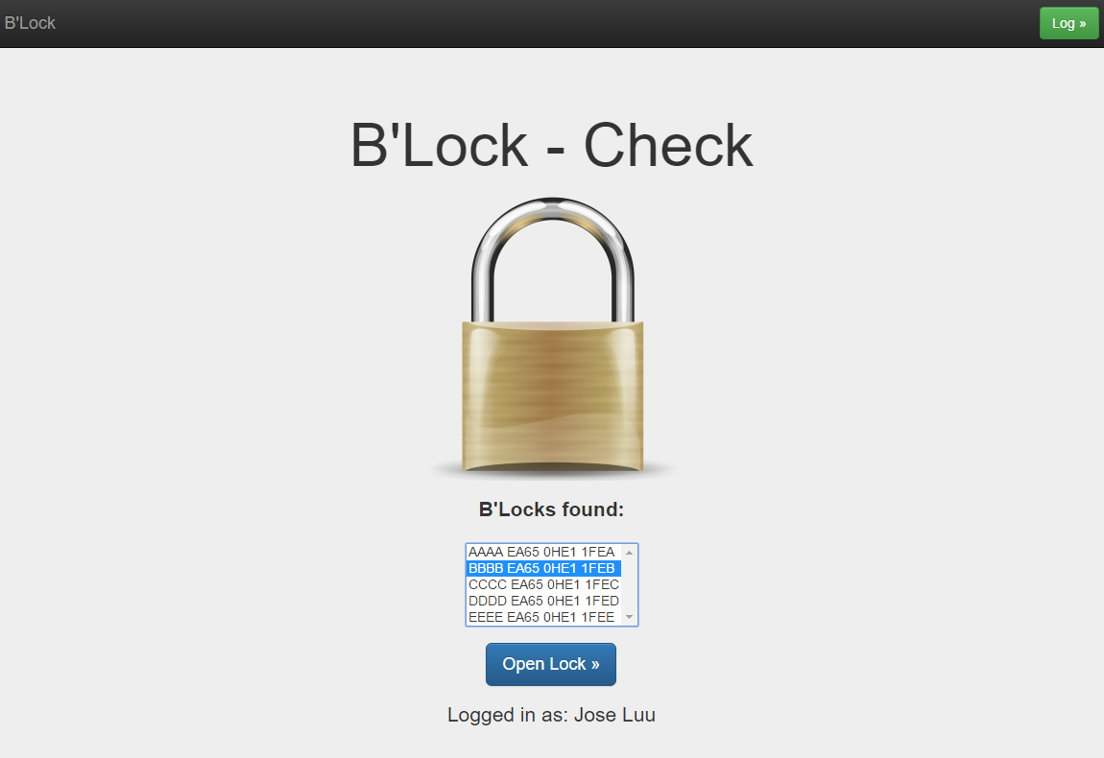

Slide 12
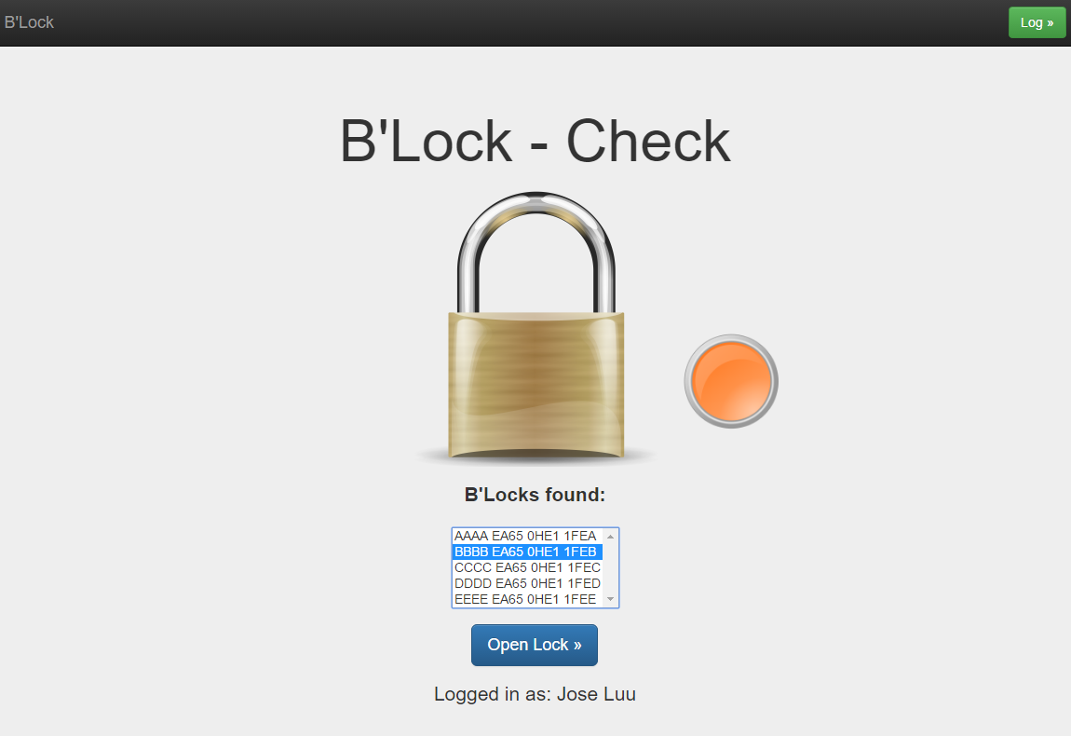

Slide 13
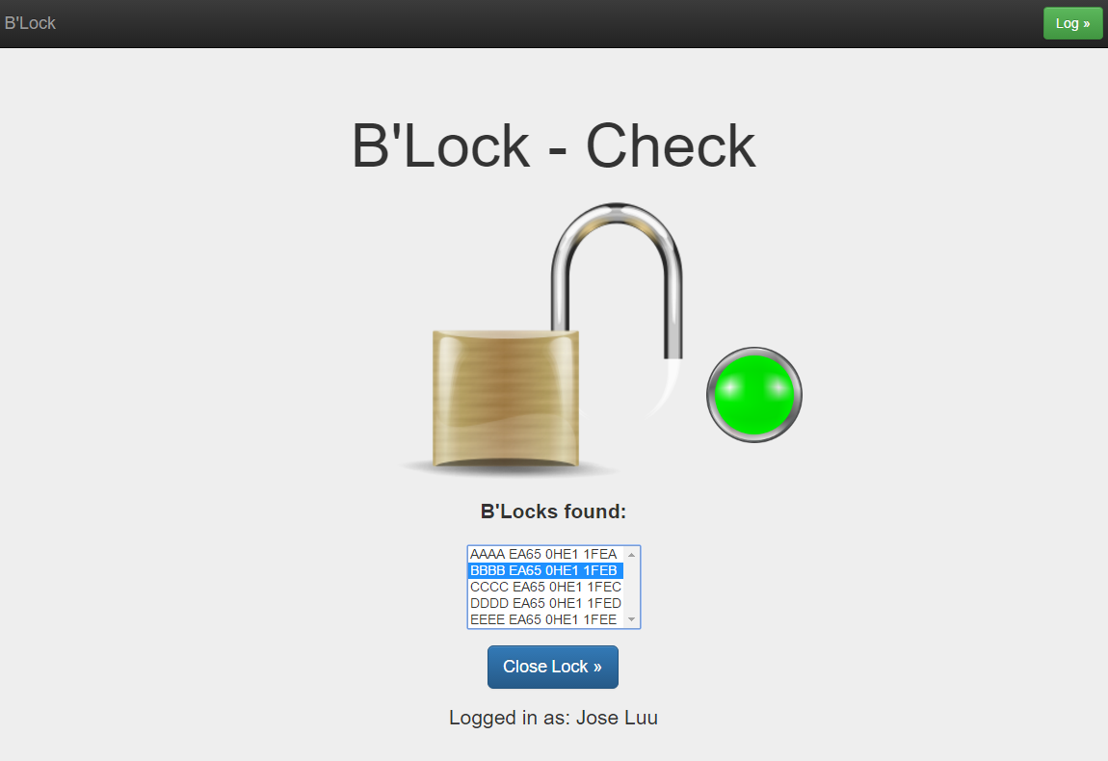

Slide 14
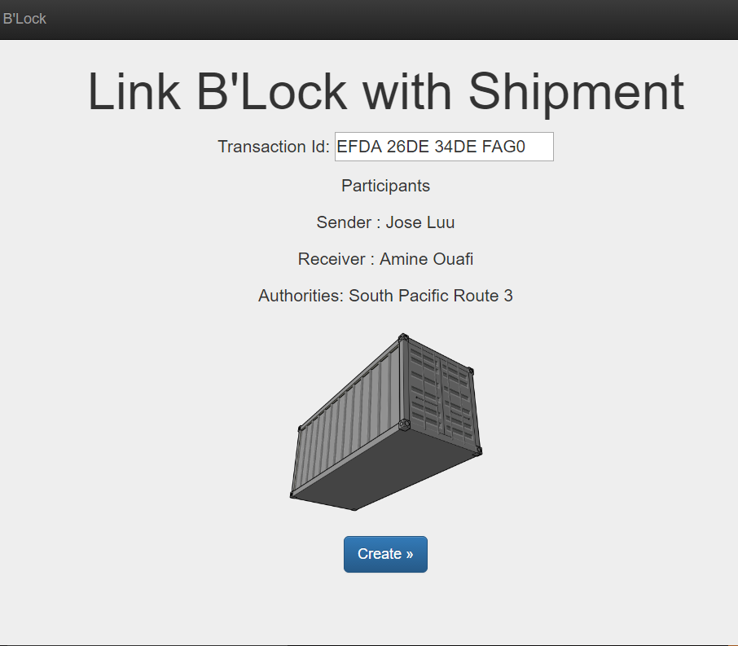

Slide 15


Slide 16
Operation summary
Padlock close/open is only authorized when there is a corresponding blockchain transaction.
Padclock is closed (busy) when its “account” is non zero on the blockchain
All opening/closures are tracked on the blockchain along with identity of operating party and GPS coordinates.

Slide 17
Operation summary (2)
Once locked, there can be multiple operating parties, they are registered on the blockchain as a multisig OR of the initial transaction, they can be vendor, buyer, port authorities, customs authorities.
Padclock can be reclosed by any of the intermediate opening parties, just give non zero amount to the lock reusing the same multisig recipients

Slide 18
The lock API: identification
PublicKey = getLockID()
This is either broadcast by the lock in bluetooth (similar to TrackR) or accessible via NFC or readable from the outside (QR code)

Slide 19
The lock API: getLockState
Bool closed = getLockState(ID)

Slide 20
The lock API: lock
The lock has an internal secret that will be used for unlocking.
The lock API returns this secret encrypted using the authorized users public keys.
<list of encrypted secrets>,rand = lockLock (allowedUserGroup1PK,
allowedUserGroup2PK,
allowedUserGroup3PK … )

Slide 21
The lock API: lock phase 2
The lock enters a wait for confirmation state
doConfirmLock(rand)
Should be called when blockchain has validated the transaction, does the physical locking action
-> if timeout then lock aborts locking operation

Slide 22
The lock API: unlock
rand = unlockLock (<crypted secret>)
The secret is crypted using the padlock publicKey along with a salt.
The padlock enters wait state
doConfirmUnlock(rand)
If timeout -> does not unlock

Slide 23
The backend API (locking)
hasBeenLockedTransaction(publicLockID, <list of encrypted secrets>,<gps coordinates>)
If transaction goes well, call doConfirmLock

Slide 24
The backend API (status)
Bool isLockBusy(publicLockID)
True if lock has a transaction towards it

Slide 25
The backend API (unlocking)
Transaction getLockTransaction(publicLockID)
TX = {
transactionID,
publicLockID,
allowedUserGroup1PK,
allowedUserGroup2PK,
allowedUserGroup3PK,
<list of encrypted (secret,salt)>,
GPS coordinates}

Slide 26
The backend API
TX was created by hasBeenLockedTransaction using lock return values from lockLock
Any one of the users is allowed to withdraw the TX using its private key as well as decode the secret that will be used for unlocking.
Now, as a result, the padlock is unlocked by calling unlockLock(<crypted secret>)

Slide 27
The backend API
EndTransaction(TransactionID)
TX is withdrawn/consumed
If successful the doConfirmUnlock is called, otherwise timeout and the padlock does not open.

