Slide 1
Bonds, Refinancing, Infrastructure, Climate Change and Clean Water
John Gage & Gordon Wozniak
February 16, 2017

Slide 2
To Bond or Not to Bond?
A short review of Berkeley’s Bond History

Slide 3
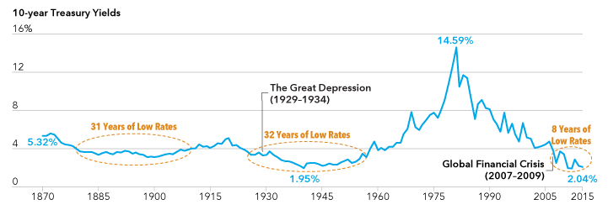

Slide 4
COB General Obligation (GO) Bonds (2000 – 2016)
Year Amount Description
2002 $17.8 M Measure G – Fire Safety
2007 $4.3 M Measure G – Fire Safety
2007 $41.2 M Measure S
Bond Refinancing (2002 -07) $62.3 M
2008 $7.2 M Measure I – Animal Shelter
2009 $10.0 M Measure FF – Branch Libraries
2010 $16.0 M Measure FF – Branch Libraries
2014 $15.0 M Measure M – Street & Watershed
2016 $15.0 M Measure M – Street & Watershed
New Bonds (2008 – 2016) $63.2 M

Slide 6
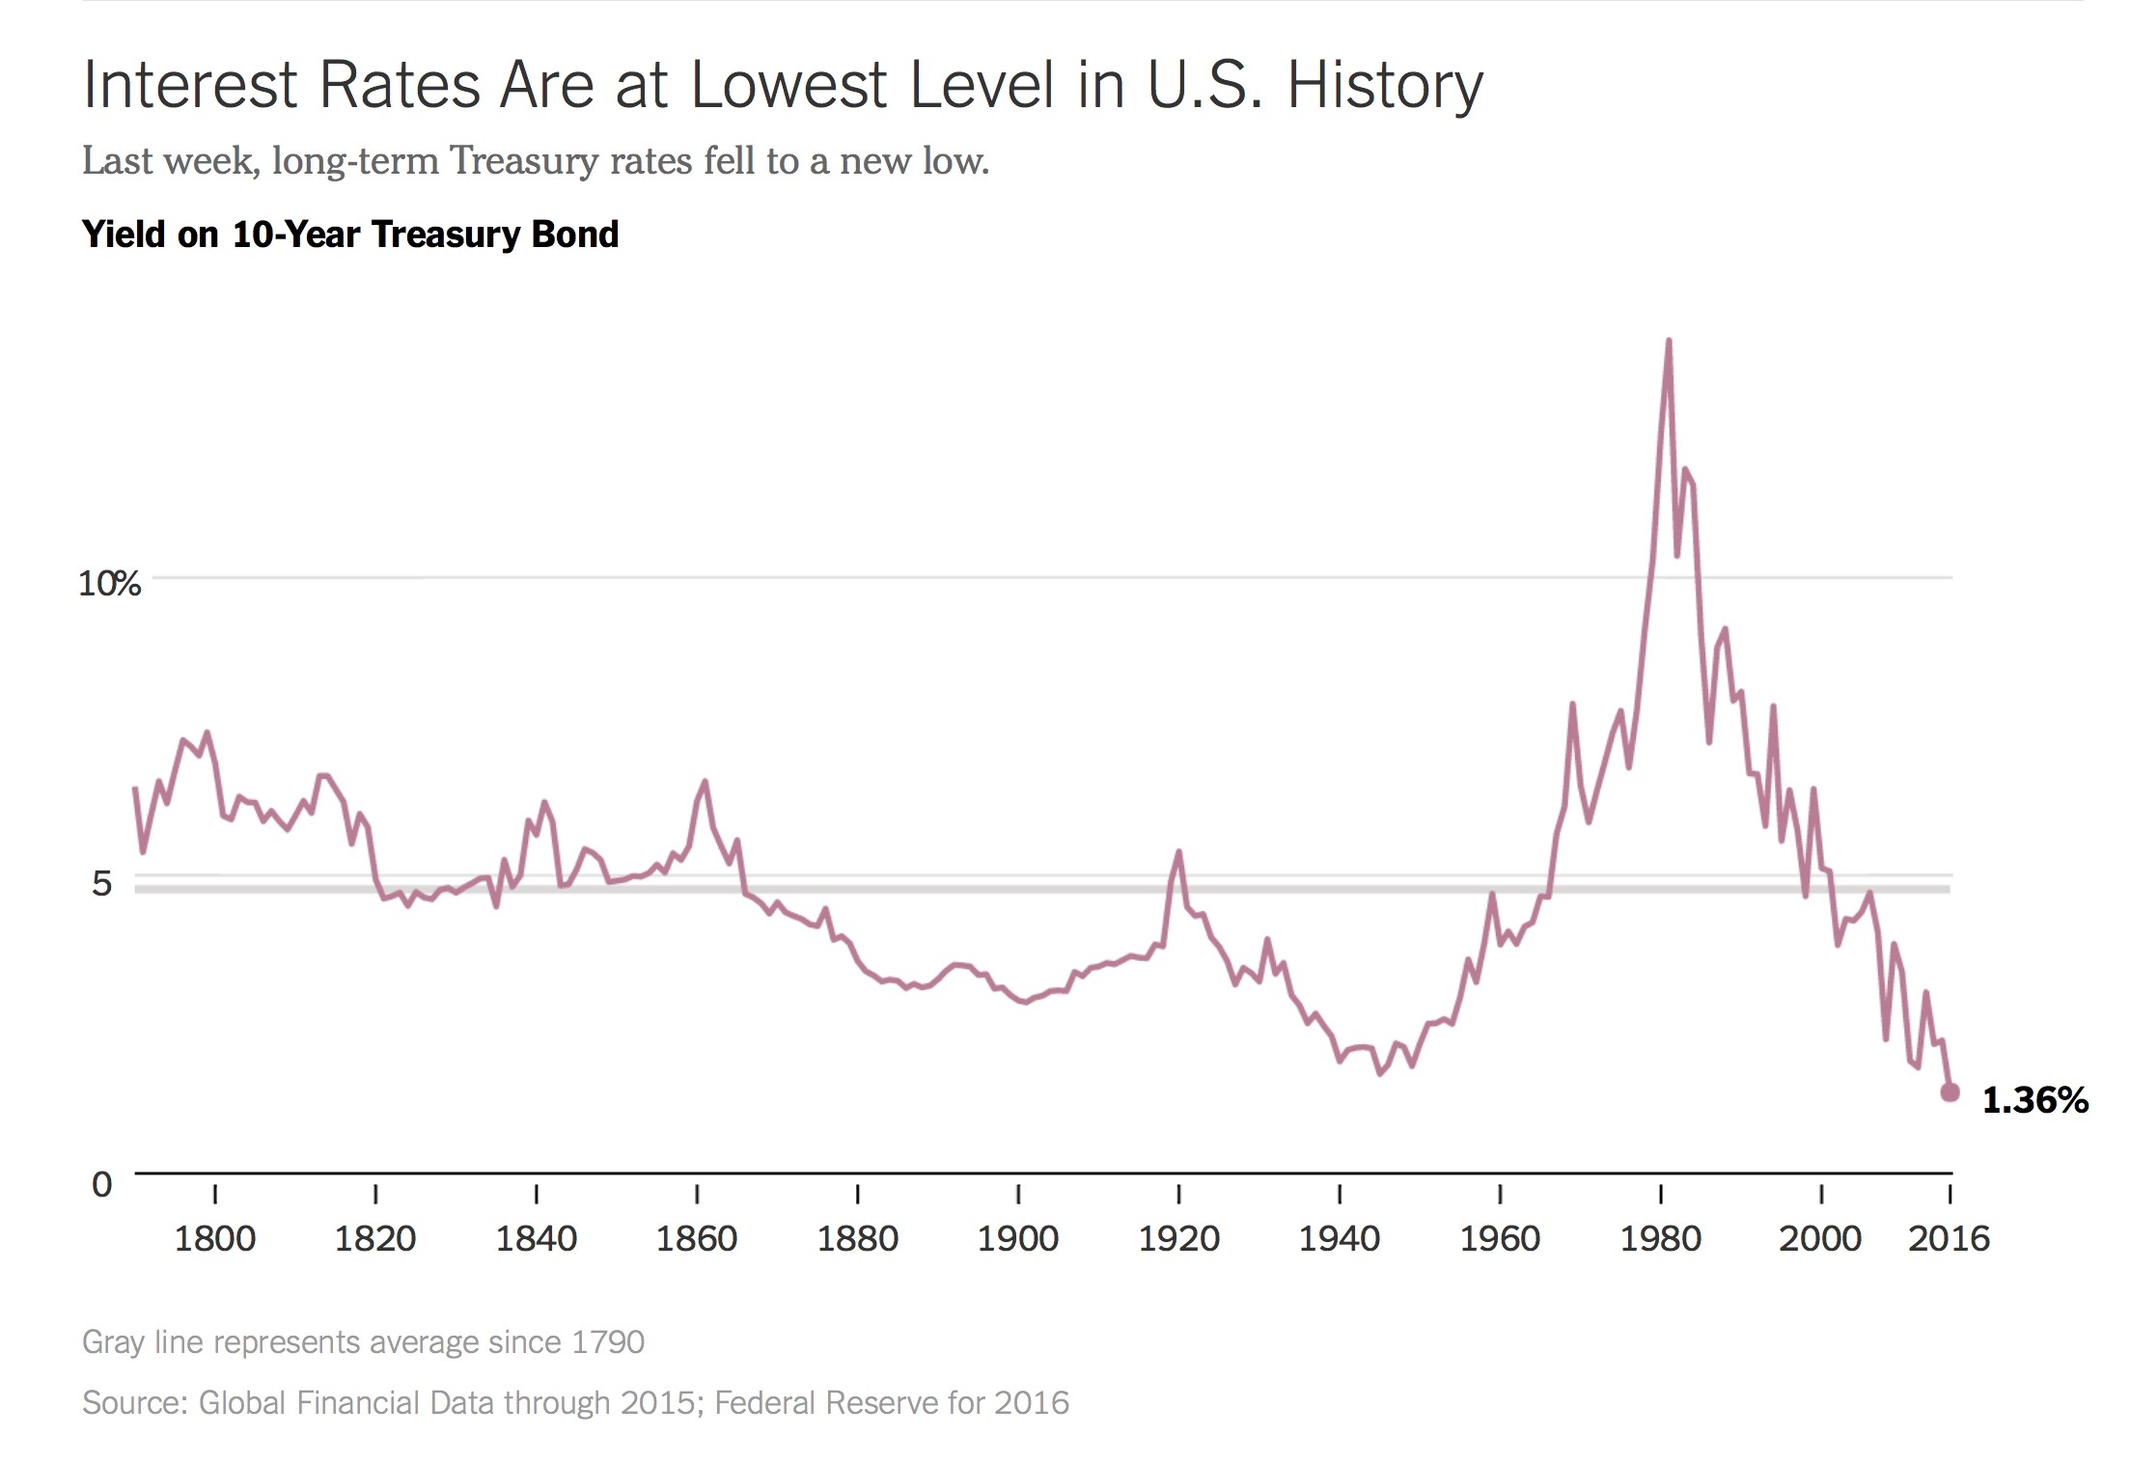
Why has Berkeley’s Debt Service Tax Rate Decreased and then stayed constant while $62 M in New Bonds were issued?

Slide 7
Property Taxes: 141 Parkside Drive
Tax Year | Net Assessment ($) | Tax Rate (%) | Tax ($) | Special Assessments ($) | Total Tax ($)
2000/01 | 536,908 | 1.2344 | 6,628 | 1,835 | 8,462
2016/17 | 699,159 | 1.2168 | 8,507 | 4,557 | 13,064
% Change | +30.2 % | -1.4% | +28.3% | +148% | +54.4%

Slide 8
Comparison Taxes and Tax Rates for 2000/1 to 2016/17 (141 Parkside Drive)
Year | Countywide Property Tax based on AV ($) | COB Tax Rate (%) | COB Tax Amount ($) | BUSD Tax Rate (%) | BUSD Tax Amount ($)
2000/1 | $5,369 | 0.0867% | $465 | 0.1250% | $671
2016/17 | $6,991 | 0.0445 | $311 | 0.1327% | $927
% Change | +30.2% | -48.7% | -33.1% | +6.2% | +38.2%

Slide 9
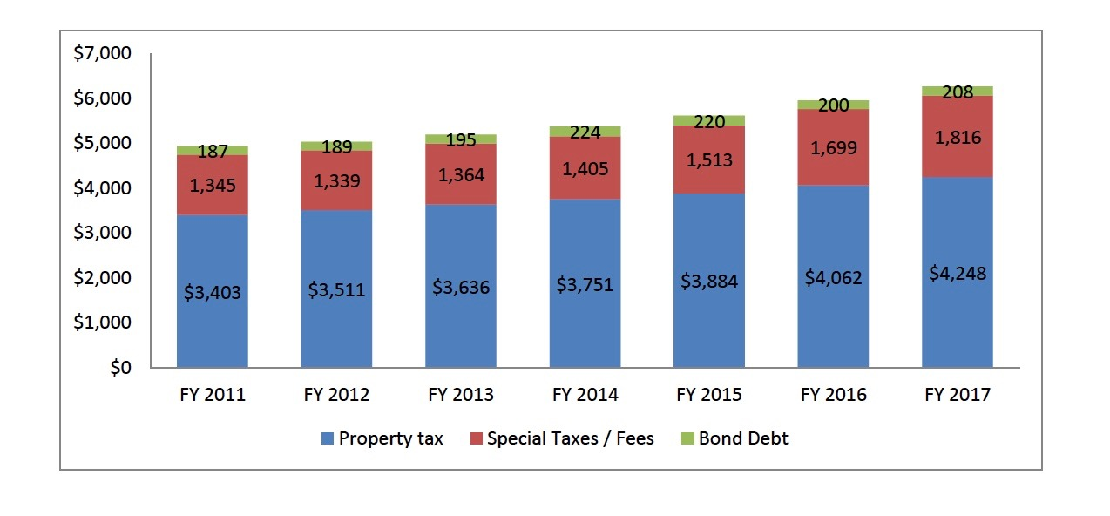
Annual Berkeley Property Taxes: FYs2011 -17 (average assessed value – 1900 ft2)

Slide 10
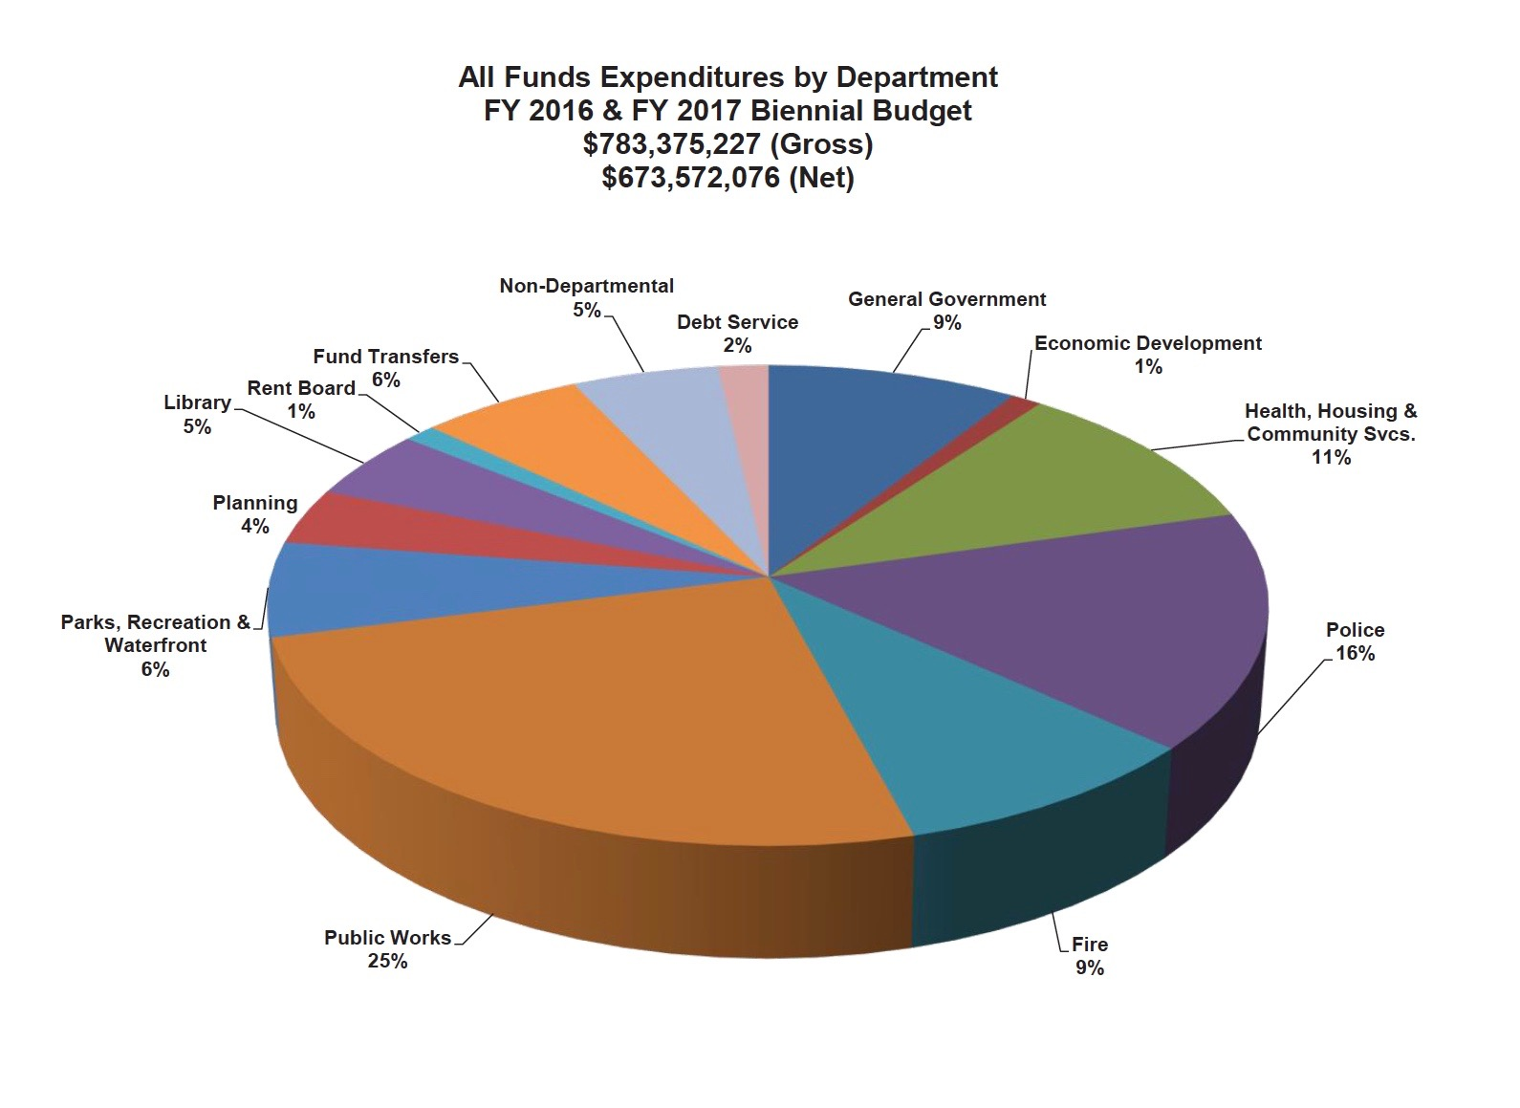
Debt Service is 2% of Total Budget

Slide 11
Possible Bond Refinancing
Council ask City Manager to review refinancing of existing GO Bonds for potential fiscal savings
GO Bonds Interest Rate Amount
Measure G (2002 & 2007 Series A) 2.0 – 7.5% $9.8M
Measure S (Series B) 4.04 – 5.6% $28.6M
Animal Shelter 2008 3.5 – 4.3% $6.4M
Branch Libraries 2009 1.25 – 5.3% $9.3M
Branch Libraries 2010 3.0 – 5.0% $14.7

Slide 12

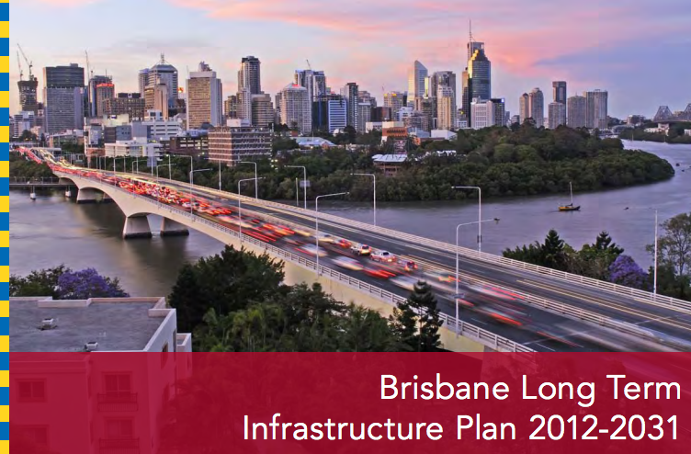
Climate Action Goal
2050 reduce GHGs by 80%
Modest progress
Limited grant funding
Infrastructure
No Goal
No Plan
$100 M – Measure T1

Slide 13
Infrastructure and Climate Change
Use New Infrastructure
to
Meet Climate Action & Resilience Goals

Slide 14
City Council
Adopt goal of completely modernizing and greening Berkeley’s infrastructure by 2050
Aligns 100% infrastructure modernization with Climate Action Plan
2. Develop Vision for Infrastructure Plan for Berkeley2050
Green – lower carbon footprint
Durable – lower maintenance costs
Resilient and Beautiful City
Undergrounding & communication
Transportation
Water conservation & flooding
Water Neutral by 2050
fiscally sustainable – savings accrue to infrastructure replacement fund
Meets CAP 2050 goals
Engage UCB in this planning effort
3. Two examples –
Replacing streetlights with LEDs - $3 Million load (1%)
Branch library modernizations – resilient & lower carbon footprint

Slide 15
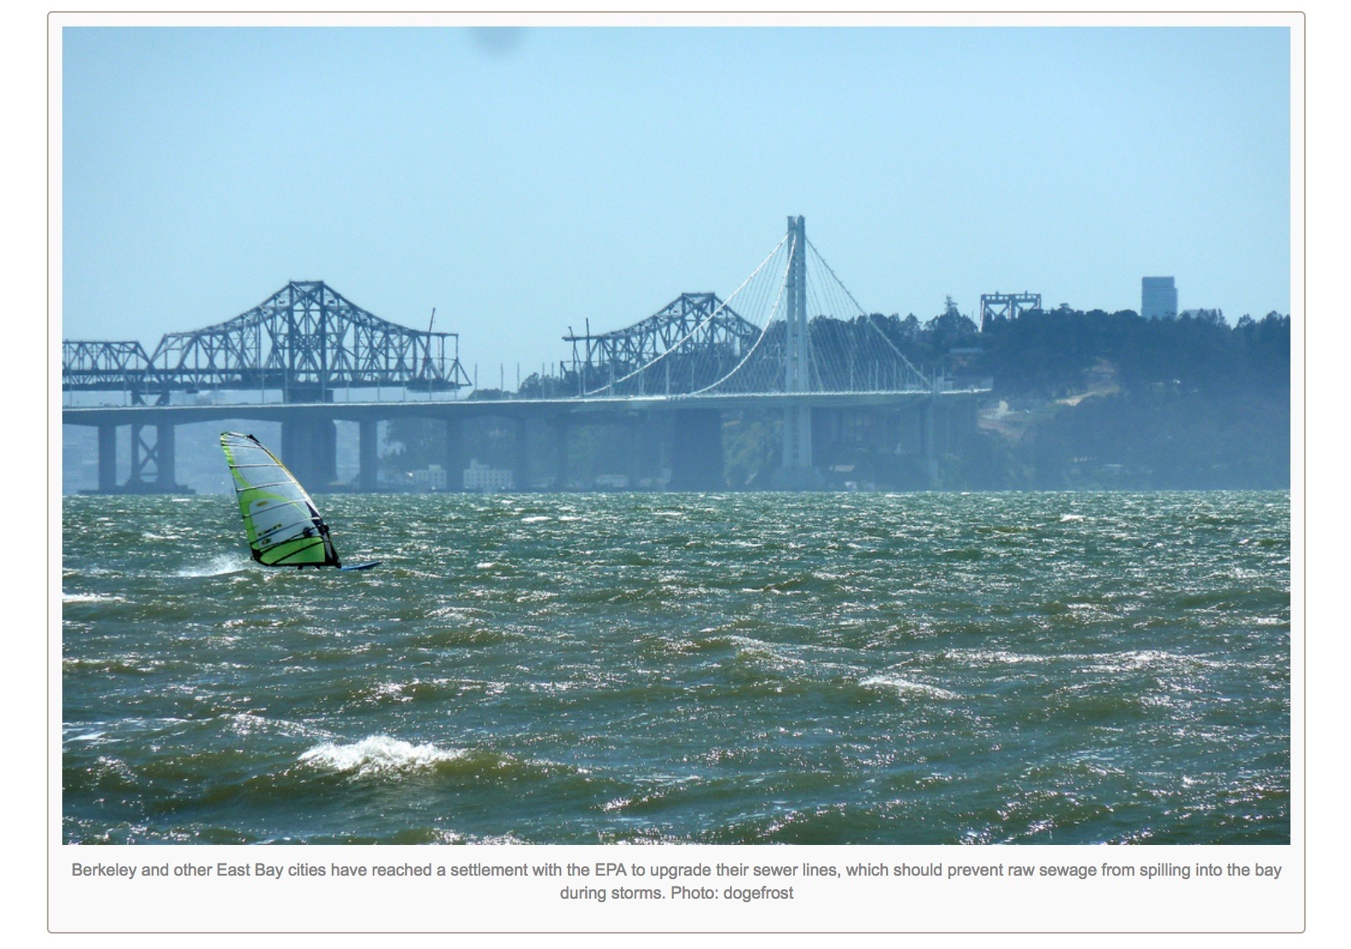
Berkeley, Sewage and San Francisco Bay

Slide 16
COB signs Consent Decree with US EPA to stop the release of partially treated sewage into SF Bay
2014 – Consent Decree requires COB
Reduce inflow and infiltration
Reduce sanitary sewer overflows
Repair and replace aging sewer pipelines
2026
Replace 50 miles of sewer pipeline
Replace all noncompliant manholes
Perform condition assessment on 25 miles of sewer annually
Increased required maintenance activities

Slide 17
Berkeley’s Sanitary Sewer Service Rates (Adopted by Council in June 2015)
Single Family
FY 2016 +46.0%
FY 2017 +24.2%
FY 2018 +14.2%
FY 2019 +7.0%
FY 2020 +3.6%
Total +131%

Slide 18
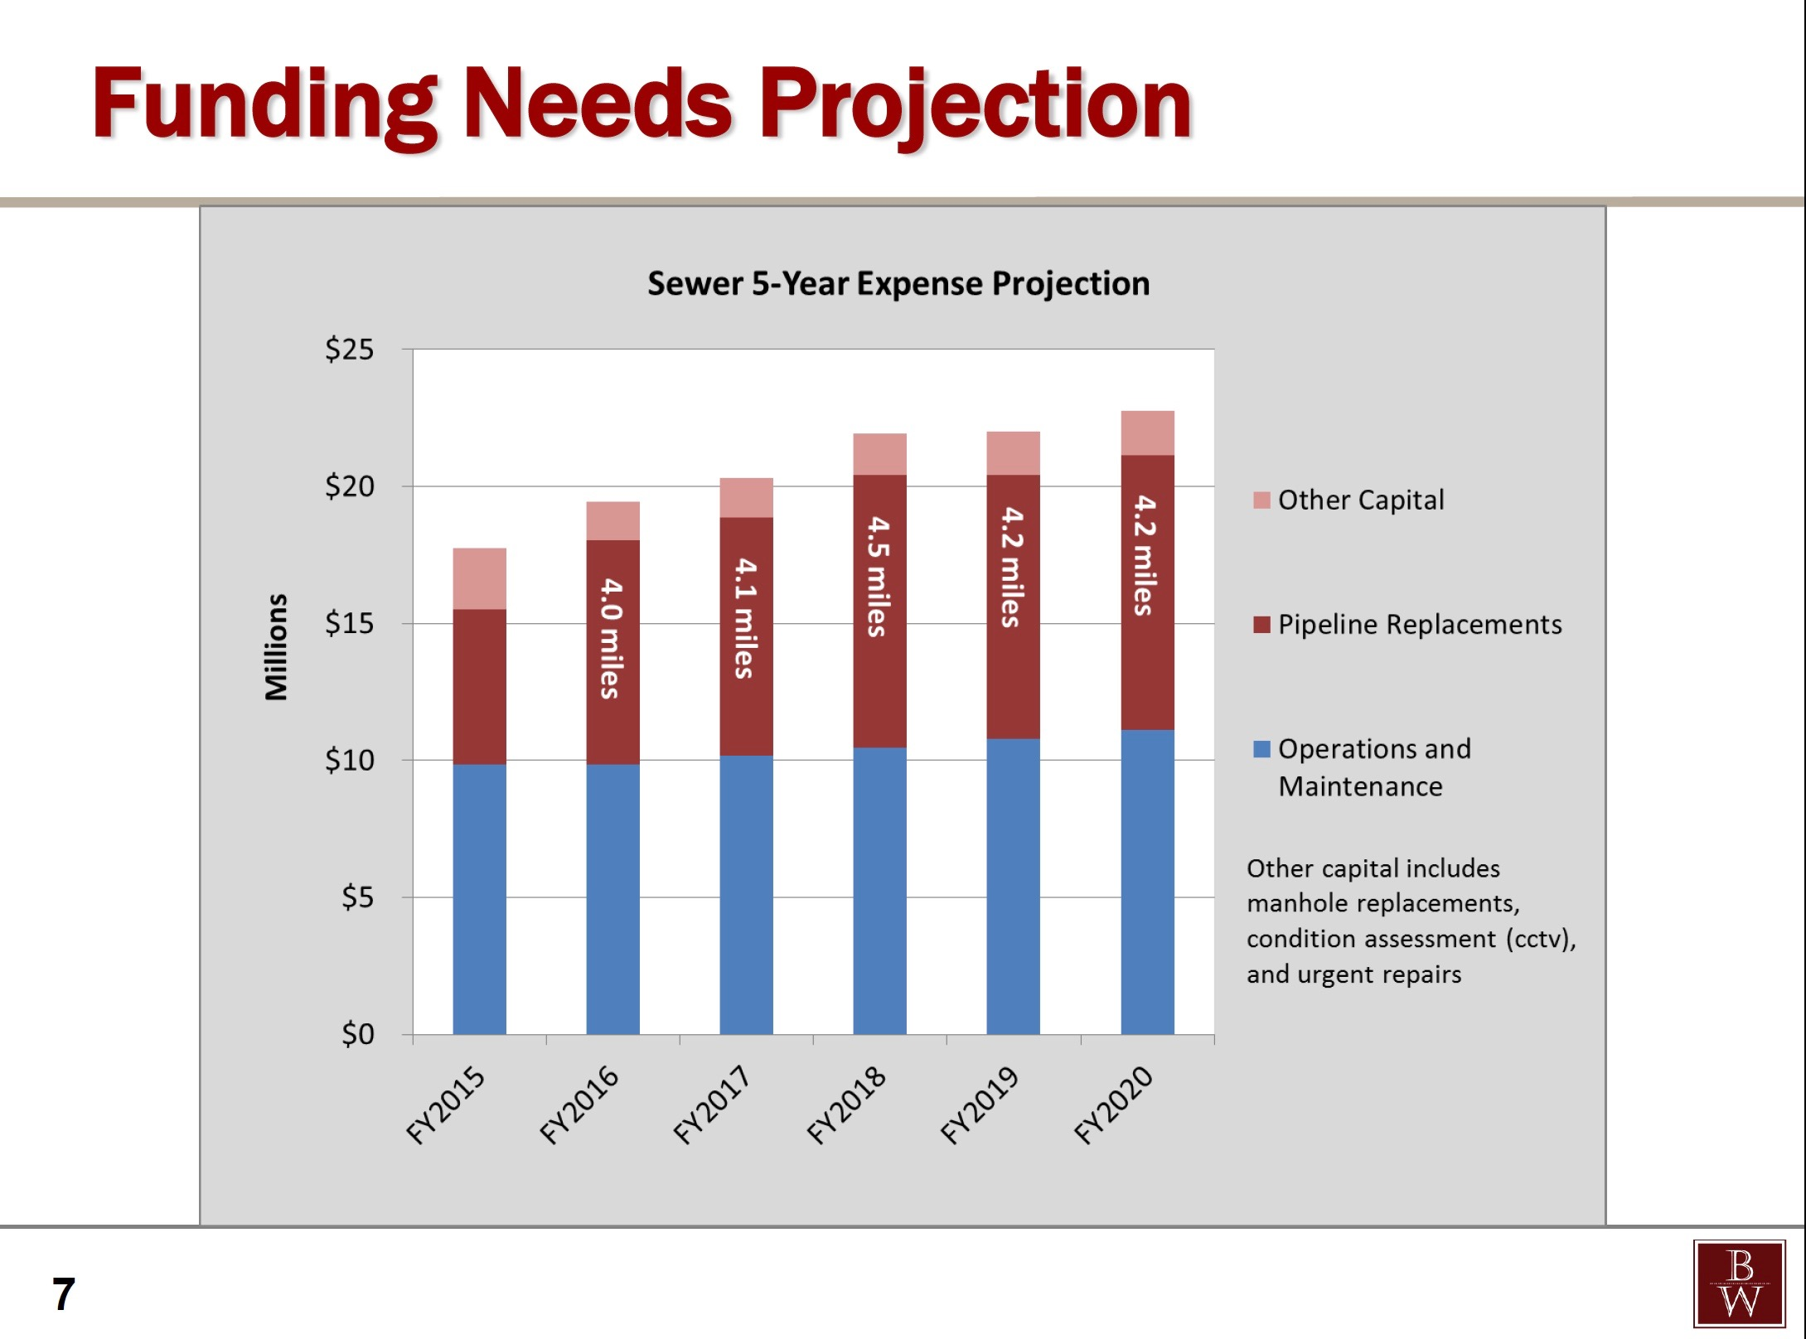
COB Proposed: Sanitary Sewer Capital Spending
Capital Project
~4 miles/yr of pipeline replacement
Fund with $100M Revenue bond – similar to new parking garage
Use sewer fee increase to pay bonds
Benefits
complete project in 5 vs 10 years
Less pollution in SF Bay
Lower maintenance costs?
Lower peak sewer fees?

Slide 19
Undergrounding
Utilities
Arterials + collectors - $135M
Residential streets - $600M
Install fiber – Cost ??
Add pedestrian scale streetlights – Cost??

Slide 20
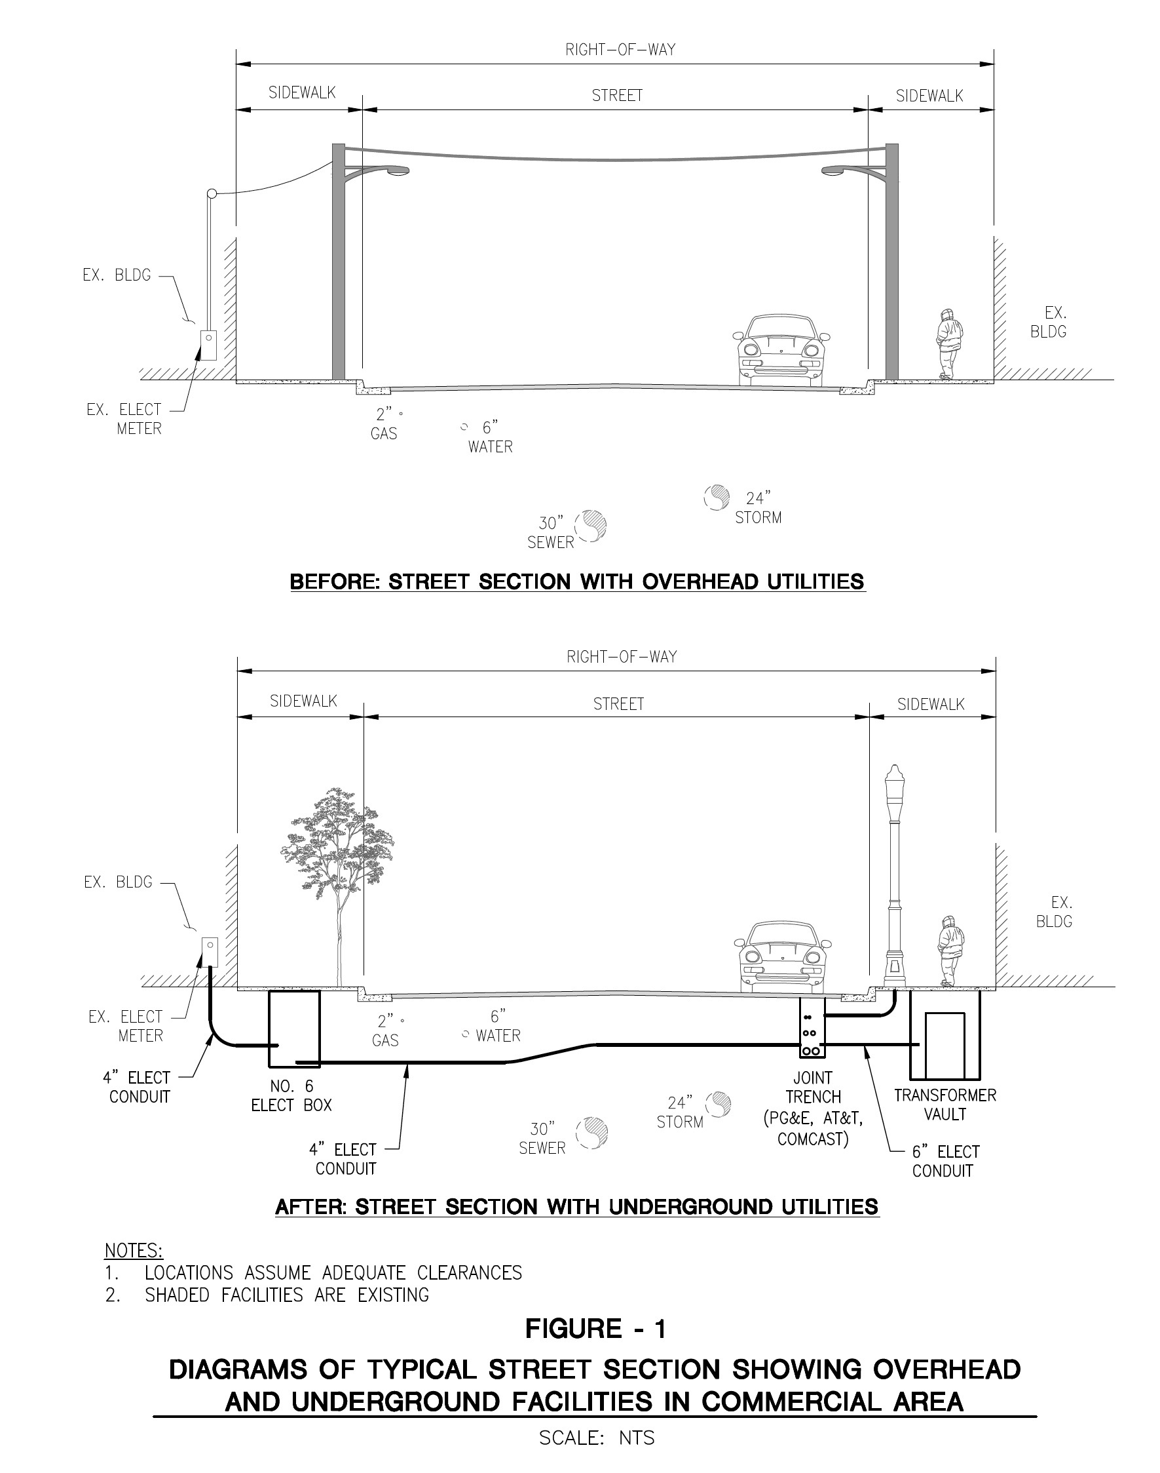
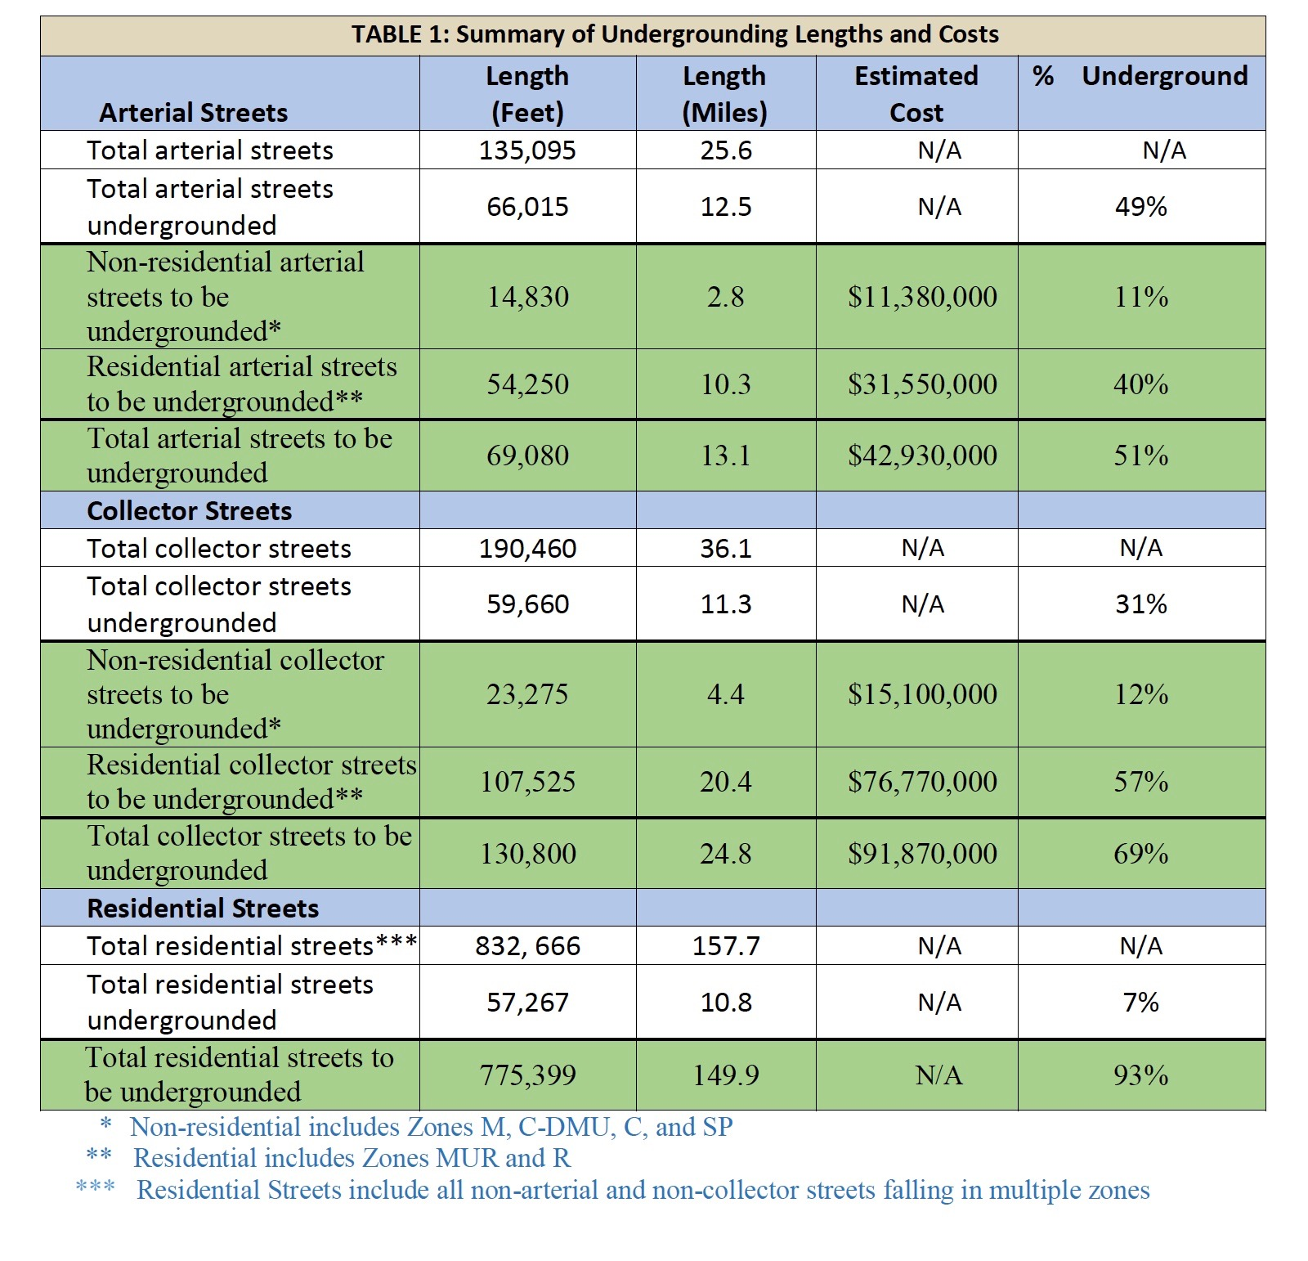
fiber
Notes:
Add fiber to trench

Slide 21
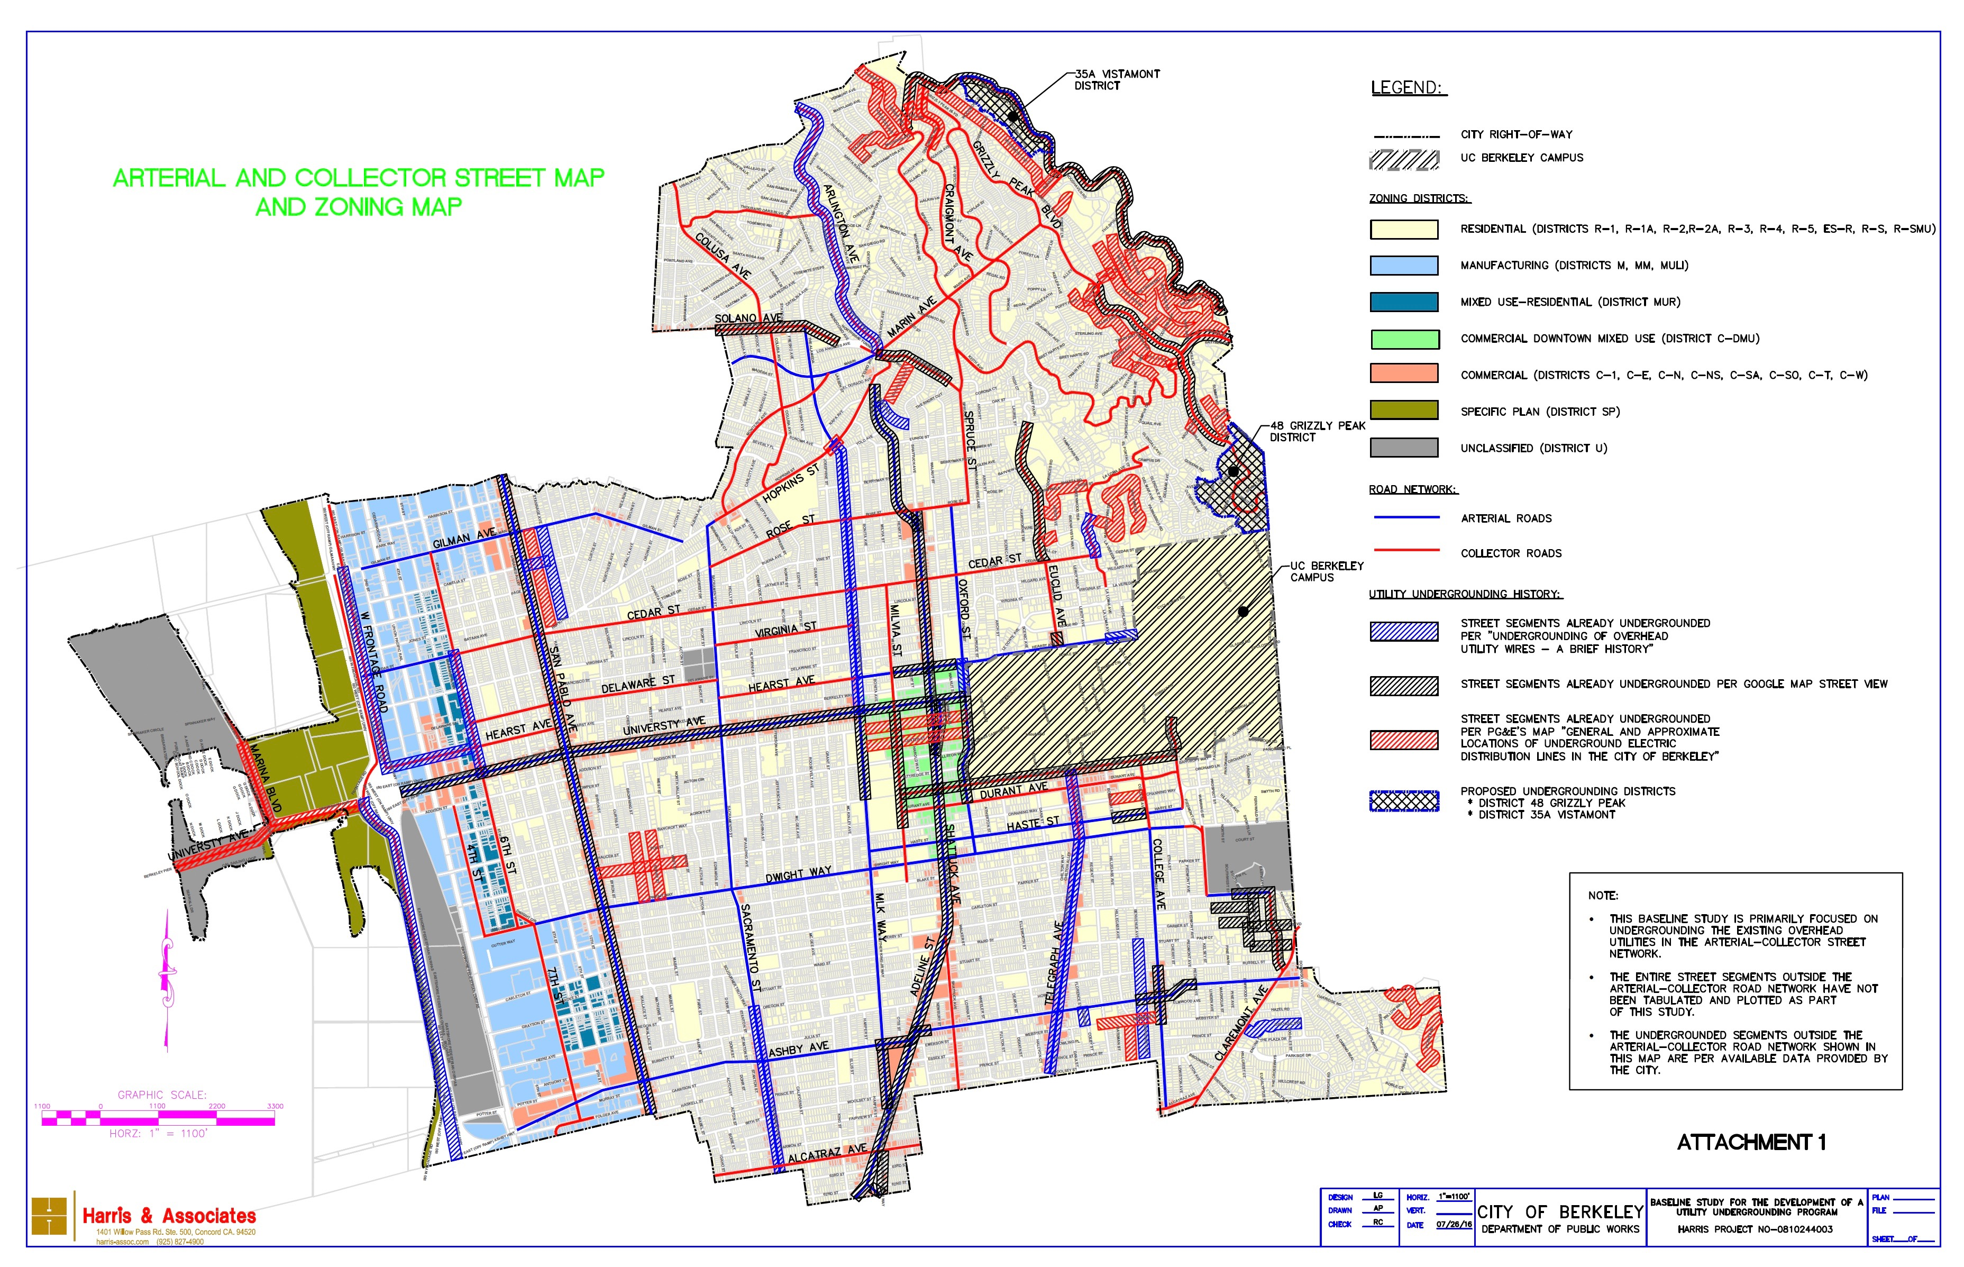

Slide 22
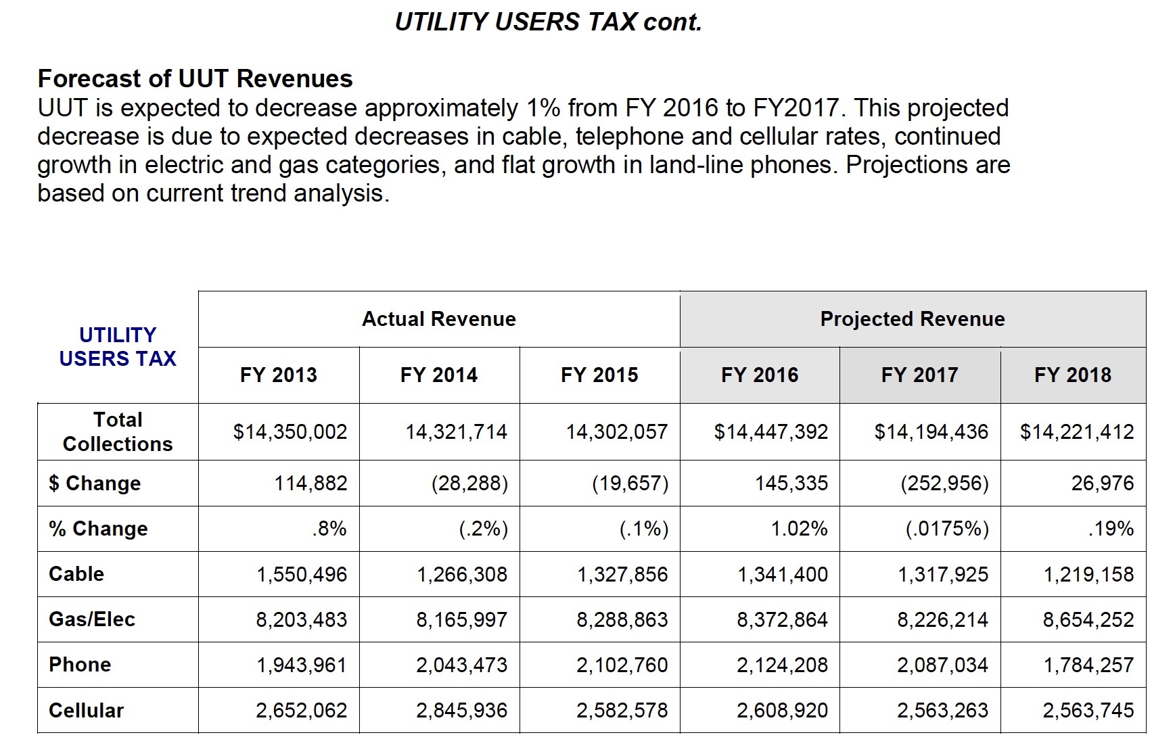

Slide 23
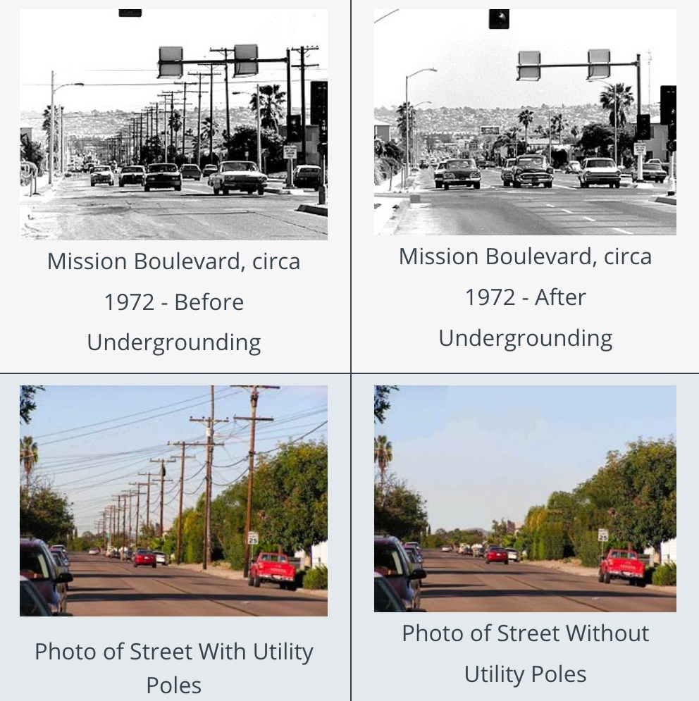
Undergrounding: San Diego
Berkeley Undergrounding
37.9 miles of Arterial and Collector streets
Finance undergrounding with increase in UUT.
Dedicate 2.5% of existing UUT to residential undergrounding
Utility Users Tax (7.5%) → ~$14.5 million/yr
Increase UUT 2.5% to 10.0% → ~4.7M/yr
Issue $135 million of Revenue Bonds
* Finance RBs with income stream from UUT
Negotiate with PG&E and other utilities for cost sharing
Install conduit and fiber optic cable

Slide 24
Residential Streets???
150 miles of residential streets
~$600 million to underground
Cost Reduction
Work with Utilities to partially finance undergrounding costs
Energy Conservation model (PG&E)
2018 Ballot Measure: increase UUT 7.5% to 10%
City Council -> Sweeter
Sweeter - dedicate 2.5% from the existing 7.5% to underground residential areas.
Creates additional revenue stream of ~$4.7M/yr
Issue ~$135M in Revenue Bonds

Slide 25
Building Seismic & Energy Retrofits
Single Family – incentivize energy retrofits, water conservation, storm water capture, solar + battery backups
Transfer Tax – seismic rebate – expand to cover energy efficiency & water conservation

Slide 26
Water Neutral by 2050
Water capture
Drought
Reduce Flooding

Slide 27
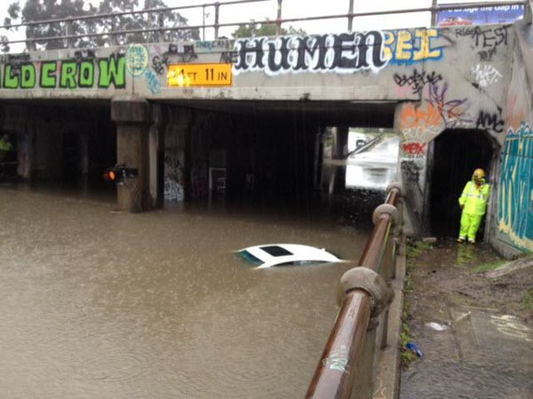
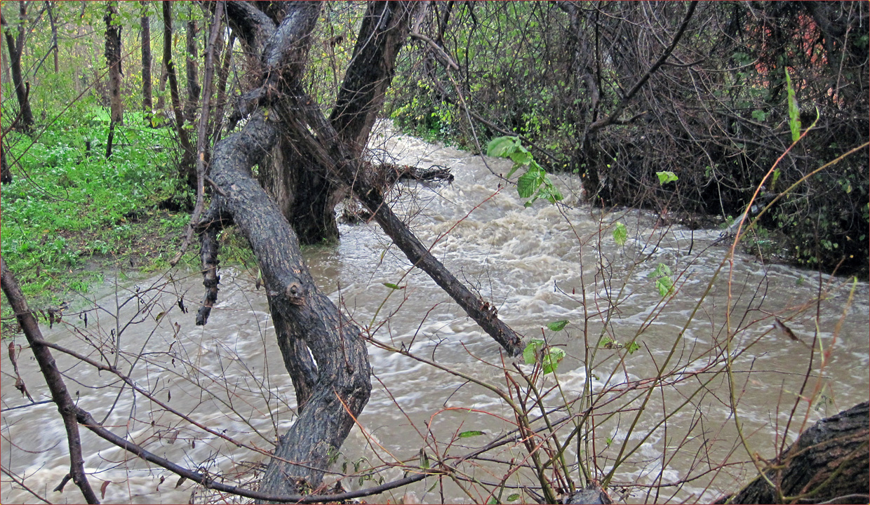
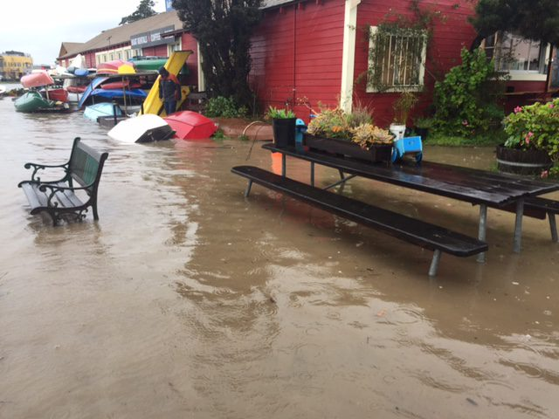
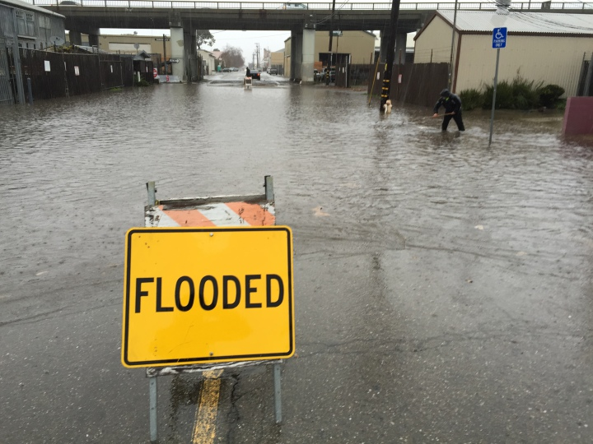
Flooding in Berkeley

Slide 28
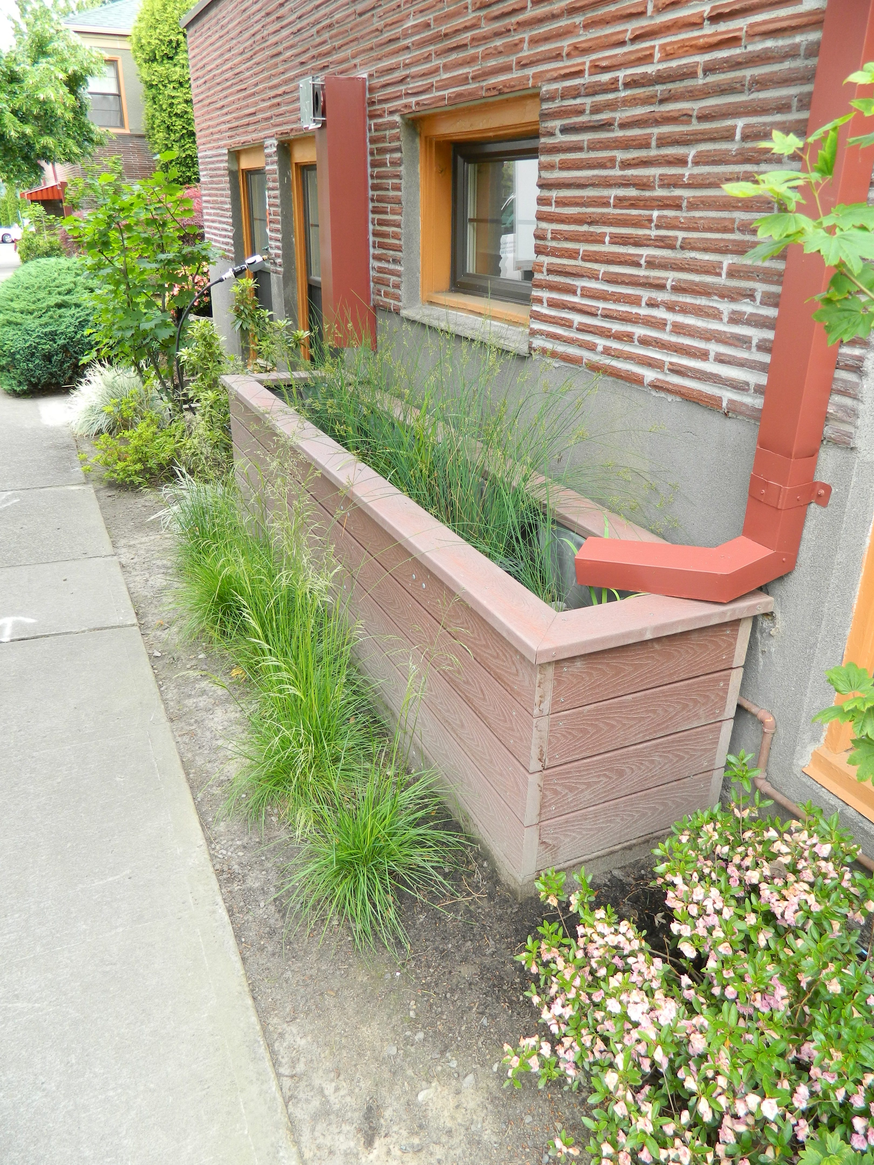
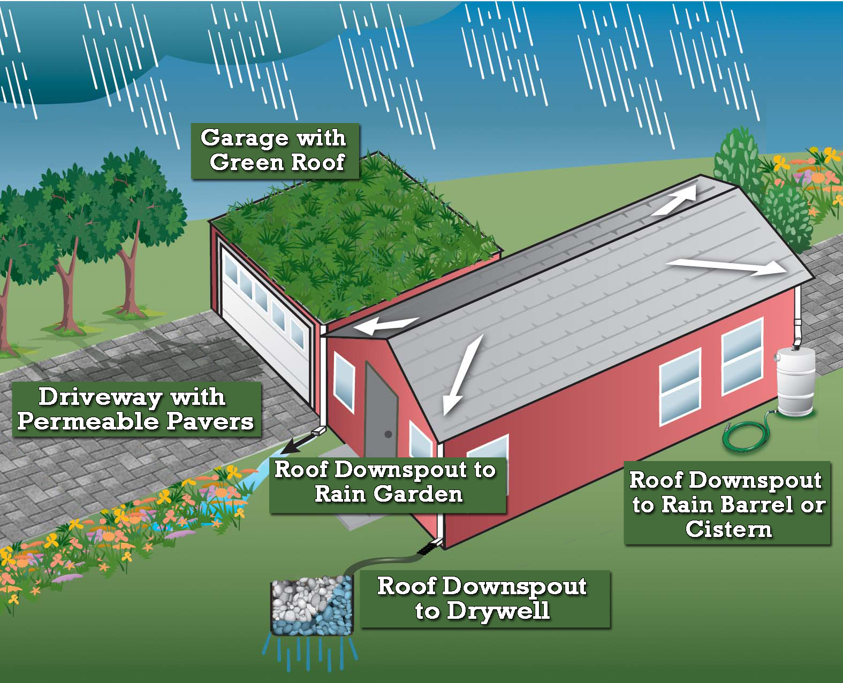
Water Neutral

Slide 29
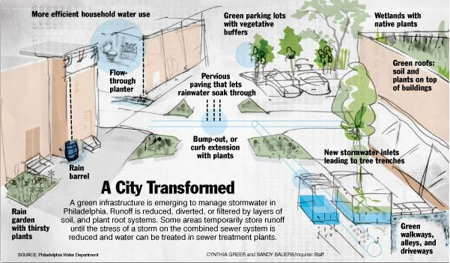

Slide 30
Flooding
Permeable Pavers – special bond issue
Water retention and capture systems
Work with EBMUD
Drought
Residential storm water storage
New multiunit buildings – require onsite storm water capture & storage
Transfer tax – seismic rebate – expand to cover water & energy efficiency
Work with EBMUD

Slide 31
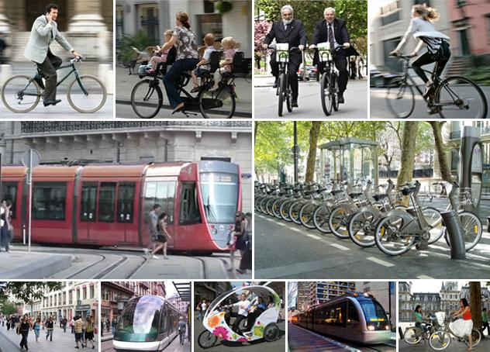
Transportation
Self driving vehicles
Separated Bike Lanes
Free shuttle buses
Car Share
Electric charging stations on street lights

Slide 32
Resilience
New modern infrastructure will improve Berkeley’s resilience
Reduce recovery cost of a major disaster
Approach Insurers about helping to fund new infrastructure
Federal Funds

Slide 33
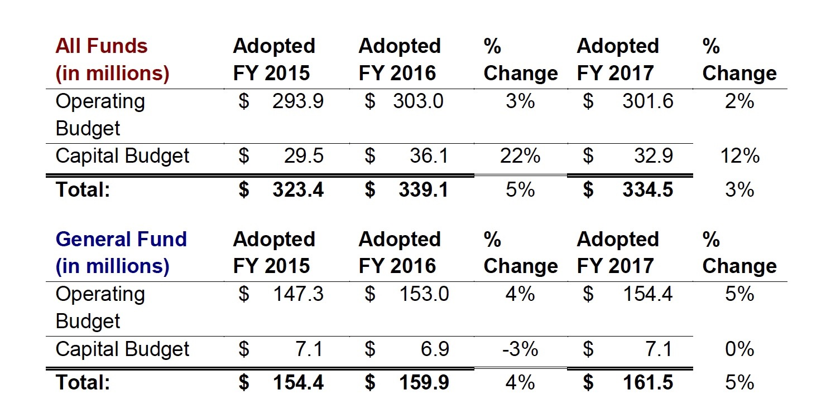

Slide 34
City Council Takeaways
Adopt goal of completely modernizing and greening Berkeley’s infrastructure by 2050
Aligns 100% infrastructure modernization with Climate Action Plan
2. Develop Vision for Infrastructure Plan for Berkeley2050
UCBerkeley
Berkeley Lab in part
Drought/Flooding
EBMUD
Resilience
Insurance Companies
Utilities

Slide 35
The End

Slide 36
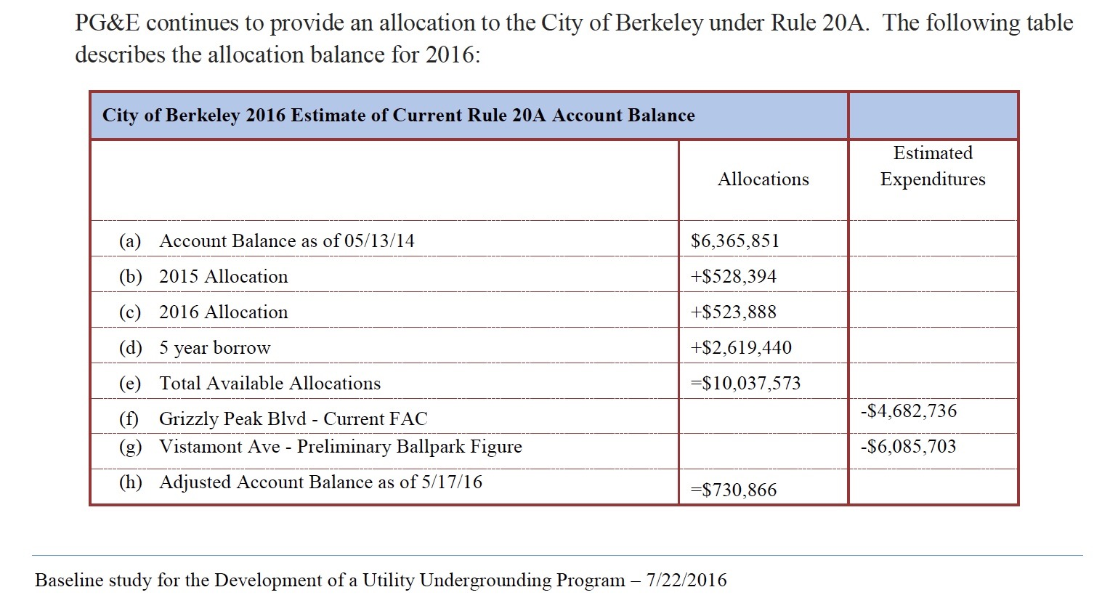
Rule 20A Funds

Slide 37
