Slide 1
Infrastructure2050
New Infrastructure
Climate Action Goals Resilience Goals
John Gage & Gordon Wozniak
March 7, 2017
Notes:
For the last six months, John Gage and I have been brainstorming on how to meet the challenge of creating a 21st Century infrastructure for Berkeley.

Slide 2

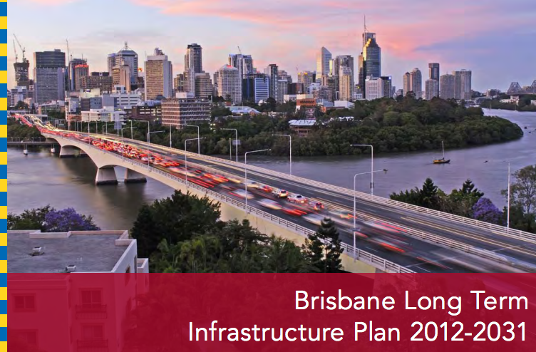
Climate Action
2050 Goal
Reduce GHGs by 80%
Progress
Limited Funding
Berkeley Infrastructure
No Goal
No Plan
Notes:
Road Map for Climate Action
No Road Map for Infrastructure

Slide 3
INFRASTRUCTURE NEEDS
> $1 Billion
Undergrounding Utilities
$740M
Flooding & Drought
>$200M
Transportation
$XXX M
Parking $36M
COB Identified Capital Needs
~$400M
Resilience
$XXX M
T1
$100M
Notes:
Infrastructure Needs are HUGE?
Red Ink overwhelms the black Ink.
Need a Long term Infrastructure Plan

Slide 4
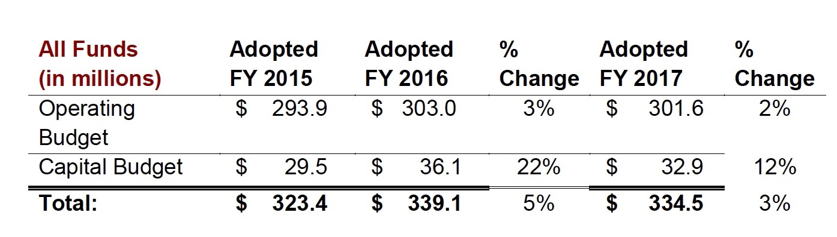
Think Long Term & Plan!
FY2015 → FY2050
$1050 Million
$30M/yr
Notes:
If Berkeley could dedicate ~$30+ million/year fro the next 30+ years, we could build a modern infrastructure.

Slide 5
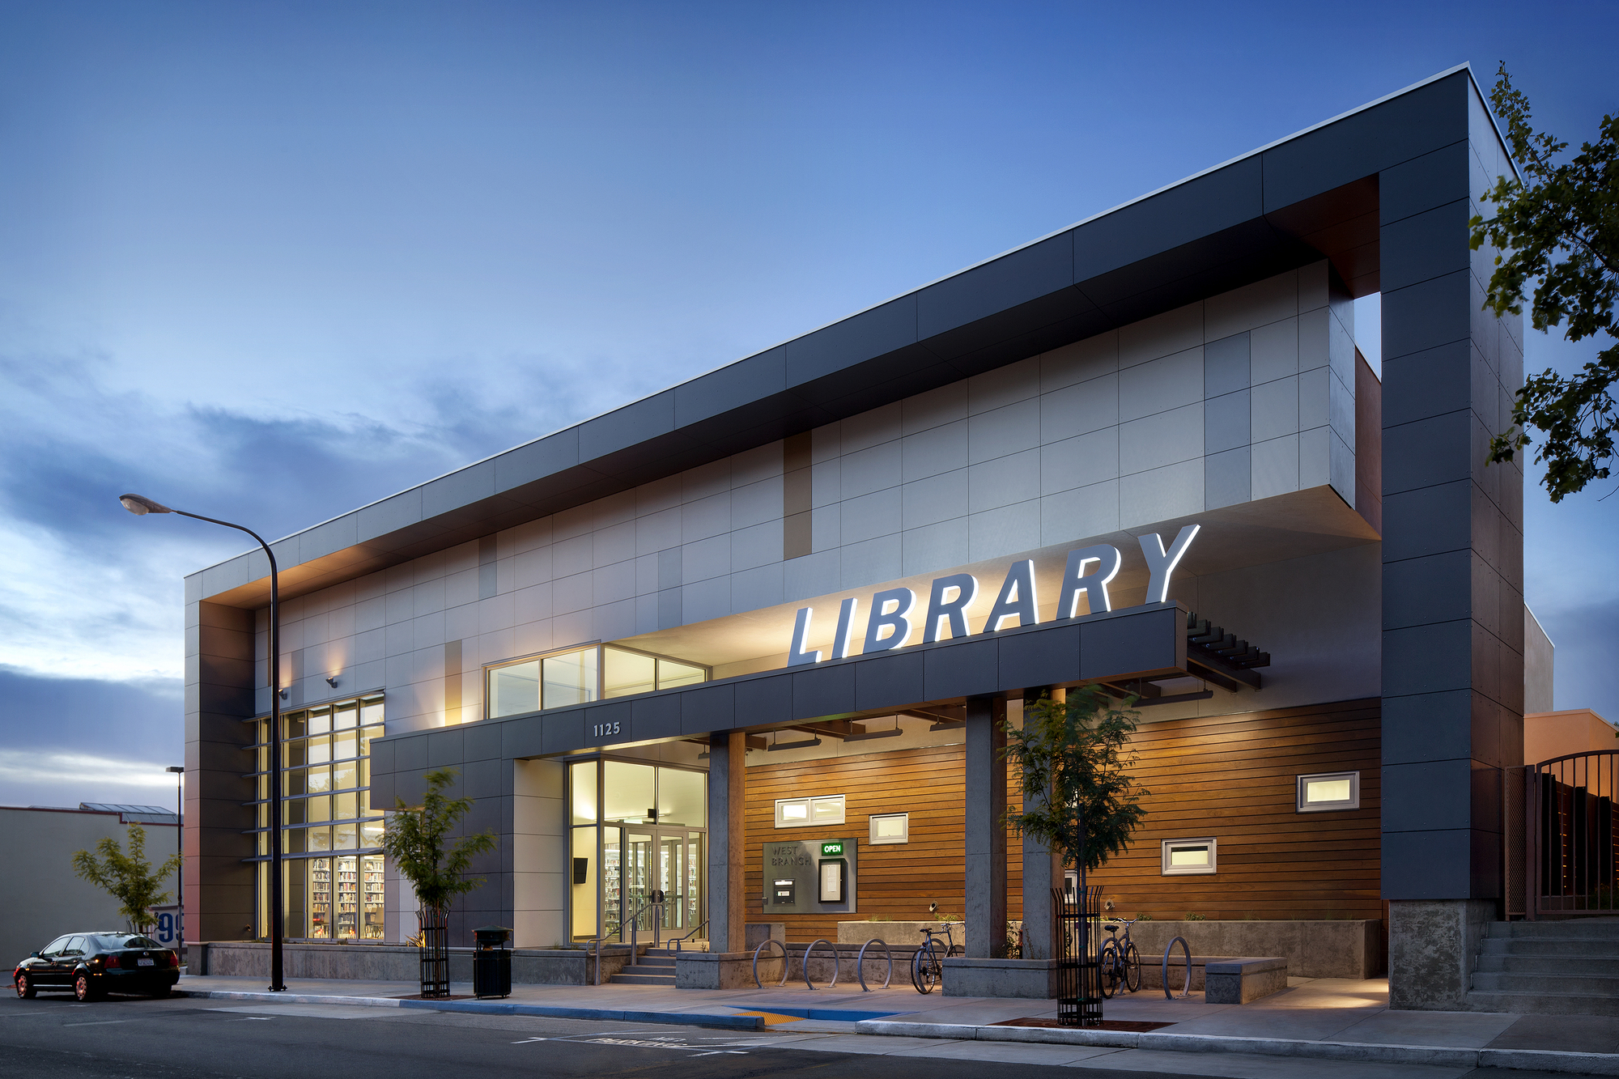
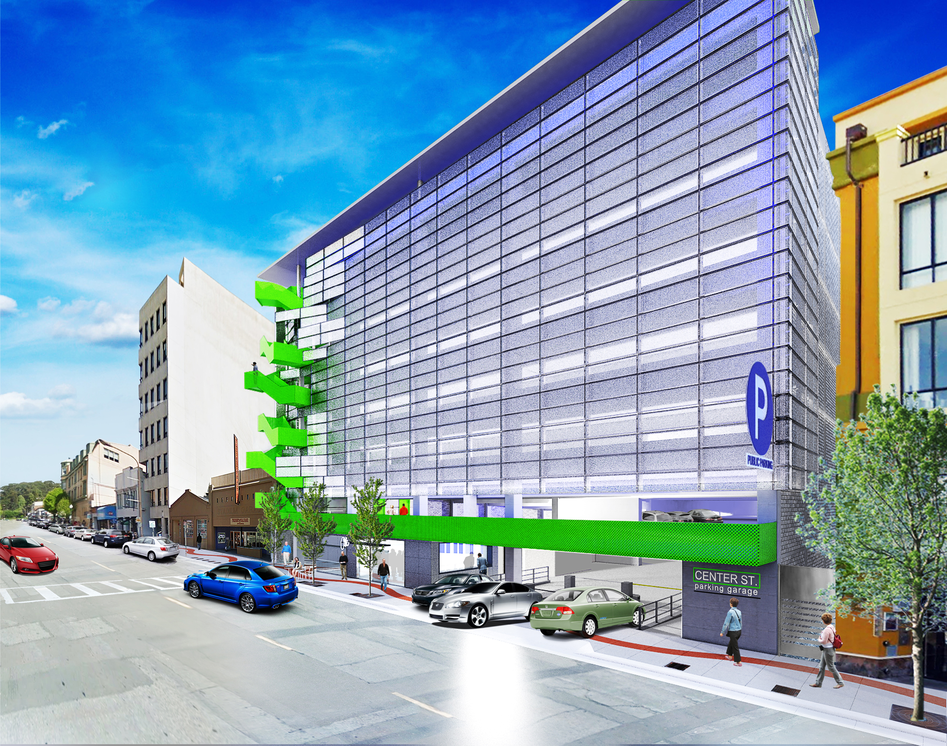
How Does Berkeley Finance Capital Projects?
General Obligation Bonds – Tax on Property
Revenue Bonds – revenue stream
Notes:
Two main finance mechanisms
GO Bonds ($92M) -> interest & principal are paid by a tax on real property – vote – appears on property tax bill
Revenue Bonds($42M) -> secured by a revenue stream – e.g. parking revenue from garage.
Both - Similar to fixed rate mortgages

Slide 6
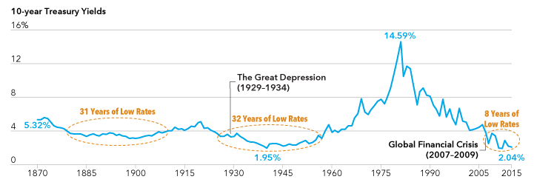
To Bond or Not to Bond?
Notes:
Take on debt during low-interest rate periods.

Slide 7
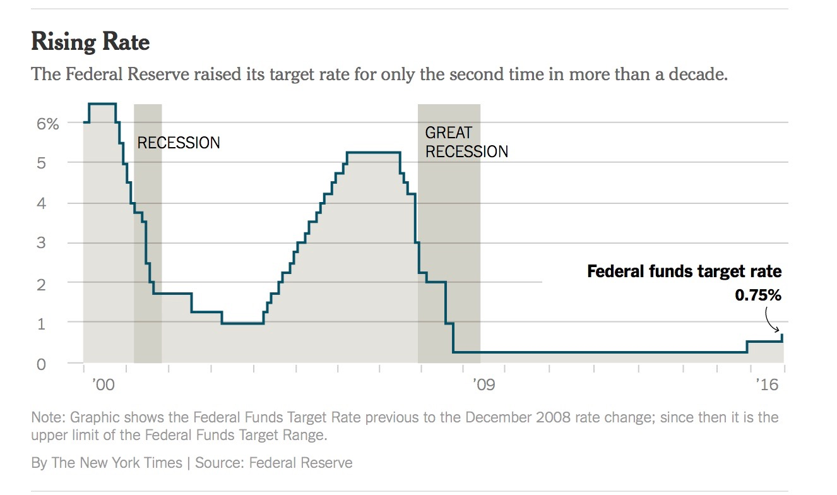
From 2000 – 2016, Berkeley issued $62 Million in New Bonds Did its Debt Service Tax Rate go up or down?
Notes:
Taking Advantage of low interest rates,
the COB refinanced ~$93 million in higher interest rate bonds, lowering the cost to the property owners.
Assessed Property Values doubled in the last 15 years.

Slide 8
Comparison Taxes and Tax Rates for 2000/1 to 2016/17 (141 Parkside Drive)
Year | Countywide Property Tax based on AV ($) | COB Tax Rate (%) | COB Tax Amount ($) | BUSD Tax Rate (%) | BUSD Tax Amount ($)
2000/1 | $5,369 | 0.0867% | $465 | 0.1250% | $671
2016/17 | $6,991 | 0.0445 | $311 | 0.1327% | $927
% Change | +30.2% | -48.7% | -33.1% | +6.2% | +38.2%
Notes:
A Little Known Fact – COB’s Debt Service Rate has decreased by over 48%

Slide 9
Notes:
While some taxpayers may applaud the City for reducing its taxes,
I believe that the BUSD approach of keeping the Debt service rate ~constant is the better long term approach to financing capital projects.
MEASURE T1 will increase Debt Service Rate

Slide 10
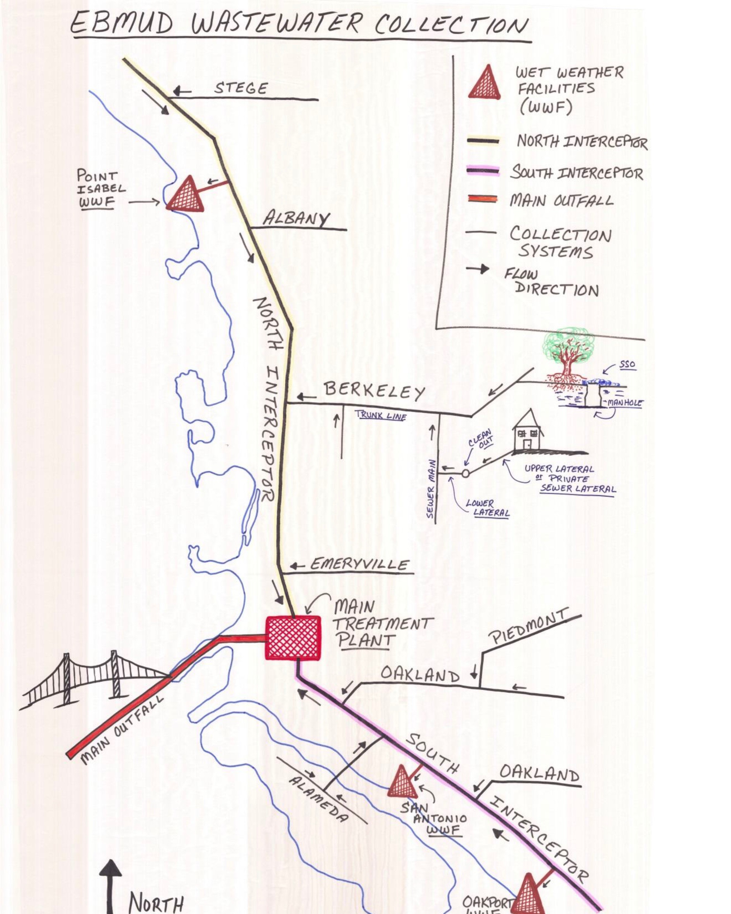
Berkeley Violates Clean Water Act
REVENUE BONDS?
2014 – Consent Decree requires COB
Reduce inflow and infiltration
Reduce sanitary sewer overflows
Repair and replace aging sewer pipelines
2026
Replace 50 miles of sewer pipeline -> $100M
Replace all noncompliant manholes
Perform annual assessment on 25 miles of sewers
Increase maintenance activities
Notes:
Berkeley and other East Bay Cities have reached a settlement with the EPA to upgrade their sewer lines to stop releasing raw sewage in the Bay during storms.
During storms the water flow in the sewer lines can be 10 – 15x normal. Overwhelms EBMUD treatment plant.

Slide 11
Capital Project: Sewer Pipeline Replacement
EPA Settlement
Mandates 4.2 mi/y = $8.4 million
Operating Budget
~5M/yr → 2.5 miles of pipeline replacement
Shortfall = $3.4 M/yr
Two Options
Raise sewer fees?
Keep to original schedule
$100M Revenue bond?
Complete project faster
Less pollution
Notes:
Raise fees to cover shortfall
Use existing revenue stream to fund a Revenue Bonds

Slide 12
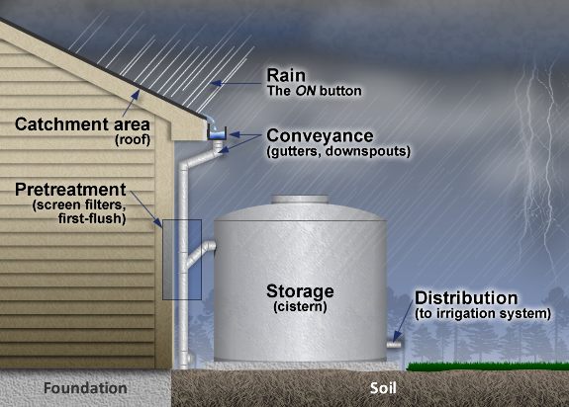
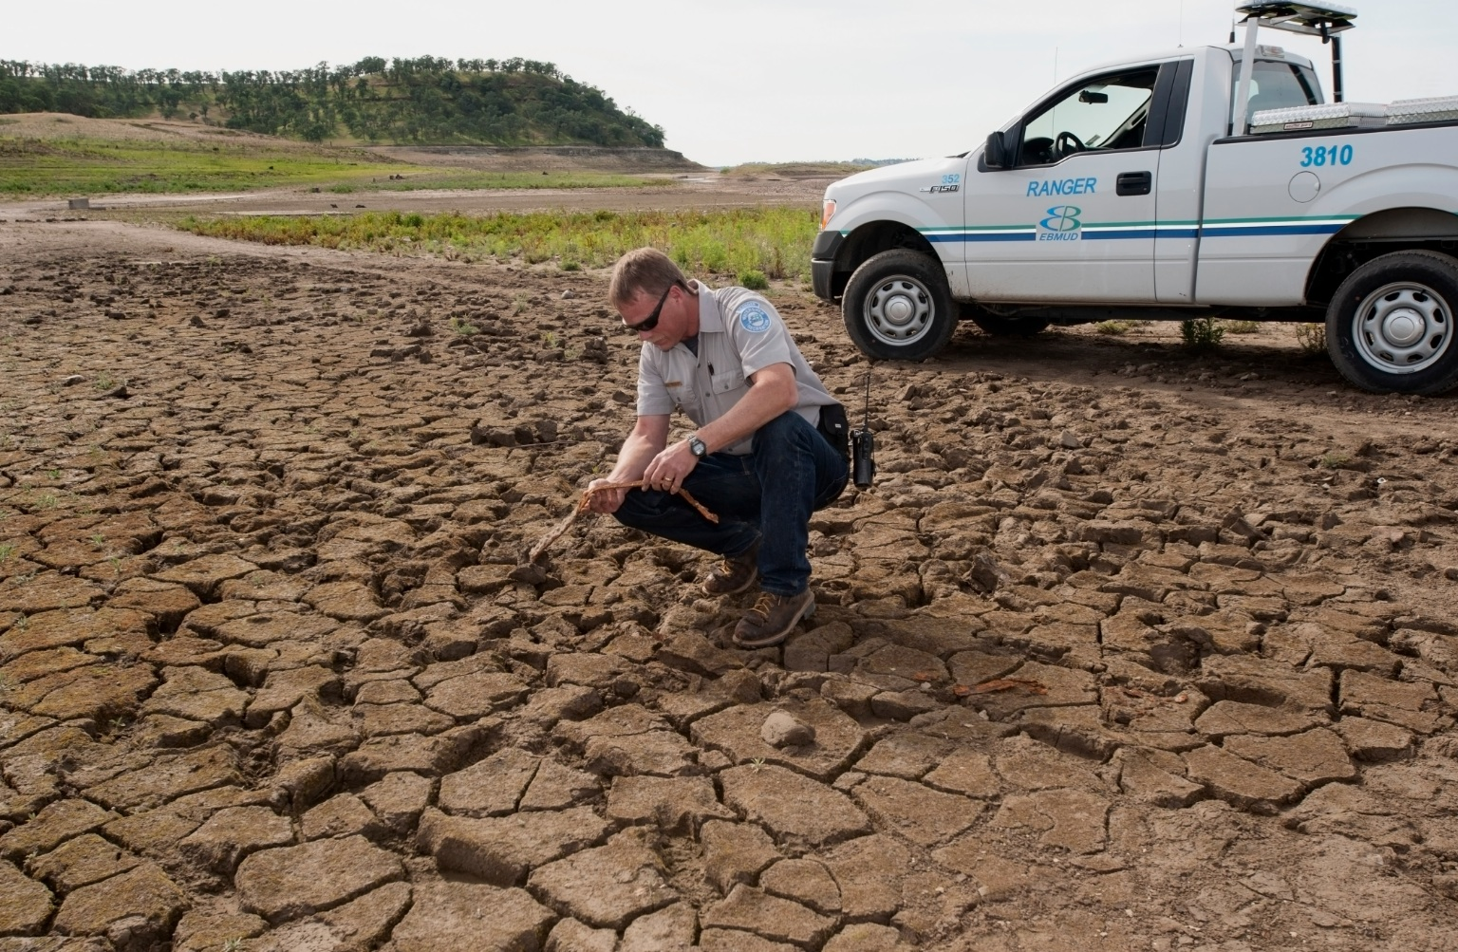
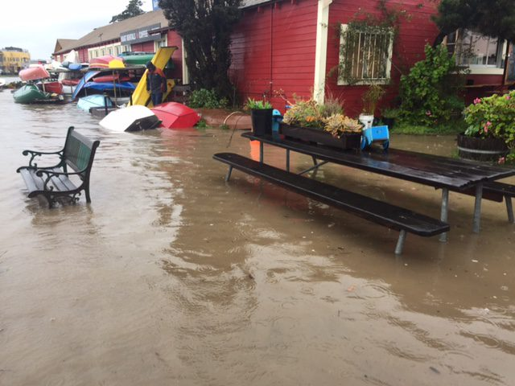
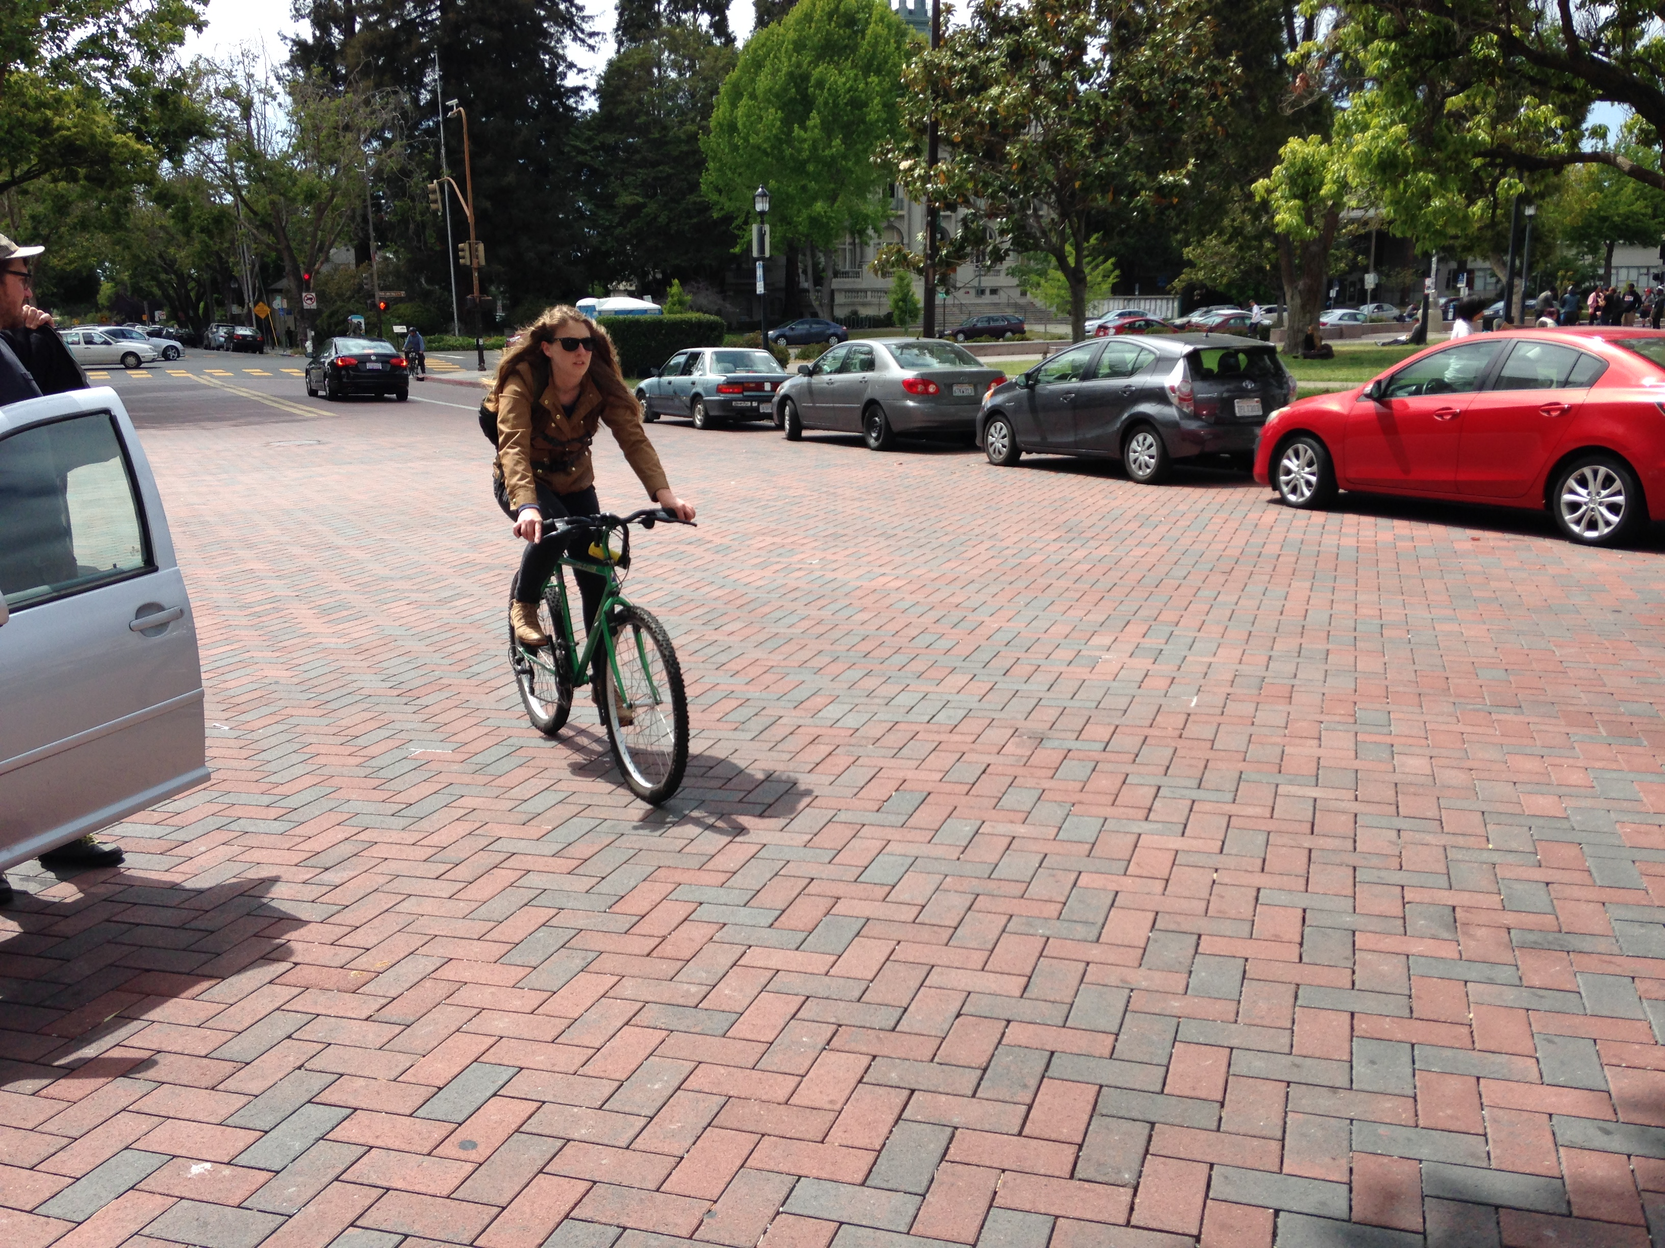
FUTURE Drought/Flooding GO Bond
Rainwater Harvesting
Permeable Surfaces
Notes:
Rainwater Retention systems → mitigate drought & flooding
Permeable surfaces → reduce flooding and recharge local aquifers

Slide 13
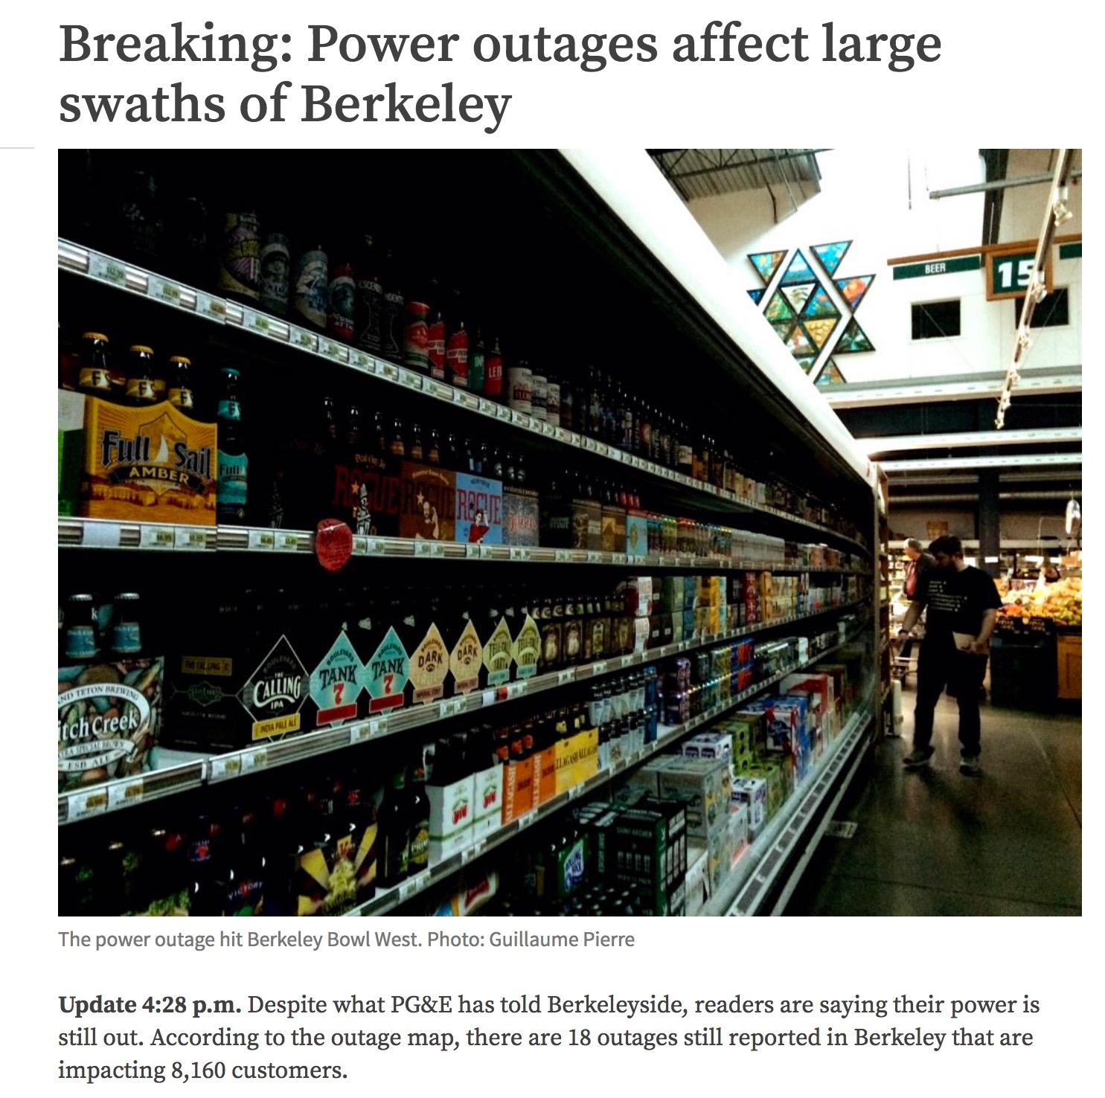
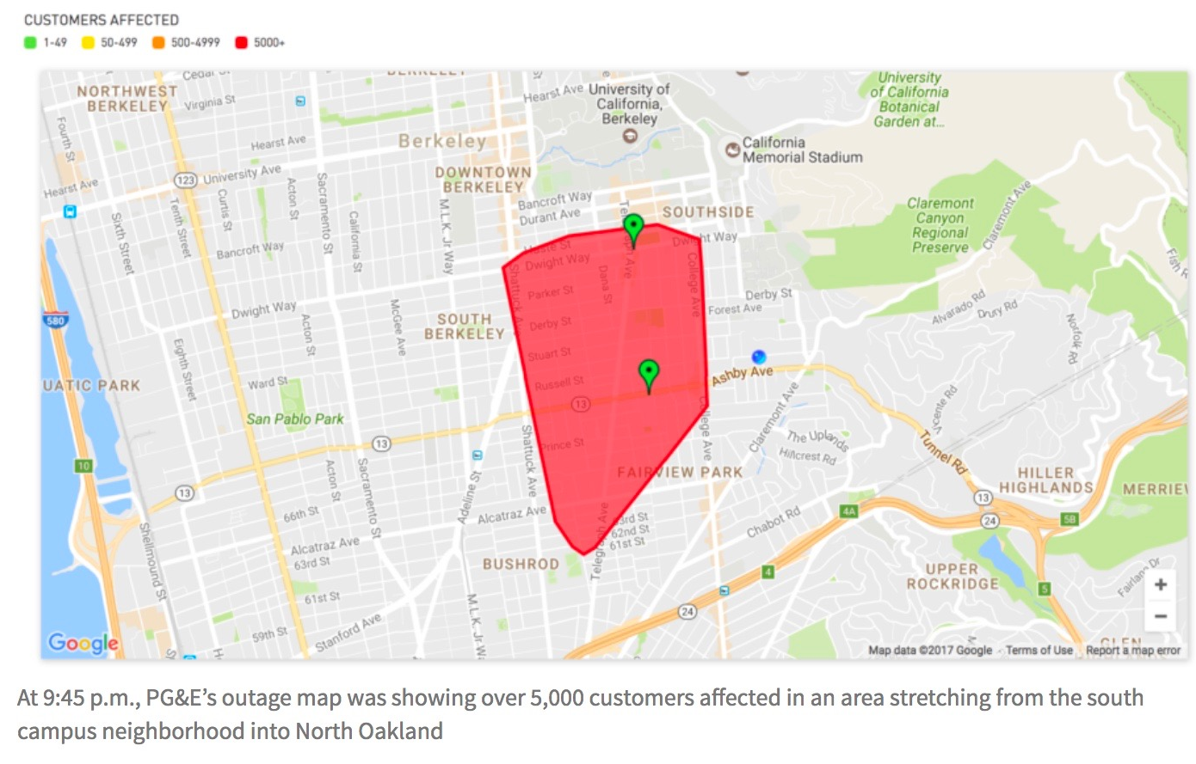
Undergrounding Utilities
Notes:
Power Outages: Dec 2016 and Feb 2017

Slide 14
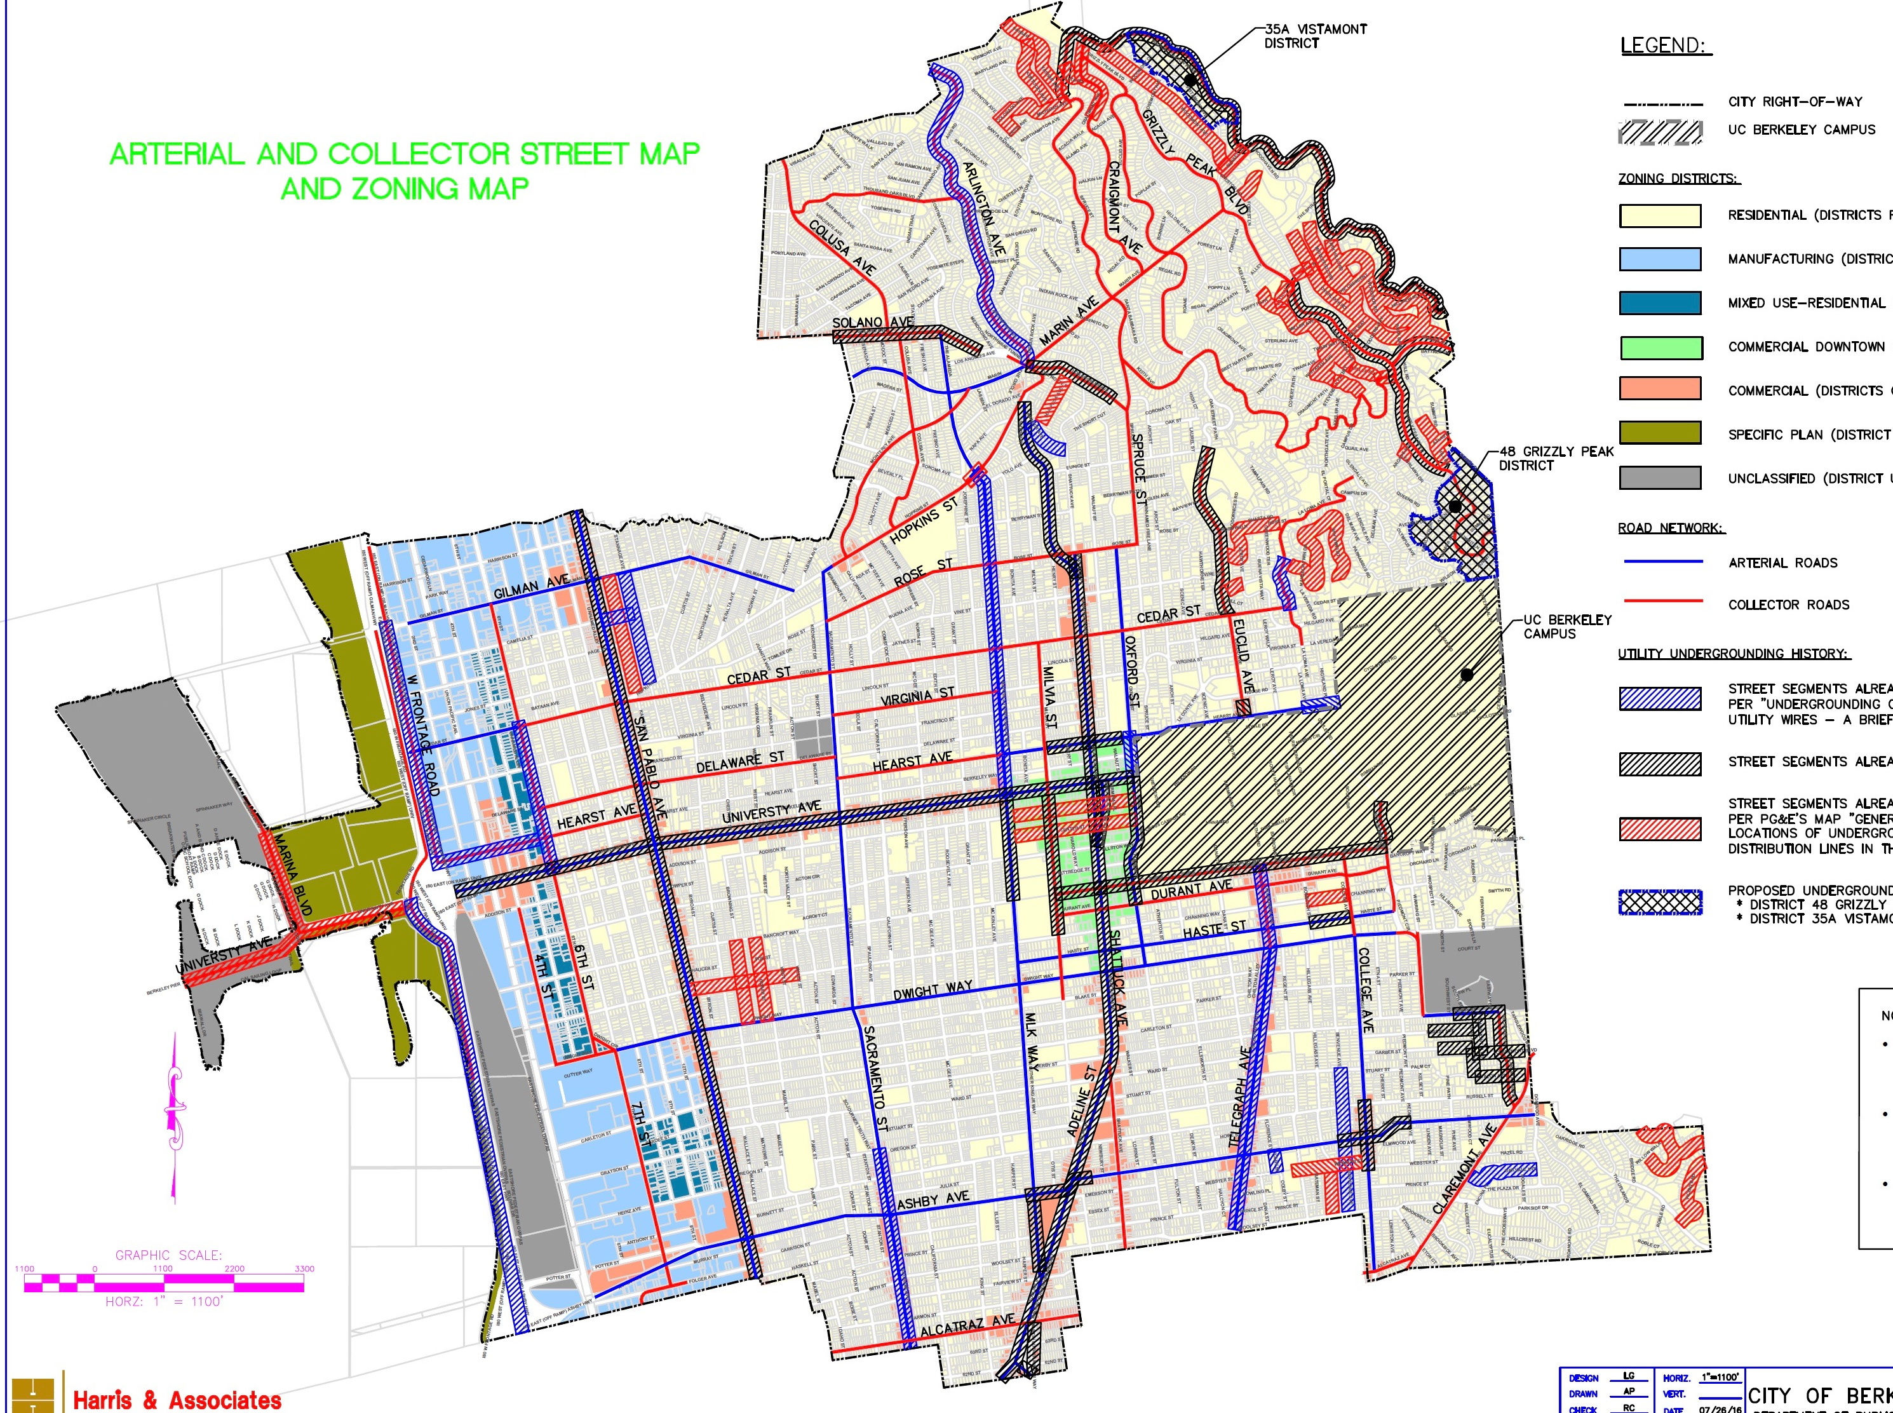
Underground Utilities?
Arterials/Collectors = $135M
Increase UUT from 7.5% to 10.0%
Issue $135M in Revenue Bonds
Residential streets = ~$600M
Dedicate 2.5% of current UUT
Issue $135M in Revenue Bonds
Shortfall = $465M
Notes:
$135 million for Arterials and Collectors – 2.5% UUT increase
$600 million for residential streets – dedicate 2.5% of existing UUT
Work with PG&E and other utilities for cost sharing
Install conduit and fiber optic cable

Slide 15
Seismic Rebate – 1992 Transfer Tax
Very Successful
Over 60% of private residences have participated
Number of participates is declining
Expand Rebate to include Climate and Water Goals
energy efficiency
solar power
water conservation, rainwater capture & reuse
Requires Ballot Measure
No tax increase
Notes:
0.5% of sale price can be used to finance seismic improvements

Slide 16
30 Year Capital Financing Plan ($30M x 30 yrs = $900M)
GO Bonds
Assessed Values → x4 - Measure T1
Ask Voter to set Debt-Service Rate at FY2000 value of 0.0867%
Revenue Bonds
Use $5M capital steam in sewer fund to issue Revenue bonds
UUT increase by 2.5% to 10%
Use $4.7M increase to fund revenue bonds for undergrounding collectors & arterials
Dedicate 1/3 of current UUT to undergrounding residential streets
Ask Utility & Insurance Companies to subsidize residential undergrounding
Property Transfer Tax
Broaden Seismic Exemption to include energy & water efficiency
Partnerships
EBMUD, Utilities, Insurance Companies

Slide 17
City Council Takeaways
Adopt goal for Infrastructure2050
Modern
Durable
Green
sustainable
2. Develop Vision for Infrastructure2050
UCBerkeley
Berkeley Lab
Establish Planning Process
Citizen involvement

Slide 18
The End

Slide 19
What is Berkeley’s Vision for 2050?
Carbon Neutral
Water Neutral, conservation & flooding
Rainwater capture & reuse
Permeable surfaces
Grey water
Fiscally sustainable
Durable – lower maintenance costs
E.g. LED street lights
E.g. Branch libraries seismic/energy upgrades
Infrastructure replacement fund
Resilient and Beautiful City
Undergrounding & fiber optics
Parks & greenways
Fishing pier

Slide 20
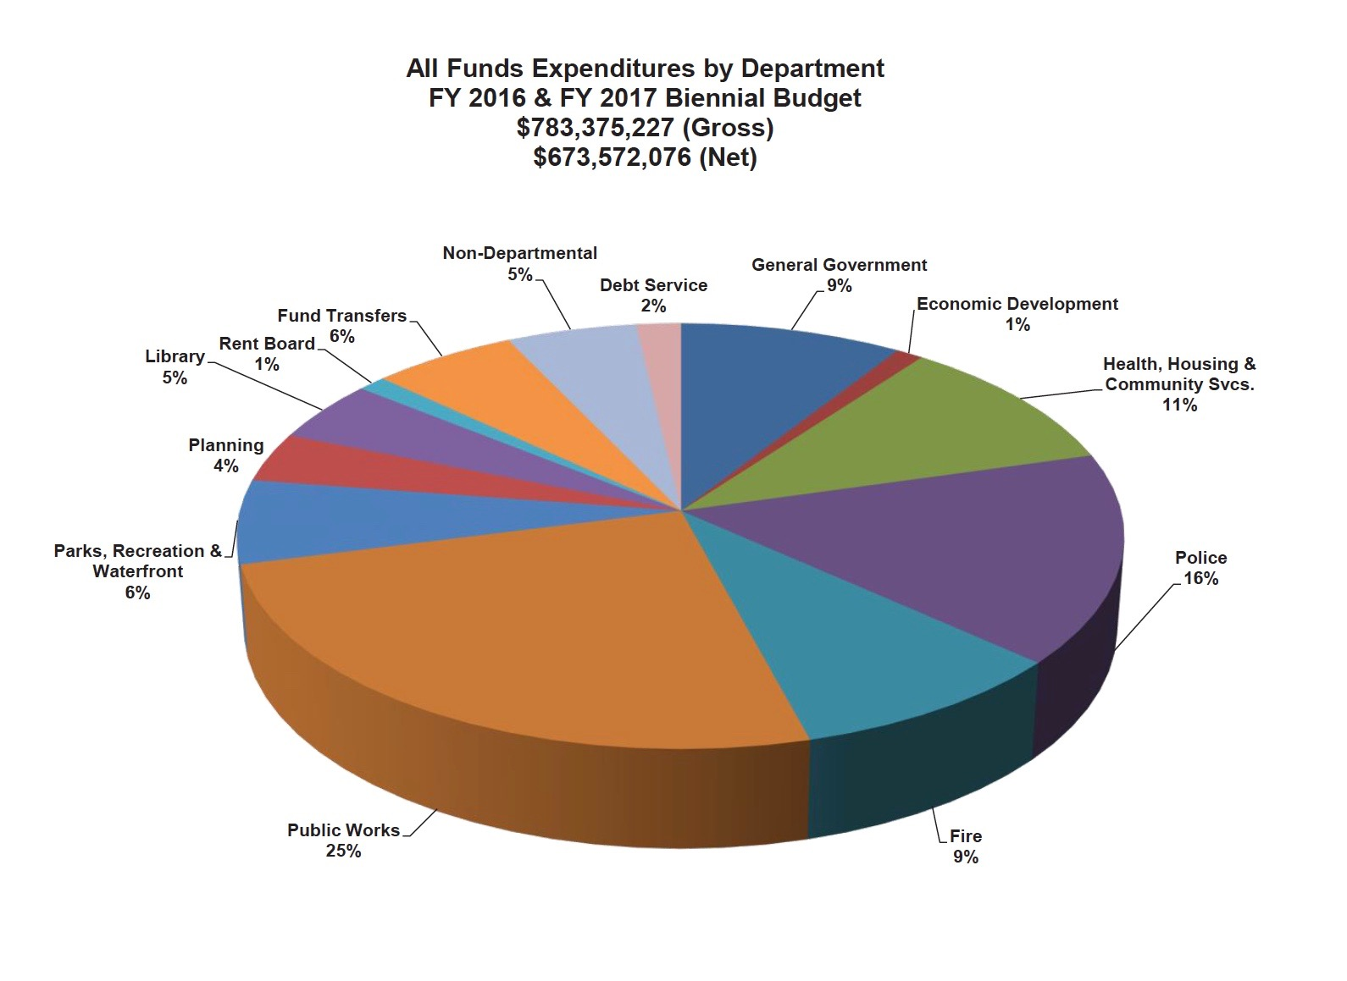
Debt Service is 2% of Total Budget

