Slide 1
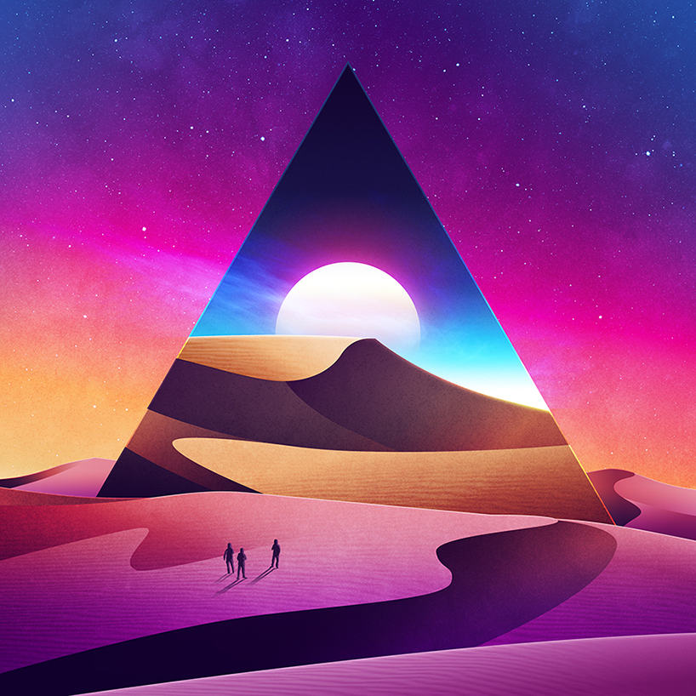
Dark Crystal v1.0.2
Back up your secrets using the trust in your social network
Built on-top of protocol & distributed data architecture Secure Scuttlebutt

Slide 2
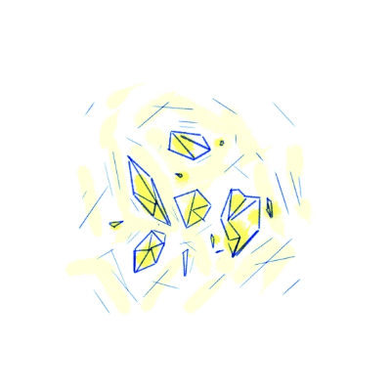
What is Dark Crystal?
Dark Crystal transforms secrets into crystal shards that you can send to trusted friends. If you lose the secret, or something happens to you, your friends can combine the shards to recover the crystal and reveal the secret.
Dark Crystal uses cryptography so that no individual shard reveals anything about your secret on its own. Your secret is only revealed if the people you chose cooperate and put their shards together.

Slide 3


What is Secure Scuttlebutt?
Scuttlebutt is a protocol for building decentralized applications that work well offline and that no one person can control. Because there is no central server, Scuttlebutt clients connect to their peers to exchange information.
Scuttlebutt is a flexible protocol, capable of supporting many different types of applications. One of its first applications was as a social network called Patchwork.
The first thing a user needs to participate in Scuttlebutt is an identity. An identity is an Ed25519 key pair and typically represents a person, a device, a server or a bot. It’s normal for a person to have several Scuttlebutt identities.

Slide 4
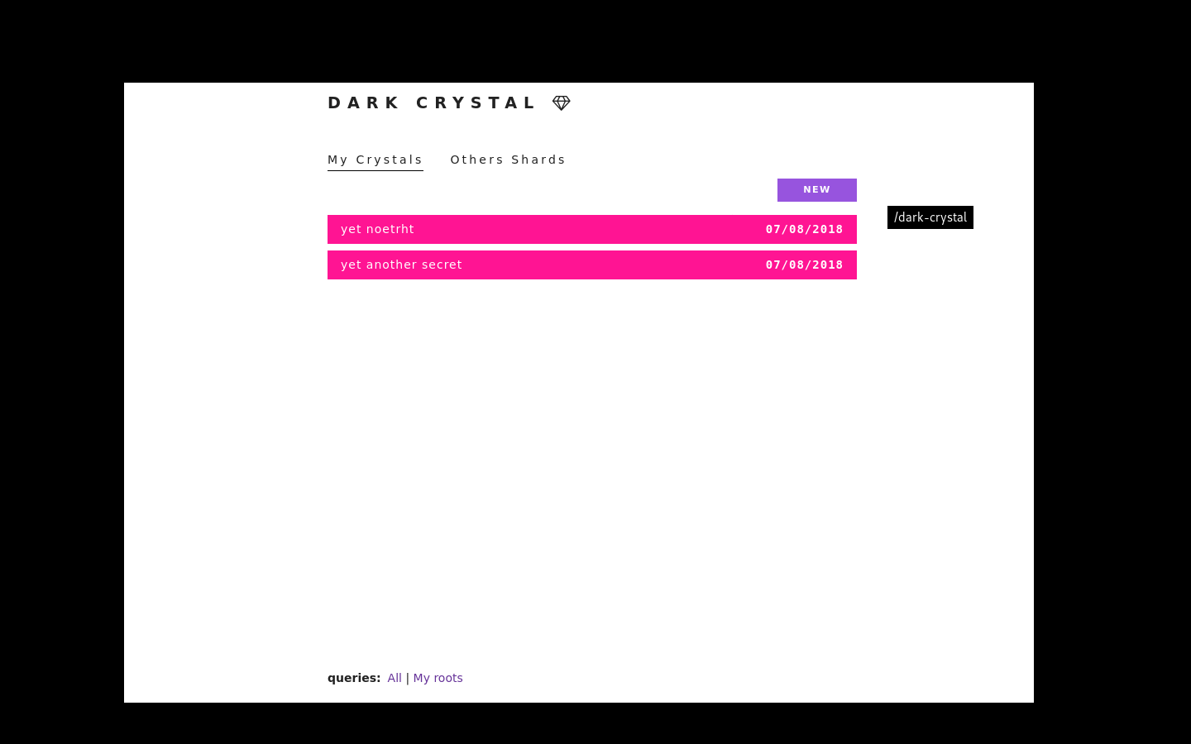
What does Dark Crystal have to do with Scuttlebutt?
Dark Crystal uses the p2p scuttlebutt protocol and database as a platform to securely back up secrets between peers. It directly utilises the trust in your social network. Your secret (wallet seed, password, etc) is split into 'shards', which are given to your trusted friends. If you lose the secret or something happens to you, your friends can combine the shards to recover the secret. Dark Crystal makes this whole process simpler and less error prone and more accessible.

Slide 5
WHY?
The custody problem (securing private keys) is a ubiquitous wicked problem that needs solving for cryptocurrencies and cypherspace in general to go mainstream. Part of this is to do with cryptography, but arguably a larger part is a people problem.
Password managers have been in use for decades, yet haven't achieved widespread adoption. Approximately 20% of all bitcoins are said to have been lost due to access errors.
What we propose is a people-centric design utilising existing distributed systems. Our thesis is that this is a coordination problem rather than a purely technical problem.

Slide 6
Use Dark Crystal for....
- Passwords
- Cryptocurrency seeds & keys
- Directions to the hidden treasure
- Any other secret in text form

Slide 7
“In P2P spaces, your friends are the data center. Data get wiped? Resync it from your friends. Lose your private key? Piece together the shards from your friends. That radical interdependence with real people that we trust can remove our dependency on corporate cloud providers. This feels important; an undoing of decades of capitalist efforts to isolate us and separate us from each other. P2P technology can help people reconnect with each other on a human beings level.”
-- noffle

Slide 8
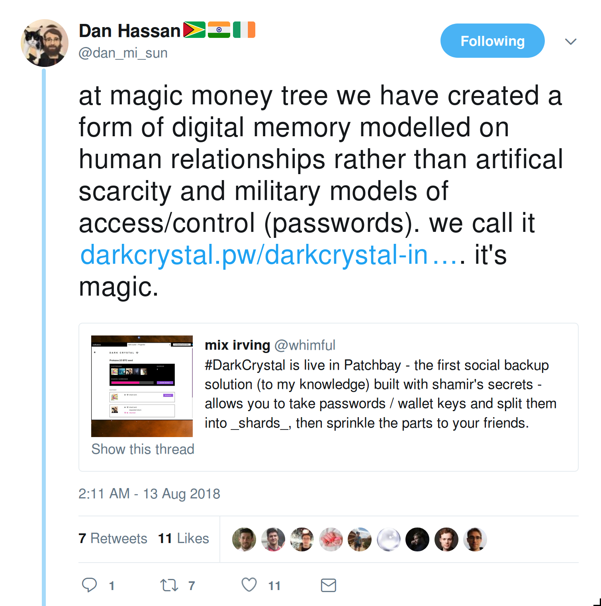
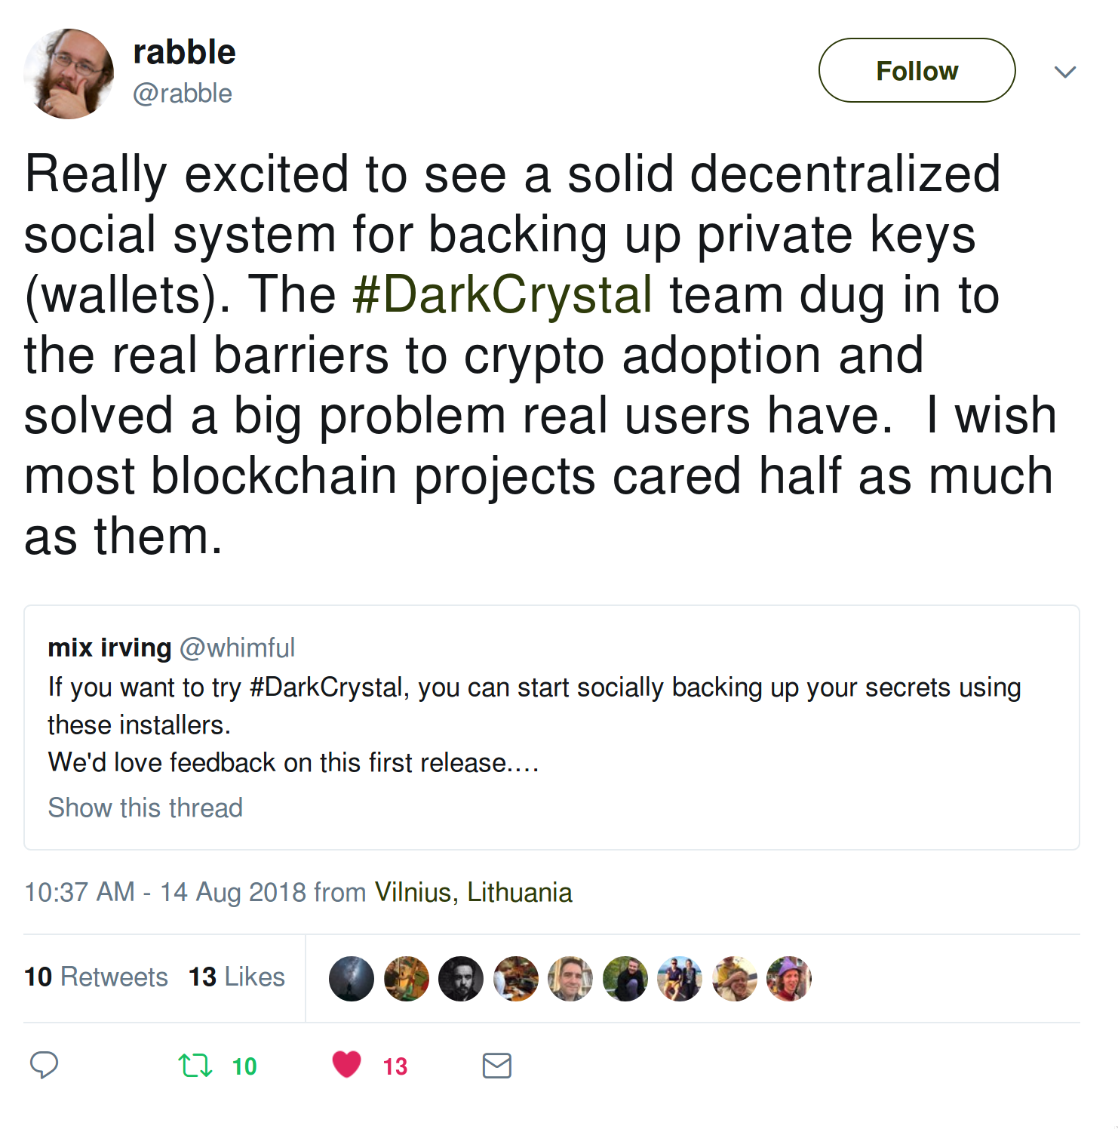
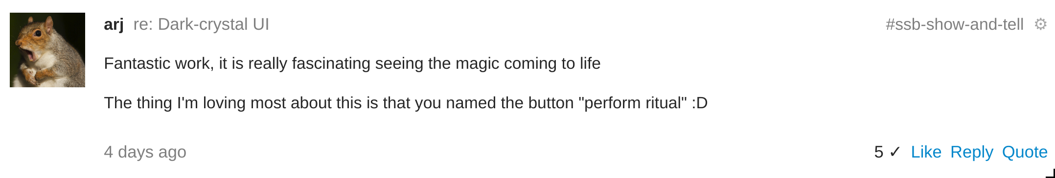

Slide 9
Funding
We are on the hunt for funding to continue our work in this space. This funding would enable us to:
- Complete follow-up research with the SSB community.
- Review research and enact upgrades to address the needs of the SSB community.
- Transfer the Dark Crystal protocol to other distributed systems such as Holochain, Ethereum, Blockstack
Our longer-term vision is to make tools for collaboratively managing cryptocurrency. Much development in the crypto space has come from an individualist mindset.
Our backgrounds and passions are in cooperatives, communities, and high-trust networks, and we think crypto can become even more revolutionary by powering groups of people working together.
We want to build a new multi-signature cryptocurrency wallet designed with group collaboration and social finance at its core with Dark Crystal a central feature.

Slide 10
Release: https://github.com/ssbc/patchbay/releases/tag/v7.14.0 |
Website: http://darkcrystal.pw |
Code: https://github.com/blockades/scuttle-dark-crystal | https://github.com/blockades/patchbay-dark-crystal |
https://github.com/blockades/ssb-dark-crystal-schema
Team: kieran@tenthousandthings.org.uk | dh@blockades.org |
alanna@enspiral.com | mix@enspiral.com | ameba23@systemli.org
Find us on SSB: @kieran | @dan hassan | @alanna | @mixmix | @peg
For a complete history of all our research and the development process that led to Dark Crystal, check out the #mmt and #dark-crystal channels on Secure Scuttlebutt.

