Slide 1

Targeting Zero MEV
in the Base Layer
@pmcgoohanCrypto

Slide 2
Root Cause of MEV
MEV = the profit to be made by reordering and censoring transactions.
MEV is the profit to be made by reordering and censoring transactions.
(original definition, not block rewards or gas fees, not latency arbitrage)
Reordering/Censoring Txs = Data Corruption
(txs are data, reordering is data corruption)
Data Order As Important As Data Content
(eg: data in a picture file)

Slide 3


Slide 4


Slide 5
tx ordered by arrival time
tx order corrupted by MEV/GPA/MEVA

Slide 6
We are selling the right to corrupt transaction data
via GPA, MEVA & by permitting MEV
MEV = Reordering/Censoring Txs = Data Corruption
MEV
Tx inclusion time stats:
Avg 2:30 mins, Stdev 20 mins!!
Time order corrupt, so latency arbitrage is not possible
= all MEV is bad
Only preventable in base layer
Only a base layer fix will work
Reordering
Censoring Txs
Data
Corruption

Slide 7
Transactional Order Integrity
What is Fair Order?
“By what measure? Fair for who? How do we decide?”

Slide 8
Transactional Order Integrity
What is Fair Order?
Send Time Order
If Alice sent her tx before Bob’s, it should be included first.
If Bob sent his before Alice, his should be included first.

Slide 9
Transactional Order Integrity
What is Fair Order?
objectively fair (models reality)
Send Time Order
no MEV
If Alice sent her tx before Bob’s, it should be included first.
If Bob sent his before Alice, his should be included first.
Remember: MEV is the profit to be made by reordering and censoring transactions

Slide 10
Measuring Order Integrity
minimal divergence from send time
(visibility by tracking known txs through the network, statistical measures, kendall tau distance)
symmetrical divergence from send time
(asymmetry = Citadel always have ≈0ms latency, WSB traders always have 300ms+ latency)
Worst |  | Best
Ethereum Now | NASDAQ | Ethereum Soon!
High, Asymmetrical STE | Low, Asymmetrical STE | Low, Symmetrical STE
Tx order is very corrupt Wealthiest/best resourced benefit (avg 2:30 mins, stdev 20 mins) | Tx order is broadly ok Wealthiest/best resourced benefit | Tx order approximates send time All participants treated equally
Centralized
exchanges
can’t do this!

Slide 11
Content Layer Solutions
Class of solutions
Many implementations
3 characteristics
Decentralize content creation
Structure the mempool
Enforced in attestation

Slide 12
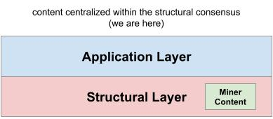
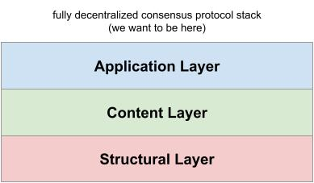
Content Layer Solutions
So why let miners order?
Can’t stop them.
Content centralized.
Decentralize content creation
Structure the mempool
Enforced in attestation
Solution is no surprise. Satoshi solved double spending.
It's how we'll solve MEV. Decentralize.
Many nodes = content of one block.

Slide 13
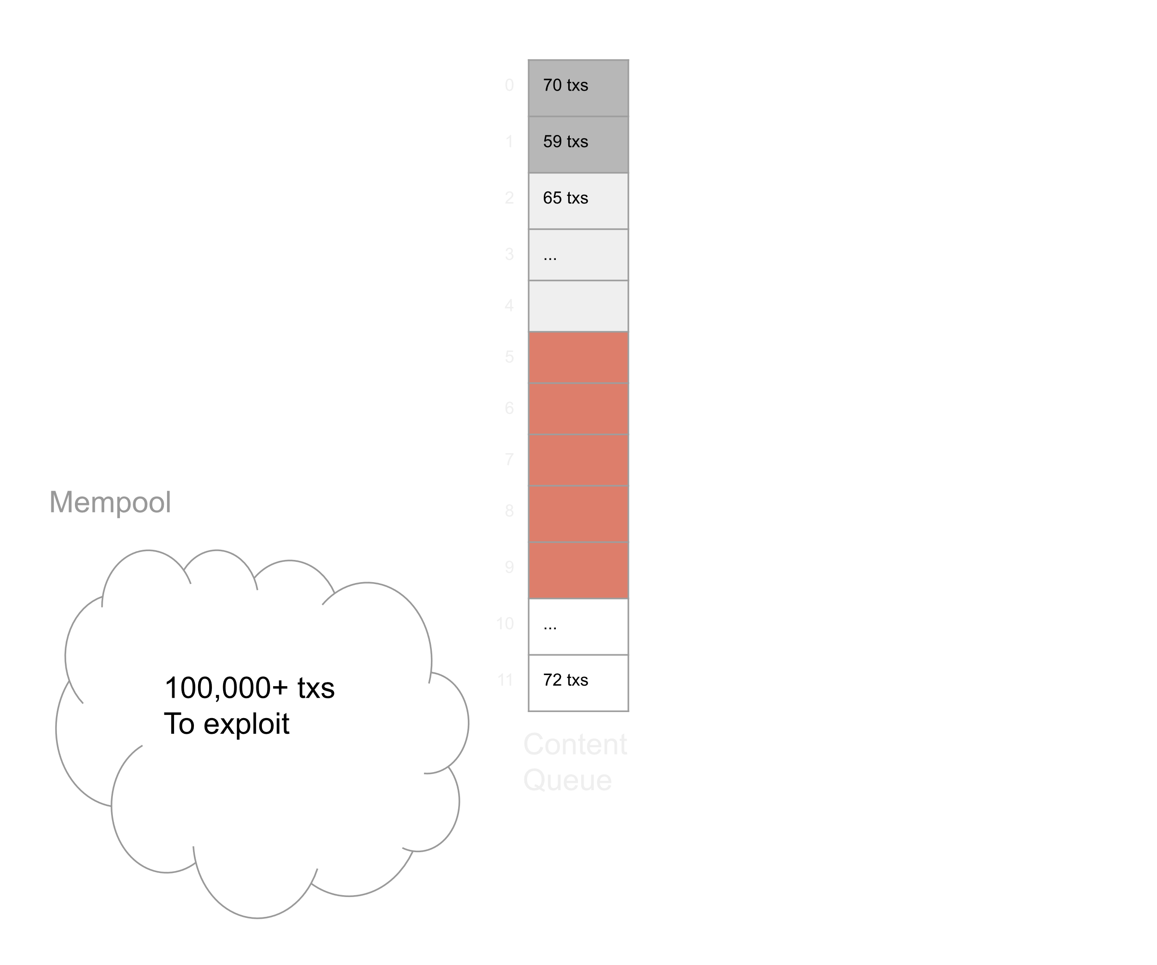
Content Layer Solutions
Decentralize content creation
Structure the mempool
Enforced in attestation
Chunk up the mempool
At low latency (1-3 secs)
Fast - no need to execute / update state / attest
Only ≈70 txs to exploit
per chunk
So less MEV
Unstructured Mess
Graveyard for send time order
100,000s txs sloshing around
Increased choice of txs =
Increased MEV opportunities
100,000+ txs
to exploit for
MEV

Slide 14
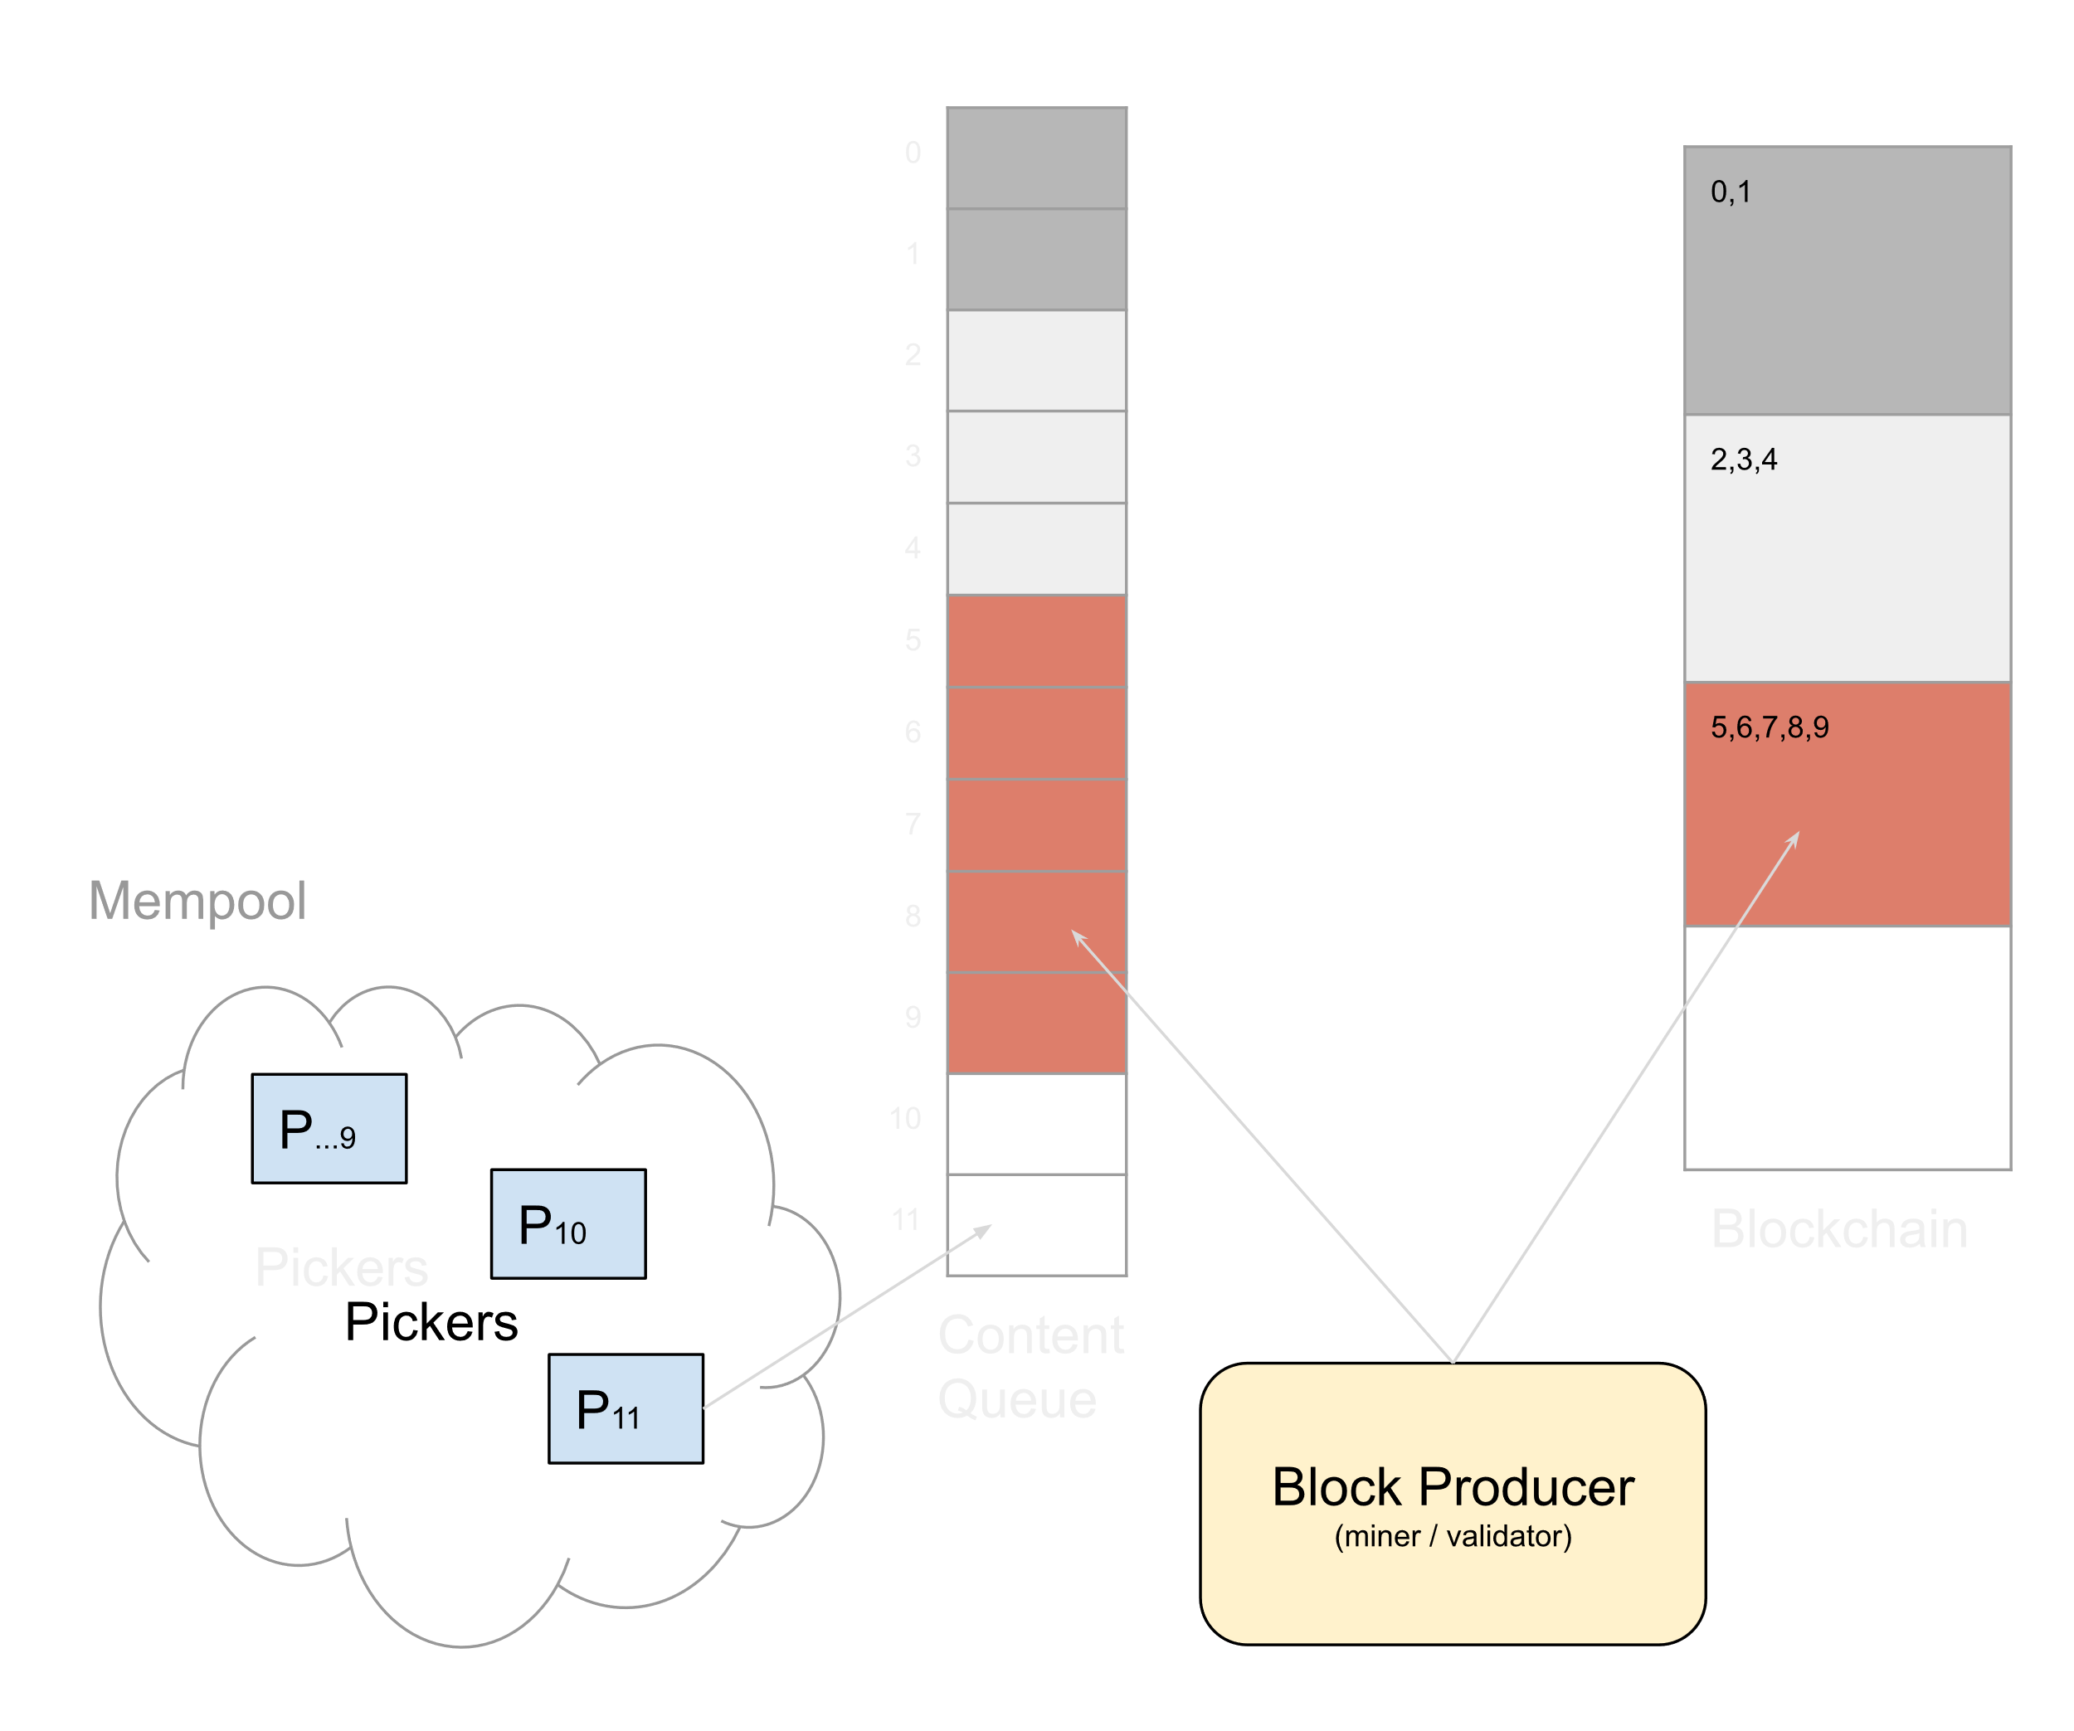
Content Layer Solutions
Plain Alex
(basic content layer)
Decentralize content creation
Structure the mempool
Enforced in attestation
To work it must be non-optional
Base layer solution
Content layer creates chunks
Validators write chunks in order
Or fail attestation
Corrupting tx order requires
51% attack

Slide 15
Advantages
Plain Alex
(basic content layer)
12 sec content chunks
= 40% reduction
in most exploitative MEV
(sandwich, backrun)
Aim to chunk every 1-3 sec
(MEV reduction could be greater)

Slide 16
Advantages
40% reduction in most exploitative MEV
Lower user costs (MEV extracted + Bid costs)
Better Data Integrity (STE down from 02:30 stdev 20:00 to ≈00:02 stdev 00:05)
UX Improvements
Accurate block inclusion estimates for user
Gas Price Auction less significant (possibly not needed)
Remaining MEV more democratized (only 70 txs to mine not 100,000+ txs)
Bandwidth reduction (fewer tx messages once chunked)
Multiplies L2s power to force inclusion (num validators X chunk count per block)

Slide 17
Roadmap reducing MEV solving MEV
Plain Alex – Simple (2022)
Quick to implement (early eth2)
Immediate/significant MEV reduction
Dark Alex – Encrypted (2023)
Users encrypt txs – send to the mempool
Timelock Enc – chunking every 3 secs – decrypt after 5 sec – no block delays
Threshold Enc – reputation market for key split holders
MEV solved
Fair Alex - Fair Ordered (2024)
Pickers map closely to Aequitas replicas
No collusion (Bad actors are minimally incentivized to order enc txs fairly)
MEV solved & objectively fair distributed systems for all – best on the planet - YAY!!
Random Alex (shelved due to stat arb issues)
@pmcgoohanCrypto

