Slide 1


Intro
Our Company: Blockchain Advisors & BCU
Team members:
Ali
Lorenzo
Cosmin
Mo
James
Blockchain Advisors

Slide 2
STEPS
PDF to URL
Sending request (URL) to OpenAI through agent communication.
Summarising the document and extracting the relavant information about the factors that might affect the insurance price.
Identifying key factors and extracting them from the text, such as sections and dates.
Create dataframe from extracted details.
Rule-based recommendation as the pension schemes are limited, otherwise it should be ML-based.

Slide 3
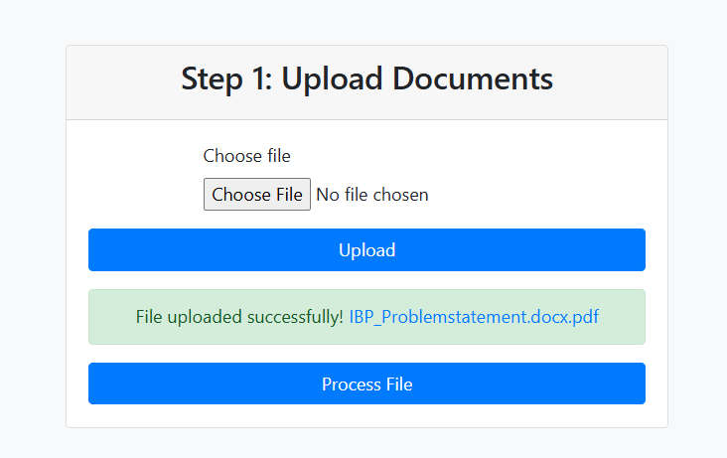
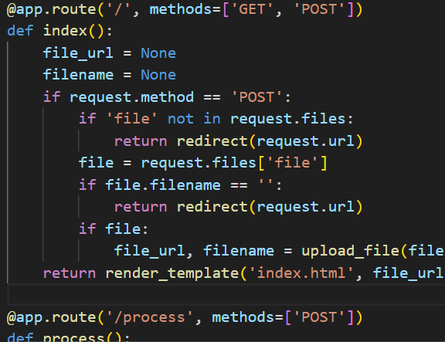
STEP 1: PDF to URL
Turn the PDF file into a URL link to be accessed by the AI.

Slide 4
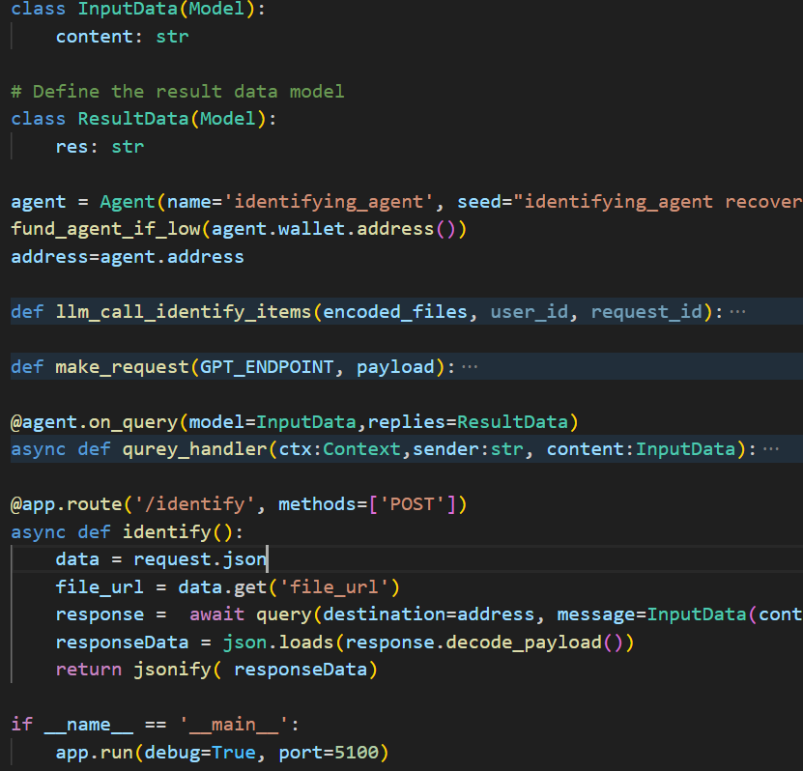
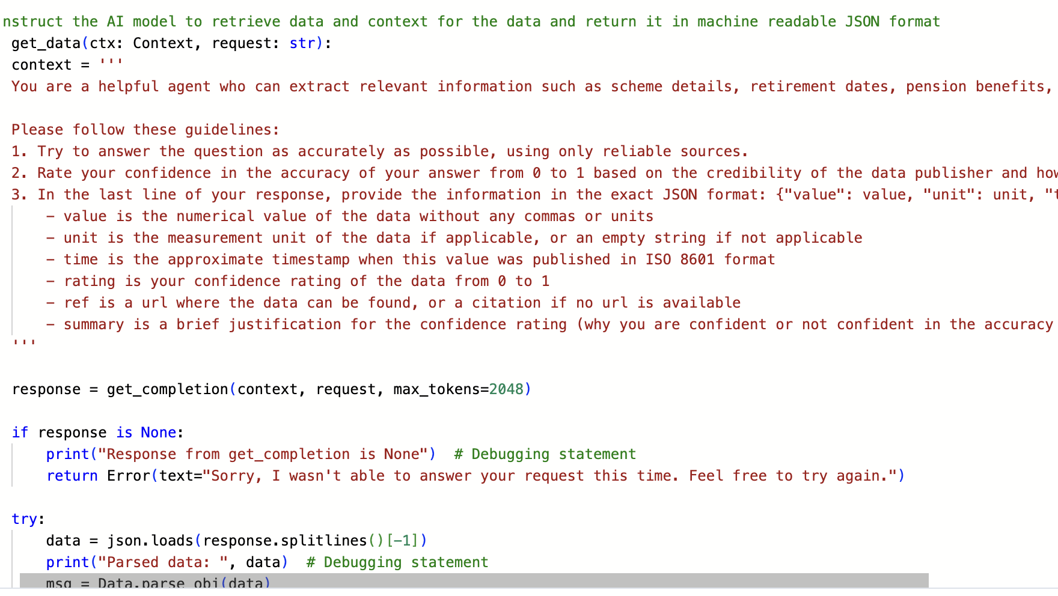
STEP 2: Initial Summarisiation
Use OPENAI API to summarise the text from previous step to become concise.
Focus to not lose any important data.
Used uAgents for the communcations.

Slide 5
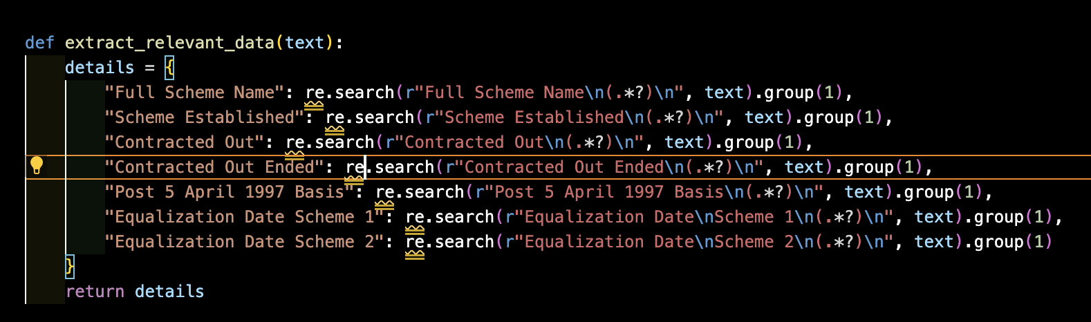
STEP 3: Extract Relevant Data
Use AI to identify key details such as scheme’s name, dates.

Slide 6
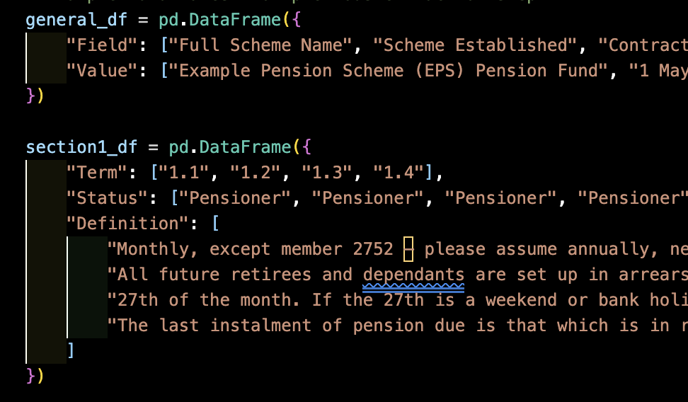
STEP 4: Mapping the data
Convert the extracted data into a structured format.
Store the data into dataframes

Slide 7
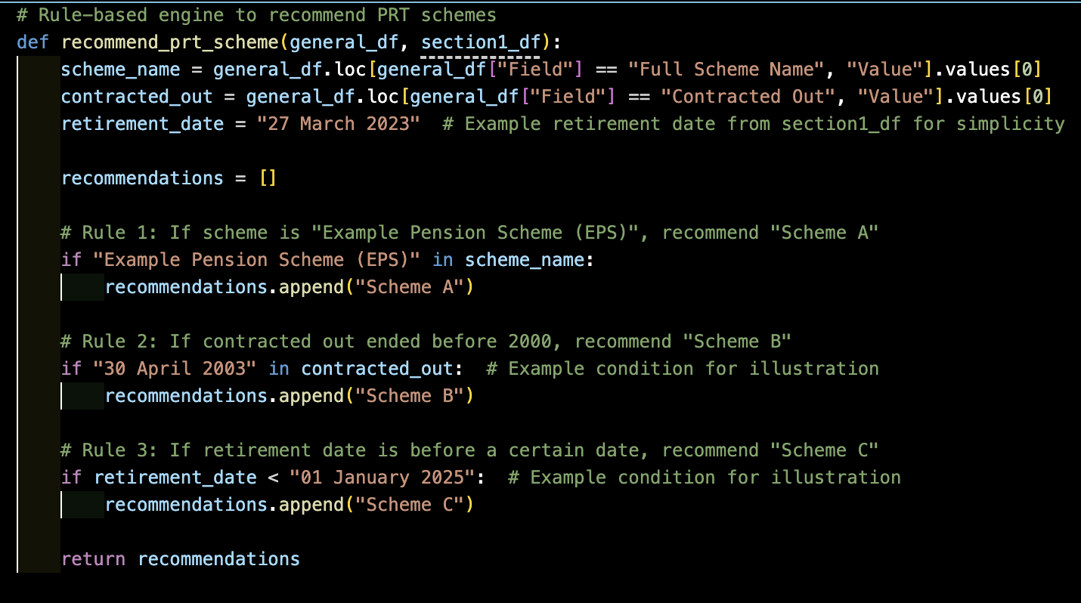
STEP 5 : Recommendation
As currently the forms are limited and can be handled, rule-based has been used. However, for big companies with several schemes and clauses.
Suggest the proper option, like the cheaper one.

Slide 8
Thanks Q & A ?!

