Slide 1
E-commerce goods tracebility sytstem based on blockchain
16124277 张江北
17170042 张昊澜
16124272 刘子豪
16124291 韦苏恒

Slide 2
CONTENTS
01
02
Project overview
Related work
03
04
Utilized technology and methods
Goal of the system
05
06
System structure
Code implementation

Slide 3
1
Project overview

Slide 4
Producer/Brand
Customer
Logistic institution
Quality testing
e-commerce commodity traceability and quality supervision
Commodity production
Selling
Quality testing
Transporting
Producer

Slide 5
2
Related work

Slide 6
Application of blockchain technology
Background
Application
Satoshi Nakamoto
Technology of bitcoin
Financial field
Medical field
Education field

Slide 7
Research on commodity traceability
Blockchain
RFID
Openness
non-tampering
Radio Frequency Identification
Non-contact identification
Application in agriculture
Application in manufacture
reliability and traeability
manufacture、store、sales and distribution
openess and transparency
Efficient supply chain
Low cost

Slide 8
3
Utilized technology
and methods

Slide 9
Utilized Technology
Blockchain
Data crawling
Main technology utilized to construct the commodity traceability system
One of the methods of acquiring the data from the Internet .

Slide 10
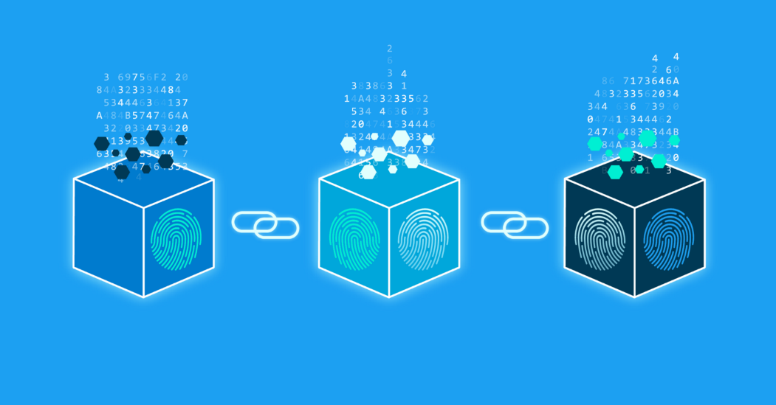
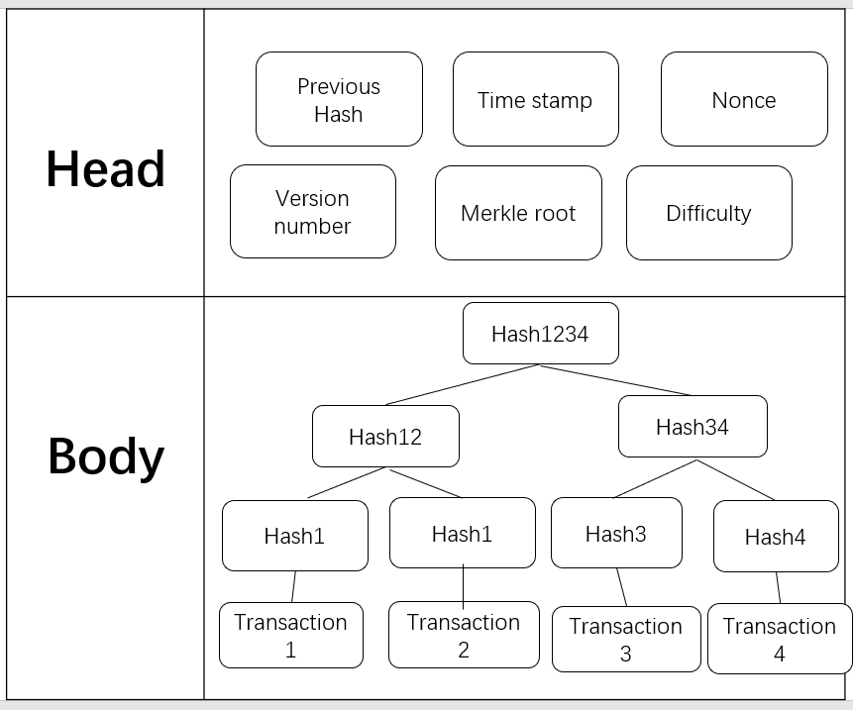
Blockchain technology
A blockchain is, a time-stamped series of immutable record of data that is managed by cluster of computers not owned by any single entity.
Distributed Ledger
Crytography
Replicated databases
Asymmetrical cryptographic algorithm
Public key and private key
4 concepts
Digital Signature
Consensus
Authenticate the sender’s identity
Ensure the integrity of info transmission
Proof of work/Proof of stake

Slide 11
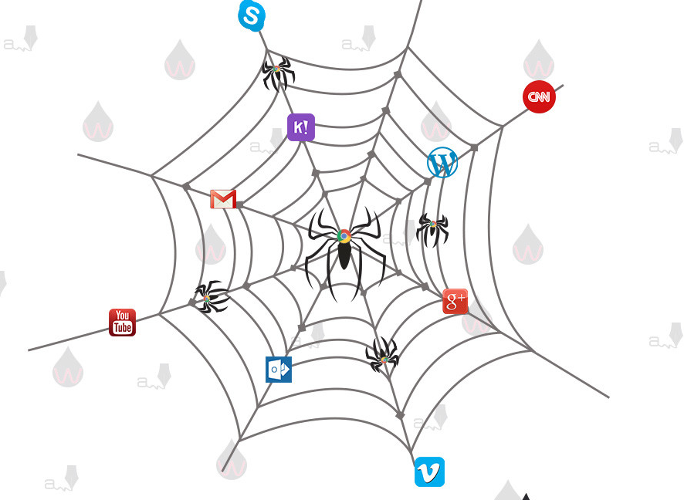
Data Crawling
A crawler is a computer program that automatically searches documents on the Web. They are primarily programmed for repetitive actions so that browsing is entirely automated.
We use this technology mainly to fetch data about some certain products

Slide 12
4
Goals of the
blockchain system

Slide 13
Goals of the blockchain system
Trace the online products
Record every transactions from the manufacturing to the actual selling of the products.
Taking advantage of the traits of the blockchain
Act accordingly and timely when a certain batch of the products have issues.
Anti-counterfeit
It will be extremely difficult for the counterfeit products or flawed products to have a clean record.

Slide 14
5
System structure

Slide 15
System Structure
Infomation of commodity
Blockchain
Unqualified
Block1
Block2
Quality Testing
Buyer Information
Qualified
FIRST
Contract

Slide 16

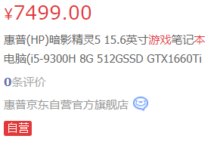
Simulation of
Commodity Information, Buyer Information
Name of product
UserName
created by ourselves
Manufacturer
UserID
Brand
UserAddress
FIRST
Price
Order
Crawling information
Commodity Information
Buyer Information

Slide 17


Quality Detection Simulation
Take last two numbers of the price as score
>=60
yes
Qualified
FIRST
no
Unqualified

Slide 18
6
Code implementation

Slide 19
The implementation process
public static void main(String[] args) {
List<Goods> goods = produceGoodsService();// 商品生产
qualityInspectionService(goods);// 质量检测
electricityContract.setGoods(goods);
List<Consumers> consumers = userService();// 创建用户
electricityContract.setConsumers(consumers);
salesService(electricityContract);// 销售
storageBlock();// 发布电商智能合约
}

Slide 20
6.1 goods produce
public class Goods {
private String name;//商品名称
private String manufacturers;// 制造商 生产者
private String serialNumber =UUID.randomUUID().toString();//编号
private String brand;//品牌 一般制造商也做自己的品牌
private int inventory;
private int quality ; // 数值越大,质量越高
private double price ; //零售价
private List<Evaluation> evaluation; //评分对象
private Date productionTime = new Date(); //商品生产时间
private Date lastUpdateTime = new Date(); ;//最后修改时间
public Goods(String name, String manufacturers, String brand, int quality, double price ,int inventory) {
this.name = name;
this.manufacturers = manufacturers;
this.brand = brand;
this.quality = quality;
this.price = price;
this. inventory = inventory ;
}

Slide 21
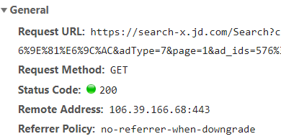
Java crawler code
Two methods to visit website resources: HttpGet
HttpPost
static List<Goods> produceGoodsService() {
ArrayList<Goods> goodsList = new ArrayList();
try {
System.out.println("正在爬取京东商品信息......");
CloseableHttpClient httpClient = HttpClientBuilder.create().build();
HttpGet httpGet = new HttpGet(
"https://search.jd.com/Search?keyword=%E6%B8%B8%E6%88%8F%E6%9C%AC&enc=utf-8&wq/"
+ "=%E6%B8%B8%E6%88%8F%E6%9C%AC&pvid=2c0f32eefb4f4430898af463e0ef4490");
httpGet.setHeader("User-Agent",
"Mozilla/5.0 (Windows NT 6.1; Win64; x64; rv:50.0) Gecko/20100101 Firefox/50.0");
CloseableHttpResponse response = httpClient.execute(httpGet);
String result = EntityUtils.toString(response.getEntity(), "utf-8");
Document document = Jsoup.parse(result);
Elements elementsByClass = document.getElementsByClass("gl-i-wrap");
setHeader: Simulate the browser environment

Slide 22
Java crawler code
for (int i = 0; i < 10; i++) {
Element element = elementsByClass.get(i);
Elements shopStr = element.getElementsByClass("p-shop");
Element element2 = shopStr.get(0);
Elements elementsByClass2 = element.getElementsByClass("curr-shop");
String brand = elementsByClass2.text();
Elements shopnum = element.getElementsByClass("p-shopnum");
Elements name = element.getElementsByClass("p-name");
Elements price = element.getElementsByClass("p-price");
//
String priceStr = price.text();
String quality = priceStr.substring(1, priceStr.length());
String shopnumStr = shopnum.text();
String nameStr = name.text();
System.out.println("商品名称：" + nameStr + " 生产商（品牌/制造商）：" + brand + " 出售价格：" + quality);
Goods goods = new Goods(nameStr, brand, nameStr, (int) (Math.random() * 100), Double.valueOf(quality),
999);
goodsList.add(goods);
}
} catch (Exception e) {
System.out.println("获取失败");
}
return goodsList;
}
i: amount of goods obtained
P-shop: information from the internet

Slide 23
6.2 quality Inspection Service
static void qualityInspectionService(List<Goods> goodsList) {
System.out.println("质量检测中");
Iterator<Goods> it = goodsList.iterator();
while (it.hasNext()) {
Goods goods = it.next();
int quality = 60;
if (goods.getQuality() < quality)
{
it.remove();
System.out
.println("商品:" + goods.getSerialNumber() + " 质检发现该商品质量低于" +
quality + " 鉴定为不合格,不给予上架并删除");
}
The quality score is produced by the price
String quality = priceStr.substring(1, priceStr.length());

Slide 24
6.3 Simulate sales of goods
static void salesService(ElectricityContract electricityContract) {
System.out.println("商品销售中");
List<Consumers> consumers = electricityContract.getConsumers();
List<Goods> goods = electricityContract.getGoods();
for (int c = 0; c < consumers.size(); c++) {
if (c < goods.size()) {
Consumers consumer = consumers.get(c);
Goods s = goods.get(c);
double balance = consumer.getBalance();
double price = s.getPrice();
if (balance > price) {
double newBalance = balance - price; // balance = balance -price
consumer.setBalance(newBalance);
System.out.println("消费者: " + consumer.getNickname() + "付款:" + price);
System.out.println("消费者: " + consumer.getNickname() + "账户余额:" + newBalance);
int inventory = s.getInventory();
inventory--;
s.setInventory(inventory);
System.out.println("商品: " + s.getName() + "库存减一 ,剩余:" + inventory);
System.out.println("消费者: " + consumer.getNickname() + "购买了:" + s.toString());
Order order = new Order(UUID.randomUUID().toString(), price, consumer.getUid(),
Logistics.SEND_GOODS, false, Arrays.asList(s));
System.out.println("生成订单: " + order.toString());
System.out.println("商品: " + s.getName() + "正准备出仓");
logistics(order);
evaluationService(consumer, s);
electricityContract.setOrders(Arrays.asList(order));}}}}

Slide 25
6.4 Simulated logistics and evaluation function
static void logistics(Order order) {
try {
Thread.sleep(1000);
System.out.println("商品: " + order.getGoods().get(0).getName() + " 发货");
Thread.sleep(1000);
System.out.println("商品: " + order.getGoods().get(0).getName() + " 运输中");
Thread.sleep(1000);
System.out.println("商品: " + order.getGoods().get(0).getName() + " 派件中");
Thread.sleep(1000);
System.out.println("商品: " + order.getGoods().get(0).getName() + " 签收");
order.setLogistic(Logistics.SIGN_FOR);
order.setState(true);
} catch (InterruptedException e) {
e.printStackTrace();
}
}

Slide 26
6.4 Simulated logistics and evaluation function
static void evaluationService(Consumers consumer, Goods s) {
Evaluation evaluation = new Evaluation(consumer.getNickname(), (int) (Math.random() * 5), new Date());
s.setEvaluation(Arrays.asList(evaluation));
System.out.println(
"消费者: " + consumer.getNickname() + "评级了:" + s.getName() + "评分:" + evaluation.getEvaluationScore());
}

Slide 27
6.5 Store information in the blockchain
static void storageBlock() {
System.out.println("商品数据&用户数据存储到区块链中");
String s = gson.toJson(electricityContract);
for (int a = 0; a < 2; a++) {
blockchain.add(new Block(s, a + "")); // 创建区块
System.out.println("Trying to Mine block " + a + "......");
blockchain.get(a).mineBlock(difficulty);//
}

Slide 28
6.5 RESULT, crawl one data as example
正在爬取京东商品信息......
商品名称：微星(MSI) GL63GTX1060独显6G吃鸡游戏本8代I7笔记本电脑双风扇七铜管散热 i7-8750H 8G内存 1TB硬盘+128G固态 94%色域 生产商（品牌/制造商）： 出售价格：6999.00
质量检测中
商品:c166a753-6c3e-4385-a6f0-2fdcc6fcf438 质检发现该商品质量低于60 鉴定为不合格,不给予上架并删除
商品销售中
商品数据&用户数据存储到区块链中
Trying to Mine block 0......
Block Mined!!!:0b3c673aecc1ee8a0fa531ad660129b248805e2ff9f85171900a722c34b4a8a4
Trying to Mine block 1......
Block Mined!!!:05ac3346393dafbfb7268db4fcdff8f8f8a53ab9a32f52ff03797b539a945338
The block chain:
[
{
"hash": "0b3c673aecc1ee8a0fa531ad660129b248805e2ff9f85171900a722c34b4a8a4",
"previousHash": "0",
"data": "{\"goods\":[],\"consumers\":[{\"uid\":\"29bd987d-b8a0-401f-8679-2a1987944274\",\"nickname\":\"CaryonVLelouch\",\"balance\":9999.0,\"shippingAddress\":\"上海市嘉定区城中路20号上海大学\"},{\"uid\":\"6bee9e03-bbbe-4890-be46-ec0223846e70\",\"nickname\":\"Thor\",\"balance\":9999.0,\"shippingAddress\":\"上海市嘉定区城中路20号上海大学\"},{\"uid\":\"71c7286c-8d75-4b50-be71-60c98e48ad36\",\"nickname\":\"Lan\",\"balance\":9999.0,\"shippingAddress\":\"上海市嘉定区城中路20号上海大学\"}],\"orders\":[]}",
"timeStamp": 1558080047208,
"nonce": 13
},
{
"hash": "05ac3346393dafbfb7268db4fcdff8f8f8a53ab9a32f52ff03797b539a945338",
"previousHash": "1",
"data": "{\"goods\":[],\"consumers\":[{\"uid\":\"29bd987d-b8a0-401f-8679-2a1987944274\",\"nickname\":\"CaryonVLelouch\",\"balance\":9999.0,\"shippingAddress\":\"上海市嘉定区城中路20号上海大学\"},{\"uid\":\"6bee9e03-bbbe-4890-be46-ec0223846e70\",\"nickname\":\"Thor\",\"balance\":9999.0,\"shippingAddress\":\"上海市嘉定区城中路20号上海大学\"},{\"uid\":\"71c7286c-8d75-4b50-be71-60c98e48ad36\",\"nickname\":\"Lan\",\"balance\":9999.0,\"shippingAddress\":\"上海市嘉定区城中路20号上海大学\"}],\"orders\":[]}",
"timeStamp": 1558080047210,
"nonce": 18
}
]

Slide 29
Group division
韦苏恒：Make PPT, Compile Main function
张昊澜：Make PPT, Compile Class
刘子豪：Make PPT, Compile Main function
张江北：Make PPT, Compile network reptile
FIRST

Slide 30
Thanks for watching!

