Slide 1

A Blockchain-based Audio
Copyright Protection System
Tutor : Nan Jing Group Member : 16124327 Jiaying Xu; 16124280 Shulu Dai;
16124321 Shuying Guan; 16124340 Yuyan Zheng
Date : 06/17/2019

Slide 2
1| Introduction
2| Literature review
3| Audio eigenvalue extraction
CONTENTS
4| Audio Originality Test
5| Blockchain technology implementation
6| Conclusion

Slide 3
Part 1
Introduction
Awareness, legal & technology
Piracy & Plagiarism
Damage to rights & influence creation

Slide 4
1. Introduction
Consumers lack copyright awareness
Damage to
rights and interests
Piracy & Plagiarism are frequent
Imperfect legal system
Dispel the enthusiasm
of creation
Technology
to be improved
Notes:
为什么版权保护
互联网技术发展+音乐=数字音乐
消费者意识不够，法律不够完善，技术有待改进
盗版，抄袭事件频发
损害了创作者的正当权益，打消了创作的积极性

Slide 5
Part 2
Literature review
Current Situation of Audio Copyright Protection
Application of Block Chain in Digital Copyright Protection

Slide 6
2. Literature review
Current Situation of Audio Copyright Protection
Digital Watermarking Technology
Encryption or decryption of digital music using keys
Digital Signatureand
Cryptographic Management Technology
Digital Fingerprint
Embedding Hidden Markers in Musical Contents
Security Container
Notes:
音频版权保护现状
1 数字水印技术，体现为在音乐内容中嵌入隐蔽的标记。这种方法是目前最常见的，可用于盗版的取证与追踪。然而，这种技术并不是很完善，很难在音质保证与难以被破解之间权衡，使得进一步加入权限管理能力十分艰难。
2 密码学管理技术，具体体现为使用密匙对数字音乐进行加密或解密。如数字签名，数字指纹与安全容器。这种方式相对容易实现，但一旦被解密，就可以无限次复制使用信息，容易被攻击。

Slide 7
2. Literature review
Application of Block Chain in Digital Copyright Protection
Decentralized
Reducing the Management Cost of Copyright Protection
Solving the Problem of Copyright Registration and Proving Evidence
Difficult to tamper with
Expansibility and flexibility
Meeting the Transaction Needs of Digital Copyright
Notes:
区块链数字版权保护的应用
去中心化，成本低廉，有利于降低版权保护的管理成本
难以篡改，透明性强，有利于解决版权登记及举证难题
扩展性大，灵活性强，有利于满足数字版权的交易需求
创新商业模式，提高支付意愿，有利于培养网民版权意识

Slide 8
Audio Feature Extraction
Part 3
Read Audio File
Wave Filtering
Audio Short-term Energy Calculation
Interception of Effective Short-term Energy Data

Slide 9
3. Audio Feature Extraction
Read Audio file
Audio.mp3
Wave Filtering
double array
Audio Short-term Energy Calculation
double array
Interception of Effective Data
double array
MP3 → double array
{double data}
Normalized
15-16 valid digits
Bytes: 8 bits
IIR Digital
Filter
Hamming
Window
Accepted
Threshold
Double是java对象，double是java原型数据类型。最大的区别是Double数组中可以有null值。
Double数组是一个对象数组，double型数组是一个原型数组。
从效率来看，double数组的效率会高。
Float，单精度浮点数有效数字位6-7，4字节

Slide 10
3.2 Wave Filtering
IIR Digital Filter (Recursive Filter)
【 Y = filter(B,A,X) 】
B/A provides filter coefficients
Difference equation：
y(n) = 1*x(n)+(-0.9375)*x(n-1)
Wave filtering
Filter the frequency of a specific band in the signal.
Suppress and prevent interference.
static double[] showFilterWave(double[] standardAudioData) {
if (null == standardAudioData) {
return standardAudioData;
}
// y(n) = 1*x(n)+(-0.9375)*x(n-1)
standardAudioData = AudioDataOperate.filter(standardAudioData, 1, -0.9375); //滤波
standardAudioData = AudioDataOperate.normalize(standardAudioData); //归一化
// standardAudioData = AudioDataOperate.getUsefulData(standardAudioData);
return standardAudioData;
}
IIR数字滤波器（递归滤波器）
滤波：滤波（Wave filtering）是将信号中特定波段频率滤除的操作，是抑制和防止干扰的一项重要措施。是根据观察某一随机过程的结果，对另一与之有关的随机过程进行估计的概率理论与方法。
Y = filter(B,A,X) ，输入X为滤波前序列，Y为滤波结果序列，
B/A 提供滤波器系数，B为分子， A为分母
整个滤波过程是通过下面差分方程实现的：
Y(n) = a1*Y(n-1) + a2*Y(n-2) + ... + ak*Y(n-k) + b0*X(n) + b1*X(n-1) + b2*X(n-2) + ... + bk*X(n-k)
优点：高通，低通，带通，带阻任意

Slide 11
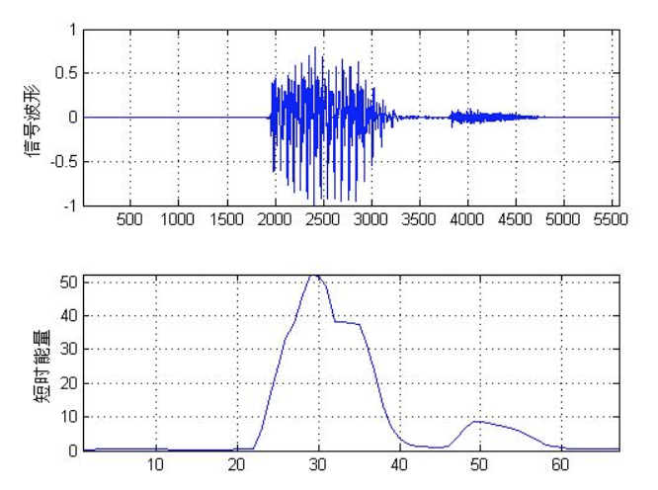
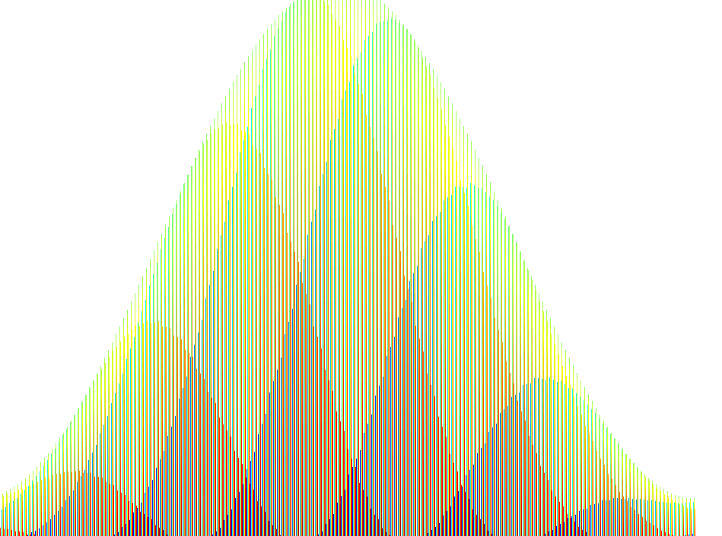
3.3 Audio Short-term Energy Calculation
Short-term energy
Audio — quasi-steady-state process in a very short time range
Endpoint Detection of audio by short-term Energy
Eg： distinguishing between silent and voiced
Short-term analysis
1. Framing
Divided into segments. Length: 10-30 ms.
2. Hamming Window — A truncation function
Advantages: Overcome leakage more effectively, more smooth low-pass characteristics, more widely used
短时能量：
音频在极短时间范围内可看作准稳态过程，具有短时性。因此可通过短时能量对音频进行端点检测。（如清音和浊音、区分无声和有声的分界）
音频包含能量，可以通过时域波形进行理解。
短时分析：借助分帧加窗。
帧：将语音分成段。帧长一般10～30ms
窗：分帧后一段段处理，使用Hamming Window，一种截断函数，可以更有效克服泄漏现象，更平滑的低通特性，应用更广泛
中间的数据体现出来了，两边的数据信息丢失了，所以等会移窗的时候，只会移1/3或1/2窗，这样被前一帧或二帧丢失的数据又重新得到了体现。

Slide 12
3.3 Audio Short-term Energy Calculation
static double[] showEnergyWave(double[] standardAudioData) {
double[] standardEnergyData;
if (null == standardAudioData) {
return standardAudioData;
}
double[] dotProductData = AudioDataOperate.dotProduct(standardAudioData); //点乘
double[] wins = AudioDataOperate.generateHammingWindows(32, 16); //生成汉明窗
double[] convValue = AudioDataOperate.conv(dotProductData, wins); //计算卷积
standardEnergyData = AudioDataOperate.normalize(convValue);
// drawWave(mStandardAudioWaveView, standardEnergyData);
return standardEnergyData;
}
短时能量：
音频在极短时间范围内可看作准稳态过程，具有短时性。因此可通过短时能量对音频进行端点检测。（如清音和浊音、区分无声和有声的分界）
音频包含能量，可以通过时域波形进行理解。
短时分析：借助分帧加窗。
帧：将语音分成段。帧长一般10～30ms
窗：分帧后一段段处理，使用Hamming Window，一种截断函数，可以更有效克服泄漏现象，更平滑的低通特性，应用更广泛
中间的数据体现出来了，两边的数据信息丢失了，所以等会移窗的时候，只会移1/3或1/2窗，这样被前一帧或二帧丢失的数据又重新得到了体现。

Slide 13
3.4 Interception of Effective Data
static double[] showUsefulWave(double[] standardEnergyData) {
double[] standardUsefulData;
if (null == standardEnergyData) {
return standardEnergyData;
}
standardUsefulData = AudioDataOperate.getUsefulData(standardEnergyData);
return standardUsefulData; //得到double数组形式的音频特征
}

Slide 14
Audio Similarity Computation
Part 4
Cosine Similarity

Slide 15
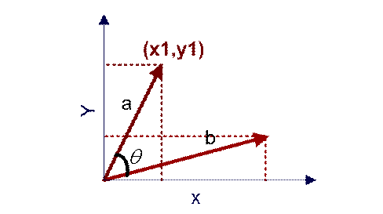
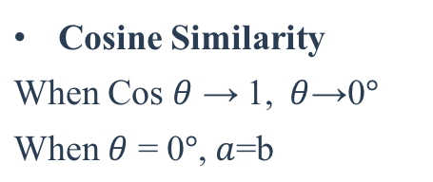
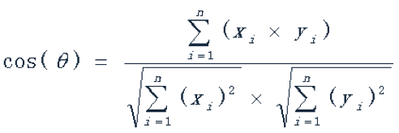
4. Audio Feature Extraction
static double calculateCompareResult(double[] standardUsefulData,double[] compareUsefulData)
{
double similarity;
if (null == standardUsefulData || null == compareUsefulData) {
System.out.println("standardUsefulData or compareUsefulData is null");
return 0; }
final double result = AudioDataOperate.cosineDistance(standardUsefulData, compareUsefulData);
System.out.println((int) (result * 100) + “%”); //返回相似度 _ %
return result;
}
向量空间余弦相似度(Cosine Similarity)
余弦值越接近1，就表明夹角越接近0度，也就是两个向量越相似，夹角等于0，即两个向量相等，这就叫"余弦相似性"。
将待比较的两个音频文件转换后的double array转化成向量，计算两个向量的余弦相似度

Slide 16
Blockchain technology
implementation
Part 5
Data uploading
Getting information about the blocks to be used
Mining

Slide 17
5. Blockchain technology implementation
Data uploading
compute similarity
Store in database
MD5 Encryption
Put into userlist
If similarity <0.2,
save to database
Converting Double arrays to String
Generate a fixed 32-byte hash to reduce data size
If userlist has two data
generate new blocks
If not
the audio plagiarism
Create data class including storage location ID, MD5 encrypted data, singer name, miner name
Notes:
(除了第一个)检验后-转化为string存入数据库-md5加密-放入交易池-交易池有两个数据打包成区块链
存储位置ID，MD5加密后数据，演唱者，矿工姓名
计算哈希值

Slide 18
5. Blockchain technology implementation
Getting information about the blocks to be used
Collect a list of unconfirmed code feature value
Gather previous hash, timestamp and difficulty
Generate Merkle Root
public static String getMerkleRoot(ArrayList<Data> transactions) {
int count = transactions.size();
ArrayList<String> previousTreeLayer = new ArrayList<>();
for (Data transaction : transactions) {
String layer=new String(transaction.ID+transaction.audiofingerprint);
previousTreeLayer.add(layer);
}
ArrayList<String> treeLayer = previousTreeLayer;
while (count > 1) {
treeLayer = new ArrayList<>();
for (int i = 1; i < previousTreeLayer.size(); i++) {
treeLayer.add(applySha256(previousTreeLayer.get(i - 1) + previousTreeLayer.get(i)));
}
count = treeLayer.size();
previousTreeLayer = treeLayer;
}
String merkleRoot = (treeLayer.size() == 1) ? treeLayer.get(0) : "";
return merkleRoot;
}
Notes:
生成Merkle Root→收集待确认的代码特征值列表T→获取previoushash、Timestamp和difficulty
区块链网络中的矿工通过同步最新区块链获得下一个区块的记账权，获取和上一个区块的哈希值Previous Hash，调用代码作品区块难度值设置函数得到新区块头的难度值Difficulty。对一段时间内网络获取Winnowing后得到的代码特征值进行收集T={T₁,T₂,…,T_{n}},获取时间戳TimeStamp，通过原创性认证的代码特征值的哈希值生成Merkle Root。

Slide 19
5. Blockchain technology implementation
Mining
Continuously trying nonce value until calculate Hash satisfy target
Set difficulty target
Generate random nonce
Calculate Hash
public void mineBlock(int difficulty) {
merkleRoot = StringUtil.getMerkleRoot(transactions);
String target = new String(new char[difficulty]).replace('\0', '0'); // Create a string with difficulty * "0"
while (!hash.substring(0, difficulty).equals(target)) {
nonce++;
hash = calculateHash();
}
System.out.println("Block Mined!!! : " + hash);
}
Notes:
设置挖矿难度→生成随机数Nonce→计算哈希值CaculateHash→不断尝试nonce值知道CalculateHash

Slide 20
5. Blockchain technology implementation
compute similarity
Store in database
MD5 Encryption
Put into userlist
Collect a list of unconfirmed code feature value
Gather previous hash, timestamp and difficulty
Generate Merkle Root
Set difficulty target
Generate random nonce
Calculate Hash
Continuously trying nonce value until calculate Hash satisfy target
Link the new block

Slide 21
Part 6
Conclusion
Threshold

Slide 22
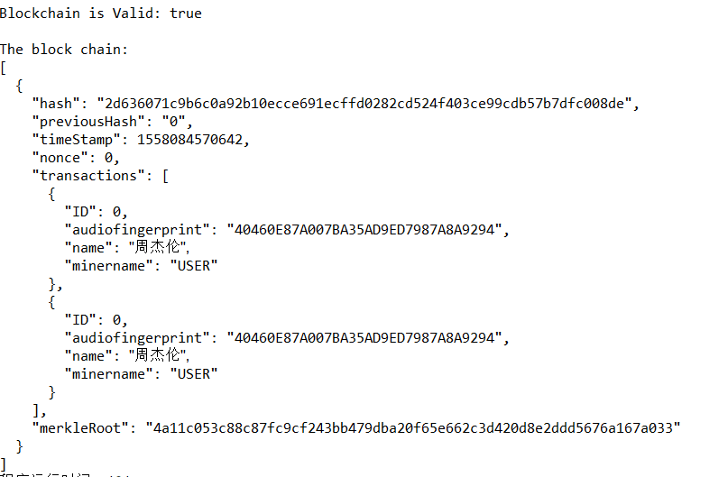
6. Conclusion

Slide 23
Thanks
Q&A

